Slide 1
linked list CMSC 14300: System Programming I 13th Lecture
Instructor:
Prof. Adam Shaw
Prof. Junchen Jiang

Slide 2
Recap: struct & union
struct point {
double x, y;
};
typedef struct point point;
struct circle {
point center;
double radius;
};
typedef struct circle circle;
struct square {
point topleft;
double side;
};
typedef struct square square;
struct rectangle {
point topleft;
double width, height;
};
typedef struct rectangle rectangle;
enum shape_tag {
CIRCLE, SQUARE, RECTANGLE
};
union shape {
circle c;
square s;
rectangle r;
};
struct tagged_shape {
enum shape_tag tag;
union shape shape;
};
typedef struct tagged_shape tagged_shape;
tagged_shape s;
s.shape.c.center.x = 10;
s.shape.c.center.y = 20;
s.shape.c.radius = 5;
s.tag = CIRCLE;
shape_perimeter(s);
shape_area(s);

Slide 3
Lists in C
arr = []
for i in range(1000000):
arr.append(i)
How to represent lists in Python?
Two ways to present lists in C
Linked lists (Today)
Arrays (2 weeks ago)
Tradeoffs:
Linked lists can grow and shrink, but takes n iterations to get to the n^{th} element of a linked list
Arrays have a fixed length, but any index within an array can be accessed for the same low cost

Slide 4
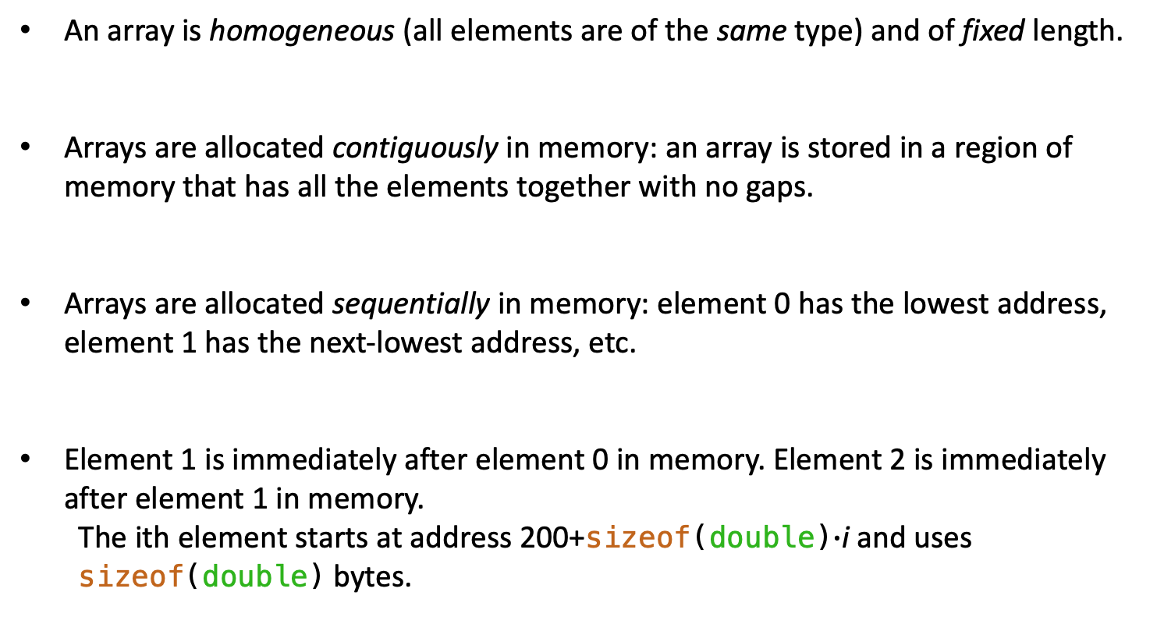
Recap: Memory Layout of Array
An array is homogeneous (all elements are of the same type) and of fixed length.
Arrays are allocated contiguously in memory: an array is stored in a region of memory that has all the elements together with no gaps.
Arrays are allocated sequentially in memory: element 0 has the lowest address, element 1 has the next-lowest address, etc.
Element 1 is immediately after element 0 in memory. Element 2 is immediately after element 1 in memory.
The ith element starts at address 200+sizeof(double)$∙$i and uses sizeof(double) bytes.
Memory
…
element 3
addr = 224
element 2
addr = 216
element 1
addr = 208
element 0
addr = 200
…

Slide 5
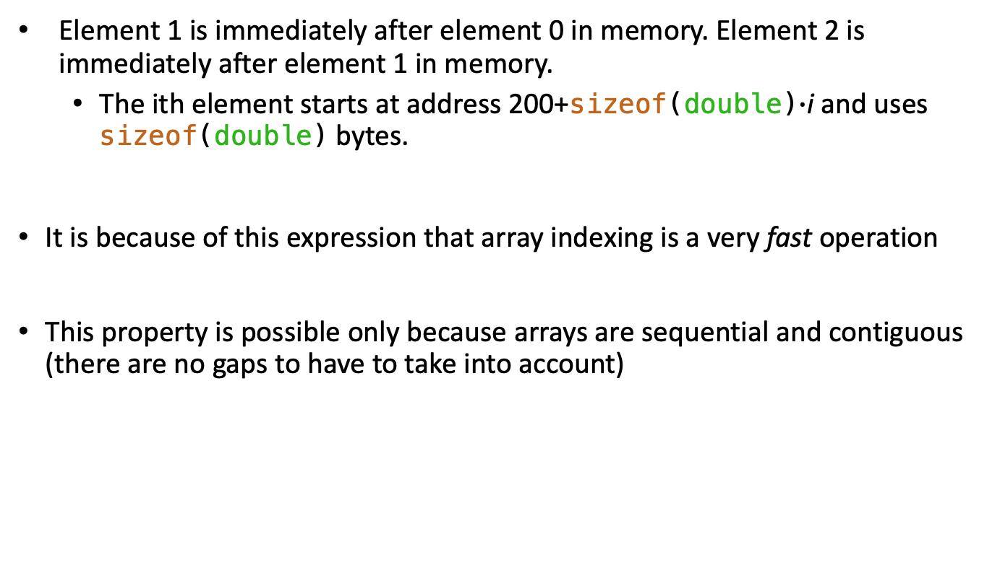
Array access
Element 1 is immediately after element 0 in memory. Element 2 is immediately after element 1 in memory.
The ith element starts at address 200+sizeof(double)$∙$i and uses sizeof(double) bytes.
It is because of this expression that array indexing is a very fast operation
This property is possible only because arrays are sequential and contiguous (there are no gaps to have to take into account)
Memory
…
element 3
addr = 224
element 2
addr = 216
element 1
addr = 208
element 0
addr = 200
…

Slide 6
Array: Growing and Shrinking
Memory
Sequentiality and contiguity is easy when a fixed length array is allocated up-front.
Simply allocate a contiguous region of the requisite size
Easy to shrink the array
Can deallocate the latter part of the allocation and reuse that space for something else
Not so easy to grow the array
Memory immediately after the array could be in use by another, unrelated allocation
Can’t just move things around in memory
(would need to find all pointers to that block of memory and update them to the new location)
(moving large allocations takes time)
…
element 4
element 3
element 2
element 1
element 0
…

Slide 7
Solution: Array of pointers?
Instead of allocating a whole list at once, allocate one element at a time
Relax the requirement that adjacent elements (by index) be adjacent in memory
How to track the locations of each element? Make an array of pointers
Use a pointer to store where a given element is in memory
Benefits: Makes it easy to grow the list
Can always find space to allocate one element’s worth of memory somewhere
Drawbacks: Doesn't help to grow the length of this array when needed
Have just moved the same problem somewhere else
Memory
…
element 0
pointer 2
pointer 1
pointer 0
element 2
element 1
…

Slide 8
A Better Idea: Linked List
Combine Elements and Pointers
Each element is stored along with a pointer to the next element
Allocate these together
Can find the i^{th} element by starting at the first and following pointers repeatedly
Memory
…
element 2
pointer 1
element 0
pointer 2
Element i
Element i+1
…
element 1
…
…
Logical View of Linked List

Slide 9
Linked List Data Structure
Would need to declare separate structs for other types of lists
typedef struct intlist intlist;
// Forward declaration of data type gets around circular dependency
struct intlist {
int val;
intlist* next;
};
val holds one element
next holds pointer to next element
next is NULL for the last element
l
8
9
10
NULL
val
next
Logical View of Linked List

Slide 10
Linked List Helpers
int is_empty(intlist* l) {
return l == NULL;
}
int first(intlist* l) {
if (l != NULL) {
return l->val;
}
fprintf(stderr, "first on empty list\n");
exit(1);
}
intlist* rest(intlist* l) {
if (l != NULL) {
return l->next;
}
fprintf(stderr, "rest on empty list\n");
exit(1);
}
l
...
val
next

Slide 11
Linked List Helpers
typedef struct intlist intlist;
struct intlist {
int val;
intlist* next;
};
// creating a new struct and make it the first
intlist* cons(int first, intlist* rest) {
intlist* res = (intlist*)malloc(sizeof(intlist));
if (res == NULL) {
fprintf(stderr, "cons: allocation failed\n");
exit(1);
}
res->val = first;
res->next = rest;
return res;
}
first
rest
...
(current list)
res
val
next

Slide 12
Making a List
// creating a new struct and make it the first
intlist* cons(int first, intlist* rest) {
intlist* res = (intlist*)malloc(sizeof(intlist));
if (res == NULL) {
fprintf(stderr, "cons: allocation failed\n");
exit(1);
}
res->val = first;
res->next = rest;
return res;
}
first
rest
...
(current list)
res
val
next
intlist* l = cons(8, cons(9, cons(10, NULL)));
l
8
9
10
NULL
l points to a struct that contains the element 8 and a pointer to the second element
l->next points to a struct that contains the element 9 and a pointer to the third element
l->next->next points to a struct that contains the element 10 and a NULL pointer

Slide 13
Summing a Linked List
intlist* l = cons(8, cons(9, cons(10, NULL)));
l
8
9
10
NULL
// summing a linked list (recursion)
int sum(intlist* l) {
if (is_empty(l)) {
return 0;
}
return first(l) + sum(rest(l));
}
// summing a linked list (iteration)
int sum(intlist* l) {
int res = 0;
while (l) {
res += l->val;
l = l->next;
}
return res;
}

Slide 14
Freeing a Linked List
intlist* l = cons(8, cons(9, cons(10, NULL)));
l
8
9
10
NULL
// freeing a linked list (recursion)
void list_free(intlist* l) {
if (is_empty(l)) {
return;
}
list_free(rest(l));
free(l);
}
// freeing a linked list (iteration)
void list_free(intlist* l) {
intlist* next;
while (l) {
next = l->next;
free(l);
l = next;
}
}
What if these two lines are swapped?
What if these two lines are swapped?
What if these two lines are swapped?

Slide 15
Squaring a List "Destructively" (in-place)
intlist* l = cons(8, cons(9, cons(10, NULL)));
l
8
9
10
NULL
// squaring elements (recursion)
void squares_change(intlist* l){
if (!is_empty(l)) {
l->val *= l->val;
squares_change(l->next);
}
}
// squaring elements (iteration)
void squares_change(intlist* l) {
while (l) {
l->val *= l->val;
l = l->next;
}
}

Slide 16
Copying Squares to a New List
in
8
9
10
NULL
out
64
81
100
NULL
// copying squares (iteration)
intlist* squares_copy(intlist* in){
intlist* out = NULL;
intlist* tail; // tail of "out"
while (in) {
item = cons((in->val)*(in->val), NULL);
if (out) { // not first element
tail->next = item;
} else { // first element
out = item;
}
in = in->next;
tail = item;
}
return out;
}
// copying squares (recursion)
intlist* squares_copy(intlist* in){
if (is_empty(in)) {
return NULL;
}
return cons((in->val)*(in->val),
squares_copy(in->next));
}

Slide 17
Copying Even Elements to a New List
in
8
9
10
NULL
out
8
10
NULL
// finding even elements (iteration)
intlist* evens(intlist* in) {
intlist* out = NULL;
intlist* tail; // tail of "out"
while (in) {
if ((in->val % 2) == 0) {
intlist* item = cons(in->val, NULL);
if (out) { // not first even
tail->next = item;
} else { // first even
out = item;
}
tail = item;
}
in = in->next;
}
return out;
}
// finding even elements (recursion)
intlist* evens(intlist* in) {
if (is_empty(in)) {
return NULL;
}
if (first(in) % 2 == 0) {
return cons(first(in), evens(rest(in)));
}
return evens(rest(in));
}
Why does iteration code look much longer than the recursion code?

Slide 18
Conclusion
Array: Contiguous, sequential memory layout
Fast access to any element
Cannot grow
Linked list:
Slower access to elements
Can grow dynamically
More operations next time

Slide 20
Summing a Linked List (recursion)
int is_empty(intlist* l) {
return l == NULL;
}
int first(intlist* l) {
if (l != NULL) {
return l->val;
}
fprintf(stderr, "first on empty list\n");
exit(1);
}
intlist* rest(intlist* l) {
if (l != NULL) {
return l->next;
}
fprintf(stderr, "rest on empty list\n");
exit(1);
}
l
val
next
// summing a linked list (recursion)
int sum(intlist* l) {
if (is_empty(l)) {
return 0;
}
return first(l) + sum(rest(l));
}

Slide 21
Summing a Linked List (Iteration)
int is_empty(intlist* l) {
return l == NULL;
}
int first(intlist* l) {
if (l != NULL) {
return l->val;
}
fprintf(stderr, "first on empty list\n");
exit(1);
}
intlist* rest(intlist* l) {
if (l != NULL) {
return l->next;
}
fprintf(stderr, "rest on empty list\n");
exit(1);
}
l
val
next
// summing a linked list (iteration)
int sum(intlist* l) {
int res = 0;
while (l) {
res += l->val;
l = l->next;
}
return res;
}

Slide 22
Freeing a List (Recursion)
int is_empty(intlist* l) {
return l == NULL;
}
int first(intlist* l) {
if (l != NULL) {
return l->val;
}
fprintf(stderr, "first on empty list\n");
exit(1);
}
intlist* rest(intlist* l) {
if (l != NULL) {
return l->next;
}
fprintf(stderr, "rest on empty list\n");
exit(1);
}
l
val
next
void list_free(intlist* l) {
if (is_empty(l)) {
return;
}
list_free(rest(l));
free(l);
}

Slide 23
Freeing a List (Iteration)
int is_empty(intlist* l) {
return l == NULL;
}
int first(intlist* l) {
if (l != NULL) {
return l->val;
}
fprintf(stderr, "first on empty list\n");
exit(1);
}
intlist* rest(intlist* l) {
if (l != NULL) {
return l->next;
}
fprintf(stderr, "rest on empty list\n");
exit(1);
}
l
val
next
void list_free(intlist* l) {
intlist* next;
while (l) {
next = l->next;
free(l);
l = next;
}
}

Slide 24
Finding Even Elements
l
int is_empty(intlist* l) {
return l == NULL;
}
int first(intlist* l) {
if (l != NULL) {
return l->val;
}
fprintf(stderr, "first on empty list\n");
exit(1);
}
intlist* rest(intlist* l) {
if (l != NULL) {
return l->next;
}
fprintf(stderr, "rest on empty list\n");
exit(1);
}
val
next
intlist* evens(intlist* l) {
if (is_empty(l)) {
return NULL;
}
if (first(l) % 2 == 0) {
return cons(first(l), evens(rest(l)));
}
return evens(rest(l));
}

Slide 25
Squaring a List "Destructively" (in-place)
int is_empty(intlist* l) {
return l == NULL;
}
int first(intlist* l) {
if (l != NULL) {
return l->val;
}
fprintf(stderr, "first on empty list\n");
exit(1);
}
intlist* rest(intlist* l) {
if (l != NULL) {
return l->next;
}
fprintf(stderr, "rest on empty list\n");
exit(1);
}
l
val
next
void squares_change(intlist* l) {
while (l) {
l->val *= l->val;
l = l->next;
}
}

Slide 26
Why Python is slow

Slide 27
Making a List
typedef struct intlist intlist;
struct intlist {
int val;
intlist* next;
};
intlist* cons(int first, intlist* rest) {
intlist* res = (intlist*)malloc(sizeof(intlist));
if (res == NULL) {
fprintf(stderr, "cons: allocation failed\n");
exit(1);
}
res->val = first;
res->next = rest;
return res;
}
intlist* l = cons(10, cons(20, cons(30, NULL)));
l
10
20
30
NULL
l points to a struct that contains the element 10 and a pointer to the second element
l->next points to a struct that contains the element 20 and a pointer to the third element
l->next->next points to a struct that contains the element 30 and a NULL pointer

Slide 28
Linked List Helpers
typedef struct intlist intlist;
struct intlist {
int val;
intlist* next;
};
// creating a new struct and make it the first
intlist* cons(int first, intlist* rest) {
intlist* res = (intlist*)malloc(sizeof(intlist));
if (res == NULL) {
fprintf(stderr, "cons: allocation failed\n");
exit(1);
}
res->val = first;
res->next = rest;
return res;
}
first
rest
...
(current list)
res
val
next
tail
last
// appending a new struct at the end
void append(int last, intlist* tail){
intlist* out = cons(last, NULL);
tail = out;
}
...
(current list)
NULL
val
next

Slide 29
Making a List
tail
last
// appending a new struct at the end
void append(int last, intlist* tail){
intlist* out = cons(last, NULL);
tail = out;
}
...
(current list)
NULL
val
next
intlist* l = cons(10, NULL);
append(20, l->next);
append(30, l->next);
l
10
20
30
NULL
l points to a struct that contains the element 10 and a pointer to the second element
l->next points to a struct that contains the element 20 and a pointer to the third element
l->next->next points to a struct that contains the element 30 and a NULL pointer

Slide 30
Locating the End of a Linked List
intlist* last(intlist* l) {
if (l != NULL) {
while (l->next)
l = l->next;
return l;
}
fprintf(stderr, "last on empty list\n");
exit(1);
}
intlist* evens(intlist* in) {
intlist* out = NULL;
intlist* tail; // tail of "out"
while (in) {
if ((in->val % 2) == 0) {
intlist* item = cons(in->val, NULL);
if (out) { // not first even
tail->next = item;
} else { // first even
out = item;
}
tail = item;
}
in = in->next;
}
return out;
}
intlist* evens_iter(intlist* l) {
intlist* res = NULL;
while (l) {
if ((l->val % 2) == 0) {
if (res) {
last(res)->next = cons(l->val, NULL);
} else {
res = cons(l->val, NULL);
}
}
l = l->next;
}
return res;
}
Tracking the tail of a list

Slide 31
Generating a New List of Squares
l
8
9
10
NULL
// finding even elements (recursion)
intlist* evens(intlist* l) {
if (is_empty(l)) {
return NULL;
}
if (first(l) % 2 == 0) {
return cons(first(l), evens(rest(l)));
}
return evens(rest(l));
}
// finding even elements (iteration)
intlist* evens(intlist* in) {
intlist* out = NULL;
intlist* tail; // tail of "out"
while (in) {
if ((in->val % 2) == 0) {
intlist* item = cons(in->val, NULL);
if (out) { // not first even
tail->next = item;
} else { // first even
out = item;
}
tail = item;
}
in = in->next;
}
return out;
}
Why does this code look so complicated?

