Slide 1
Thread I CMSC 14300: System Programming I 17th Lecture
Instructor:
Prof. Adam Shaw
Prof. Junchen Jiang

Slide 2

Motivating Example: Highway
Single-lane road
Multi-lane road
Higher throughput

Slide 3

Motivating Example: Video Encoding
Video frames
all.mp4
part1.mp4
part2.mp4
part3.mp4
part4.mp4
Compress frames to mp4 by sequentially going through all frames
all.mp4
Split frames to independent frame groups and compress the groups in parallel

Slide 4
Parallelism
These are examples of parallelism
Can be split into independent subtasks that can run in parallel
The order of completion of the subtasks does not matter
Threads allow a computer to parallelize execution across multiple processors.
A thread of execution is a sequence of instructions that can be independently scheduled to run on a processor.
An application can run multiple threads.

Slide 5
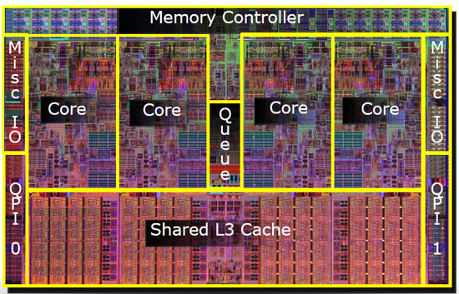
Simple Example of Parallelism
Multi-core/processor – parallelism
Quad-core → 4 cores
server: 64-128 cores per machine
How to exploit parallelism?
A simple example: Count sum of a million numbers
int arr[1000000], total = 0;
for (int i = 0; i < 1000000 i++) {
total += arr[i];
}

Slide 6
Leveraging multiple CPUs
Thread 1
T1= Total of arr
[0-250K)
Thread 2
T2 = Total of arr [250-500K)
Thread 3
T3 = Total of arr [500-750K)
Thread 4
T4 = Total of arr
[750-1000K)
All total = T1+ T2 + T3 + T4
4x faster!!

Slide 7
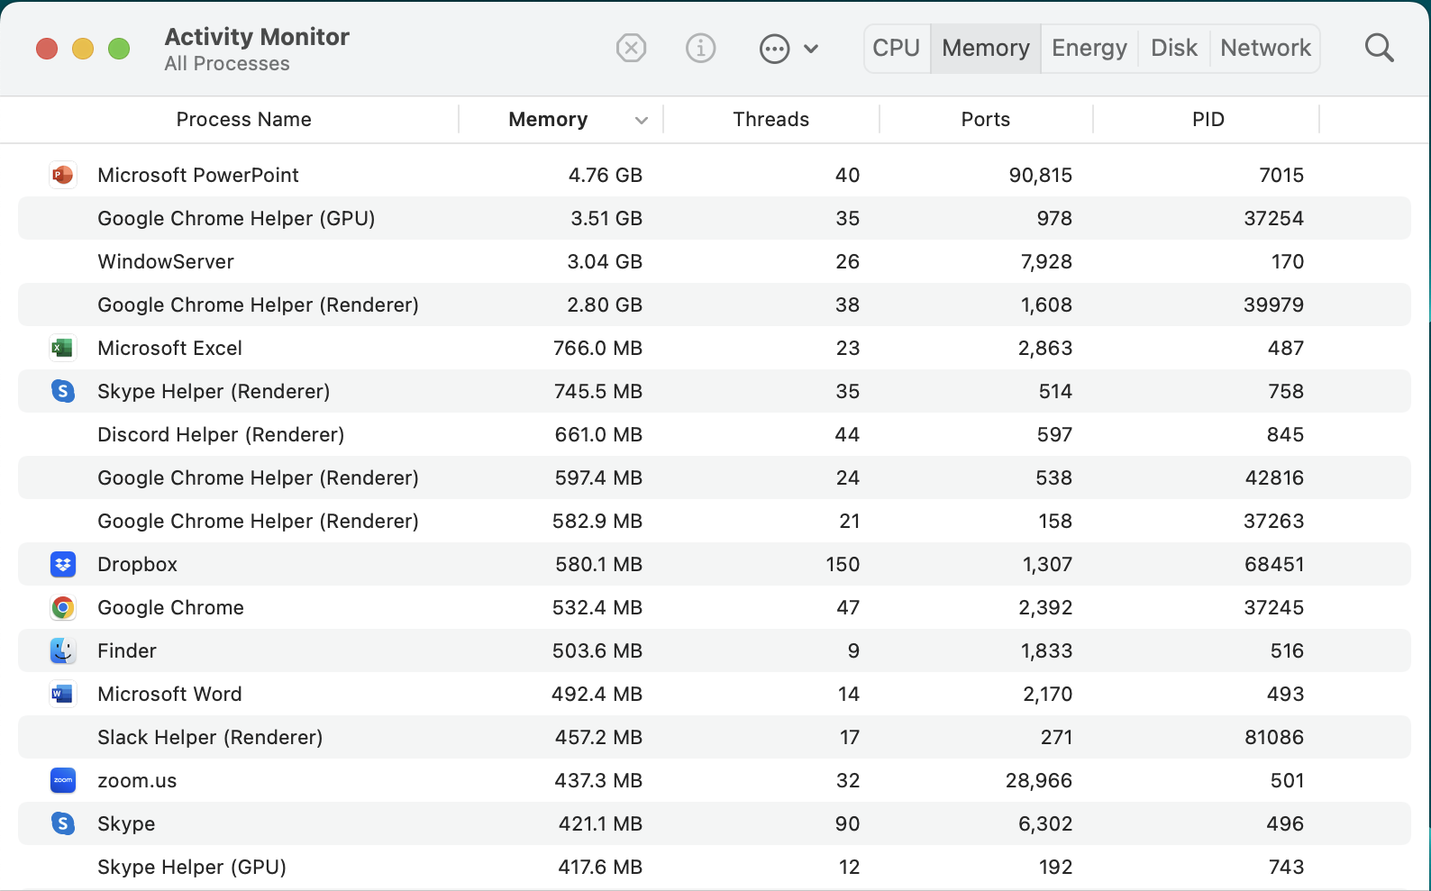
Threads are everywhere

Slide 8
A Basic Question in Thread
main()
How to tell thread i what to do?
How about each thread waits for main() to give the next instruction?
can be bottlenecked by main()
→ kills parallelism!
Thread 0
Thread 1
Thread 2
Thread 3
Better idea: Pass the function to each thread
so each thread can run its function independently

Slide 9
Outline
Motivation
Function Pointers
Thread API: Creation and Termination
Example of Speedup

Slide 10
Function Pointer vs. Data Pointer
Regular pointer
Function pointer syntax:
ReturnType (*f)(ArgType1, …)
(use void, if no argument)
void foo(){
int x = 5;
int *p = &x;
int *q = (int*)malloc(sizeof(int));
// p and q are pointers }
Function pointer
Code is stored in memory
Point to code, not data
void func(){
printf("hello!\n");
}
void bar(){
void (*f)(void) = func;
// f is a function pointer
f(); // prints out "hello!\n"
}

Slide 11
Code Segment
Regular pointer
foo's stack
void foo(){
int x = 5;
int *p = &x;
int *q = (int*)malloc(sizeof(int));
// p and q are pointers }
x = 5
p = &x
q
Heap
Code
foo()

Slide 12
Code Segment and Function Pointer
bar's stack
f = func
Function pointer
func's stack
void func(){
printf("hello!\n");
}
void bar(){
void (*f)(void) = func;
// f is a function pointer
f(); // prints out "hello!\n"
}
Heap
Code
func()
bar()

Slide 13
Passing Arguments Through Function Pointer
f = add
bar's stack
x = 3
y = 4
void add (int x, int y) {
printf("%d + %d = %d\n", x, y, x+y);
}
void bar(){
int x = 3, y = 4;
void (*f)(int, int) = add;
f(x, y);
}
add's stack
x = 3
y = 4
Heap
Code
add(x,y)
bar()

Slide 14
Uses of Function Pointer
Method 1: Without function pointers
void foo(int x, int y){
int i = rand() % 4;
// random in [0,1,2,3]
switch(i){
case 0:
add(x,y); break;
case 1:
subs(x,y); break;
case 2:
mul(x,y); break;
case 3:
divi(x,y); break;
}
}
Randomly select a function and apply it on x and y
void add (int x, int y) {
printf("%d + %d = %d\n", x, y, x+y);
}
void subs(int x, int y) {
printf("%d - %d = %d\n", x, y, x-y);
}
void mul (int x, int y) {
printf("%d * %d = %d\n", x, y, x*y);
}
void divi(int x, int y) {
printf("%d / %d = %d\n", x, y, x/y);
}
Method 2: With function pointers
Code is cleaner
void foo(int x, int y){
int i = rand() % 4;
void (*f_arr[])(int,int) =
{add, subs, mul, divi};
f_arr[i](x, y);
}

Slide 15
Passing Function Pointer as An Argument
1 | 2 | 3 | 4 | 5
void map(int (*fun)(int), int *arr, int len) {
for (int i = 0; i < len; i++){
arr[i] = fun(arr[i]);
}
}
int half(int x) {
return x/2;
}
int main(){
int arr[] = {1, 2, 3, 4, 5};
map(half, arr, 5); // pass function "half" as an argument
// arr becomes 0, 1, 1, 2, 2
}
fun
fun
fun
fun
fun
0 | 1 | 1 | 2 | 2
this is like map(func,list) in python

Slide 16
Outline
Motivation
Function Pointers
Thread API: Creation and Waiting
Example of Speedup

Slide 17
An Example of Thread: pthread
#include<pthread.h>
#include<stdio.h>
void *print_message(void *arg) {
char *str = (char*)arg;
printf("%s\n", str);
return NULL;
}
int main() {
pthread_t tid;
pthread_create(&tid, NULL, print_message, "hello!");
pthread_join(tid, NULL);
printf("done");
}
Function to be run by a thread
Launches a new thread to run print_message
Waiting for the thread to terminate
Notes:
pthread_t

Slide 18
Creating a Thread
pthread_create creates a new thread and makes it executable.
(no need to explicitly start a thread.)
Once created, each thread is assigned a thread ID by OS.
OS saves this value in *tid.
#include<pthread.h>
int pthread_create(pthread_t *tid,
const pthread_attr_t *attr,
void *(*start_routine)(void*),
void *arg);
Thread attribute. Just set to NULL in this class
Function pointer: the function run by the thread.
The function takes a generic pointer (void*) as argument and returns a generic pointer (void*)
Input argument: a generic pointer.
Can be casted to other types within start_routine.
Notes:
how to know when it starts? you can't
how to know when it ends? you can't

Slide 19
Creating a Thread
main thread
#include<pthread.h>
#include<stdio.h>
void *print_message(void *arg) {
char *str = (char*)arg;
// cast generic pointer (void*) to a string (char*)
printf("%s\n", str);
return NULL;
}
int main() {
pthread_t tid;
pthread_create(&tid, NULL, print_message, "hello!");
pthread_join(tid, NULL);
printf("done");
}
peer thread
pthread_create()
Input argument.
pthread_join()
printf("hello!\n");
return (from join())
printf("done");
launch a peer thread to run print_message and pass argument "hello!" to it
Return code of peer thread. (Usually NULL)
The pthread_join() blocks the calling thread until the specified thread ID tid terminates.
Notes:
pthread_t

Slide 20
Outline
Motivation
Function Pointers
Thread API: Creation and Waiting
Example of Speedup

Slide 21
Example: Faster Speed
0.439 seconds (~3x faster)
int NUM_THREADS = 4;
int N = 10000000;
int sums[4];
void *func(void *arg){
int i = (int)arg, subtotal = 0;
int SUB_N = N/NUM_THREADS;
int n = SUB_N * i, end = n + SUB_N;
do{
subtotal += is_prime(n);
} while (n++ < end);
sums[i] = subtotal;
return NULL;
}
int main() {
pthread_t tid0, tid1, tid2, tid3;
pthread_create(&tid0, NULL, func, 0);
pthread_create(&tid1, NULL, func, 1);
pthread_create(&tid2, NULL, func, 2);
pthread_create(&tid3, NULL, func, 3);
pthread_join(tid0, NULL);
pthread_join(tid1, NULL);
pthread_join(tid2, NULL);
pthread_join(tid3, NULL);
int total = sums[0]+sums[1]+sums[2]+sums[3];
}
Count the # of prime numbers before 10 Million
1.372 seconds
int N = 10000000;
int main() {
int total = 0, n = 0, end = N;
do{
total += is_prime(n);
// return 1 if prime, else 0
}
while (n++ < end);
}

Slide 22
Thread Timelines
0.439 seconds (~3x faster)
int NUM_THREADS = 4;
int N = 10000000;
int sums[4];
void *func(void *arg){
int i = (int)arg, subtotal = 0;
int SUB_N = N/NUM_THREADS;
int n = SUB_N * i, end = n + SUB_N;
do{
subtotal += is_prime(n);
} while (n++ < end);
sums[i] = subtotal;
return NULL;
}
int main() {
pthread_t tid0, tid1, tid2, tid3;
pthread_create(&tid0, NULL, func, 0);
pthread_create(&tid1, NULL, func, 1);
pthread_create(&tid2, NULL, func, 2);
pthread_create(&tid3, NULL, func, 3);
pthread_join(tid0, NULL);
pthread_join(tid1, NULL);
pthread_join(tid2, NULL);
pthread_join(tid3, NULL);
int total = sums[0]+sums[1]+sums[2]+sums[3];
}
main thread
peer thread 3
peer thread 2
peer thread 1
peer thread 0
pthread_create()
x 4
func
func
func
func
pthread_join()
x 4
return (from join())
total = …

Slide 23
Array of Threads
int NUM_THREADS = 8;
int N = 10000000;
sums[8];
void *func(void *arg){
// ignored. see last slide
}
int main() {
pthread_t tid0, tid1, tid2, tid3,
tid4, tid5, tid6, tid7;
pthread_create(&tid0, NULL, func, 0);
pthread_create(&tid1, NULL, func, 1);
pthread_create(&tid2, NULL, func, 2);
pthread_create(&tid3, NULL, func, 3);
pthread_create(&tid4, NULL, func, 4);
pthread_create(&tid5, NULL, func, 5);
pthread_create(&tid6, NULL, func, 6);
pthread_create(&tid7, NULL, func, 7);
pthread_join(tid0, NULL);
pthread_join(tid1, NULL);
pthread_join(tid2, NULL);
pthread_join(tid3, NULL);
pthread_join(tid4, NULL);
pthread_join(tid5, NULL);
pthread_join(tid6, NULL);
pthread_join(tid7, NULL);
int total = sums[0]+ sums[1]+sums[2]+ sums[3]+
sums[4]+ sums[5]+sums[6]+ sums[7];
}
#define NUM_THREADS 8
int N = 10000000;
int sums[NUM_THREADS];
void *func(void *arg){
// ignored. see last slide
}
int main() {
pthread_t tids[NUM_THREADS];
int total = 0;
for (int i = 0; i < NUM_THREADS; i++)
pthread_create(&tids[i], NULL, func, i);
for (int i = 0; i < NUM_THREADS; i++){
pthread_join(tids[i], NULL);
total += sums[i];
}
}
for (int i = 0; i < NUM_THREADS; i++){
pthread_create(&tids[i], NULL, func, i);
pthread_join(tids[i], NULL);
total += sums[i];
}
What if we merge the two for loops?
it will kill the parallelism

Slide 24
Conclusion
Threads can implement parallelism
Function pointers allow passing function to a thread
How to create a new thread? How to wait for its completion?

Slide 27
Thread 1
Analogy of parallelism
Define parallelism
Ex1: adding a number to each element of a long array
Ex2: avoid I/O blocking (?)
Basic API
Function as argument
Simple thread creation example
Thread 2
Non-determinism
Embarrassingly parallel example
Thread 3
How things look like on stack
Shared memory space
Example of thread-based sorting

Slide 28
Hierarchy of Threads
Thread ID
Main vs Peers
Share memory space (main stack and heap).
Main stack is accessible to all threads

Slide 29
Motivating Example: Web Service

Slide 30
An Example of Thread
#include<pthread.h>
#include<stdio.h>
void *print_message(void *arg) {
char *str = (char*)arg;
printf("%s\n", str);
return NULL;
}
int main() {
pthread_t tid;
pthread_create(&tid, NULL, print_message, "hello!");
pthread_join(tid, NULL);
}
Thread arguments
(void *arg)
OS will return the thread id "tid"
Thread start routine
function pointer
Thread attributes
(usually NULL)
wait until tid is done
Notes:
pthread_t

Slide 31
Creating a Thread
When created, each thread is assigned a thread ID by OS. It's saved in *tid.
#include<pthread.h>
int pthread_create(pthread_t *tid,
const pthread_attr_t *attr,
void *(*subroutine)(void*),
void *arg);
Thread attribute. Just set to NULL in this class
Function pointer: the function run by the thread.
Subroutine is a function that takes a generic pointer (void*) as argument and returns no value.
Input argument: a generic pointer
This routine creates a new thread and makes it executable.
There's no separate run_thread subroutine
Once created, threads are peers
The pthread_create subroutine returns the new thread ID via the thread argument.
The attr parameter is used to set thread attributes. Can be an object, or NULL for the default values
start_routine is the C routine that the thread will execute once it is created. A single argument may be passed to start_routine via arg as a void pointer.
Notes:
how to know when it starts? you can't
how to know when it ends? you can't

Slide 32
Creating a Thread
main thread
#include<pthread.h>
#include<stdio.h>
void *print_message(void *arg) {
char *str = (char*)arg;
// cast generic pointer (void*) to a string (char*)
printf("%s\n", str);
return NULL;
}
int main() {
pthread_t tid;
pthread_create(&tid, NULL, print_message, "hello!");
pthread_join(tid, NULL);
}
peer thread
Input argument.
launch a peer thread to run print_message and pass argument "hello!" to it
Notes:
pthread_t

Slide 33
Waiting for a Thread to Complete
The pthread_join() blocks the calling thread until the specified thread ID tid terminates.
ID of the thread being waited by the calling thread
int pthread_join(pthread_t tid,
void **retval);
#include<pthread.h>
#include<stdio.h>
void *print_message(void *arg) {
char *str = (char*)arg;
// cast generic pointer (void*) to a string (char*)
printf("%s\n", str);
return NULL;
}
int main() {
pthread_t tid;
pthread_create(&tid, NULL, print_message, "hello!");
pthread_join(tid, NULL);
}
Notes:
how to know when it starts? you can't
how to know when it ends? you can't

Slide 34
Timeline of Execution
main thread
#include<pthread.h>
#include<stdio.h>
void *print_message(void *arg) {
char *str = (char*)arg;
printf("%s\n", str);
return NULL;
}
int main() {
pthread_t tid;
pthread_create(&tid, NULL, print_message, "hello!");
pthread_join(tid, NULL);
}
pthread_create()
returns
peer thread
printf(“MAIN-T”)
printf(“hello!”)
pthread_join()
return;
Wait …
(peer thread
terminates)
Returns (from join())
Notes:
how to know when it starts? you can't
how to know when it ends? you can't

Slide 35
Example: Faster Speed
#include<pthread.h>
#include<stdio.h>
int NUM_THREADS = 8;
int N = 10000000;
int subtotals[8];
void *func(void *arg){
int i = (int)arg, subtotal = 0;
int SUB_N = N/NUM_THREADS;
int n = SUB_N * i, end = n + SUB_N;
do{
subtotal += is_prime(n);
} while (n++ < end);
subtotals[i] = subtotal;
return NULL;
}
int main() {
pthread_t tids[NUM_THREADS];
int total = 0;
for (int i = 0; i < NUM_THREADS; i++)
pthread_create(&tids[i], NULL, func, i);
for (int i = 0; i < NUM_THREADS; i++){
pthread_join(tids[i], NULL);
total += subtotals[i];
}
printf("total = %d\n", total);
}
int N = 10000000000;
int main() {
int total = 0, start = 0, end = N;
do{
total++;
} while (start++ < end);
}
84% cpu, 0.954 seconds
712% cpu, 0.125 seconds

Slide 36
Example: Faster Speed
#include<pthread.h>
#include<stdio.h>
#define NUM_THREADS 8
int N = 10000000000;
int subtotals[NUM_THREADS];
void *func(void *arg){
int i = (int)arg, subtotal = 0;
int start = N/NUM_THREADS * i;
int end = start + N/NUM_THREADS;
do{
subtotal ++;;
} while (start++ < end);
subtotals[i] = subtotal;
return NULL;
}
int main() {
pthread_t tids[NUM_THREADS];
int total = 0;
for (int i = 0; i < NUM_THREADS; i++)
pthread_create(&tids[i], NULL, func, i);
for (int i = 0; i < NUM_THREADS; i++){
pthread_join(tids[i], NULL);
total += subtotals[i];
}
}
main thread
pthread_create(0)
pthread_create(1)
…
pthread_create(7)
peer thread 7
peer thread 1
peer thread 0
pthread_join(0)
…
pthread_join(1)
…
(thread 7
terminates)
(thread 1
terminates)
(thread 0
terminates)
pthread_join(7)
Wait …
Returns (from join())
712% cpu, 0.125 seconds

