Slide 1
Hash Table (1) CMSC 14300: System Programming I 20th Lecture
Instructor:
Prof. Adam Shaw
Prof. Junchen Jiang

Slide 2
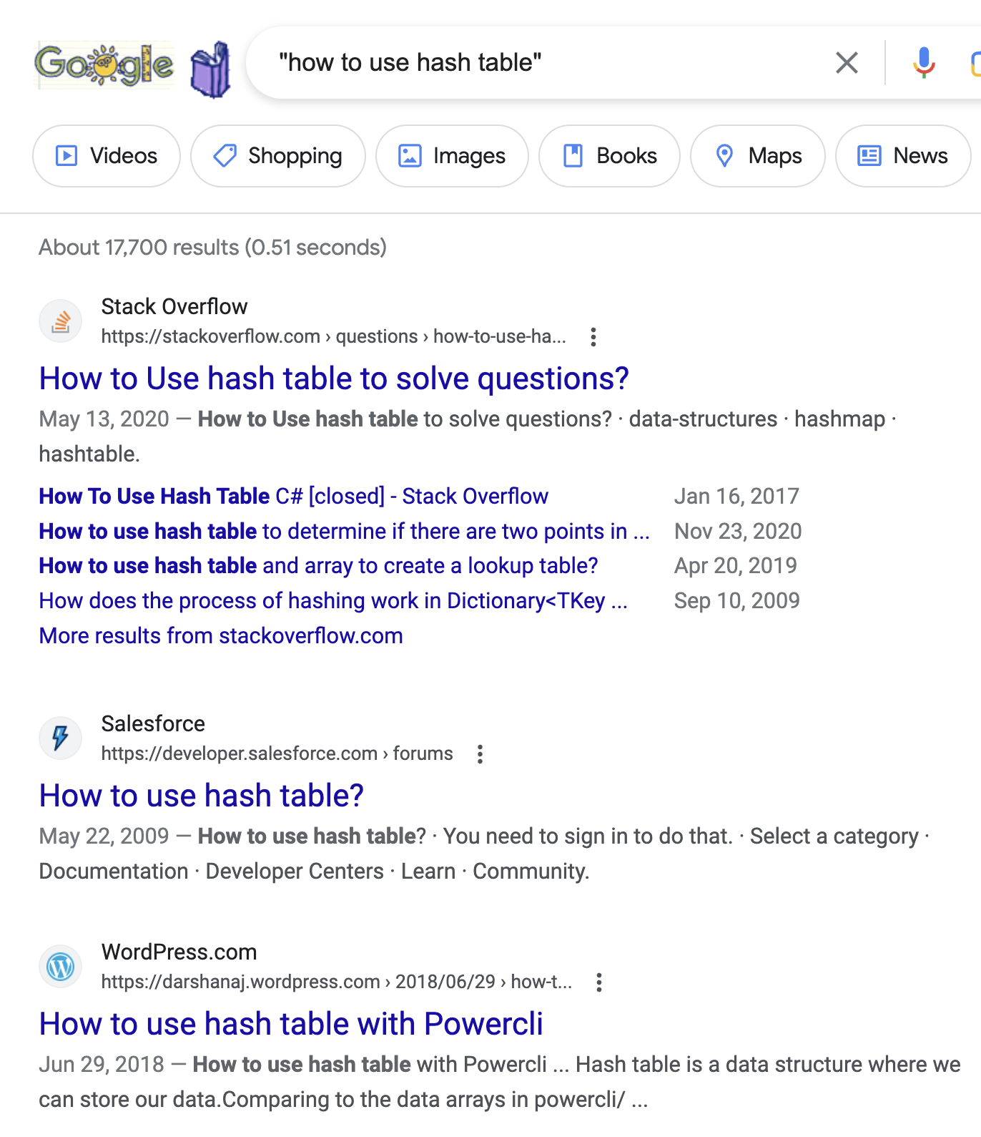
Motivation
Searching a keyword in your email inbox.
How many emails? at least 10s of thousands…
How many words? at least millions…
How long does it take to search a keyword in your inbox? Less than a second!!!
Search a keyword on search engine.
How many webpages? Billions?
How many words? Even more…
How long does it take to search a keyword on Google? Less than a second!!!

Slide 3
Abstraction: Dictionaries, Sets, & Key Lookup
A dictionary is a data structure that maps keys to values.
Also called key-value store
Ex. map CnetID to name. CNetID is the key, name is the value.
"junchenj": "Junchen Jiang"
"ams": "Adam Shaw"
A set is a data structure that stores a collection of unique keys.
Basic operation: Key lookup
Check whether a dictionary contains a given key or a set contains a given key.
Ex. does "ams" appear as a key in a dictionary?
We start with integers as keys, and then extend it to other key types

Slide 4
Integer Lookup
Given a dictionary D, check whether a given integer key appears in D.
Ex. D = {5: "str0", 4423: "str1", 9: "str2", 25: "str3", 1100: "str4"}
Does key = 25 appear as a key in D? (Yes)
…
Python set or dictionary?
How do we store a dictionary or a set of values in C?
D = {5: "str0", 4423: "str1", 9: "str2", 25: "str3", 1100: "str4"}
print(25 in D)

Slide 5
Idea #1: Create an array of keys and search exhaustively
Given D = {5: "str0", 4423: "str1", 9: "str2", 25: "str3", 1100: "str4"}
5 | 4423 | 9 | 25 | 1100
Lookup(25)
match!
Lookup(100)
no match!
Assume that D has n keys,
Time to create data structure (key array)?
How much space for data structure?
Time to lookup one value?
O(1), O(log n), O(n), O(n log n)?
O(1)
O(1), O(log n), O(n), O(n log n)?
O(n)
O(1), O(log n), O(n), O(n log n)?
O(n)
Lookup too slow

Slide 6
Idea #2: Sort first, then binary search
Given D = {5: "str0", 4423: "str1", 9: "str2", 25: "str3", 1100: "str4"}
5 | 4423 | 9 | 25 | 1100
Prepare: Heap Sort
5 | 9 | 25 | 1100 | 4423
Lookup(25)
match!
Lookup(100)
no match!
Assume that D has n keys,
Time to create data structure (sorted array)?
How much space for data structure?
Time to lookup one value?
O(1), O(log n), O(n), O(n log n)?
O(n log n)
O(1), O(log n), O(n), O(n log n)?
O(n)
O(1), O(log n), O(n), O(n log n)?
O(log n)
Lookup still too slow

Slide 7
Idea #3: Create and check a counter array
Given D = {5: "str0", 4423: "str1", 9: "str2", 25: "str3", 1100: "str4"}
5 | 4423 | 9 | 25 | 1100
Prepare: Create a counter array
a[5]
a[9]
a[25]
a[1100]
a[4423]
counter array
a[4424]
 | 1 |  | 1 |  | 1 |  | 1 |  | 1
red cells are all 0's
Lookup(25)
a[25] > 0: Match!
Lookup(100)
a[100] == 0: No Match!
Assume that D has n keys,
Time to create data structure (counter array)?
How much space for data structure?
Time to lookup one value?
Use too much space
O(1), O(log n), O(n), O(n log n)?
O(n)
O(1), O(log n), O(n), O(n log n)?
O(max key)
O(1), O(log n), O(n), O(n log n)?
O(1)

Slide 8
Recap: Performance of Integer Key Lookup
Given a dictionary D, check whether a given integer key appears in D.
 | Time to lookup a key | Space usage
Idea #1: Exhaustive Search | O(n) | O(n)
Idea #2: Sort then binary search | O(log n) | O(n)
Idea #3: Create and check a counting array | O(1) | O(max key)
Can we do better?

Slide 9
Hash Table
Goal:
We want to lookup values in (nearly) constant time.
Low space usage
Insight: Lookup an index in an array takes constant time.
Idea: Use a hash function to map each value to an index in a small array!

Slide 10
Revisit "Counter Array"
Given D = {5: "str0", 4423: "str1", 9: "str2", 25: "str3", 1100: "str4"}
5 | 4423 | 9 | 25 | 1100
a[5]
a[9]
a[25]
a[1100]
a[4423]
counter array
a[4424]
 | 1 |  | 1 |  | 1 |  | 1 |  | 1
red cells are all 0's
Size of counter array: max_value (4424)
O(1) lookup, but it needs too many space to store the counters

Slide 11
Revisit "Counter Array"
Given D = {5: "str0", 4423: "str1", 9: "str2", 25: "str3", 1100: "str4"}
5 | 4423 | 9 | 25 | 1100
index = key
a[5]
a[9]
a[25]
a[1100]
a[4423]
counter array
a[4424]
 | 1 |  | 1 |  | 1 |  | 1 |  | 1
Size of counter array: max_key (4424)
O(1) lookup, but it needs too many space to store the counters
Key reason: index = key

Slide 12
Hashing Integers
Given D = {5: "str0", 4423: "str1", 9: "str2", 25: "str3", 1100: "str4"}
5 | 4423 | 9 | 25 | 1100
What's this hash function?
index = hash(key)
a[hash(25)]
hash table:
hash_table[m]
… | 1 | …
Hash function, hash(), maps a key to an index in a small range [0, …, m-1].

Slide 13
Hashing Integers
Given D = {5: "str0", 4423: "str1", 9: "str2", 25: "str3", 1100: "str4"}
5 | 4423 | 9 | 25 | 1100
What's this hash function?
Collision:
What if hash(4423) = hash(25)
index = hash(key)
a[hash(25)]
hash table:
hash_table[m]
… | 1 | …
Collisions are hard to completely avoid with small m.
For simplicity, we assume no collision for now.
More on how to handle collisions in next lecture
Hash function, hash(), maps a key to an index in a small range [0, …, m-1].
Hope: Low chance of collision

Slide 14
Hashing Integers
Given D = {5: "str0", 4423: "str1", 9: "str2", 25: "str3", 1100: "str4"}
5 | 4423 | 9 | 25 | 1100
What's this hash function?
Collision:
What if hash(4423) = hash(25)
index = hash(value)
a[hash(25)]
hash table:
hash_table[m]
… | 1 | …
Collisions are hard to completely avoid with small m.
For simplicity, we assume no collision for now.
More on how to handle collisions in next lecture
Hash function, hash(), maps a key to an index in a small range [0, …, m-1].
Hope: Low chance of collision
General format of hash()
hash(x) = (a*x+b) % m, where a*x+b is the hash code
More on this in next lecture

Slide 15
Example:
Given D = {5: "str0", 4423: "str1", 9: "str2", 25: "str3", 1100: "str4"}
5 | 4423 | 9 | 25 | 1100
index = (key * 7) % 11
0 | 1 | 2 | 3 | 4 | 5 | 6 | 7 | 8 | 9 | 10
hash table:
hash_table[11]
NULL | NULL | NULL | NULL | NULL | NULL | NULL | NULL | NULL | NULL | NULL
(1100, "str4")
(5, "str0")
(4423, "str1")
(25, "str3")
(9, "str2")

Slide 16
Example:
Given D = {5: "str0", 4423: "str1", 9: "str2", 25: "str3", 1100: "str4"}
5 | 4423 | 9 | 25 | 1100
index = (key * 7) % 11
0 | 1 | 2 | 3 | 4 | 5 | 6 | 7 | 8 | 9 | 10
hash table:
hash_table[11]
 | NULL |  | NULL | NULL | NULL | NULL |  |  | NULL
(1100, "str4")
(5, "str0")
(4423, "str1")
(25, "str3")
(9, "str2")
Lookup (7)
Calculate hash index: hash(7) = (7*7) % 11 = 5
Check if index 5 is NULL ➔ no match!

Slide 17
Example:
Given D = {5: "str0", 4423: "str1", 9: "str2", 25: "str3", 1100: "str4"}
5 | 4423 | 9 | 25 | 1100
index = (key * 7) % 11
0 | 1 | 2 | 3 | 4 | 5 | 6 | 7 | 8 | 9 | 10
hash table:
hash_table[11]
 | NULL |  | NULL | NULL | NULL | NULL |  |  | NULL
(1100, "str4")
(5, "str0")
(4423, "str1")
(25, "str3")
(9, "str2")
Lookup (25)
Calculate hash index: hash(25) = (25*7) % 11 = 10
Check if index 10 is NULL
The key associated with index 10 is 25 ➔ match!

Slide 18
Example:
Given D = {5: "str0", 4423: "str1", 9: "str2", 25: "str3", 1100: "str4"}
5 | 4423 | 9 | 25 | 1100
index = (key * 7) % 11
0 | 1 | 2 | 3 | 4 | 5 | 6 | 7 | 8 | 9 | 10
hash table:
hash_table[11]
 | NULL |  | NULL | NULL | NULL | NULL |  |  | NULL
(1100, "str4")
(5, "str0")
(4423, "str1")
(25, "str3")
(9, "str2")
Lookup (14)
Calculate hash index: hash(14) = (14*7) % 11 = 10
Check if index 10 is NULL
The key associated with index 10 is not 14 ➔ no match!

Slide 19
Code example
#define SIZE 11
typedef struct pair pair;
struct pair{int key; char* val;};
int hash(int key) {
return key * 7 % SIZE;
}
void lookup(pair **hash_table, int key){
int index = hash(key);
if (hash_table[index] != NULL &&
hash_table[index]->key == key)
printf("%d appears\n", key);
else printf("%d does not appear\n", key);
}
int main(){
pair* hash_table[SIZE];
for (int i = 0; i < SIZE; i++)
hash_table[i] = NULL;
pair pr0 = {5, "str0"};
hash_table[hash(pr0.key)] = &pr0;
pair pr1 = {4423, "str1"};
hash_table[hash(pr1.key)] = &pr1;
pair pr2 = {9, "str2"};
hash_table[hash(pr2.key)] = &pr2;
pair pr3 = {25, "str3"};
hash_table[hash(pr3.key)] = &pr3;
pair pr4 = {1100, "str4"};
hash_table[hash(pr4.key)] = &pr4;
lookup(hash_table, 7);
lookup(hash_table, 25);
lookup(hash_table, 14);
}

Slide 20
Code example
#define SIZE 11
typedef struct pair pair;
struct pair{int key; char* val;};
int hash(int key) {
return key * 7 % SIZE;
}
void lookup(pair **hash_table, int key){
int index = hash(key);
if (hash_table[index] != NULL &&
hash_table[index]->key == key)
printf("%d appears\n", key);
else printf("%d does not appear\n", key);
}
int main(){
pair* hash_table[SIZE];
for (int i = 0; i < SIZE; i++)
hash_table[i] = NULL;
pair pr0 = {5, "str0"};
hash_table[hash(pr0.key)] = &pr0;
pair pr1 = {4423, "str1"};
hash_table[hash(pr1.key)] = &pr1;
pair pr2 = {9, "str2"};
hash_table[hash(pr2.key)] = &pr2;
pair pr3 = {25, "str3"};
hash_table[hash(pr3.key)] = &pr3;
pair pr4 = {1100, "str4"};
hash_table[hash(pr4.key)] = &pr4;
lookup(hash_table, 7);
lookup(hash_table, 25);
lookup(hash_table, 14);
}

Slide 21
Conclusion
Given a dictionary D, check whether a given integer key appears in D.
 | Time to lookup a key | Space usage
Idea #1: Exhaustive Search | O(n) | O(n)
Idea #2: Sort then binary search | O(log n) | O(n)
Idea #3: Create and check a counting array | O(1) | O(max key)
Idea #4: Hash Table | O(1) | O(m)
m is the hash table size. Usually, m is proportional to n, not max key.
Does this apply to other key types (e.g., strings)?
How to avoid collisions? How handle collisions?
Next lecture!

