Slide 1
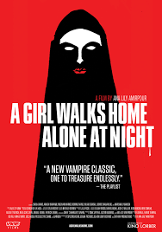
Worldbuilding and Unbuilding
Creed (1993) * Armipour (2014)

Slide 2
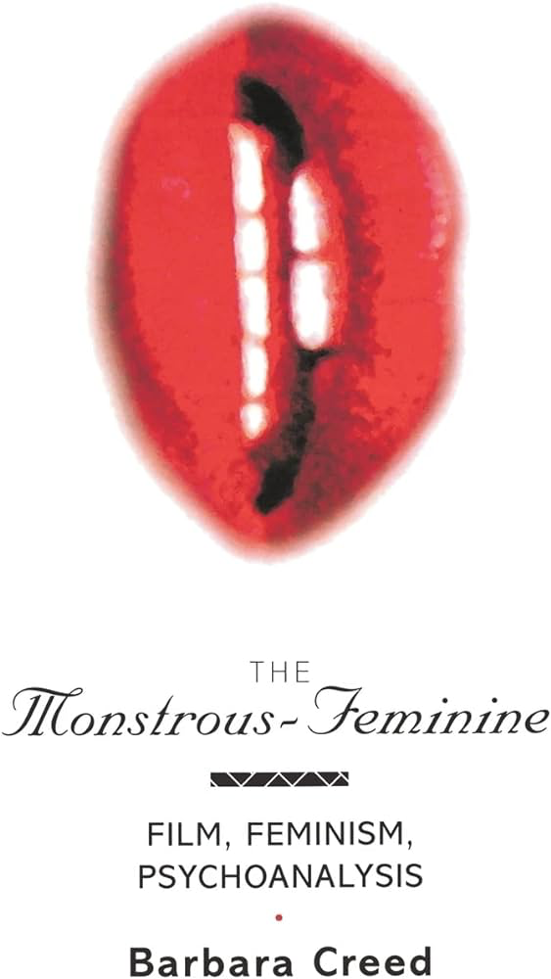
Agenda
Announcements
Overview
Keywords
Student Presentations with Kaitlyn and Taylor
Discussion
Notes:
This week marks a transition from the first part of the quarter which explored how sex/uality is regulated by hegemonic forces (biopower, national heterosexuality, structural racism, capitalism, and neo-liberalism), while also showing the destabilizing power of queer desire, sociality, and collation-building. In our lead up to discussions of reproductive futurity and queer worldbuilding, this week’s materials introduce the conceptual language of monstrous, cyborg, and glitch feminism.
Day 1 extends Creed’s analysis of the monstrous feminine in American horror films to consider the subversive potential of the trope in relation to the Iranian vampire movie A Girl Walks Home Alone at Night. Read together, the pairing demonstrates how this monstrosity is symptomatic of patriarchal anxieties about women and their sexuality. AGWHAAN models how monstrosity can be mobilized against patriarchal systems of oppression while also disrupting the vampire archetype (white, male, hypersexualized, preying on women).

Slide 3
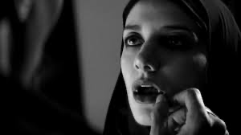
Adding to Our Conceptual Vocabulary

Slide 4
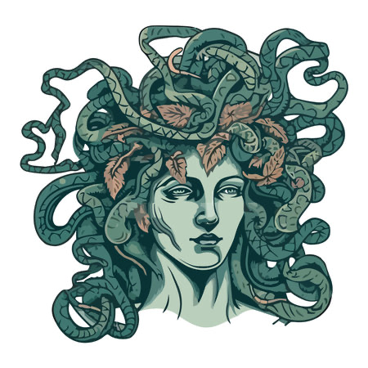
Psychoanalytic Keywords
semiotic
jouissance
abjection
chora
symbolic
Mirror stage
Ideal ego
Self/Other
Symbolic order
Subject/Object
For more: https://nosubject.com/Main_Page
Notes:
For Kristeva, the semiotic resembles the pre-oedipal and pre-mirror infantile stage of Freud, Lacan, and Melanie Klein. It is a pre-discursive space associated with instincts, emotions, and non-verbal expression that Kristeva aligns with the “feminine.” She resignifies Plato’s concept of the chora as “a nourishing maternal space” (Schippers, 2011) that recalls the uterus but also signifies the bond between mother and child before the mirror stage. For Lacan, the mirror stage occurs around 6 -18 months when the infant sees themselves in the mirror and individuates by developing a sense of self/I distinct from the (m)other. This ideal ego—a narcissistic fantasy image of the self as stable, coherent, and unburdened by the chaos of our bodily drives—becomes internalized as an ideal self that exists within the imaginary order. After the mirror stage the child enters into the symbolic order of language and shared cultural meaning.
Kristeva frames the transition from the maternal/feminine semiotic to the paternal/masculine symbolic as a process of abjection in which the child is violently thrust into the realm of language and law. She further departs from Lacan by positing that the subject continues to move between the semiotic and symbolic through processes of abjection that threaten the stability of meaning and subjective coherence by blurring the distinction between self/other and subject/object. Abjection is also closely aligned with the concept of jouissance — “excessive” forms of pleasure that transgress a subject’s regulation between bodily pleasure and pain/death that can exist within sexual and spiritual spaces.

Slide 5
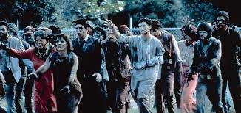
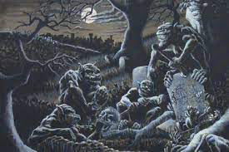
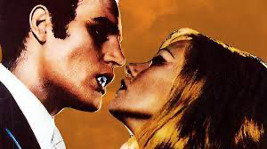
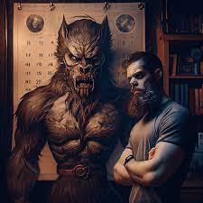
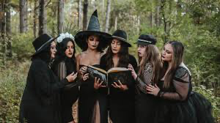
Archetypes of Horror
Zombies
Ghouls
Vampires
Werewolves
Witches
Notes:
Creed explores how key archetypes of the horror genre such as vampires (“bodies without souls”), zombies (“the living corpse”), ghouls (“the corpse-eater”), witches (accused of using corpses for magic rites), and werewolves (hybrid human-animal) operate as abject figures that threaten the distinction between life/death or human/non-human (41).

Slide 6
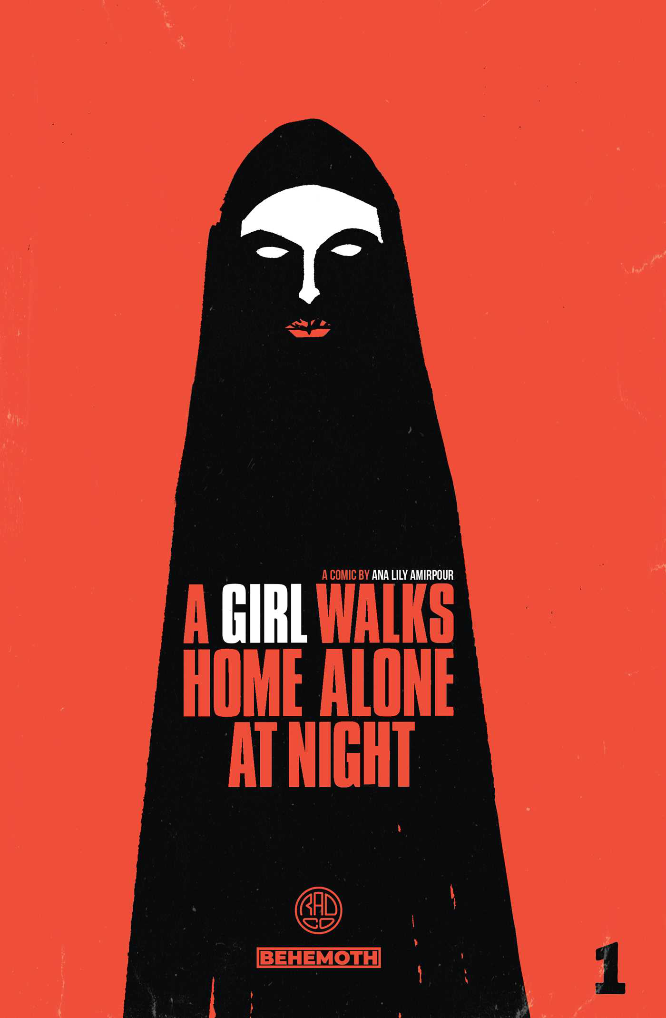
Student Presentations with Kaitlyn and Taylor

