Slide 1


Week 8: Repro Futures
Lee Edelman’s No Future (2004) * Jose Munoz’s Cruising Utopia (2009)

Slide 2
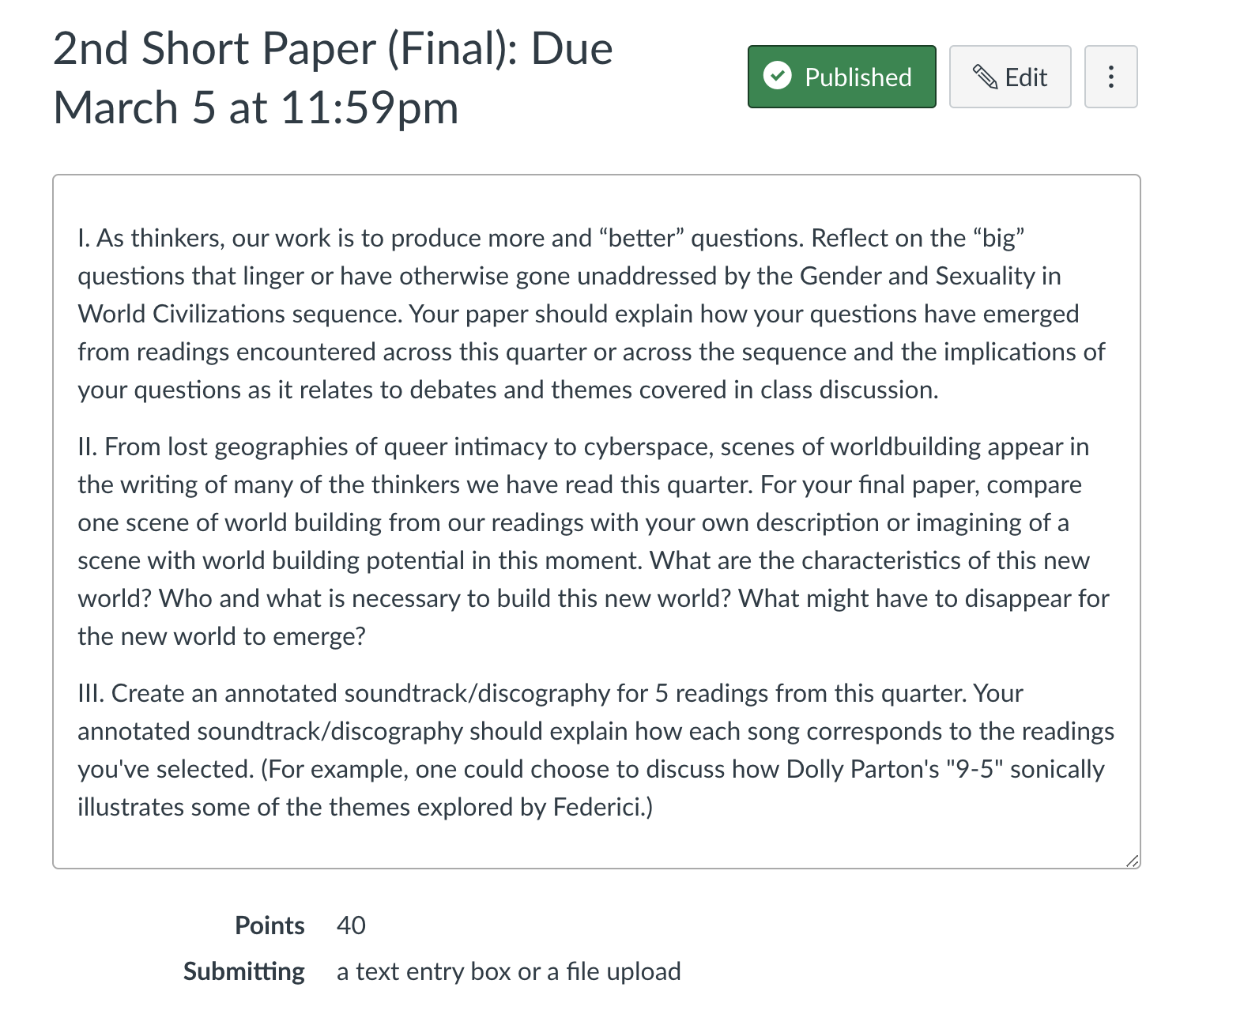
Agenda
Announcements/ Discussion of Final Exam Questions
Overview
Student Presentations with Mike and Cory
Debate/Discussion
Notes:
Talk about next week’s reading—Read Parts I –III for Tuesday, and part IV for Thursday. Content warning—SA and violence

Slide 3

The Stakes of Edelman’s Argument…
Edelman: “The fantasy subtending the image of the Child invariably shapes the logic within which the political itself must be thought” (2)…. “queerness names the side of those not ‘fighting for the children’, the side outside the consensus by which all politics confirms the absolute value of reproductive futurism” (3).
Conceptual Questions:
* Who is the Child?
* What is reproductive futurity?
* Queer negativity?
* Anti-relationality?
“Fuck the social order and the Child in whose name we’re collectively terrorized; fuck Annie; fuck the waif from Les Mis; fuck the poor, innocent kid on the net; fuck Laws both with capital ls and with small; fuck the whole network of Symbolic relations and the future that serves as its prop” (29).

Slide 4

Munoz’s “Response”
In contrast (and in critical debate with Edelman), Munoz offers a vision of queer futurity and utopia that emphasizes the importance of critical idealism—what is at stake in saying “fuck the future”?
What is queerness?
What are some of the methods Munoz discusses?
What functions do concrete and abstract forms of utopia serve?
While not in your Munoz writes “the future is only the stuff of some kids” (95) a ref. to the Edelman’s chapter title “The Future is Kid Stuff”

Slide 5
Student Presentations

Slide 6
Debating Queer Futures: Staging the Encounter between Edelman and Munoz
Debate format: Three rounds of structured debate (3 minutes per team each round)
Round One:
(1a) Team One presents the affirmative position (1b) Team Two presents the negative position
• The argument (s) is introduced • The argument (s) is introduced • Evidence is submitted to support the argument • Evidence is submitted to support the argument
• No direct response is made to Team One
Round Two: The other team’s evidence and arguments may be rebutted. You will need to anticipate the other teams’ response.
(2a) Team One reintroduces the affirmative position (2b) Team Two reintroduces the negative position • Secondary arguments are introduced • Secondary arguments are introduced • More evidence is submitted • More evidence is submitted
Round Three: Respond directly to the other team’s arguments and sum up key points of your team’s position.
(3a) Team One rebuttal (3b) Team Two rebuttal

