Slide 1
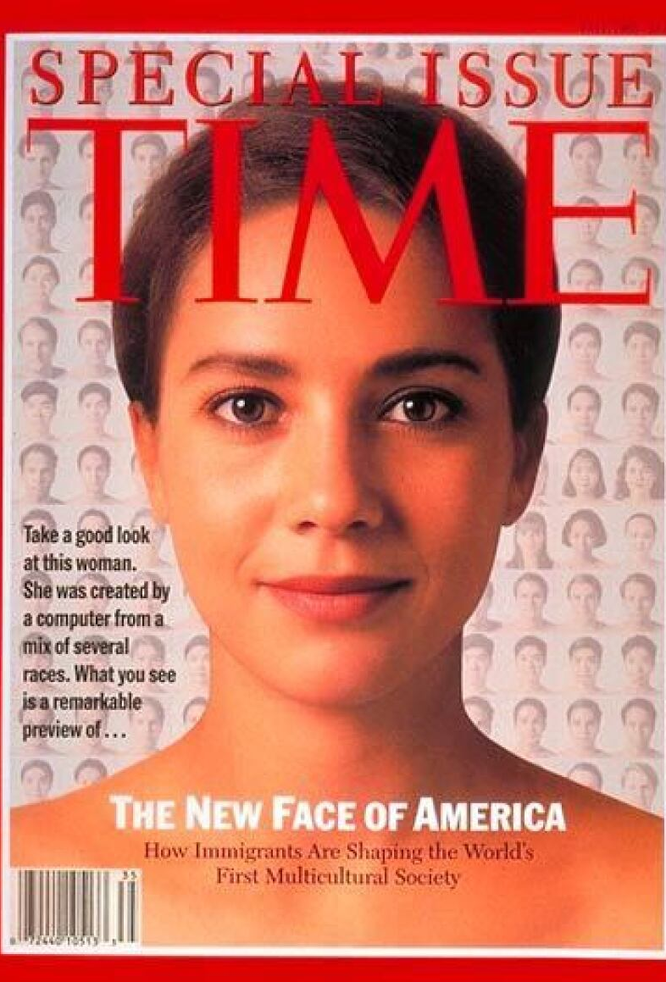
Sex in Public, Part II
Lauren Berlant & Michael Warner

Slide 2
Agenda
Announcements
Discussion Group Activity
Student Presentation
General Discussion

Slide 3
All together now: A Group Activity
As a way into today’s discussion, let’s talk about what continuities we can identify between the Delany reading and Berlant & Warner’s discussion of how capitalism and fantasies of a good life animate a national heterosexual culture?
How do Berlant & Warner take up the question of public v. private? And how does it compare to other readings from this week?
How might we think about public heterosexuality? How is it different from heteronormativity (Foucault)?

Slide 4
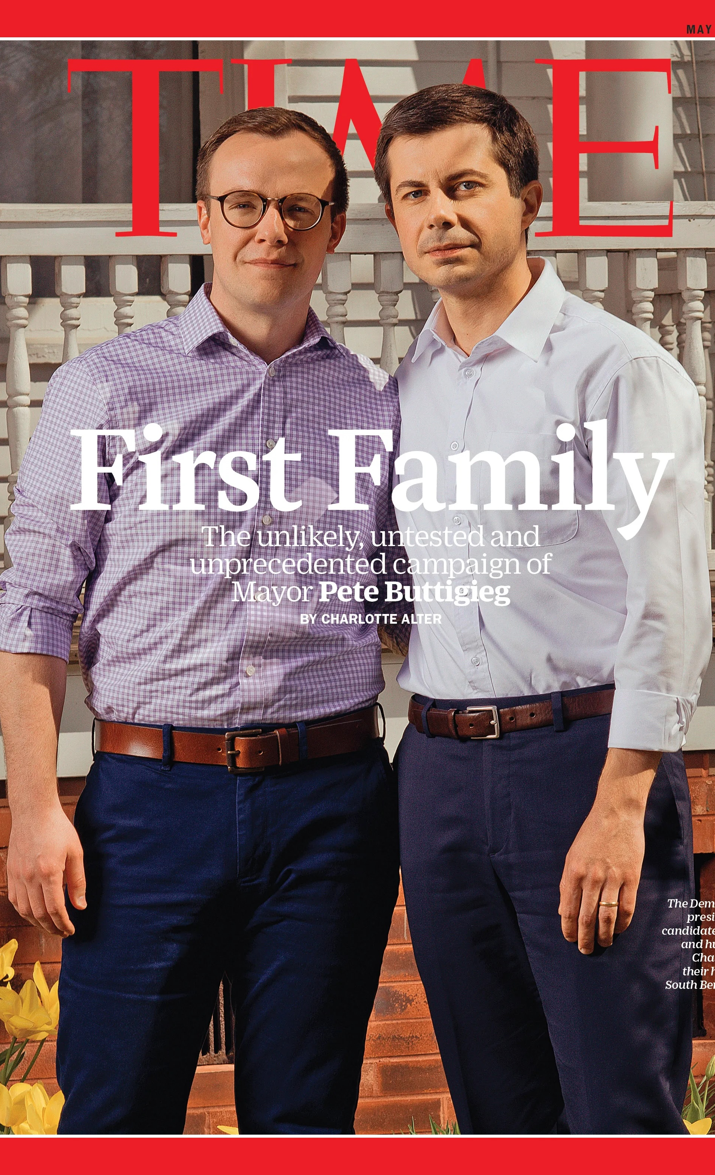
Report Back
Bonus*: What might Berlant & Warner say about this 2019 Time cover? Is this an example of queer worldmaking?

