Slide 1
AI Fit Mentor – Internship Project
Name: ARJUN VELUPRABHAKARAN
  Register No.: EA2431201010152
Program: B.C.A.-Data Science
SRM Institute of Science and Technology
Internship Presentation

Slide 2
Abstract
AI-powered fitness assistant using React, TypeScript, Tailwind, Supabase.
Personalized plans, validation, charts.

Slide 3
System Analysis
Existing limitations, proposed AI-driven web app.
Blueprint to working platform.

Slide 4
Requirements
Functional & Non-functional requirements.
Secure data, real-time validation, AI planning.

Slide 5
Technologies Used
- Vite
- TypeScript
- React
- shadcn-ui
- Tailwind CSS

Slide 6
Implementation
AI chat, plan generator, Supabase DB, RLS policies, user profiles.

Slide 7
Design
UML diagrams, DFD flow.

Slide 8
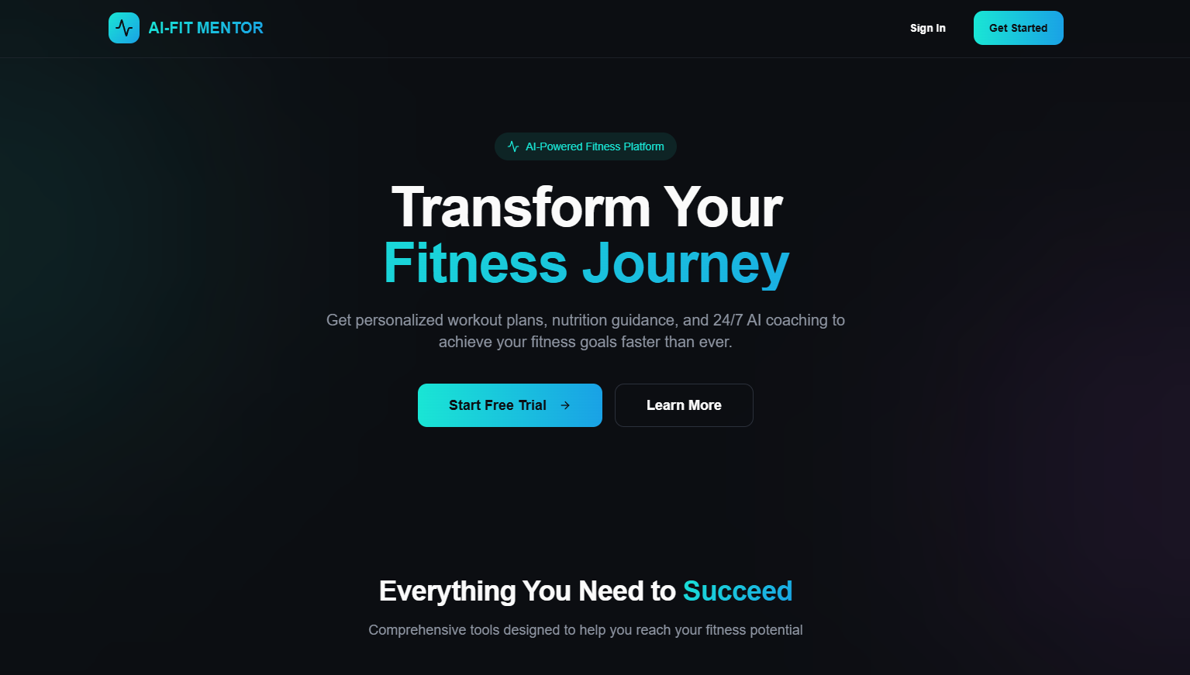
Home page

Slide 9
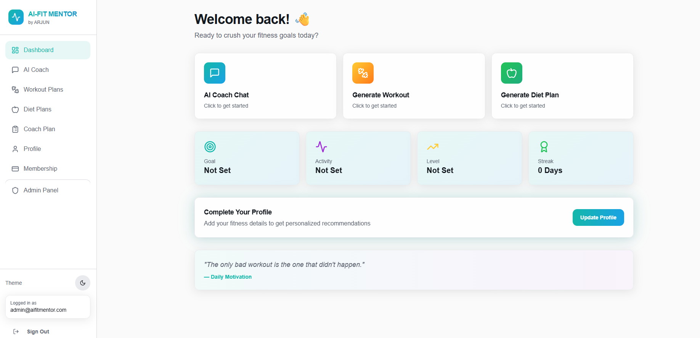
Dashboard and features.

Slide 10
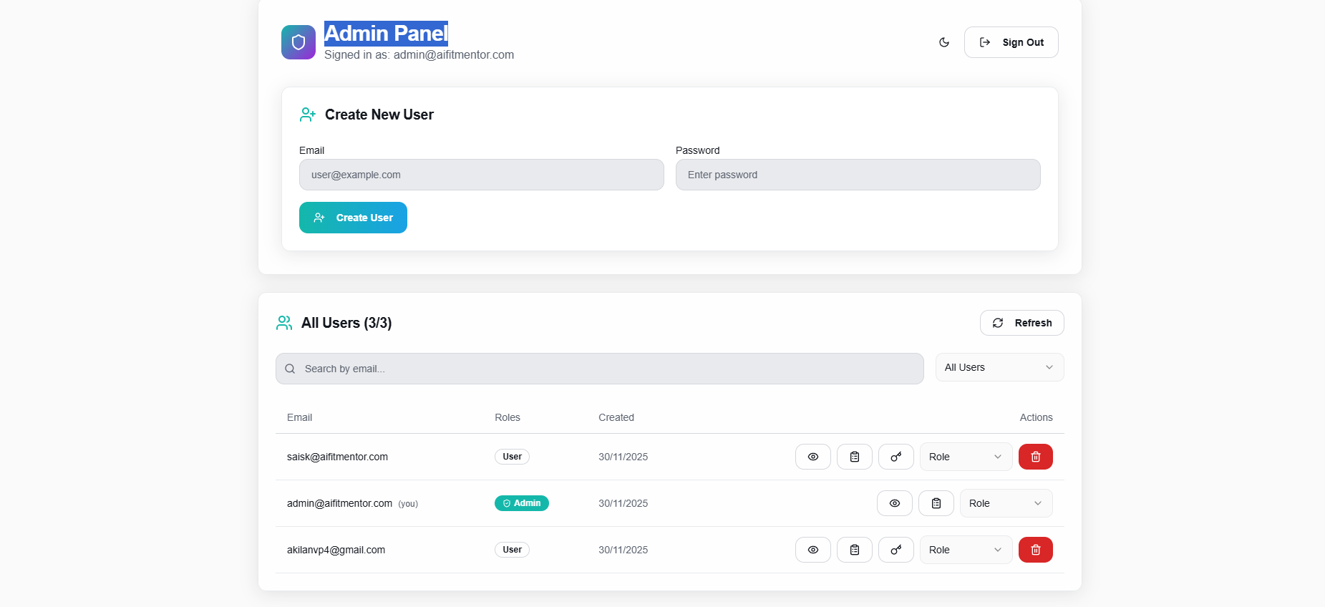
Admin Panel

Slide 11
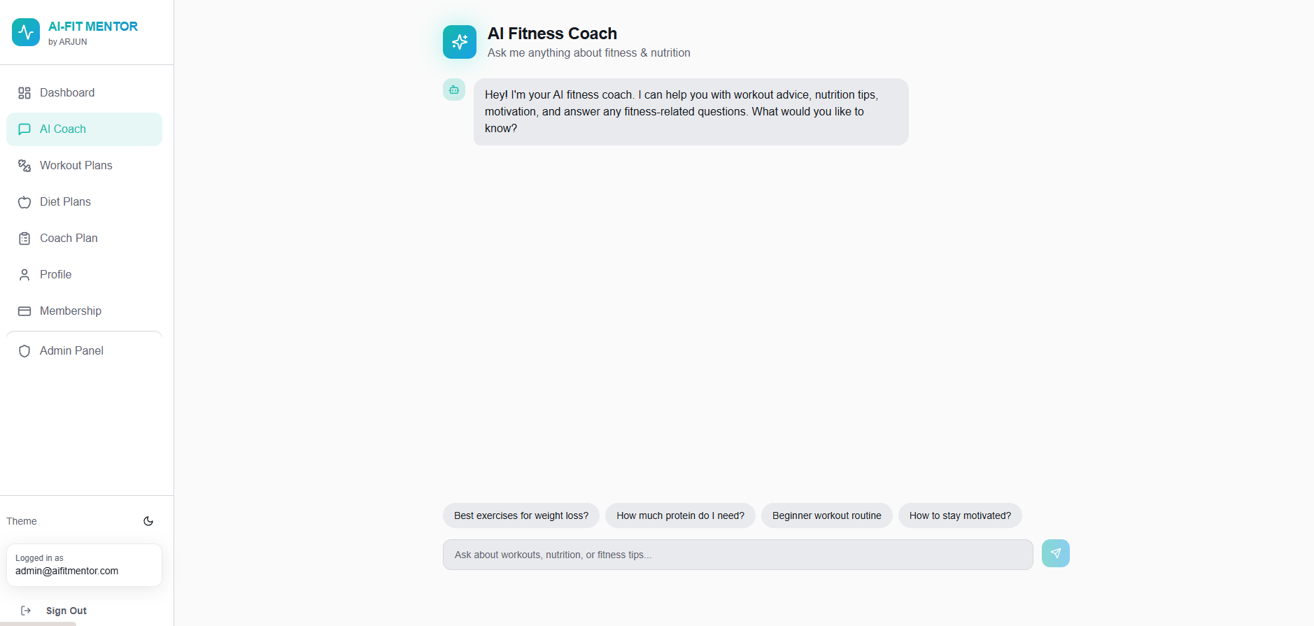
AI couch space

