Slide 1


Department of Computer Science and Engineering
MEDIA MONITORING AND ENHANCEMENT HUB
HARIHARAN S 211421104088
AJAY S 211421104013
ARJUN V RA 211421104025
Guide Name :
Dr. L. Jabasheela , M.E .,Ph.D.
Head Of Department, CSE
Coordinator Name & Designation

Slide 2
Abstract
Fake news, or material that has been proven to be untrue and is intended to deceive, has been more prevalent in recent years. Because it encourages political divisiveness and mistrust of leaders, the spread of this kind of news poses a major threat to societal cohesiveness and well-being. Since manual verification is impossible due to the vast volume of content that is shared on social media, automatic algorithms for detecting false news have been developed and put into use. This has led to the usage of sentiment analysis—the branch of text analytics that assesses the strength and polarity of sentiments expressed in a text—either as a foundation for the system or as an adjunct to it in fake news identification techniques. In this article, we examine the various applications of sentiment analysis in the identification of fake news, discussing its most pertinent features and drawbacks as well as the needs that should be addressed soon, including multilingualism, explainability, bias mitigation, and handling multimedia components.

Slide 3
Introduction
The rise of smartphones has made social media a dominant news source, with 53% of U.S. adults relying on it, though 59% expect inaccuracies. False information, including misinformation, disinformation, propaganda, and clickbait, spreads through bots, influencers, and political groups, contributing to information pollution. Sentiment Analysis (SA), a Natural Language Processing (NLP) technique, assesses emotional tones in text, classifying content as positive, neutral, or negative. Since fake news often evokes strong emotions, SA plays a key role in credibility assessment. Research by Dickerson et al. found that sentiment-based behaviors help distinguish bots from humans, as bots often amplify misleading content. Additionally, since many users engage only with headlines, emotionally charged clickbait is closely tied to fake news. This paper explores SA’s integration into fake news detection, covering key concepts, detection methods, datasets, evaluation metrics, and system challenges, providing insights into how SA enhances automated credibility assessment and misinformation control.

Slide 4
Objective of the Project
The objective of this project is to develop an intelligent system capable of detecting and identifying fake news across various digital platforms, including digital newspapers and YouTube channels. By leveraging advanced text analytics, particularly sentiment analysis, the system aims to assess the polarity and intensity of emotions expressed in content to aid in verifying its authenticity. It strives to mitigate the spread of misinformation, thereby enhancing societal cohesion and trust in media platforms. Additionally, the project addresses critical challenges such as multilingualism, bias reduction, explainability, and the integration of multimedia components to create a comprehensive and reliable framework for fake news detection.

Slide 5
Literature Survey
S. No | Year of Publication | Author Details | Title | Approach | Outcome
1 | 2022 | S. S. Korti, S. G. Kanakaraddi | Depression detection from Twitter posts using NLP and Machine learning techniques | NLP and machine learning analyze Twitter posts to detect linguistic patterns and emotional cues indicative of depression. | The system identifies depressive tendencies, enabling early intervention and support through data-driven mental health monitoring solutions.
2 | 2024 | M. Siek, E. S. Setiadi | Analysis of News Sentiment and Stock Price Using Web Scraping and Vader Sentiment Analysis | Sentiment analysis combines web scraping and machine learning to analyze emotional patterns and detect correlations in stock trends. | Insights reveal how news sentiment influences stock price fluctuations, aiding informed financial decisions and proactive market monitoring.

Slide 6
Literature Survey
S. No | Year of Publication | Author Details | Title | Approach | Outcome
3 | 2023 | K. Kavita and H. Singh | Utilizing Mixture Methods for Classifier in NLP: An Essential Consideration, | Implements mixture methods for classifier optimization in NLP to enhance accuracy and efficiency in text analysis tasks. | Provides improved performance in NLP-based classification tasks, offering robust and versatile solutions for complex language processing challenges.
4 | 202 | S. Kaliappan, L. Natrayan | Analysis of News Sentiment and Stock Price Using Web Scraping and Vader Sentiment Analysis | Combines sentiment lexicon and deep learning techniques to analyze the emotional polarity of news headlines effectively. | Provides precise sentiment classifications, enabling better understanding of public opinion and trends reflected in news headlines.

Slide 7
Problem Statement
The Press Information Bureau (PIB), the nodal agency of the Government of India for disseminating information about government policies, programs, and initiatives, requires an automated feedback system to provide effective and timely insights across regional languages using Artificial Intelligence and Machine Learning. The system should crawl approximately 200 regional media websites for news published in local languages, scan selected e-papers through Optical Character Recognition (OCR), and analyze YouTube news channels by identifying government-related bulletins via closed captioning or audio-to-text conversion. Once processed, the system must categorize the stories into concerned departments based on predefined tags and classify them as favorable, neutral, or unfavorable towards the Government of India, ensuring immediate notifications to PIB officers in cases of negative coverage. This solution aims to streamline feedback and enhance the government’s media monitoring capabilities.

Slide 8
Proposed System
The "Media Monitoring and Enhancement Hub" is an advanced solution designed to improve government communication and media monitoring by leveraging technologies such as web scraping, natural language processing, OCR, and audio-to-text conversion. It tracks and analyzes media coverage across multiple languages and platforms, offering real-time insights to government officials. Key features include automated data collection from news websites and YouTube channels, data translation, categorization, sentiment analysis, centralized storage with a user-friendly dashboard, real-time notifications for negative news, YouTube video analysis, data security, scalability, quality assurance, and ongoing support. This system equips the Government of India with a robust tool to monitor media, gain actionable insights, and make timely decisions, fostering transparency, responsiveness, and effective management of public perception and media engagements.

Slide 9
Software / Hardware used
SOFTWARE:
Operating System : Windows
Tool : Visual Studio Code, Jupyter Notebook
Language : Python
Libraries : OpenCV, Tensor Flow, PyTube, NLTK
HARDWARE:
Processor : Intel i5
Hard disk : minimum 400GB
RAM : minimum 6GB

Slide 10
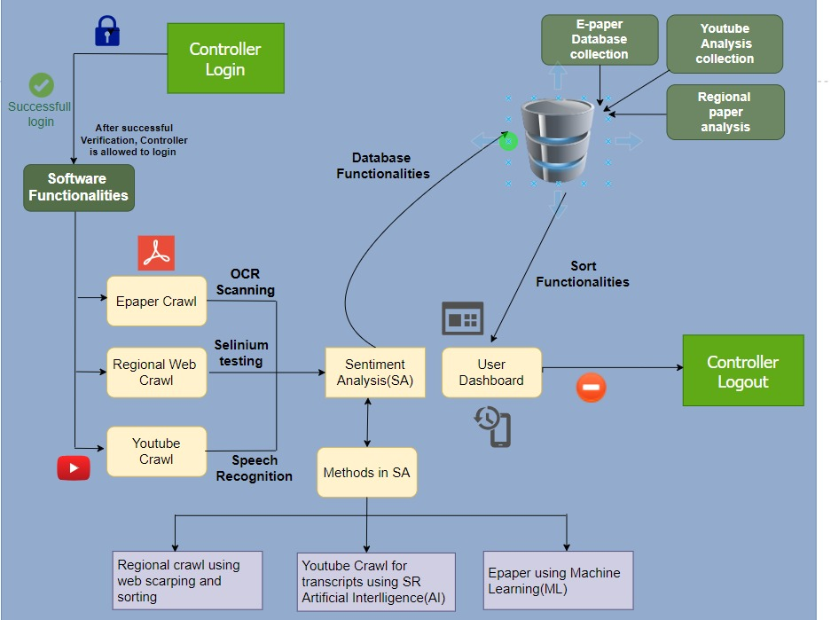
Architecture / Methodology used

Slide 11
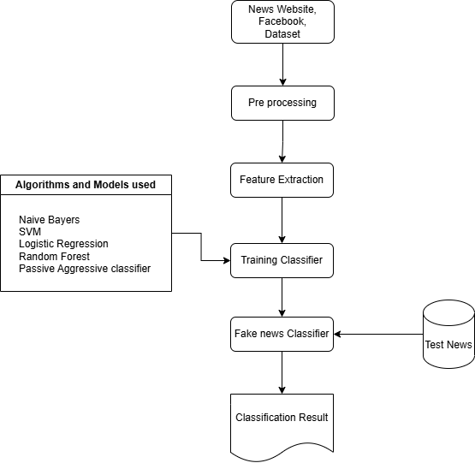
Flow Chart

Slide 12
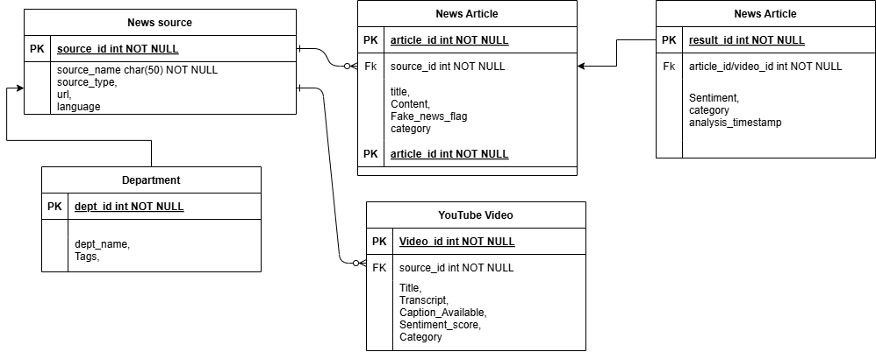
ER Diagram

Slide 13
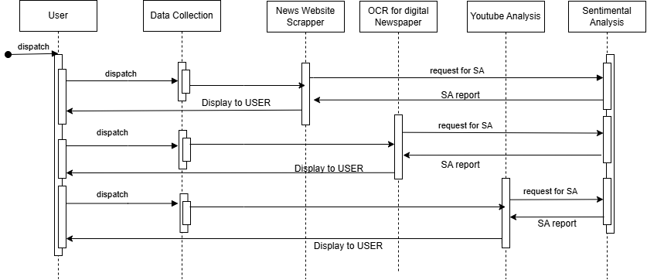
Sequence Diagram

Slide 14
Module Description
This project is structured into three interconnected modules, each addressing a specific aspect of fake news detection across diverse digital platforms. These modules work in tandem to process data from various sources, analyze it using advanced techniques, and provide actionable insights to identify and mitigate the spread of false information.
Module 1: Checking News Websites
Module 2: Digital Newspapers Module
Module 3: YouTube News Channel Analysis

Slide 15
Module Description
Checking News Websites for Identifying Fake News
This module focuses on identifying fake news from various online news websites by leveraging web scraping and the required technological frameworks. It involves extracting data from multiple news sources in a structured format using web scraping tools and techniques. The module preprocesses the extracted data, employing methods to clean and normalize text for further analysis. Sentiment analysis and fake news detection algorithms are then applied to evaluate the credibility of the news content. This module ensures systematic and real-time monitoring of digital news websites to effectively flag potentially deceptive or manipulated information.

Slide 16
Module Description
Checking Digital Newspapers for Detecting False News
In this module, the system automates the process of analyzing digital newspapers to detect false or misleading news articles. Optical Character Recognition (OCR) technology is deployed to convert scanned e-paper content into editable text. The extracted text undergoes preprocessing and sentiment analysis to identify emotional patterns or signals of fake news. By applying machine learning models trained to differentiate factual news from fake news, this module provides a reliable mechanism for monitoring digital newspapers and maintaining information integrity.

Slide 17
Module Description
Analyzing YouTube Channels News for Fake News Detection
This module concentrates on analyzing news content from YouTube channels by converting audio to text or processing captions using advanced speech-to-text conversion techniques. The extracted transcripts or captions are analyzed using natural language processing (NLP) and machine learning algorithms to detect fake news. Sentiment analysis is employed to examine the emotional tone of the content, aiding in identifying patterns of misinformation. This module ensures comprehensive coverage by monitoring multimedia platforms, further strengthening the system's ability to detect and mitigate fake news.

Slide 18
Screen Shots

Slide 19
Screen Shots

Slide 20
Screen Shots

Slide 21
Screen Shots

Slide 22
Conclusion
The proliferation of social media platforms has revolutionized the way information is shared and consumed, but it has also led to the widespread dissemination of fake news. This phenomenon has severe implications for societal trust, political stability, and the credibility of media platforms. As the volume and speed of information sharing grow, traditional manual fact-checking methods have proven insufficient, creating a critical demand for automated and scalable detection techniques. These automated methods not only enhance the accuracy and efficiency of fake news detection but also help curb its far-reaching influence across diverse online communities.

Slide 23
Conclusion
Among the various techniques utilized, Sentiment Analysis (SA) has emerged as a powerful approach for identifying fake news. Sentiment Analysis leverages advanced natural language processing (NLP) and machine learning algorithms to evaluate the emotional tone of content. Fake news often aims to manipulate readers by evoking strong emotions such as anger, fear, or excitement, making sentiment-based insights particularly valuable in distinguishing misleading information from credible sources. Additionally, SA's applicability extends beyond articles to include related user comments, discussions, and social interactions, thereby providing a holistic perspective on the dissemination and impact of fake news.

Slide 24
Future Enhancement
Looking ahead, future enhancements in fake news detection systems will focus on addressing challenges like multilingualism, multimodal data analysis, and bias mitigation. Incorporating support for multiple languages will ensure the system's effectiveness across global and diverse linguistic contexts. Enhanced multimedia processing capabilities, including video and audio analysis, will allow for the detection of fake news embedded in multimedia content. Furthermore, ensuring transparency and fairness by reducing algorithmic biases will bolster user trust and adoption. Continuous advancements in explainable AI, real-time monitoring, and adaptive machine learning models will transform the landscape of fake news detection, promoting a safer and more informed digital environment.

Slide 25
Reference Paper/ URL
S. S. Korti and S. G. Kanakaraddi, "Depression detection from Twitter posts using NLP and Machine learning techniques," 2022 Fourth International Conference on Emerging Research in Electronics, Computer Science and Technology (ICERECT), IEEE, 2022.
A. Dixit, S. Sharma, P. D. Rao, V. Reddy, M. Janaki, R. Thirumalaivasan, and M. M. Subashini, "Audio to Indian and American Sign Language Converter using Machine Translation and NLP Technique," 2022 Third International Conference on Intelligent Computing Instrumentation and Control Technologies (ICICICT), IEEE, 2022.
K. Kavita and H. Singh, "Utilizing Mixture Methods for Classifier in NLP: An Essential Consideration," 2023 International Conference on Artificial Intelligence and Smart Communication (AISC), IEEE, 2023.
V. M. Reddy, T. Vaishnavi, and K. P. Kumar, "Speech-to-Text and Text-to-Speech Recognition Using Deep Learning," 2023 2nd International Conference on Edge Computing and Applications (ICECAA), IEEE, 2023. (Cited by 11 papers)
v

Slide 26
Reference Paper/ URL
8. J. Seong, W. Lee, and S. Lee, "Multilingual Speech Synthesis for Voice Cloning," 2021 IEEE International Conference on Big Data and Smart Computing (BigComp), IEEE, 2021. (Cited by 7 papers)
M. Siek and E. S. Setiadi, "Analysis of News Sentiment and Stock Price Using Web Scraping and Vader Sentiment Analysis," 2024 International Conference on Information Management and Technology (ICIMTech), IEEE, 2024.
S. Kaliappan, L. Natrayan, and A. Rajput, "Sentiment Analysis of News Headlines Based on Sentiment Lexicon and Deep Learning," 2023 4th International Conference on Smart Electronics and Communication (ICOSEC), IEEE, 2023. (Cited by 43 papers)
N. M. K. Varma, S. H. Mattaparty, S. Ismail, J. Thaduri, G. D. Arora, and A. B. AnandKumar, "Sentiment Analysis: A Machine Learning Perspective," 2024 First International Conference on Electronics, Communication and Signal Processing (ICECSP), IEEE, 2024.
v

Slide 27

Conference / Publication / Patent Certificate/ Project Contest Winner Certificates

