Slide 1

Research Question – Tutorial Presentation for Feedback Date:
Group Name: A187 Name of Student Presenting:

Slide 2
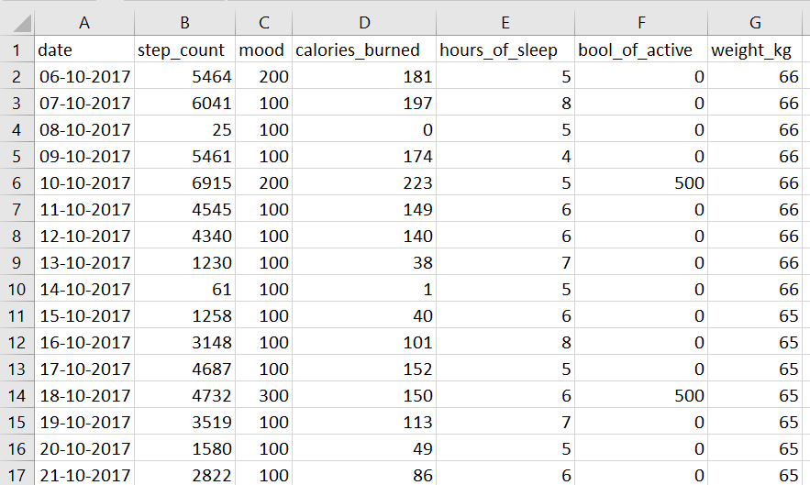

Slide 3
This dataset is interesting to us because it provides exercises data such as step-count, calories burned, and hours of sleep from 06-10-2017 to 09-01-2018. Our Independent variable is: calories_burned This Independent variable datatype is (select one): Interval Our Dependent variable is: step_count This Dependent variable datatype is (select one): Interval
Dataset ID: DS076
Notes:
Before specifying your Research Question you must define the type of data you are analysing. Are the variables you select interval data (measurement data you can divide, multiple, etc), OR are they ordinal (there is a definite order but the intervals between each variable are not necessarily equal, or the terms might be subjective like in a likert scale); OR are they just categorical/nominal (Items such as film names, cities, etc., that you can count numbers of occurrences? You also need to understand whether the variable is either dependent or independent and this will vary according to the context. Independent variables may cause an effect, whereas the dependent variable might be effected by the independent variable. Check the lecture notes on the RQ for more information and examples.
You will get only one opportunity to present your Research Question ahead of the submission date. Have your questions ready, and be ready to take notes on feedback.

Slide 4
RQ : Is there a correlation between step count and calories burned from 06-10-2017 to 09-01-2018 ?
Our Research Question is
Null hypothesis (H₀): There is no correlation between step count and calories burned from 06-10-2017 to 09-01-2018 .
Alt hypothesis (H₁): There is no correlation between step count and calories burned from 06-10-2017 to 09-01-2018 ?.

