Slide 1
A Decade in Review: Understanding Crime Trends in Baltimore through 911 Calls

Slide 2
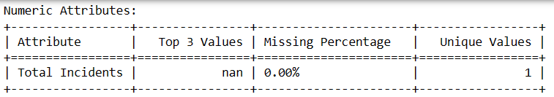
About the Dataset
This dataset is a treasure trove of crime insights, covering various aspects such as when and where crimes occur, making it incredibly versatile for analysis.
This attribute represents the count of crime incidents.
"Total Incidents" has only one unique value.
In data analysis, attributes with no variation do not provide meaningful insights.

Slide 3
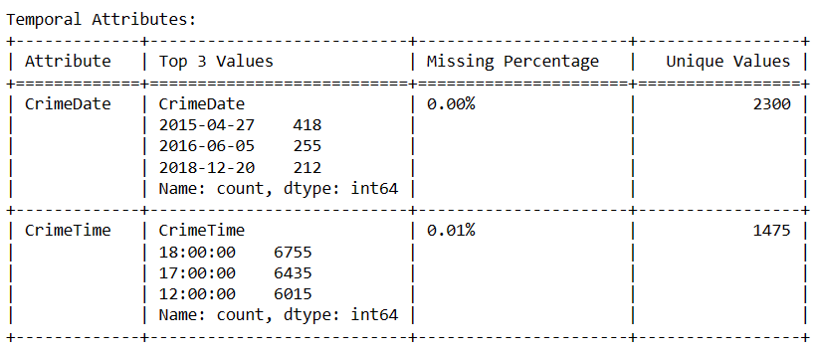
About the Dataset
'CrimeDate' and 'CrimeTime' invite us to explore crime trends over time, offering a temporal perspective.
The data indicates that a majority of crimes occurred during the evening and midnight hours.

Slide 4
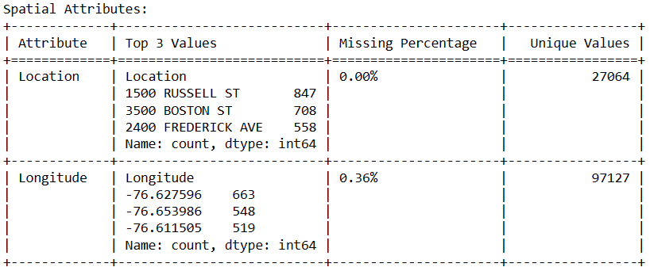
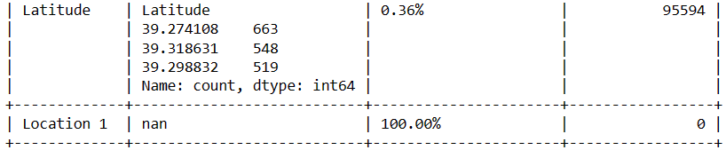
About the Dataset
'Location,' 'Longitude,' and 'Latitude' lead us on a journey to unveil geographical patterns within crime incidents, enriching our understanding of spatial trends.
The 'Location 1' attribute contains 100% missing data, making it unsuitable for analysis.
The location at “1500 Russell St” exhibits a higher crime rate
Let's piece it all together and uncover the bigger picture, including the mysteries of time-based trends!

Slide 5
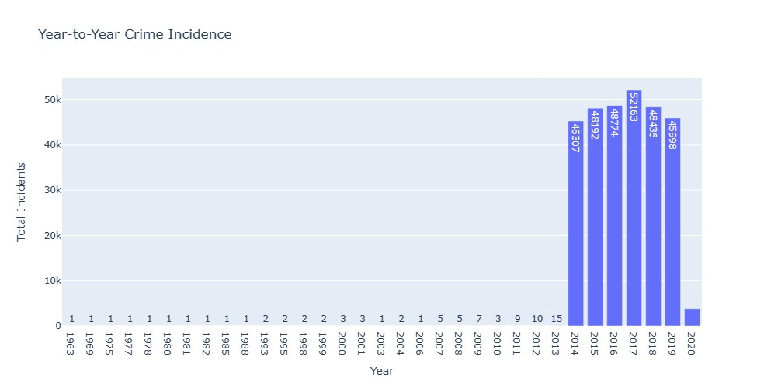
Crime Trends Over the Year
From 1963 to 2013, crime rates remained remarkably steady. This era appears as a tranquil period in our data landscape.
Now, as we move closer to the present, from 2014 to 2019, we encounter a thrilling roller coaster ride.
Crime incidents take an abrupt nosedive, plummeting to levels not seen in years. It's a surprising and uncharted drop in our data landscape.

Slide 6
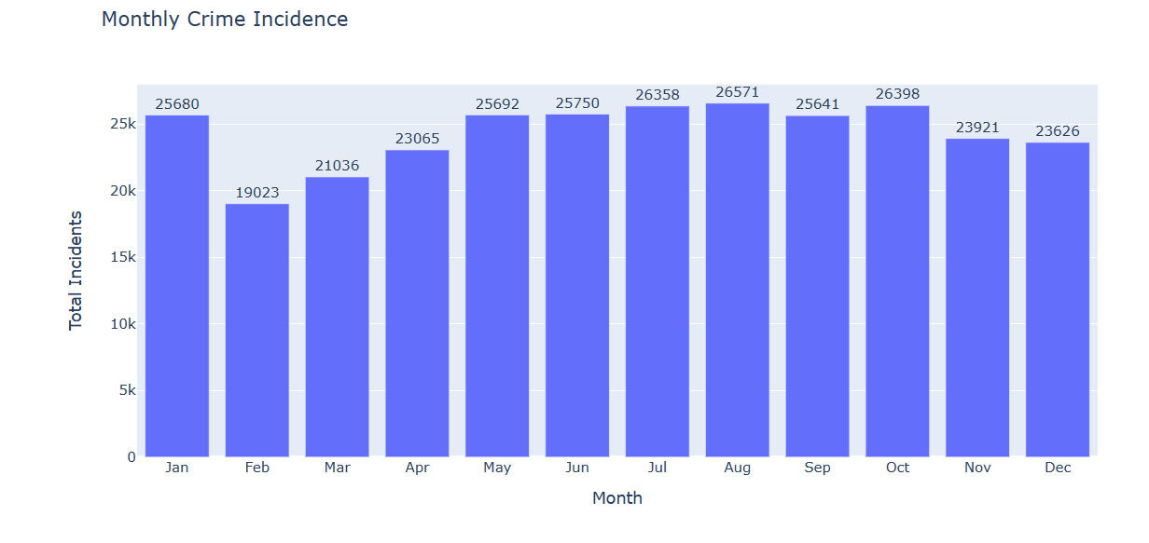
Monthly Trends in Crime
Monthly crime incidents consistently range between 19,000 to 27,000, providing a stable data backdrop.
The year kicks off with a notable peak of 25,680 incidents in January, setting the tone.
While February experiences a slight dip to 19,023, incidents gradually rise from March to May.
From May to October, a nearly flat plateau emerges in the data trend.
Towards the year's end, November and December exhibit a gentle decline in incidents.

Slide 7
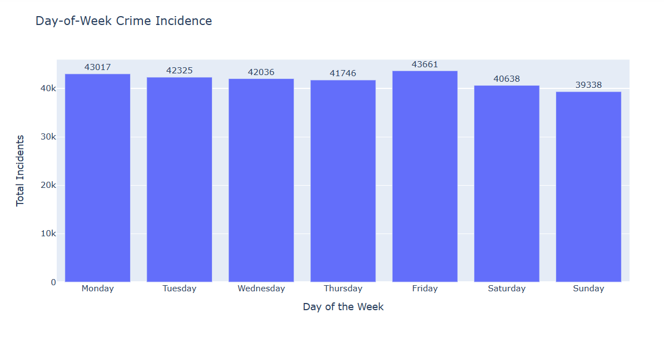
Day of Week Crime Incidence
The trends remain consistently in the range of 39,000 to 44,000 incidents per day in a week, offering a sense of stability in our data journey.
Friday emerges as the standout day with the highest number of crimes, resembling a peak before the weekend.
Overall, the data showcases steady trends and a notable Friday spike in incidents.

Slide 8
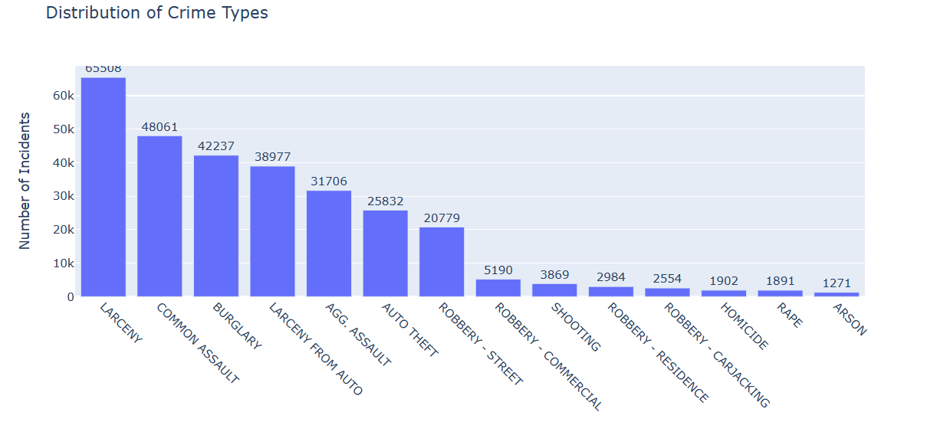
Distribution of Crime Types
'Larceny' stands out as the most common crime type, dominating the data landscape across different locations and time periods.
'Common Assault' and 'Burglary' closely follow as significant contributors to the overall crime scene.
In contrast, 'Homicide,' 'Rape,' and 'Arson' play the role of rare occurrences, adding an element of infrequency to our data narrative.

Slide 9
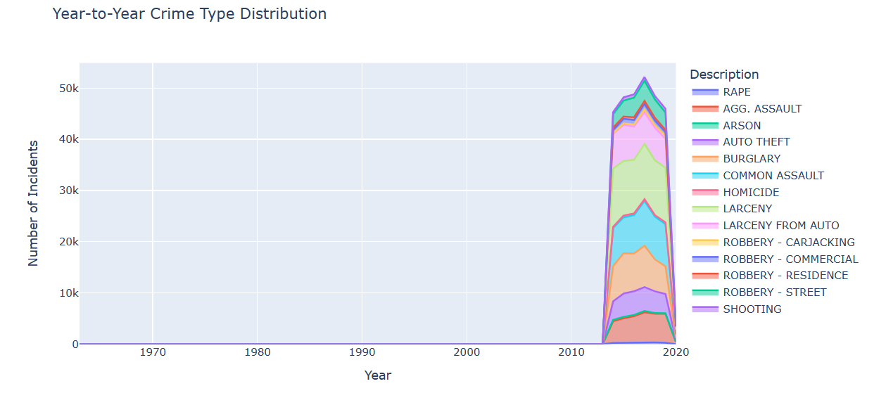
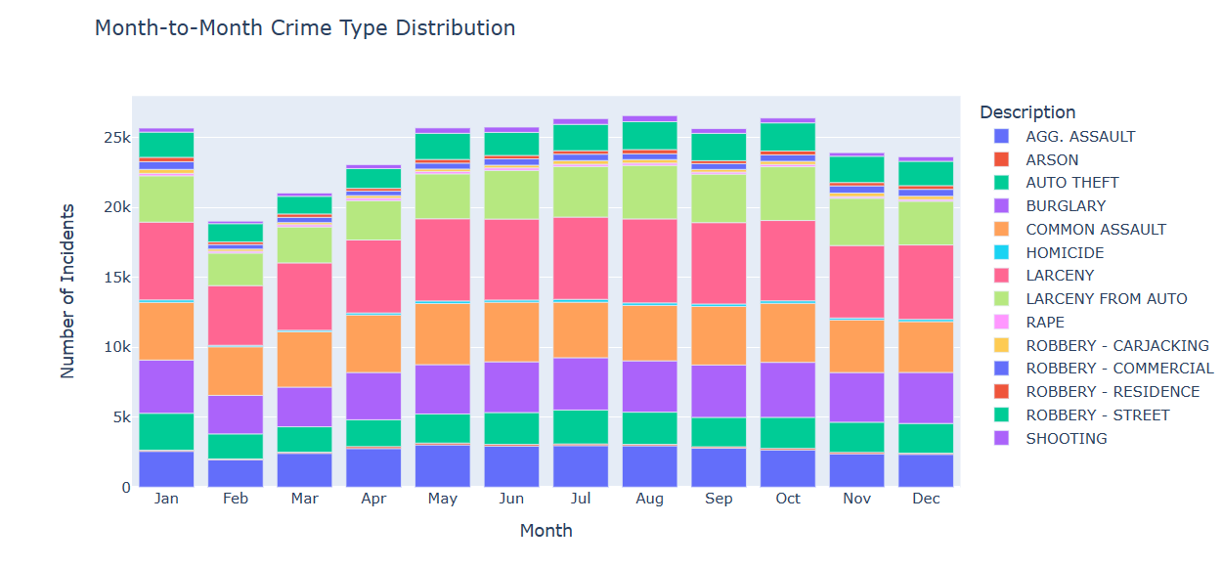
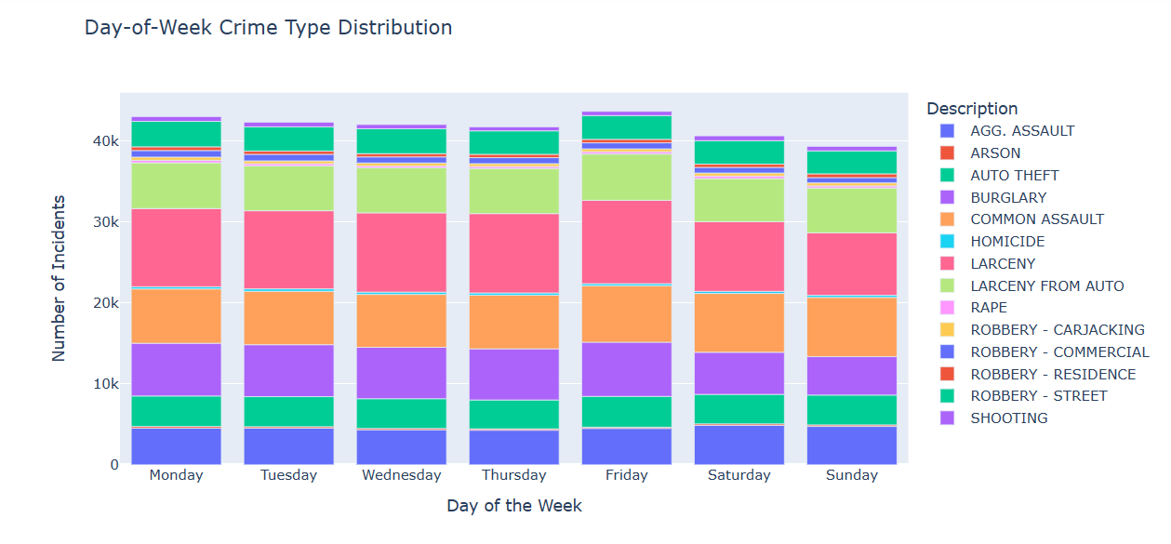
Behold these three bar plots of crime type distribution, each reveal intriguing variations from year to year, month to month, and day of the week, painting a dynamic picture of our data landscape.

Slide 10
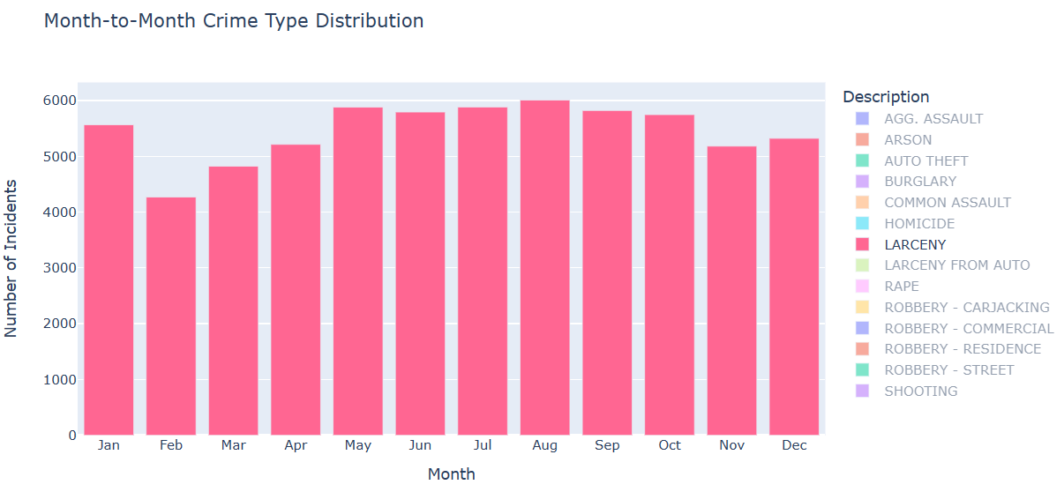
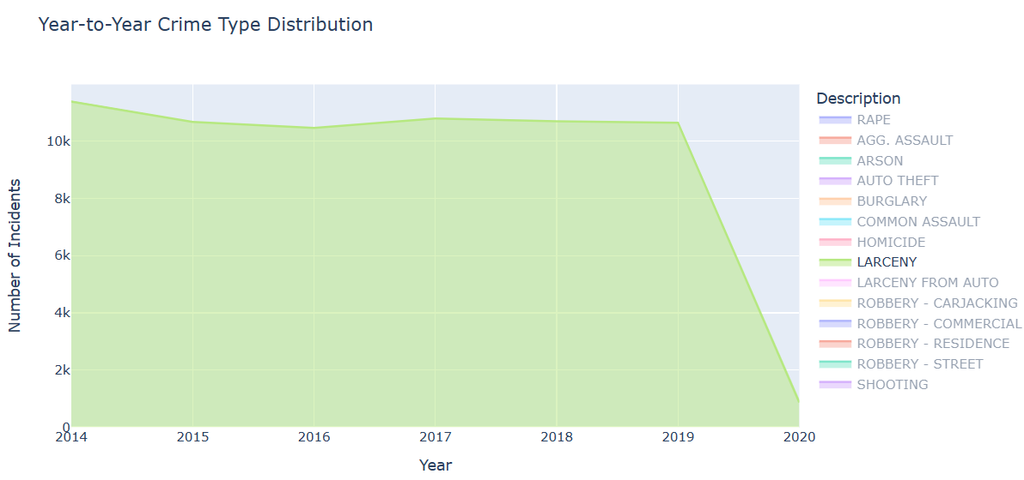
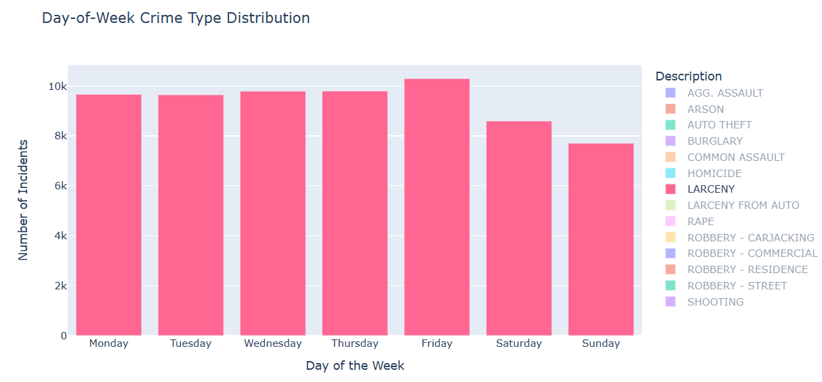
Let’s consider ‘Larceny’ and view distribution in all three cases
Larceny: Consistent over years, 2019-2020 drop, lower in Feb, declines on weekends, peaks on Fridays.

Slide 11
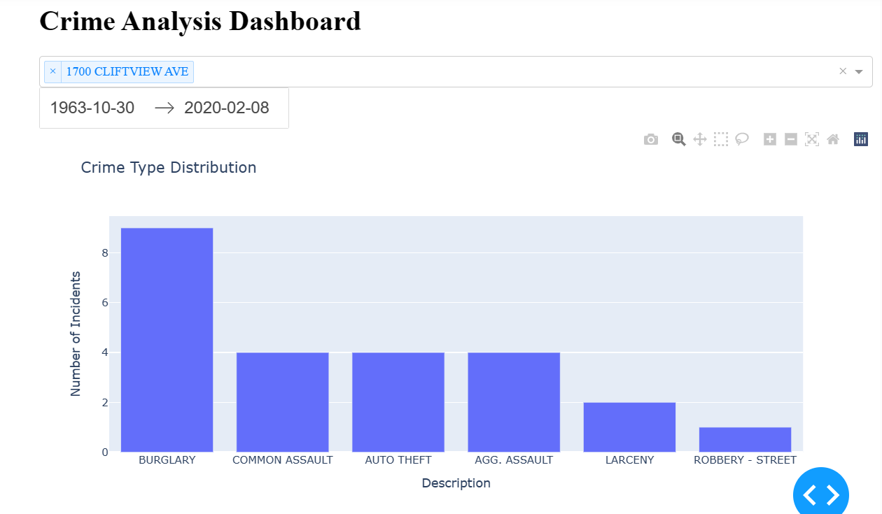
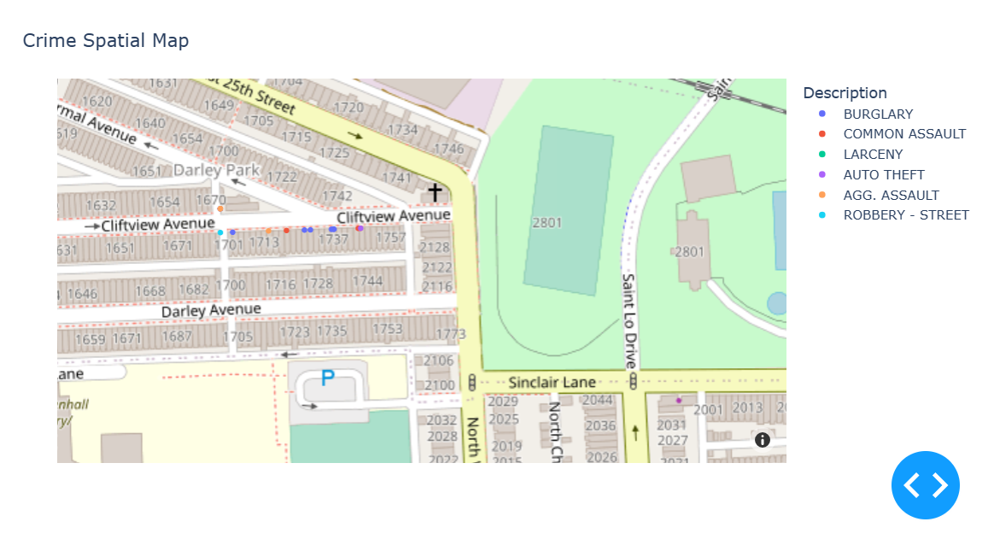
Let’s explore the dynamic dashboard and spatial crime map to instantly view the number of crime incidents by year and location.
1700 Cliftview Ave, 1963-2020: 24 incidents
Most common: 'Burglary' (9 occurrences)
Least common: 'Robbery-street' (1 occurrence)

