Slide 1
A Project on New York Times
Submitted to
Submitted by
Professor Harsh Kumar Dave
Arjun Kapila(2091127)
Sukhdeep Singh(2091154)

Slide 2
Introduction
This project is made in android studio. In this project a person can know all the latest news in new York and all the country. In this project many sections included like sports, Politics, Business.

Slide 3
Requirement
Android studio
Internet
Minimum 1 gb Ram
256gb harddisk
Processor with minimum speed of 1.4gz
Firebase

Slide 4
Login In
In the login page person can enter its details for example username and password to get the access of the application.

Slide 5
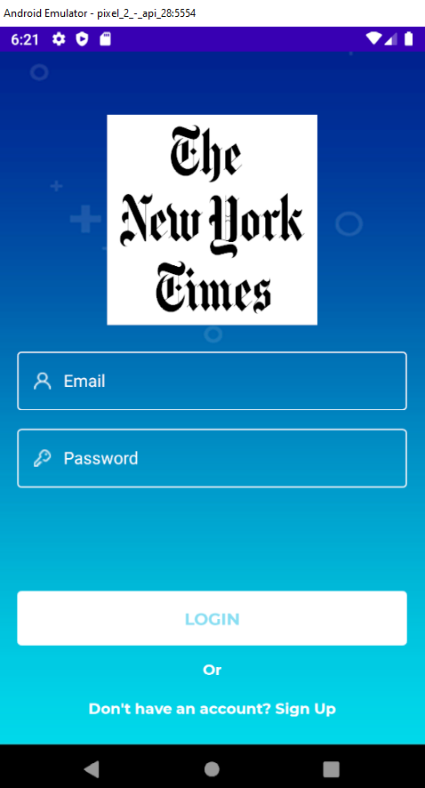

Slide 6
Sign Up Page
In this page Person can enter its details by adding username and password.

Slide 7
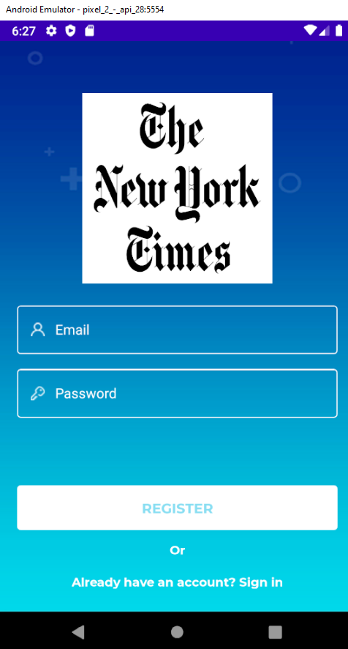

Slide 8
Top Stories
BY Clicking on Top Stories a person can see all the latest news which became headlines of the day.

Slide 9
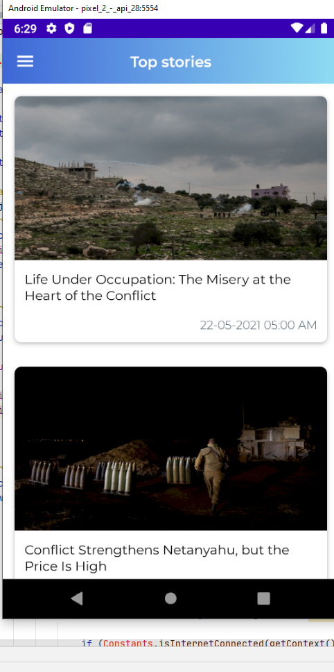

Slide 10
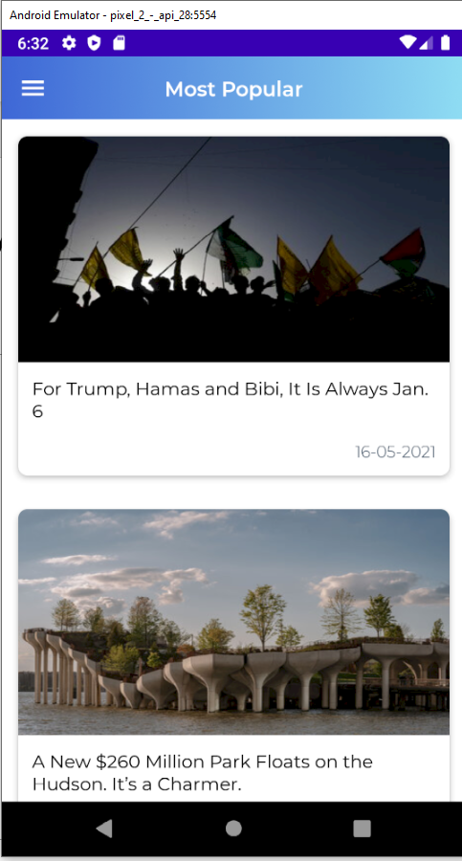
Most popular

Slide 11
finish

