Slide 1
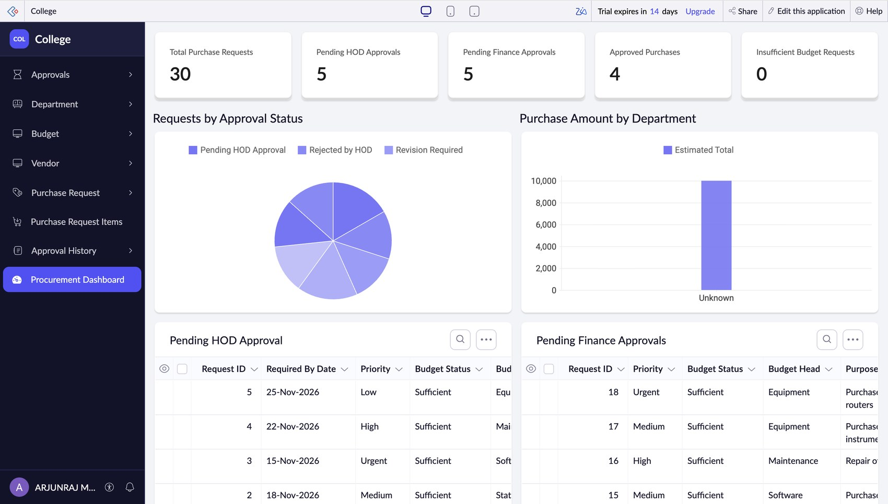
College Procurement & Purchase Approval System
Low-code application on Zoho Creator with portal-user approvals
[Student name] | [Register no.] | CB23F35 | November 2026
Notes:
Introduce the project: a purchase request and approval system for a college, built on Zoho Creator. Requesters, HODs and finance officers use it as portal users.

Slide 2



Why college purchases get stuck
Paper trail
Today's process
Requests move by notes and e-mail; they get lost or retyped.
Paper note / e-mail
Budget is invisible
Clerk copies to register
The HOD approves without seeing what the department has left.
HOD signs
No audit trail
Accounts checks ledger
Nobody can say who approved what, and when.
Faculty phones for status
Notes:
The existing process is paper and e-mail. The three pain points: lost requests, no budget visibility at approval time, and no audit trail.

Slide 3
One online system, end to end
6
27
8
3
forms + an Items grid
Deluge scripts
reports + 1 dashboard
portal roles
Requester → HOD → Finance → Budget reserved → Completed
Every step is validated, e-mailed and recorded in Approval History.
Notes:
Six forms (Department, Budget, Vendor, Purchase_Request, Items grid, Approval_History), 27 scripts including 5 schedules, 8 reports and one dashboard, and three portal roles.

Slide 4
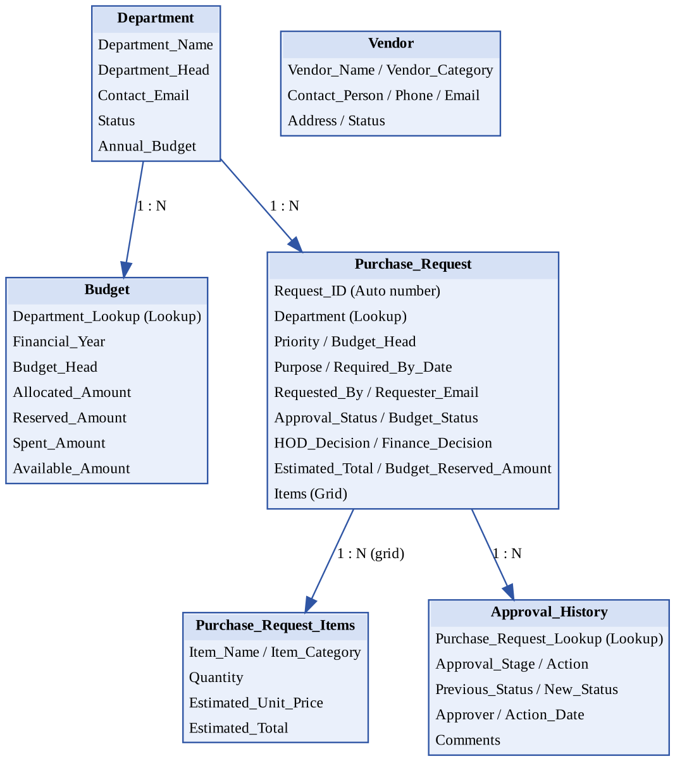
Data model
Department
one department has many budgets and many requests
Purchase_Request
holds items in a grid and many history rows
Approval_History
one row per status change; drives e-mails and budget updates
Vendor
separate master list
Notes:
Lookups link Department to Budget and Purchase_Request. Approval_History is the event record that triggers notifications and budget reservation.

Slide 5
Approval flow
Submit
Portal requester
HOD review
Approve, reject, revise
Finance review
Budget re-checked
Approved
Budget reserved
Completed
Moved to spent
Revision needed
Rejected
Always recorded
HOD asks for changes
Requester edits and saves
Request returns to HOD
HOD or Finance rejects
Comments are compulsory
Requester is e-mailed
One Approval_History row per step
E-mail to the next approver
Stage guards stop repeat decisions
Notes:
Eight status values: Draft, Pending HOD Approval, Revision Required, Rejected by HOD, Pending Finance Approval, Rejected by Finance, Approved, Completed.

Slide 6
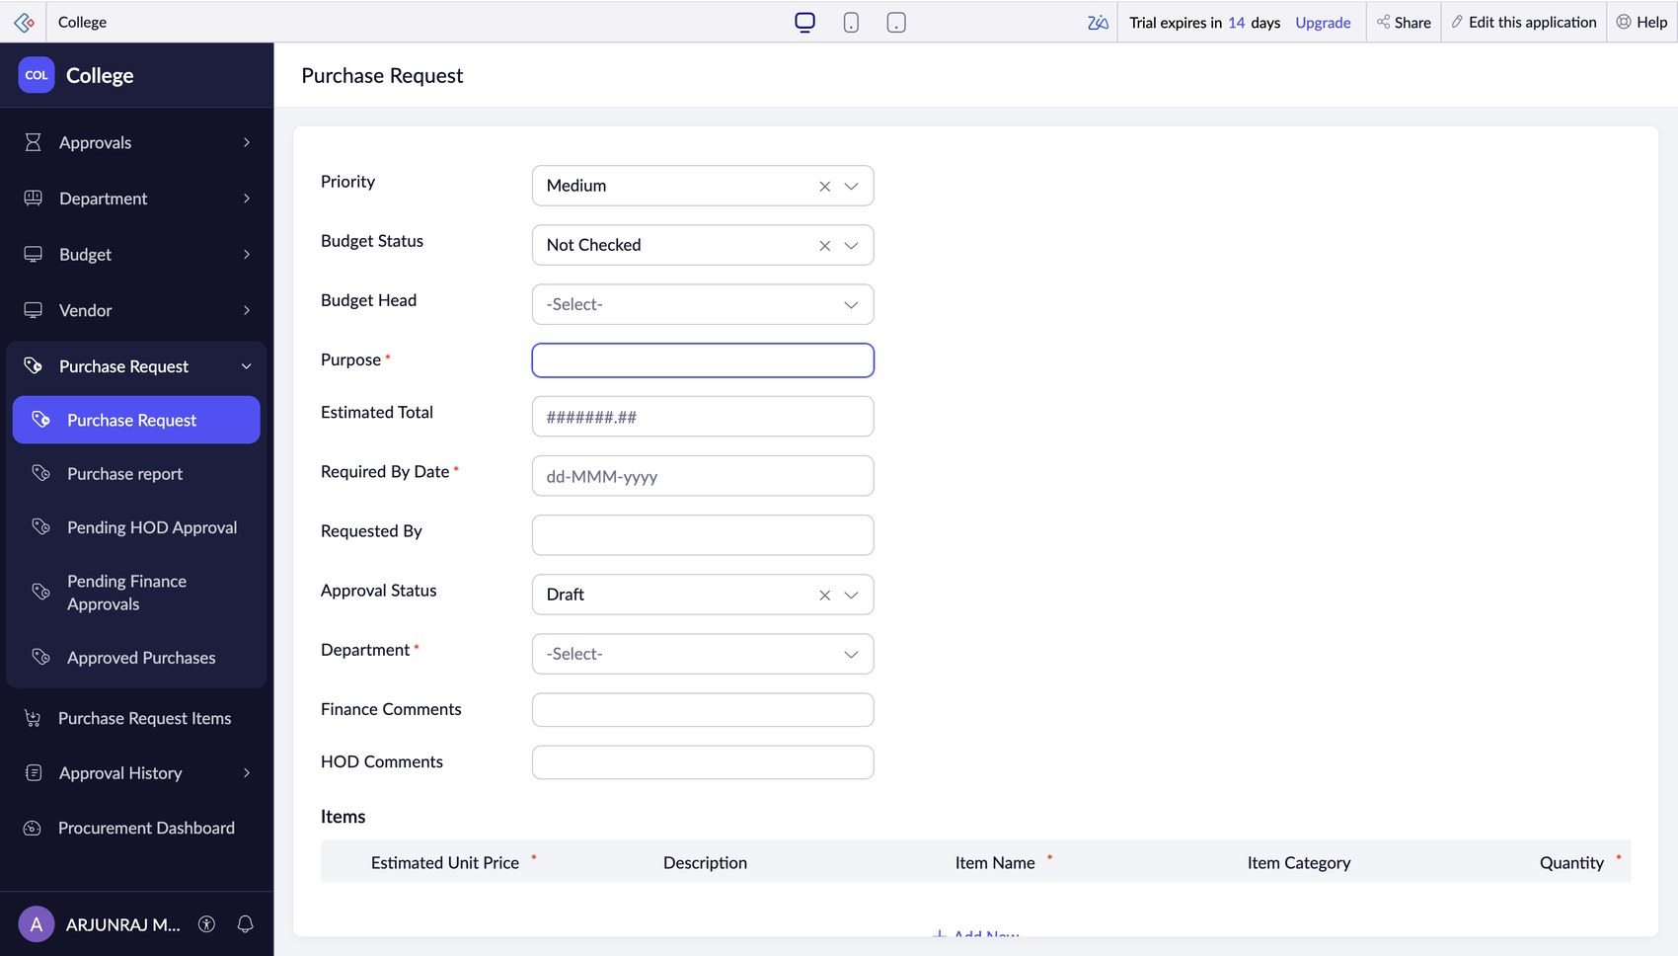



Purchase request form
Requester filled in
Name, e-mail and date come from the portal login
System fields locked
Status, total and budget fields can't be typed over
Items grid
Quantity and price per item; total is calculated
Notes:
Screenshot of the live Purchase_Request form. After the workflows were added, Requested By, Requester Email and Request Date are filled from the portal login and locked.

Slide 7
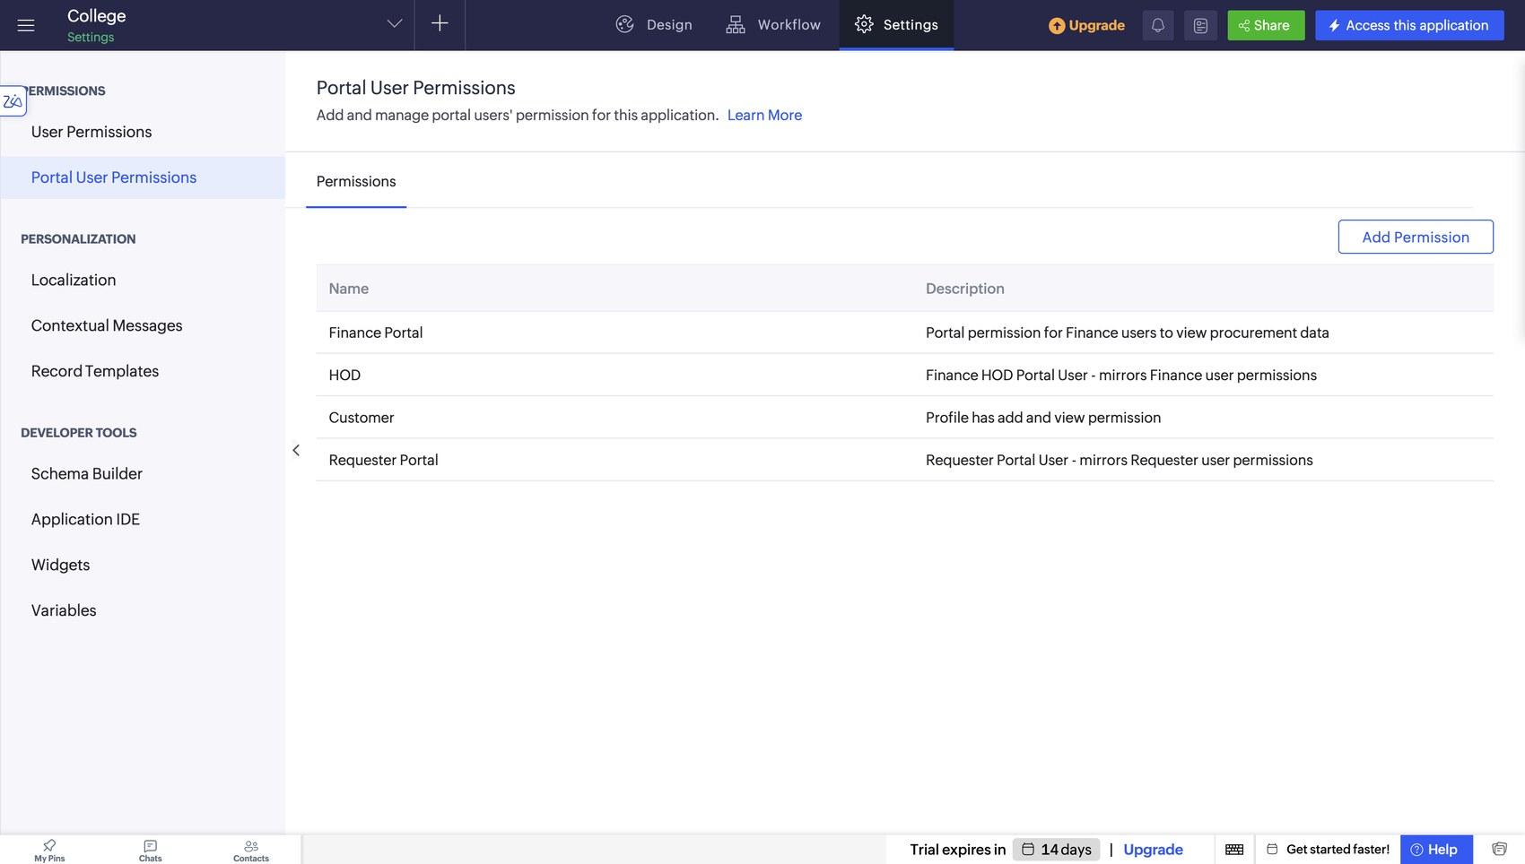
Portal users and roles
Requester Portal
Raises requests, revises when asked, sees own work
HOD
Approves, rejects or requests revision
Finance Portal
Approves after budget check, marks Completed
Scripts use thisapp.portal.isUserInProfile(...), zoho.loginuser and zoho.loginuserid, never internal-user functions.
Notes:
Four portal profiles exist: Requester Portal, HOD, Finance Portal and Customer. Budget, Department and Vendor saves are limited to Finance or Administrator by validation scripts.

Slide 8
Automation with Deluge
Validate
items, prices, dates, department, budget
// portal-safe defaults on add
input.Requested_By = zoho.loginuser;
input.Requester_Email = zoho.loginuserid;
input.Approval_Status = "Draft";
disable Requested_By;
// who is logged in?
thisapp.portal.isUserInProfile(
"Requester Portal")
Route
HOD, then Finance, with stage guards
Record
every change written to Approval History
Notify
one workflow e-mails HOD, Finance, requester
Notes:
22 form workflows, 5 schedules (reminders and budget alert), an approval process and a blueprint. Approval_History acts as the event bus: each new row triggers e-mails and budget updates.

Slide 9
Budget control
Approved
Amount is reserved
Completed
Reserved becomes spent
Rejected or withdrawn
Reservation is released
Available = Allocated − Reserved − Spent
Finance cannot approve above the available budget, and a reserved amount is stored per request so it can never be counted twice.
Notes:
Budget_Reserved_Amount on each request makes reservation idempotent. Reserved and Spent on the Budget form are locked and maintained only by workflows.

Slide 10
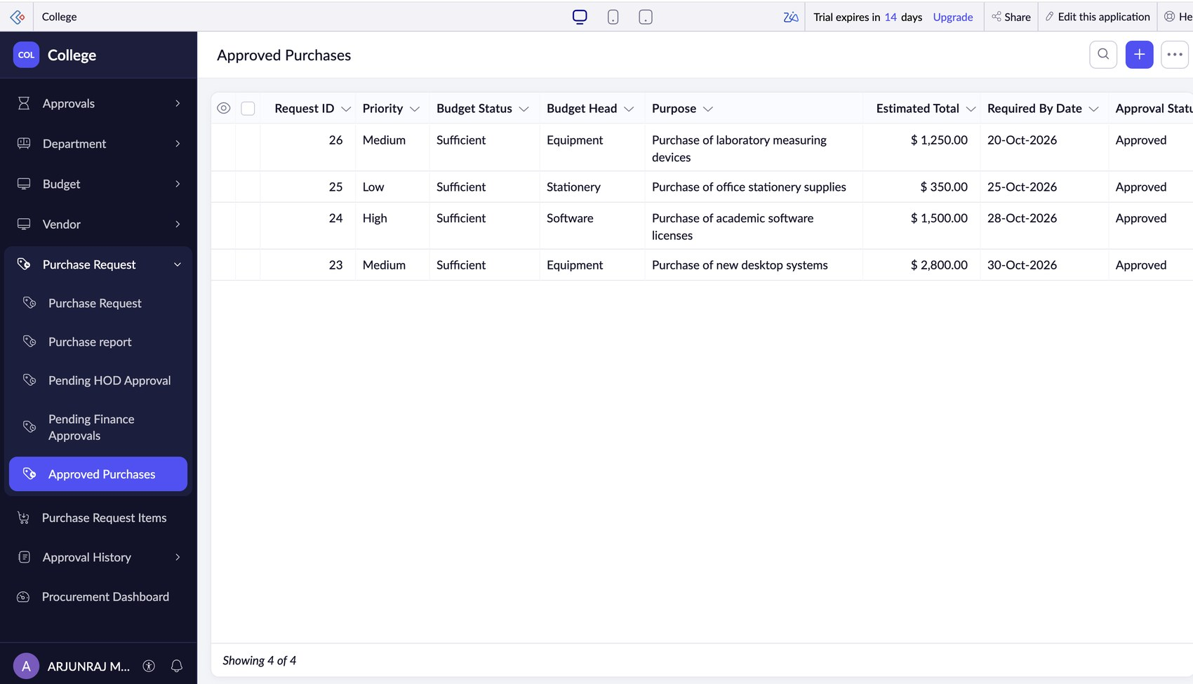
Reports as work queues
Pending HOD Approval
HOD queue
Pending Finance Approvals
Finance queue
Approved Purchases
ready to buy
Purchase report
requester's view
Department, Budget, Vendor, History
master lists
Notes:
Eight list reports. Four are filtered views of Purchase_Request that act as queues for each role.

Slide 11
Procurement dashboard
30
purchase requests
5
waiting for HOD
5
waiting for Finance
4
approved
KPI cards, a status pie, spend by department and the two approver queues on one page.
Notes:
Counts come from the sample data in the live app. The department chart groups under Unknown because the sample records have no department value; filling it in fixes the chart.

Slide 12
Testing and defects fixed
22
Problem found | Fix
Budget status values did not match the list | Values corrected
Decisions re-applied on every edit | Stage guard added
History actions not in the picklist | Mapped to choices
Department dropdown showed numbers | Shows department name
Budget never reserved or spent | Reserve and settle workflows
test cases planned
6 of 7
logged defects fixed
Notes:
Test cases are written; results should be filled in after running them in the live app. One open item: sample requests have no department value, so the department chart shows Unknown.

Slide 13
Results and next steps
Delivered
Next
Paperless request to approval flow
Budget checked before money is committed
Role-based portal access with an audit trail
Purchase orders from approved requests
Vendor quotation comparison
Approval limits by amount
OCR on uploaded quotations (Zia)
Limits to note: Zoho trial edition, USD and INR mixed across forms, Create right on portal profiles.
Notes:
Close with what was delivered, the roadmap, and the known limits (trial edition, mixed currencies, Create right on portal profiles).

