Slide 1

NLP Project for Disaster Tweet Classification
Submitted by : Arjun singh Solanki
Mail-id : arjunsingh.eee11@gmail.com
Github-id: https://github.com/Arjunssolanki

Slide 2
Exploratory Data Analysis
This analysis can provide insights into the volume of tweets concerning disasters over time, helping us identify trends and patterns in disaster-related communication. Additionally, such an analysis can inform machine learning models and other analytical approaches, enabling us to develop tools that can automatically detect disaster-related tweets and provide timely alerts or information to relevant authorities and organizations.

Slide 3
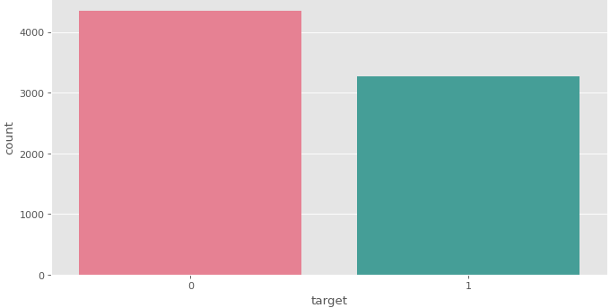
Disaster Vs Normal tweet
0 - Normal tweet
1 – Disaster tweet
From the analysis we found:
Total count of Normal tweet is 4342
Total count of Disaster tweet is 3271

Slide 4
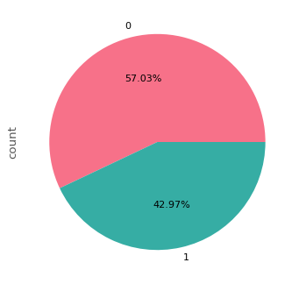
Distribution of Disaster and Non-Disaster Tweets
Conclusion: Most tweets (57.03%) are about normal topics, while disaster-related tweets make up a smaller portion (42.97%).

Slide 5
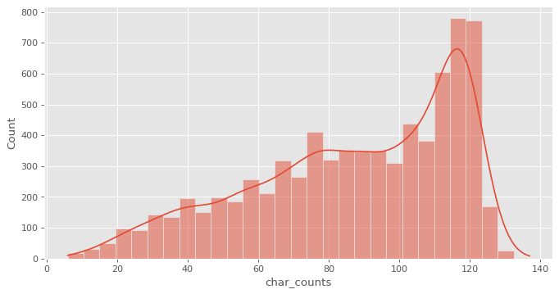
Numbers of characters Distributions in tweets
Conclusion:
Most tweets are about 120 character long
There are near about 330 tweets whose character length is between 80-100

Slide 6
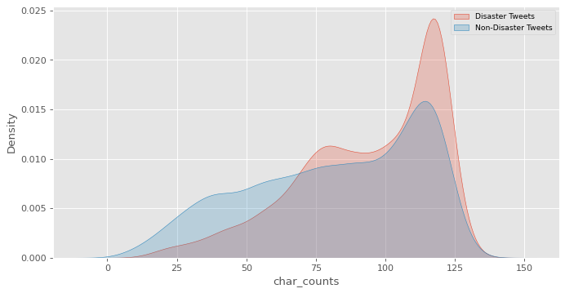
Numbers of characters Distributions in tweets
Conclusion:
For a disaster tweet overall concentration of number of character in a tweet is high as compared to normal tweet

Slide 7
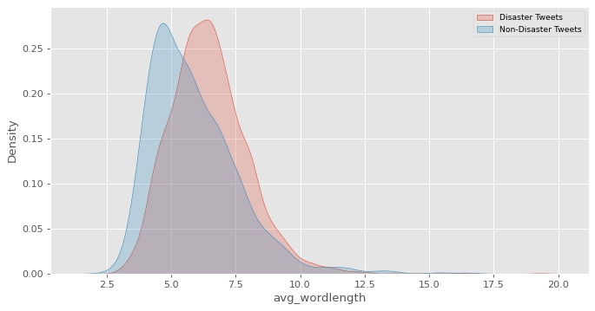
Average word length Distributions in tweets
Conclusion:
For a disaster tweet overall concentration of average word length is high as compared to normal tweet

Slide 8
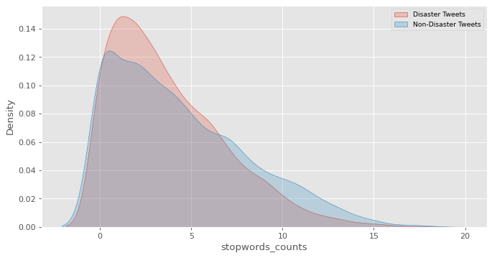
Stop words count Distributions in tweets
Conclusion:
For a disaster tweet overall concentration of stop words count is high as compared to normal tweet

Slide 9
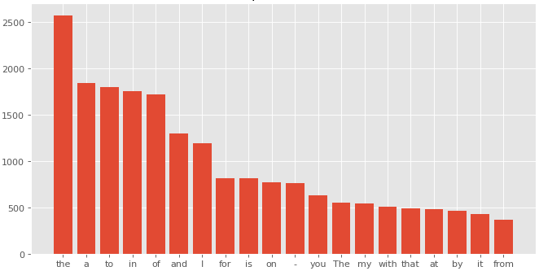
Top-20 words
Here I have selected the top-20 words based on the frequence of occurance

Slide 10
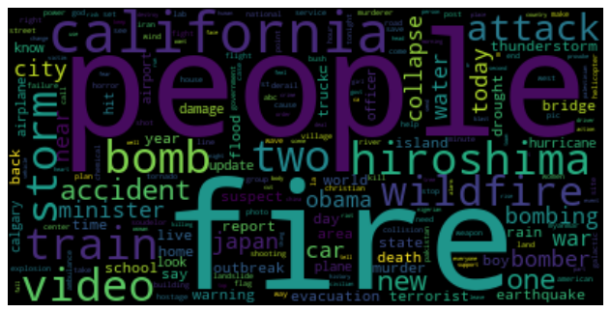
Disaster words visualization using word cloud

Slide 11
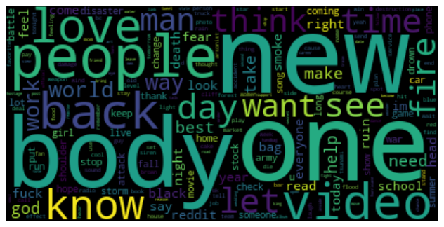
Non-Disaster words visualization using word cloud

Slide 12
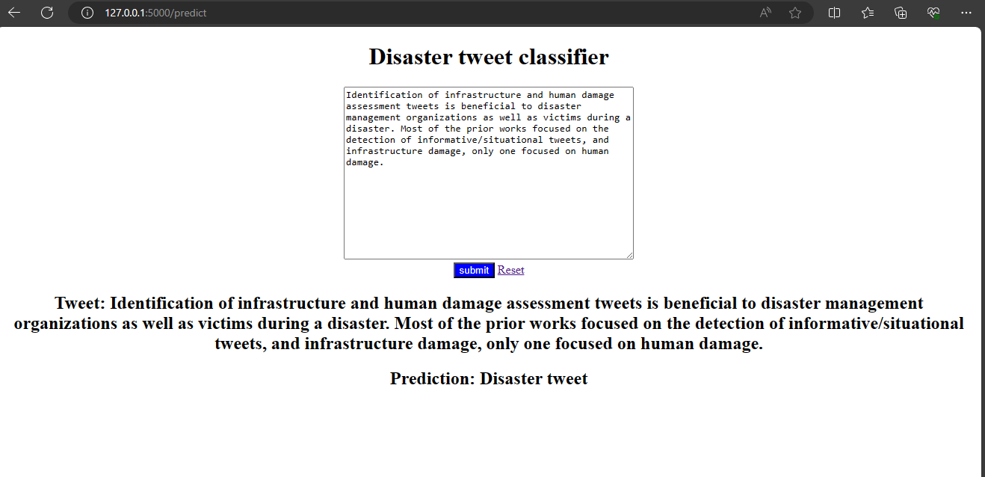
Web page for disaster tweet classification

