Slide 1

Android Operating System
Mobile Application Development (MAD)
GTU # 3170726
Prof. Mehul D Bhundiya
Computer Engineering Department
mehul.bhundiya@darshan.ac.in
9428231065

Slide 2
Introduction to Android
Android is an Operating System and programming platform developed by Google.
It supports devices like mobile phones and other devices, such as tablets, watch, TV, & auto.
Android includes a Software Development Kit (SDK) that helps you write code and assemble software modules to create apps for Android users.
Android also provides a marketplace (Play Store) to distribute apps.
It conquered around 75% of the global market share by the end of 2020.
The company named Open Handset Alliance developed Android for the first time that is based on the modified version of the Linux kernel and other open-source software.
Google sponsored the project at initial stages and in the year 2005, it acquired the whole company.
In September 2008, the first Android-powered device launched in the market.

Slide 3
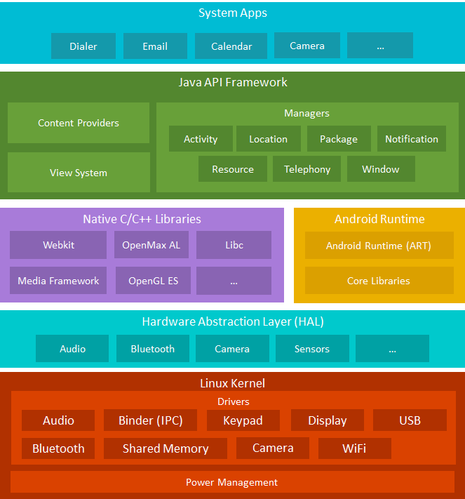
Android System With Architecture
Android comes with a set of core applications such as Contacts, Calendar, Maps, and a browser
You use these APIs to control what your app looks like and how it behaves
You can access OpenGL ES through the native C/C++ libraries to add support for drawing and manipulating 2D and 3D graphics in your app
The Android runtime comes with a set of core libraries that implement most of the Java programming language. Each Android app runs in its own process.
HAL provides an interfaces that expose device hardware capabilities to the higher-level Java API framework.
Underneath everything else lies the Linux kernel. Android relies on the kernel for drivers, and also core services such as security and memory management.

Slide 4

System Apps
System apps are pre-installed apps in the system partition with your ROM.
System app is simply an app placed under ‘/system/app‘ folder on an Android device.
‘/system/app’ is a read-only folder.
Android device users do not have access to this partition. Hence, users cannot directly install or uninstall apps to/from it.
Apps such as camera, settings, messages, Google Play Store, etc.

Slide 5
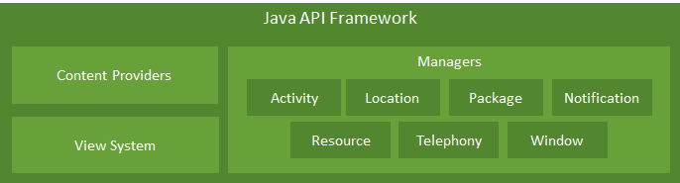
Java Api Framework
The entire feature-set of the Android OS is available using APIs written in the Java language.
These APIs form the building blocks you need to create Android apps by simplifying the reuse of core, modular system components and services.
A rich and extensible View System you can use to build an app’s UI, including lists, grids, text boxes, buttons, and even an embeddable web browser.
A Resource Manager, providing access to non-code resources such as localized strings, graphics, and layout files.
A Notification Manager that enables all apps to display custom alerts in the status bar.
An Activity Manager that manages the lifecycle of apps and provides a common navigation back stack.
Content Providers that enable apps to access data from other apps, such as the Contacts app, or to share their own data.

Slide 6
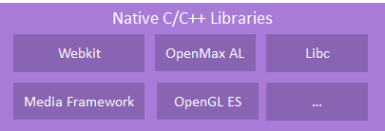
Native C/C++ Libraries
The Native Development Kit (NDK) is a set of tools that allows you to use C and C++ code with Android.
It provides platform libraries you can use to manage native activities and access physical device components, such as sensors and touch input.
The NDK may not be appropriate for most novice Android programmers who need to use only Java code and framework APIs to develop their apps.
However, the NDK can be useful for cases in which you need to do
squeeze extra performance out of a device when run games or physics simulations.
Reuse your own or other developers' C or C++ libraries.
Using Android Studio 2.2 and higher, you can use the NDK to compile C and C++ code into a native library and package it into your APK using Gradle

Slide 7
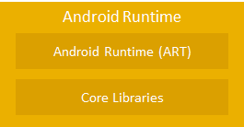
Android Run Time (ART)
Android runtime (ART) is the managed runtime used by applications and some system services.
ART and its predecessor Dalvik were originally created specifically for the Android project.
Google is claiming up to 200% performance improvements overall for ART.
ART improves garbage collection.

Slide 8

Hardware Abstraction Layer (HAL)
HAL is responsible for accessing the driver execution hardware.
A HAL defines a standard interface for hardware vendors to implement, which enables Android to be agnostic about lower-level driver implementations.
It allows you to implement functionality without affecting or modifying the higher level system.

Slide 9
Linux Kernel
A kernel is the core part of any operating system.
Android OS is built on top of the Linux kernel, with some architectural changes made by Google.
Most importantly, Linux is a portable platform that can be compiled easily on different hardware.
The kernel acts as an abstraction layer between the software and hardware present on the device.
Ex: Consider the case of a camera click. What happens when you take a photo using the camera button on your device? At some point, the hardware instruction (pressing a button) has to be converted to a software instruction (to take a picture and store it in the gallery). The kernel contains drivers to facilitate this process.

Slide 10
Android Platforms
The Android platform is a platform for mobile devices that uses a modified Linux kernel.
The Android Platform was introduced by the Open Handset Alliance in November of 2007.
Most applications that run on the Android platform are written in the Java programming language.
To create an application for the platform, a developer requires the Android SDK, which includes tools and APIs.
To shorten development time, Android developers typically integrate the SDK.

Slide 11
Android Platforms Contd.
Name | Version Number | Release Date | API Level
Cupcake | 1.5 | April 27, 2009 | 3
Donut | 1.6 | September 15, 2009 | 4
Eclair | 2.0 – 2.1 | October 26, 2009 | 5 – 7
Froyo | 2.2 – 2.2.3 | May 20, 2010 | 8
Gingerbread | 2.3 – 2.3.7 | December 6, 2010 | 9 – 10
Honeycomb | 3.0 – 3.2.6 | February 22, 2011 | 11 – 13
Ice Cream Sandwich | 4.0 – 4.0.4 | October 18, 2011 | 14 – 15
Jelly Bean | 4.1 – 4.3.1 | July 9, 2012 | 16 – 18
KitKat | 4.4 – 4.4.4 | October 31, 2013 | 19 – 20
Lollipop | 5.0 – 5.1.1 | November 12, 2014 | 21 – 22
Marshmallow | 6.0 – 6.0.1 | October 5, 2015 | 23
Nougat | 7.0 – 7.1.2 | August 22, 2016 | 24 – 25
Oreo | 8.0 – 8.1 | August 21, 2017 | 26 – 27
Pie | 9 | August 6, 2018 | 28
Android 10 | 10 | September 3, 2019 | 29
Hardly anyone use these versions.
Most devices use one of these APIs.

Slide 12
Setup Android Enviroment
you can start your Android application development on either
Mac OS X 10.5.8 or later version with Intel chip.
Microsoft Windows XP or later version.
Linux including GNU C Library 2.7 or later.
Java JDK5 or later version
You can download the latest version of Java JDK from Oracle's Java site Java SE Downloads.
You will find instructions for installing JDK in downloaded files, follow the given instructions to install and configure the setup.
Finally set PATH and JAVA_HOME environment variable to refer to the directory that contains java and javac.
Android Studio
You can download the latest version of Android Studio from Developer’s site.

Slide 13
Building Blocks
The building blocks are components that you use as an developer to build Android apps.
Main building blocks of android are
Activities
An activity is usually a single screen that the user sees on the device at one time.
Intents
Intents are messages that are sent among the major building blocks.
Services
Services run in the background and don’t have any user interface components.
Content Providers
Content providers are interfaces for sharing data between applications.
Broadcast Receivers
Broadcast receivers are Android’s implementation of a system-wide publish/subscribe mechanism, or more precisely, an Observer pattern.
Application Context
So far you have seen activities, services, content providers, and broadcast receivers. Together, they make up an application. Another way of saying this is that they live inside the same application context.

Slide 14
Activities
An application typically has multiple activities, and the user flips back and forth among them.
As such, activities are the most visible part of your application.
Just like a website consists of multiple pages, so does an Android application consist of multiple activities.
As a website has a “home page,” an Android app has a “main” activity, usually the one that is shown first when you launch the application.
And just like a website has to provide some sort of navigation among various pages, an Android app should do the same.
We can jump from an activity of one application to another activity in a completely separate application.
For example, if you are in your Contacts app and you choose to text a friend, you’d be launching the activity to compose a text message in the Messaging application.

Slide 15
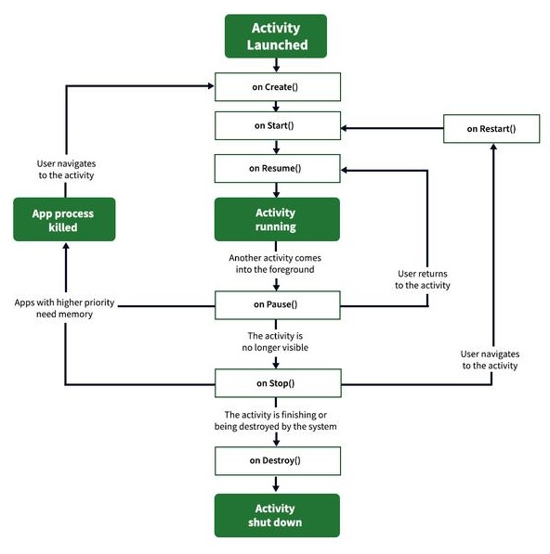
Activity Life Cycle

Slide 16
Activity Life Cycle Contd.
onCreate()
It is called when the activity is first created.
This is where all the static work is done like creating views, binding data to lists, etc.
This method also provides a Bundle containing its previous frozen state, if there was one.
onStart()
It is invoked when the activity is visible to the user.
It is followed by onResume() if the activity is invoked from the background.
It is also invoked after onCreate() when the activity is first started.
onRestart()
It is invoked after the activity has been stopped and prior to its starting stage.
Thus is always followed by onStart() when any activity is revived from background to on-screen.

Slide 17
Activity Life Cycle Contd.
onResume()
It is invoked when the activity starts interacting with the user.
At this point, the activity is at the top of the activity stack, with a user interacting with it.
Always followed by onPause() when the activity goes into the background or is closed by the user.
onPause()
It is invoked when an activity is going into the background but has not yet been killed.
It is a counterpart to onResume().
When an activity is launched in front of another activity, this callback will be invoked on the top activity (currently on screen).
The activity, under the active activity, will not be created until the active activity’s onPause() returns, so it is recommended that heavy processing should not be done in this part.
onStop()
It is invoked when the activity is not visible to the user.
It is followed by onRestart() when the activity is revoked from the background, followed by onDestroy().

Slide 18
Activity Life Cycle Contd.
onDestroy()
onDestroy() is called before the activity is destroyed.
The activity is finishing due to the user completely dismissing the activity or due to finish() being called on the activity.
The system is temporarily destroying the activity due to a configuration change ex. device rotation or multi-window mode.

Slide 19
Intents
An intent is to perform an action on the screen.
It is mostly used to start activity, send broadcast receiver, start services and send message between two activities.
It is a messaging object which tells what kind of action to be performed.
The intent’s most significant use is the launching of the activity.
Body of Intent:
action: The general action to be performed, such as ACTION_VIEW, ACTION_EDIT, ACTION_MAIN, etc.
data: The data to operate on, such as a person record in the contacts database, expressed as a Uri
Basically two intents are there in android.
Implicit Intents
Explicit Intents

Slide 20
Implicit Intent
Implicit Intent doesn’t specify the component.
In such a case, intent provides information on available components provided by the system that is to be invoked.
Implicit intents are used without a class name, where Android will help determine an appropriate Activity to handle the intent.
For example, you may write the following code to view the webpage.
Intent intent=new Intent(Intent.ACTION_VIEW);
intent.setData(Uri.parse(“http://www.javatpoint.com”));
startActivity(intent);

Slide 21
Explicit Intent
Explicit Intent specifies the component.
In such a case, intent provides the external class to be invoked.
Explicit Intent are used with class name, where Android navigate via routes.
Intent i = new Intent(getApplicationContext(), ActivityTwo.class);
startActivity(i);

Slide 22
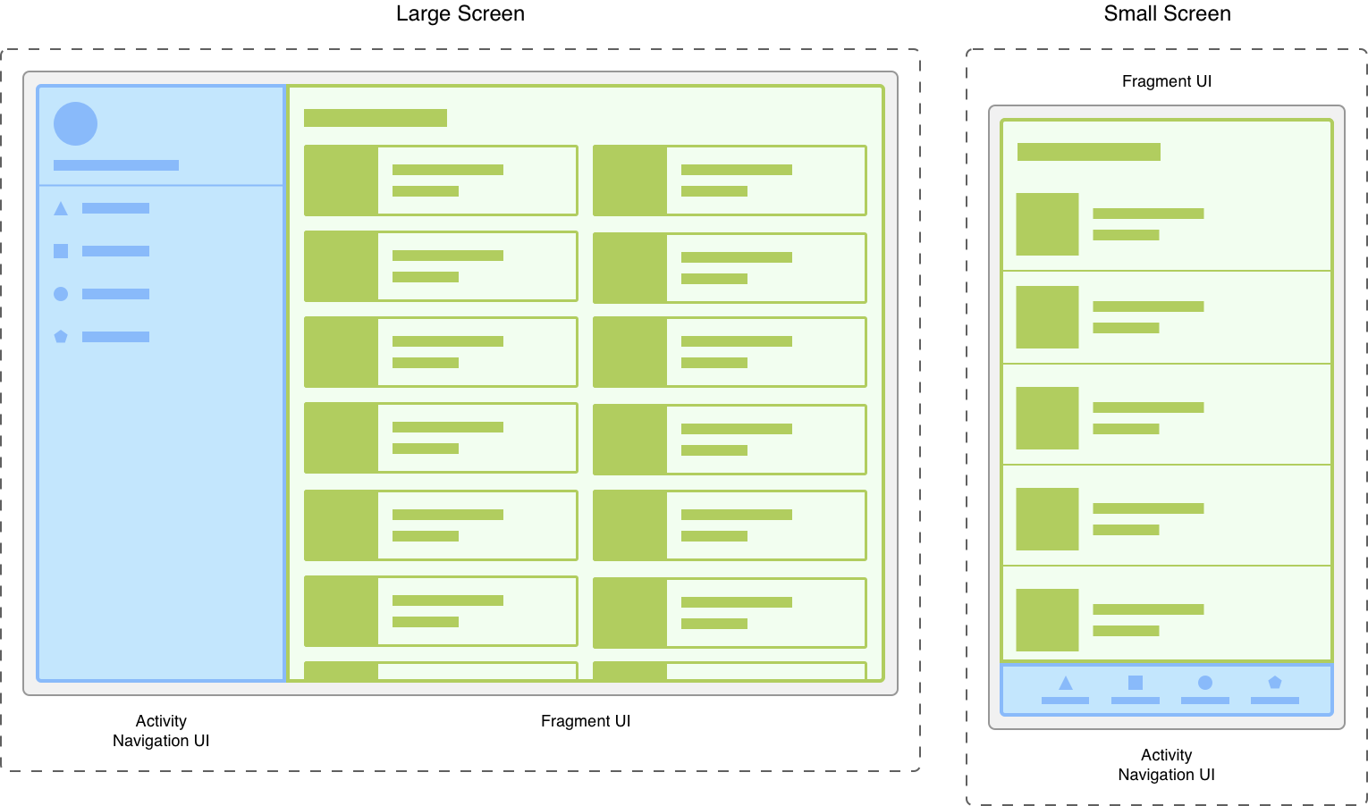
Fragment
A Fragment represents a reusable portion of app's UI.
A fragment defines and manages its own layout, has its own lifecycle, and can handle its own input events.
Fragments cannot live on their own they must be hosted by an activity or another fragment.
Android Fragment is the part of activity, it is also known as sub-activity.
There can be more than one fragment in an activity.
Using with fragment transaction. we can move one fragment to another fragment.

Slide 23
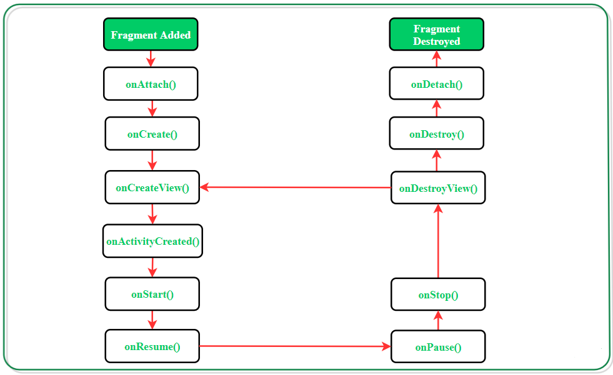
Fragment Life Cycle

Slide 24
Fragment Life Cycle
onAttach():
The fragment instance is associated with an activity instance.
The fragment and the activity is not fully initialized.
Typically you get in this method a reference to the activity which uses the fragment for further initialization work.
onCreate():
The system calls this method when creating the fragment.
You should initialize essential components of the fragment that you want to retain when the fragment is paused or stopped, then resumed.
onCreateView() :
The system calls this callback when it's time for the fragment to draw its user interface for the first time.
To draw a UI for your fragment, you must return a View component from this method that is the root of your fragment's layout.
You can return null if the fragment does not provide a UI.

Slide 25
Fragment Life Cycle
onActivityCreated():
The onActivityCreated() is called after the onCreateView() method when the host activity is created.
Activity and fragment instance have been created as well as the view hierarchy of the activity.
onStart():
The onStart() method is called once the fragment gets visible.
onResume():
Fragment becomes active.
onPause():
The system calls this method as the first indication that the user is leaving the fragment.
This is usually where you should commit any changes that should be persisted beyond the current user session.

Slide 26
Fragment Life Cycle
onStop():
Fragment going to be stopped by calling onStop().
onDestroyView():
Fragment view will destroy after call this method.
onDestroy():
onDestroy() called to do final clean up of the fragment's state but Not guaranteed to be called by the Android platform.

Slide 27

Thank You
Mobile Application Development (MAD)
GTU # 3170726
Prof. Mehul D Bhundiya
Computer Engineering Department
mehul.bhundiya@darshan.ac.in
+91-9428231065

