Slide 1

Unit-2: Wireless Communication Technology PART-3 : Spread Spectrum
Mobile Computing Wireless Communication
(MCWC)
GTU # 3170710
Prof.Swati R Sharma
Computer Engineering Department
swati.sharma@darshan.ac.in
(O) 9727747317

Slide 2
Spread Spectrum

Looping
Topics to be covered- Spread Spectrum
The Concept of Spread Spectrum
Frequency Hopping Spread Spectrum
Direct Sequence Spread Spectrum
Code Division Multiple Access

Slide 3
The Concept of Spread Spectrum

Slide 4
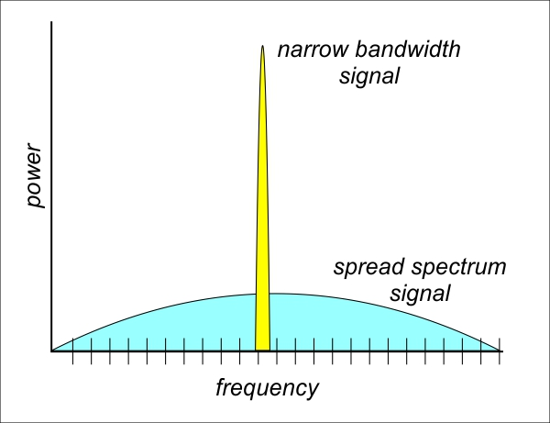
The Concept of Spread Spectrum
A collective class of signalling techniques are employed before transmitting a signal to provide a secure communication, known as the Spread Spectrum Modulation.
The pivotal aim of spread spectrum communication technique is to prevent “interference” whether it is intentional or unintentional.’
The spread spectrum signals are hard to interfere and can’t be jammed.

Slide 5
The Concept of Spread Spectrum
Narrow Band Signal features
Band of signals occupy a narrow range of frequencies
Power density is high
Spread of energy is low and concentrated
Signals are prone to interference
Spread Spectrum Signal features
Band of signals occupy a wide range of frequencies
Power density is very low
Energy is wide spread
Highly resistant to interference or jamming

Slide 6
General model of Spread Spectrum
Output
Data
Input
Data
Channel Encoder
Modulator
Channel
Demodulator
Channel Decoder
Spreading
Code
Spreading
Code
Psuedo-noise generator
Psuedo-noise generator

Slide 7
The Concept of Spread Spectrum
Applications
Military communication
It can also be used for hiding and encrypting signals. Only a recipient who knows the spreading code can recover the encoded information.

Slide 8
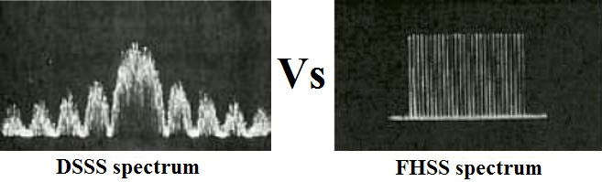
Spread Spectrum Technique
Spread Spectrum
Frequency Hoping Spread Spectrum
(FHSS)
Direct Sequence
Spread Spectrum
(DSSS)

Slide 9
Frequency Hopping Spread Spectrum(FHSS)

Slide 10
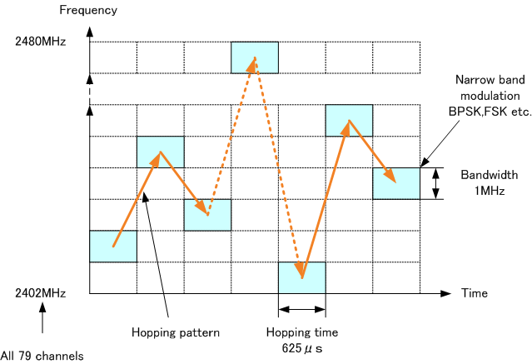
Frequency Hopping Spread Spectrum(FHSS)
The first type of spread spectrum developed is known as frequency hopping.
The sequence of channels used is indicated by a spreading code.
Signal is broadcast over seemingly random series of radio frequencies
A number of channels allocated for the FH signal
Width of each channel corresponds to bandwidth of input signal
Signal hops from frequency to frequency at fixed intervals
Transmitter operates in one channel at a time
Bits are transmitted using some encoding scheme
At each successive interval, a new carrier frequency is selected

Slide 11
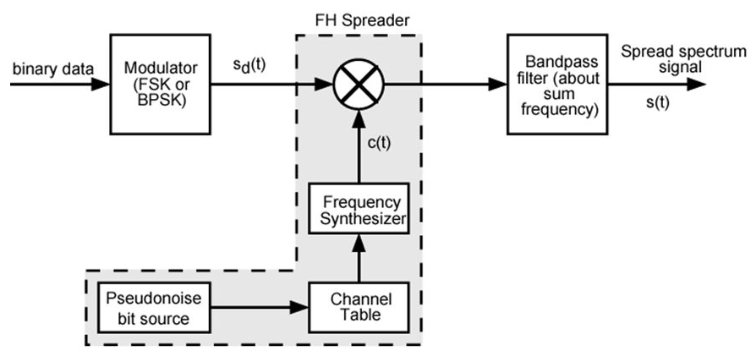
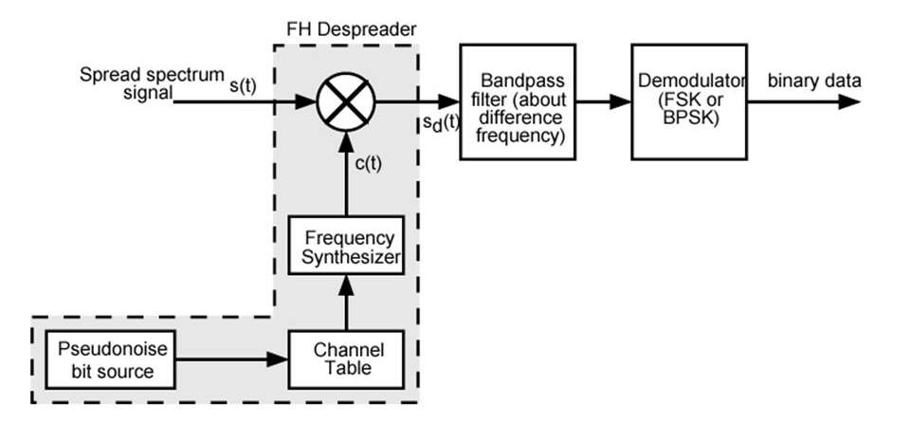
FHSS Transmitter and Receiver block diagram
FHSS Transmitter
FHSS Receiver

Slide 12
Direct Sequence Spread Spectrum(DSSS)

Slide 13
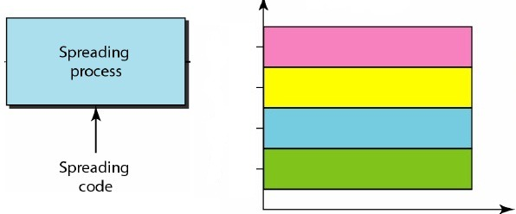
Direct Sequence Spread Spectrum(DSSS)
Each bit in original signal is represented by multiple bits in the transmitted signal
Spreading code spreads signal across a wider frequency band
Spread is in direct proportion to number of bits used
One technique combines digital information stream with the spreading code bit stream using exclusive-OR.

Slide 14
Direct Sequence Spread Spectrum
0 | 1 | 1 | 0 | 0
0 | 1 | 0 | 1 | 0
0
1
Data Input Signal (A)
PN bit stream (B)
0
0
1
1
0
1
C=A ⊕ B

Slide 15
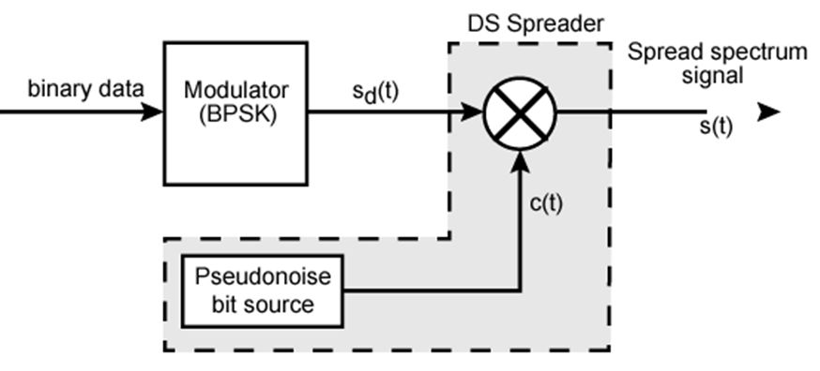
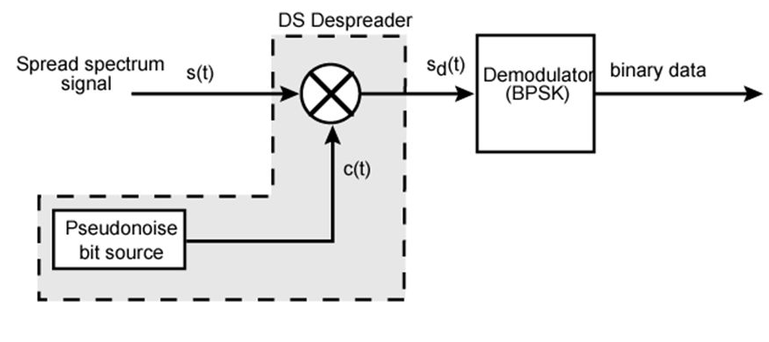
DSSS Transmitter and Receiver block diagram
DSSS Transmitter
DSSS Receiver

Slide 16
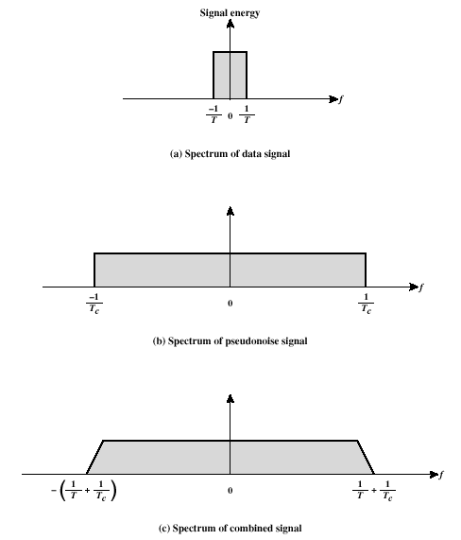
DSSS Performance Considerations

Slide 17
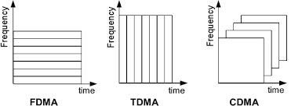
Code Division Multiple Access
CDMA is a multiplexing technique used with spread spectrum.

Slide 18
Code Division Multiple Access :Example
 | User-1 | User-2 | User-3
Data | 00 | 10 | 11
00
0101
Spread Code | 0101 | 0011 | 0000
:0000 0000
11: 1111 1111
0000: ⊕ 0000 0000
Generated Spread code
10: 1111 0000
0011: ⊕0011 0011
⊕:0101 0101
0101 0101
1100 0011
1111 1111

Slide 19
CDMA | User-1 | User-2 | User-3
Spread code
0101 0101
1100 0011
1111 1111
User-1
0 | 1 | 0 | 1 | 0 | 1 | 0 | 1
0: +1V
1: -1V
+1V
0V
-1V
User-2
1 | 1 | 0 | 0 | 0 | 0 | 1 | 1
+1V
0V
-1V
User-3
1 | 1 | 1 | 1 | 1 | 1 | 1 | 1
+1V
0V
-1V

Slide 20
User-1
0: +1V
1: -1V
Receiver
0 | 1 | 0 | 1 | 0 | 1 | 0 | 1
+1 | -1 | +1 | -1 | +1 | -1 | +1 | -1
+1V
0V
-1V
User-2
1 | 1 | 0 | 0 | 0 | 0 | 1 | 1
-1 | -1 | +1 | +1 | +1 | +1 | -1 | -1
+1V
0V
-1V
User-3
1 | 1 | 1 | 1 | 1 | 1 | 1 | 1
-1 | -1 | -1 | -1 | -1 | -1 | -1 | -1
+1V
0V
-1V

Slide 21
User-1 | Volts
User-2 | Volts
User-3 | Volts
+1 | -1 | +1 | -1 | +1 | -1 | +1 | -1
CDMA Transmitter
-1 | -1 | +1 | +1 | +1 | +1 | -1 | -1
-1 | -1 | -1 | -1 | -1 | -1 | -1 | -1
Composite Signal(Add) | Volts | -1 | -3 | 1 | -1 | 1 | -1 | -1 | -3
Composite Signal(Add)
+1V
0V
-1V
-2V
-3V

Slide 22
CDMA Receiver
Composite Signal(Add)
USER-1
+1V
0V
-1V
-2V
-3V
0 | 1 | 0 | 1 | 0 | 1 | 0 | 1
User1(0101)
0: +1V
1: -1V
+1V
0V
-1V
Multiply | Volts | -1 | 3 | 1 | 1 | 1 | 1 | -1 | 3
-1+3+1+1=4/4=+1
+1+1-1+3=4/4=+1
0: +1V
1: -1V
Voltage=11
Therefore, Data=00(i.e Original Data Sent by User-1)

Slide 23
CDMA Receiver
Composite Signal(Add) |  | -1 | -3 | 1 | -1 | 1 | -1 | -1 | -3
USER-2
+1V
0V
-1V
-2V
-3V
0 | 0 | 1 | 1 | 0 | 0 | 1 | 1
User2(0011)
+1 | +1 | -1 | -1 | +1 | +1 | -1 | -1
0: +1V
1: -1V
+1V
0V
-1V
Multiply | Volts | -1 | -3 | -1 | 1 | 1 | -1 | 1 | 3
-1-3-1+1=-4/4=-1
+1-1+1+3=4/4=+1
0: +1V
1: -1V
Voltage= -1 1
Therefore, Data=10(i.e Original Data Sent by User-2)

Slide 24
CDMA Receiver
Composite Signal(Add) |  | -1 | -3 | 1 | -1 | 1 | -1 | -1 | -3
USER-3
+1V
0V
-1V
-2V
-3V
0 | 0 | 0 | 0 | 0 | 0 | 0 | 0
User3(0000)
+1 | +1 | +1 | +1 | +1 | +1 | +1 | +1
0: +1V
1: -1V
+1V
0V
-1V
Multiply | Volts | -1 | -3 | 1 | -1 | 1 | -1 | -1 | -3
-1-3+1-1=-4/4=-1
+1-1-1-3=-4/4=-1
0: +1V
1: -1V
Voltage= -1 -1
Therefore, Data=11(i.e Original Data Sent by User-3)

Slide 25
GTU Questions: Unit 2-Part 3
Sr. | Question | Marks | Year
1. | What is Direct Sequence Spread Spectrum technology? How does it work in CDMA technology? | 7 3 | Win’18 Sum’20
2. | What is wave propagation? Discuss various modes of propagation with example | 4 7 7 | Sum’19 Win’19 Sum’20
3. | Explain FHSS. Discuss advantages and applications of FHSS. | 7 4 7 | Sum’19 Win’19 Sum’20
4. | How DSSS does works in CDMA technology? | 4 | Sum’20

Slide 26

References
Book: | Wireless Communications & Networks, Second Edition, William Stallings by Pearson

Slide 27
Thank You

