Slide 1

Unit-5: Bluetooth
Mobile Computing Wireless Communication
(MCWC)
GTU # 2170710
Prof. Swati R Sharma
Computer Engineering Department
swati.sharma@darshan.ac.in
(O) 9727747317

Slide 2
Bluetooth

Looping
Topics to be covered
Radio specification
Baseband specification
Link manager specification
Logical link control
Adaption protocol

Slide 3
Introduction of Bluetooth

Slide 4
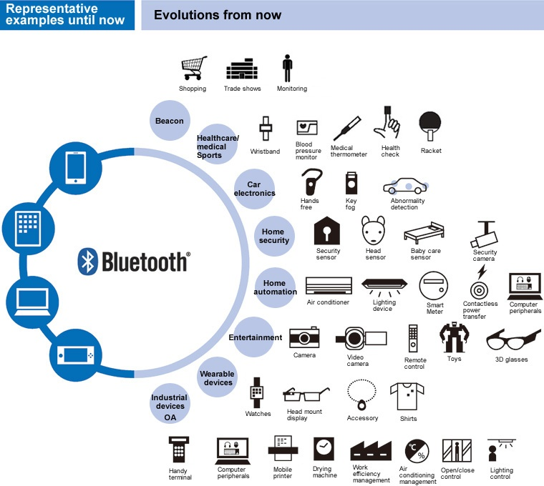

Slide 5
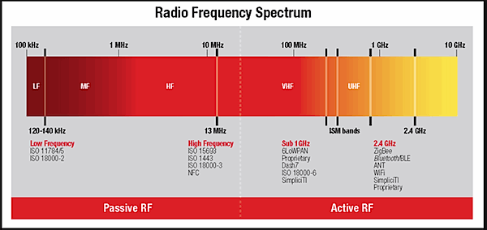
Introduction of Bluetooth
Universal short-range wireless capability
Uses 2.4-GHz band
Available globally for unlicensed users
Devices within 10m can share up to 2.1 Mbps to 24 Mbps of capacity
Supports open-ended list of applications
Data, audio, graphics, video
Started as IEEE 802.15.1
New standards come from the Bluetooth Special Interest Group (Bluetooth SIG)
Bluetooth 2.0, 2.1, 3.0, 4.0 and 5.0

Slide 6
Introduction of Bluetooth
It is a standard for the short-range wireless interconnection of mobile phones, computers, and other electronic devices.
Bluetooth technology allows users to make ad-hoc wireless connections between devices like mobile, desktop or notebook computers wirelessly.
Data transfer at a speed of about 720 Kbps within 50 meters (150 feet) of range or beyond through walls, clothing and even luggage bags.
It supports both unicast (point-to-point) and multicast (point-to-multipoint) connections.
Bluetooth protocols are a collection of many inter-related protocols.
IEEE has also adapted Bluetooth as the 802.15.1a standard.
Managed and maintained by Bluetooth Special Interest Group.

Slide 7
Bluetooth Protocol

Slide 8
Bluetooth Protocol
Bluetooth radio built into a small microchip.
Operates in a globally available frequency band ensuring worldwide interoperability.
Bluetooth uses the unlicensed 2.4 GHz ISM (Industrial Scientific and Medical) frequency band.
79 available channels set of 1 MHz each, ranges from 2.402 GHz to 2.480 GHz.
It provides power levels starting from 1mW (covering 10 centimeters) to 100mW (covering up-to 100 meters) suitable for short device zone to personal area networks within a home/office.

Slide 9
Piconet

Slide 10
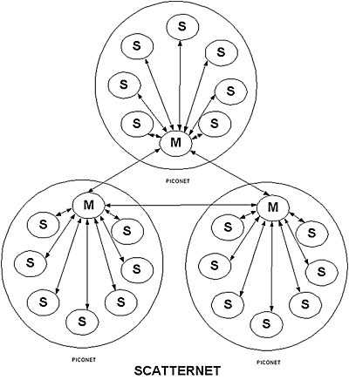
Piconet
Bluetooth protocol uses the concept of master and slave.
A piconet is an ad-hoc network that links a wireless user group of devices using Bluetooth technology protocols.
Master and slaves together form a Piconet when master allows slaves to talk.
Up to 7 ‘slave’ devices can be set to communicate with a ‘master’ in a Piconet.
A piconet consists of two or more devices occupying the same physical channel.

Slide 11
Scatternet

Slide 12
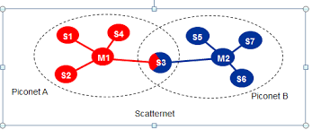
Scatternet
Scatternet formed when several of piconet are linked together to form a larger network in an ad-hoc manner.
Scatternet is a topology where a device from one piconet also acts as a member of another piconet wherein a device is a master in one piconet can simultaneously be a slave in the other one.

Slide 13
Bluetooth Protocol Architecture

Slide 14
Bluetooth Protocol Architecture/Stack
Bluetooth Core protocols plus Bluetooth radio protocols required by most Bluetooth devices.
Uses spread spectrum technologies at the Physical Layer while using both direct sequence and frequency hopping spread spectrum technologies.
Uses connectionless (ACL–Asynchronous Connectionless Link) and connection-oriented (SCO–Synchronous Connection-oriented Link) links.
Cable Replacement layer, Telephony Control layer and Adopted protocol layer form application-oriented protocols.

Slide 15
Bluetooth Protocol Stack
vCard/vCal
WAE
OBEX
WAP
AT-Commands
TCS BIN
SDP
UDP
TCP
IP
PPP
RFCOMM
L2CAP
Audio
Host Controller Interface
LMP
Baseband
Bluetooth Radio
Bluetooth Core Protocol
Cable Replacement Protocol
Telephony Control Protocol
Adopted Protocol
Telephony Control Specification Binary (TCS BIN) - defines the call control signaling protocol and handles mobility management for groups of Bluetooth TCS devices.
Attention (AT) Commands - defines a set of commands by which a mobile phone can be used and controlled as a modem for fax and data transfers.
Content Formats - used to exchange messages and notes and synchronize data amongst various devices.
Logical Link Control and Adaptation Protocol (L2CAP) – segmentation and re-assembly of fragmented packets with their multiplexing.
Point-to-Point Protocol (PPP) - means of taking IP packets to/from the PPP layer and placing them onto the LAN.
Object Exchange (OBEX) Protocol - session protocol to exchange objects and used to browse the contents of folders on remote devices.
Radio Frequency Communication (RFCOMM) - emulates RS-232 control and data signals over Bluetooth baseband protocol.
Transmission Control Protocol/Internet Protocol (TCP/IP) - used for communication across the Internet.
Link Manager Protocol (LMP) – manages devices in range, power modes, connections, duty cycles, etc.
Service Discovery Protocol (SDP) – Enables a device to join a piconet.
Baseband – enables physical RF link

Slide 16
Bluetooth Core Protocol
Baseband – enables physical RF link.
Link Manager Protocol (LMP) – manages devices in range, power modes, connections, duty cycles, etc.
Logical Link Control and Adaptation Protocol (L2CAP) – segmentation and re-assembly of fragmented packets with their multiplexing.
Service Discovery Protocol (SDP) – Enables a device to join a piconet.

Slide 17
L2CAP protocol of Bluetooth
Functions
Adaptation between higher-layer frames and lower layer frames of the Bluetooth protocol stack.
Support for both connection-oriented as well as connectionless services.
Supporting two links for the Baseband layer −
Synchronous Connection-Oriented (SCO) links for real-time voice traffic using reserved bandwidth.
Asynchronous Connection-Less (ACL) links for best-effort traffic.
Multiplexing of higher layer protocols, which allows them to use the links provided by the lower layers.
Segmentation and reassembly of data packets of the upper layer that are larger than the capacity of the radio layer underneath.
Group management.
Quality of Service (QoS) for upper-layer protocols

Slide 18
Cable Replacement Protocol
Radio Frequency Communication (RFCOMM) - emulates RS-232 control and data signals over Bluetooth baseband protocol.

Slide 19
Telephony Control Protocols
Telephony Control Specification Binary (TCS BIN) - defines the call control signaling protocol and handles mobility management for groups of Bluetooth TCS devices.
Attention (AT) Commands - defines a set of commands by which a mobile phone can be used and controlled as a modem for fax and data transfers.

Slide 20
Adopted Protocols
Point-to-Point Protocol (PPP) - means of taking IP packets to/from the PPP layer and placing them onto the LAN.
Transmission Control Protocol/Internet Protocol (TCP/IP) - used for communication across the Internet.
Object Exchange (OBEX) Protocol - session protocol to exchange objects and used to browse the contents of folders on remote devices.
Content Formats - used to exchange messages and notes and synchronize data amongst various devices.

Slide 21
Bluetooth Security

Slide 22

Bluetooth Security
Offers security infrastructure starting from authentication, key exchange to encryption.
Uses the publicly available cipher algorithm known as SAFER+ to authenticate a device’s identity.
Bluetooth security includes authorisation, authentication and optional encryption.
Authentication is the proving of identity of one Bluetooth-enabled device to another.
Authorisation is the granting or denying of Bluetooth connection access to resources or services from the requesting device.
Encryption is the translating of data into secret code so that eavesdroppers cannot read its content.

Slide 23
Bluetooth Application

Slide 24
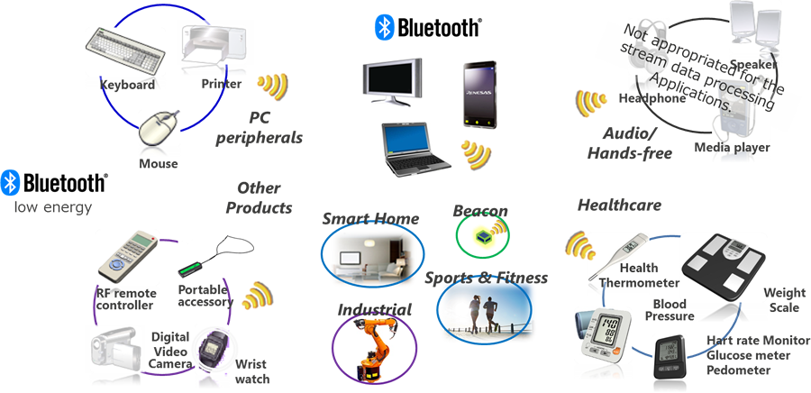
Bluetooth Application
Each application model in Bluetooth realized through a Profile.
Profiles define the protocols and protocol features supporting a particular usage model.
Some common profiles are:
File Transfer
Internet Bridge
LAN Access
Synchronization
Headset

Slide 25
Power saving states of Bluetooth

Slide 26
Power saving states of Bluetooth device
The Bluetooth Low Energy (BLE) guideline was released in 2010.
Bluetooth radio can use up to 30mA when receiving, it is important that it be used as little as possible to save battery power
Bluetooth Low Energy (BLE) is embedded in smartphones, laptops, medical devices, sensors, and other applications that benefit from the technology’s key differentiators:
lower power consumption
reduced memory requirements
efficient discovery
connection procedures
short packet lengths
simple protocols and services
There are 3 low-power modes:
Hold: Allows devices to be inactive for a single short period.
Sniff: Allows devices to be inactive except for periodic sniff slots.
Park: Similar to Sniff, except parked devices give up their active member address.

Slide 27

References
Book: | Wireless Communications & Networks, Second Edition, William Stallings by Pearson
Web: | www.bluetooth.com

Slide 28
Unit-5: Bluetooth
Mobile Computing Wireless Communication
(MCWC)
GTU # 2170710
Prof.Swati R Sharma
Computer Engineering Department
swati.sharma@darshan.ac.in
(O) 9727747317

