Slide 1

Introduction to Android App Development
Mobile Computing and Wireless Communication (MCWC)
GTU # 2170710
Prof. Mayur Padia
Computer Engineering Department
mayur.padia@darshan.ac.in
(M) 99255 15118

Slide 2
Table of Contents
Installation of Android Studio
Exploring the Development Environment
Android Architecture / Application Framework
The Application Components
The manifest file
Layouts
Working with Activities
Widgets
Intents
Activity Life Cycle
Developing and Executing the first Android Application

Slide 3
Installation of Android Studio
Click the arrow below to download Android Studio.
Once downloaded, the setup, install it on your machine using the setup wizard.
Once installed Android Studio, go through the setup wizard, which will install latest Android SDK, platform built tools required for mobile app development.
Your setup need continuous internet while doing the installation, as the process may download required plugins.
https://developer.android.com/studio

Slide 4
Exploring the Developing Environment
Some of the important files in the Android Studio are:
MainActivity
This is the main activity. It’s the entry point for your app. When you build and run your app, the system launches an instance of this Activity and loads its layout.
activity_main.xml
This XML file defines the layout for the activity’s user interface (UI).
It contains a TextView element with the text “Hello, World!”.
AndroidManifest.xml
The manifest file describes the fundamental characteristics of the app and defines each of its components.
build.gradle
There are two files with this name: one for the project, “Project: My First App”, and one for the app module, “Module: app”. Each module has its own build.gradle file, but this project currently has one module.

Slide 5
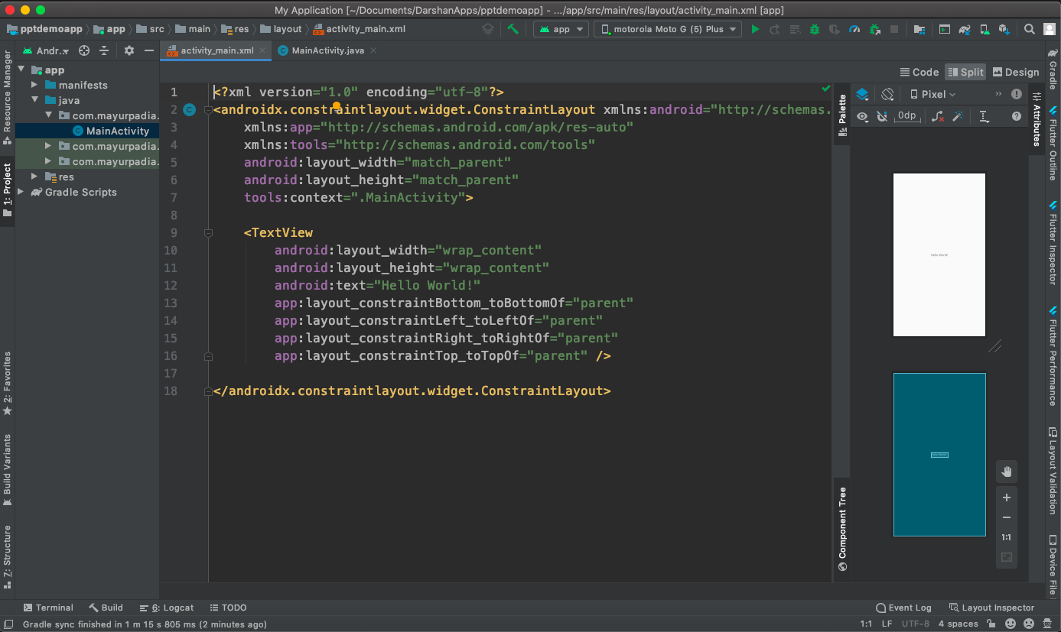
Exploring the Developing Environment
Select between
Code View
Split View
Design View
Project Explorer
Code window

Slide 6
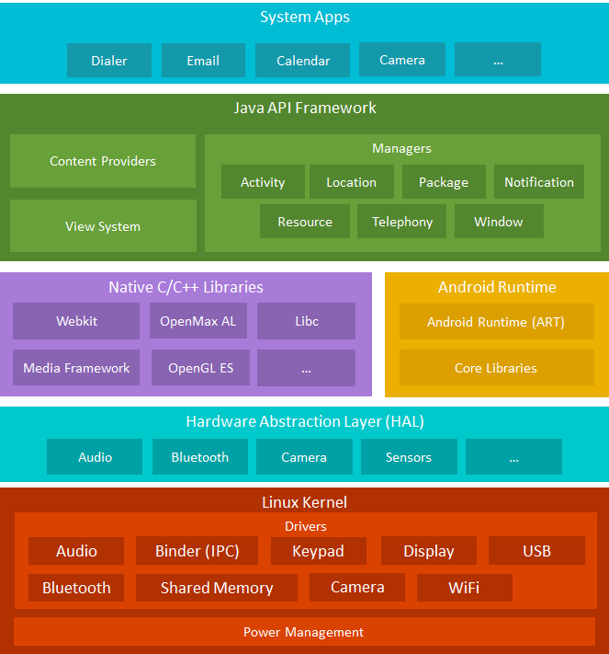
Android Architecture / Application Framework
Android comes with a set of core applications such as Contacts, Calendar, Maps, and a browser
You use these APIs to control what your app looks like and how it behaves
The Android runtime comes with a set of core libraries that implement most of the Java programming language. Each Android app runs in its own process.
You can access OpenGL ES through the native C/C++ libraries to add support for drawing and manipulating 2D and 3D graphics in your app.
HAL provides an interfaces that expose device hardware capabilities to the higher-level Java API framework.
Underneath everything else lies the Linux kernel. Android relies on the kernel for drivers, and also core services such as security and memory management.

Slide 7
The Application Components
App components are the essential building blocks of an Android app.
Each components is an entry point through which the system or a user can enter your app.
There are 4 types of application components:
Components | Uses
Activities | It handles the user interactions to the device.
Services | It handles background processing associated with an application.
Broadcast Receivers | It handles communication between android operating systems and your applications.
Content Providers | It handles data and database management related issues.

Slide 8
The Application Components - Activities
An activity is the entry point for interacting with the user.
It represents a single screen with a user interface.
Key interactions between system and app are:
Keeping track of what the user currently cares about (what is on screen) to ensure that the system keeps running the process that is hosting the activity.
Knowing what previously used processes contain things the user may return to (stopped activities), and thus keeping highly prioritize processes around.
Helping the app handle having its process killed so the user can return to activities with their previous state restored.
Providing a way for apps to implement user flows between each other, and for the system to coordinate these flows.
Example: an email app have one activity to show list of mails, another to compose mail, and a third activity to read an email.
public class MainActivity extends Activity {
}

Slide 9
The Application Components - Services
A service is a general-purpose entry point for keeping an app running in the background for all kinds of reason.
It is a component that runs in the background to perform long-running operations or to perform work for remote processes.
A service does not provide a user interface.
Example: a service may be play music in background / or sync some data in background while the user is in different app.
public class MyService extends Service {
}

Slide 10
The Application Components – Broadcast Receivers
A broadcast receivers is a component that enables the system to deliver events to the app outside of a regular user flow, allowing the app to respond to system-wide broadcast announcements.
As broadcast receivers are another well-defined entry point into the app, the system can deliver broadcasts even to apps that aren’t currently running.
Example: an app can schedule an alarm to post a notification to tell the user about an upcoming event.
Broadcast receivers don’t display a user interface, they may create a status bar notification to alert the user when a broadcast event occurs.
public class MyReceiver extends BroadcastReceiver {
public void onReceive(context, intent){}
}

Slide 11
The Application Components – Content Providers
A content provider manages a shared set of app data that you can store in the file system, in a SQLite database, on the web, or on any other persistent storage location that your app can access.
Through the content provider, other apps can query or modify the data if the content provider allows it.
Example: content providers manages user’s contact information
public class MyContentProvider extends ContentProvider {
public void onCreate(){}
}

Slide 12
The Manifest file
Every app project must have an AndroidManifest.xml file at the root of the project source set.
The manifest file describes essential information about your app to the Android build tools, the Android operating system, and Google Play.
You app must declare all its components in this file, which must be at the root of the app project directory.
The manifest does a number of things in addition to declaring the app’s components, such as:
Identifies any user permissions the app requires, such as internet access, etc.,
Declares the minimum API level required by the app
Declares the hardware and software features used or required by the app, such as camera, Bluetooth, etc.,
Declares API libraries the app needs to be linked against such as Google Maps library.

Slide 13
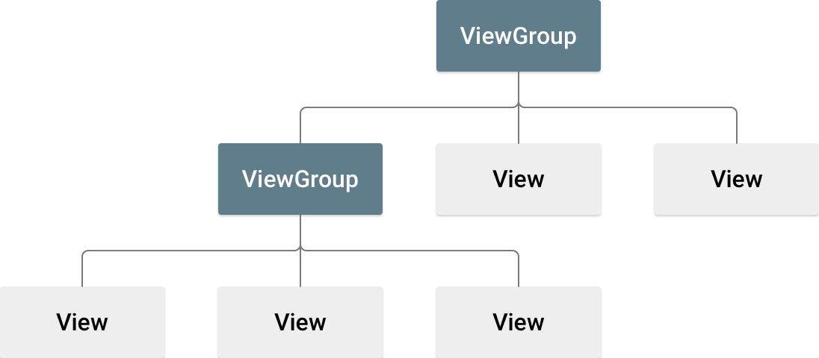
Layouts
A layout defines the structure for a user interface in your app, such as in an activity. All elements in the layout are built using a hierarchy of View and ViewGroup objects.
A view usually draws something the user can see and interact with.
The view objects are usually called “widgets”, and can be one of many subclasses, such as Button or TextView.
A ViewGroup is an invisible container that defines the layout structure for View and other ViewGroup objects.
The ViewGroup objects are usually called “layouts”, and can be one of many types that provide a different layout structure, such as LinearLayout or ConstraintLayout.
Each subclass of the ViewGroup class provides a unique way to display the views you nest within it.

Slide 14


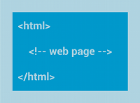
Some of the common layouts types
Linear Layout | Relative Layout | WebView
A layout that organizes its children into a single horizontal or vertical row. It creates a scrollbar if the length of the window exceeds the length of the screen. | Enables you to specify the location of child objects relative to each other or to the parent. | Displays web pages.

Slide 15
Layouts Types
ScrollView Layout | Table Layout | Frame Layout
A view group that allows the view hierarchy placed within it to be scrolled. | A layout that arranges its children into rows and columns. | FrameLayout is designed to block out an area on the screen to display a single item.
Scroll view may have only one direct child placed within it. | A TableLayout consists of a number of TableRow objects, each defining a row. | Child views are drawn in a stack, with the most recently added child on top. The size of the FrameLayout is the size of its largest child, visible or not.
Scroll view supports vertical scrolling only. | TableLayout containers do not display border lines for their rows, columns, or cells. The table has as many columns as the row with the most cells. A table can leave cells empty. Cells can span columns, as they can in HTML.

Slide 16
Working with Activities
The activity serves as the entry point for an app’s interaction with the user. You implement an activity as a subclass of the Activity class.
An activity provides the window in which the app draws its UI.
Example: inbox in your Gmail app, compose activity, individual mail activity, etc.,

Slide 17
Widgets
TextView
A user interface element that displays text to the user.
<TextView
android:id="@+id/text_view_id"
android:layout_height="wrap_content"
android:layout_width="wrap_content"
android:text="@string/hello" />

Slide 18
Widgets
EditText
A user interface element for entering and modifying text.
When you define an edit text widget, you must specify the R.styleable.TextView_inputType attribute. Choosing the input type configures the keyboard type that is shown, acceptable characters, and appearance of Edit Text.
<EditText
android:id="@+id/plain_text_input"
android:layout_height="wrap_content"
android:layout_width="match_parent"
android:inputType="text"/>

Slide 19
Widgets
Buttons
A button consists of text or an icon or both that communicates what action occurs when the user touches it.
<Button
android:layout_width="wrap_content"
android:layout_height="wrap_content"
android:text="@string/button_text"
... />

Slide 20
Widgets
Image Buttons
A button consists of text or an icon or both that communicates what action occurs when the user touches it.
<ImageButton
android:layout_width="wrap_content"
android:layout_height="wrap_content"
android:src="@drawable/button_icon"
android:contentDescription="@string/button_icon_desc"
... />
<Button
android:layout_width="wrap_content"
android:layout_height="wrap_content"
android:text="@string/button_text"
android:drawableLeft="@drawable/button_icon"
... />

Slide 21
Widgets
Radio Buttons
Radio buttons allow the user to select one option from a set. To create each radio button, create a RadioButton in your layout.
As radio buttons are mutually exclusive, you must group them together inside a RadioGroup. By grouping, only one radio button can be selected at a time.
<?xml version="1.0" encoding="utf-8"?>
<RadioGroup xmlns:android="http://schemas.android.com/apk/res/android"
android:layout_width="match_parent"
android:layout_height="wrap_content"
android:orientation="vertical">
<RadioButton android:id="@+id/radio_pirates"
android:layout_width="wrap_content"
android:layout_height="wrap_content"
android:text="@string/pirates"
android:onClick="onRadioButtonClicked"/>
<RadioButton android:id="@+id/radio_ninjas"
android:layout_width="wrap_content"
android:layout_height="wrap_content"
android:text="@string/ninjas"
android:onClick="onRadioButtonClicked"/>
</RadioGroup>

Slide 22
Widgets
CheckBox
Checkboxes allow the user to select one or more options from a set. To create each checkbox option, create a CheckBox in your layout.
As a set of checkbox options allows the user to select multiple items, each checkbox is managed separately and you must register a click listener for each one.
<?xml version="1.0" encoding="utf-8"?>
<LinearLayout xmlns:android="http://schemas.android.com/apk/res/android"
android:orientation="vertical"
android:layout_width="fill_parent"
android:layout_height="fill_parent">
<CheckBox android:id="@+id/checkbox_meat"
android:layout_width="wrap_content"
android:layout_height="wrap_content"
android:text="@string/meat"
android:onClick="onCheckboxClicked"/>
<CheckBox android:id="@+id/checkbox_cheese"
android:layout_width="wrap_content"
android:layout_height="wrap_content"
android:text="@string/cheese"
android:onClick="onCheckboxClicked"/>
</LinearLayout>

Slide 23
Widgets
Menus
Menus are common user interface component in many types of applications. The three fundamental types of menus are:
Options menu
Context menu
Popup menu
<?xml version="1.0" encoding="utf-8"?>
<menu xmlns:android="http://schemas.android.com/apk/res/android">
<item android:id="@+id/menu_save"
android:icon="@drawable/menu_save"
android:title="@string/menu_save" />
<!-- menu group -->
<group android:id="@+id/group_delete">
<item android:id="@+id/menu_archive"
android:title="@string/menu_archive" />
<item android:id="@+id/menu_delete"
android:title="@string/menu_delete" />
</group>
</menu>

Slide 24
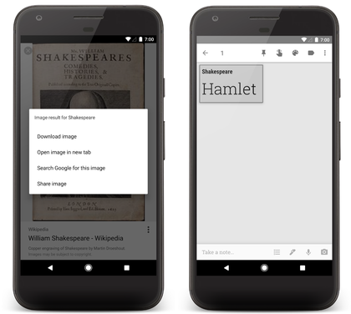
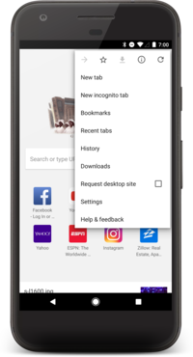
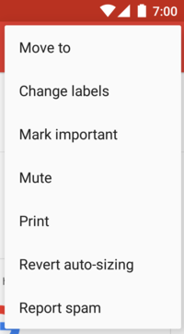
Widgets
Context Menu
Option Menu
Popup Menu

Slide 25
Intents
An Intent is a messaging object you can use to request an action from another app component.
Use the intents to:
Start an activity
Start a service
Deliver a broadcast

Slide 26
Intent Types
Explicit Intent
Explicit intents specify which application will satisfy the intent, by supplying either the target app's package name or a fully-qualified component class name.
You'll typically use an explicit intent to start a component in your own app.
For example, you might start a new activity within your app in response to a user action, or start a service to download a file in the background.
Implicit Intent
Implicit intents allows a component from another app to handle the action.
E.g., if you want to show the user a location on a map, you can use an implicit intent to request that another app show a specified location on a map.
Intent sendIntent = new Intent();
sendIntent.setAction(Intent.ACTION_SEND);
sendIntent.putExtra(Intent.EXTRA_TEXT, textMessage);
sendIntent.setType("text/plain");
// Verify that the intent will resolve to an activity
if (sendIntent.resolveActivity(getPackageManager()) != null) {
startActivity(sendIntent);
}

Slide 27
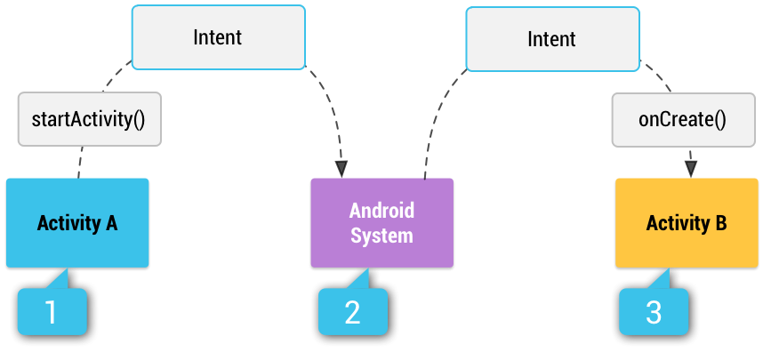
Implicit Intents
Figure above shows how an intent is used when starting an activity.
Activity A creates an Intent with an action description and passes it to startActivity().
The Android System searches all apps for an intent filter that matches the intent. When a match is found,
The system starts the matching activity (Activity B) by invoking its onCreate() method and passing it the Intent.

Slide 28
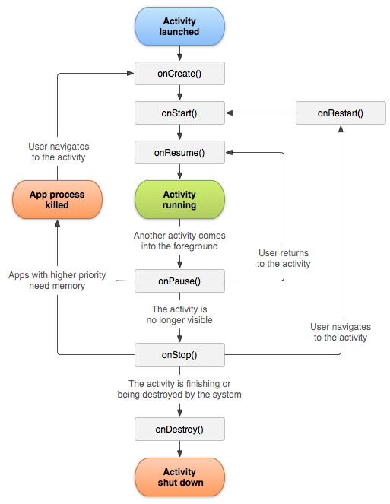
Activity Life Cycle
The activity instances in your app transition through different states in their lifecycle, as a user navigates through your app.
The Activity class provides a number of callbacks that allow the activity to know that a state has changed: that the system is creating, stopping, or resuming an activity, or destroying the process in which the activity resides.
Within the lifecycle callback methods, you can declare how your activity behaves when the user leaves and re-enters the activity.

Slide 29
Activity Life Cycle
E.g., if you're building a streaming video player, you might;
Pause the video and
Terminate the network connection when the user switches to another app.
When the user returns, you can reconnect to the network and
Allow the user to resume the video from the same spot.
Life cycle methods helps you avoid:
Crashing if the user receives a phone call or switches to another app while using your app.
Consuming valuable system resources when the user is not actively using it.
Losing the user's progress if they leave your app and return to it at a later time.
Crashing or losing the user's progress when the screen rotates between landscape and portrait orientation.
For more details: click here

Slide 30
Activity Life Cycle - Methods
onCreate()
You must implement this method, which fires when the system first creates the activity.
On activity creation, the activity enters the Created state.
In the onCreate() method, you perform basic application startup logic that should happen only once for the entire life of the activity.
onStart()
When the activity enters the Started state, the system invokes this method.
The onStart() call makes the activity visible to the user, as the app prepares for the activity to enter the foreground and become interactive.
E.g., this method is where the app initializes the code that maintains the UI.

Slide 31
Activity Life Cycle - Methods
onResume()
When the activity enters the Resumed state, it comes to the foreground, and then the system invokes the onResume() method.
This is the state in which the app interacts with the user.
The app stays in this state until something happens to take focus away from the app.
Such an event might be, for instance, receiving a phone call, the user’s navigating to another activity, or the device screen’s turning off.
onPause()
The system calls this method as the first indication that the user is leaving your activity; it indicates that the activity is no longer in the foreground.
Use the onPause() method to pause or adjust operations that should not continue while the Activity is in the Paused state, and that you expect to resume shortly.

Slide 32
Activity Life Cycle - Methods
onStop()
When your activity is no longer visible to the user, it has entered the Stopped state, and the system invokes the onStop() callback.
E.g.,
When a newly launched activity covers the entire screen.
The system may also call onStop() when the activity has finished running, and
It is about to be terminated.
onDestroy()
onDestroy() is called before the activity is destroyed. The system invokes this callback either because:
the activity is finishing (finish() being called on the activity), or
the system is temporarily destroying the activity due to a configuration change (such as device rotation or multi-window mode)

Slide 33
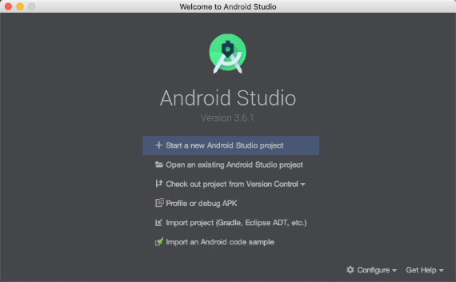
Developing and Executing the first Android Application
In the Welcome to Android Studio window, click Start a new Android Studio project.
If you have a project already opened, select File > New > New Project.
In the Select a Project Template window, select Empty Activity and click Next.

Slide 34
Developing and Executing the first Android Application
In the Configure your project window, complete the following:
Enter "My First App" in the Name field.
Enter "com.example.myfirstapp" in the Package name field.
If you'd like to place the project in a different folder, change its Save location.
Select either Java or Kotlin from the Language drop-down menu.
Select the lowest version of Android your app will support in the Minimum SDK field.
If your app will require legacy library support, mark the Use legacy android.support libraries checkbox.
Leave the other options as they are.
Click Finish.
After some processing time, the Android Studio main window appears.

Slide 35
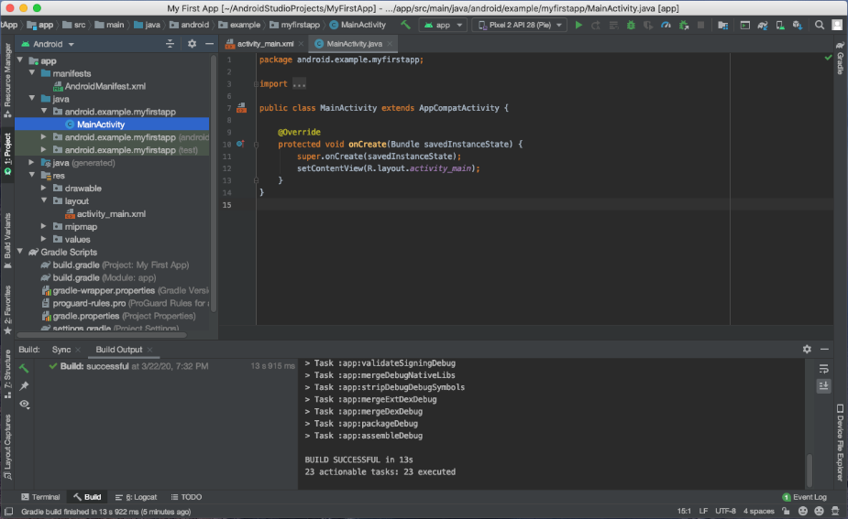
Developing and Executing the first Android Application
Follow the steps given here to create your first app.

Slide 36
References
Developers Guide: https://developer.android.com/guide

Slide 37
Thank You

