Slide 1
SECURE HASH ALGORITHM(SHA)
Name: BHUMIT SHETH
Enrollment Number:170210107056
Branch: C.E.(Sem-7)
Subject: INFORMATION NETWORK & SECURITY(2170709)
College: GOVERNMENT ENGINEERING COLLEGE, BHAVNAGAR
Guided By: Prof. K. P. Kandoriya

Slide 2

Content
Introduction
SHA-1
SHA-2
SHA-512
SHA-3
References

Slide 3
Introduction
The Secure Hash Algorithm(SHA) was developed by the National Institute of Standards and Technology(NIST) and published as a federal information processing standard(FIPS 180) in 1993; a revised version was issued as FIPS 180-1 in 1995 and is generally referred to as SHA-1.
SHA is based on the hash function MD4 and it’s design closely models MD4.
As mentioned earlier, hashing functions are independent of keys and the main focus is to apply hash functions on plain-text to produce fixed length output.
This algorithm is also called “Authentication Algorithm”.
H(M) = h
where M is plain-text, H is hash function , h is hash code(message digest).

Slide 4
SHA-0
Published in 1993.
160 bit message digest size.
It was withdrawn shortly after publication due to an undisclosed "significant flaw" and replaced by the slightly revised version SHA-1.

Slide 5
SHA-1
Published in 1995.
160-bit hash function based on MD-5 algorithm.
designed by the National Security Agency (NSA) to be part of the Digital Signature Algorithm.
In 2005, NIST announced to move to SHA-2 by 2010. shortly thereafter, a research team described an attack in which two separate messages could be found that delivered the same SHA-1 hash using 2⁶⁹ operations, far fewer than the 2⁸⁰ operations previously thought needed to find a collision with a SHA-1 hash.

Slide 6
SHA-2
Published in 2001.
Was wholly accepted by cryptographers in the year 2011.
A family of two similar hash functions, with different block sizes, known as SHA-256 and SHA-512.

Slide 7
Comparison of SHA Parameters
 | SHA-1 | SHA-256 | SHA-384 | SHA-512
Message digest size | 160 | 256 | 384 | 512
Message size | <2⁶⁴ | <2⁶⁴ | <2¹²⁸ | <2¹²⁸
Block size | 512 | 512 | 1024 | 1024
Word size | 32 | 32 | 64 | 64
Number of steps | 80 | 64 | 80 | 80
Security | 80 | 128 | 192 | 256
Table 1

Slide 8
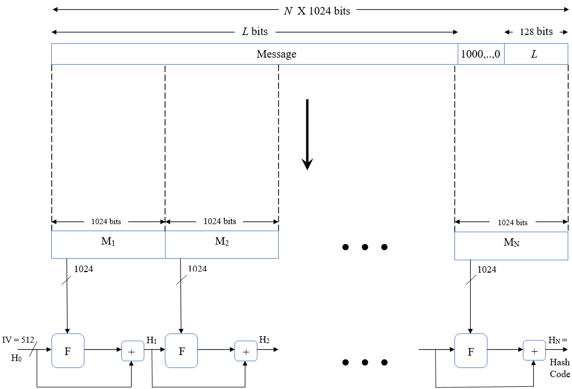
SHA-512 Logic
The algorithm takes an input a message with a maximum length of less than 2¹²⁸ bits and produces an output a 512-bit message digest. The input is processed in 1024 bit blocks. Following figure depicts the overall processing of a message to produce a digest.
Fig 1

Slide 9
Steps involved in process
Step-1 Append padding bits:
The message is padded with single 1 bit followed by the necessary number of 0 bits so that its length is congruent to 896 modulo 1024. Padding is always added, even if the message is already of the desired length.
Step-2 Append length:
A block of 128 bits is appended to the message.This block is treated as an unsigned 128-bit integer(most significant byte first) and contains the length of the original message(before padding).
The outcome of the first two steps yields a message that is an integer multiple of 1024 bits in length.

Slide 10
Step-3 Initialize hash buffers:
There are 8 buffers(a, b, c, d, e, f, g, h) used each of size 64 bits. The 8 buffers are initialized in hexadecimal format.
Table 2
Step-4 Process message in 1024 bit blocks:
The heart of algorithm is a module that consists of 80 rounds.
Each round takes as input the 512-bit buffer value, abcdefgh and updates the contents of the buffer. At input to first round, the buffer has the value of the intermediate hash value.
Each round t makes use of a 64 bit value W_{t} derived using a message schedule from current 1024-bit block being processed.
Each round also makes use of an additive constant K_{t} , based on the fractional parts of cube roots of first 80 prime numbers.
a = 6A09E667F3BCC908 | b = BB67AE8584CAA73B
c = 3C6EF372FE94F82B | d = A5FF53A5F1D36F1
e = 510E527FADE682D1 | f = 9B05688C2B3E6C1F
g = 1F83D9ABFB41BD6B | h = 5BE0CD19137E2179

Slide 11
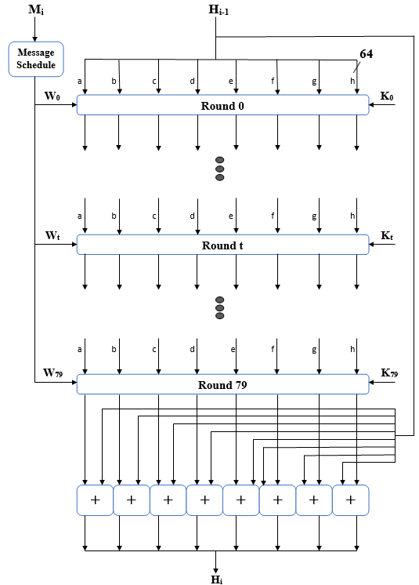
The output of 80th round is added to input to first round to produce the final hash value for this message block, which forms the input to the next iteration of this compression function.
Fig 2

Slide 12
Step-5 Output:
After all N 1024-bit blocks have been processed, the output from the N^{th} stage is the 512-bit message digest.
Hence, we can summarize the behavior of SHA-512 as follows:
H₀ = IV
H_{i} = SUM₆₄(H_{i-1} , abcdefgh_{i})
MD = H_{N}
Where,
IV = initial value of abcdefgh buffer, defined in step3
abcdefgh_{i} = output of last round of processing of the i^{th} message block.
N = number of blocks in message(including padding and length fields)
SUM₆₄ = Addition modulo 2⁶⁴ performed separately on each word of the pair of inputs.
MD = final message digest value.

Slide 13
SHA-512 Constants
42a2f98d728ae22 3956c25bf348b538 d807aa98a3030242 72be5d74f27b896f e49b69c19ef14ad2 2de92c6f592b0275 983e5152ee66dfab c6e00bf33da88fc2 27b70a8546d22ffc 650a73548baf63de a2bfe8a14cf10364 d192e819d6ef5218 19a4c116b8d2d0c8 391c0cb3c5c95a63 748f82ee5defb2fc 90befffa23631e28 ca273eceea26619c 06f067aa72176fba 28db77f523047d84 4cc5d4becb3e42b6 | 7137449123ef65cd 59f111f1b605d019 12835b0145706fbe 80deb1fe3b1696b1 efbe4786384f25e3 4a7484aa6ea6e483 a831c66d2db43210 d5a79147930aa725 2e1b21385c26c926 766a0abb3c77b2a8 a81a664bbc423001 d69906245565a910 1e376c085141ab53 4ed8aa4ae341ab53 78a5636f43172f60 a4506cebde82bde9 d186b8c721c0c207 0a637dc5a2c898a6 32caab7b40c72493 597f299cfc657e2a | b5c0fbcfec4d3b2f 923f82a4af194f9b 243185be4ee4b28c 9bdc06a725c71235 0fc19dc68b8cd5b5 5cb0a9dcbd41fbd4 b00327c898fb213f 06ca6351e003826f 4d2c6dfc5ac42aed 81c2c92e47edaee6 c24b8b70d0f89791 f40e35855771202a 2748774cdf8eeb99 5b9cca4f7763e373 84c87814a1f0ab72 bef9a3f7b2c67915 eada7dd6cde0eb1e 113f9804bef90dae 3c9ebe0a15c9bebc 5fcb6fab3ad6faec | e9b5dba58189dbbc ab1c5ed5da6d8118 550c7dc3d5ffb4e2 c19bf174cf692694 240ca1cc77ac9c65 76f988da831153b5 bf597fc7beef0ee4 142929670a0e6e70 53380d139d95b3df 92722c851482353b c76c51a30654be30 106aa07032bbd1b8 34b0bcb5e19b48a8 682e6ff3d6b2b8a3 8cc702081a6439ec c67178f2e372532b f57d4f7fee6ed178 1b710b35131c471b 431d67c49c100d4c 6c44198c4a475817

Slide 14
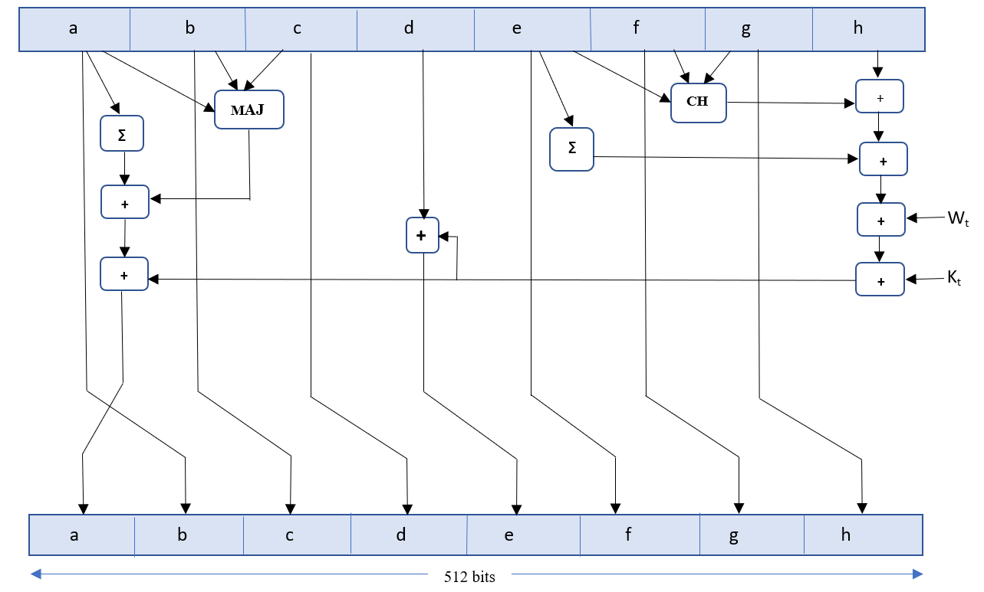
SHA-512 Round Function
Fig 3

Slide 15
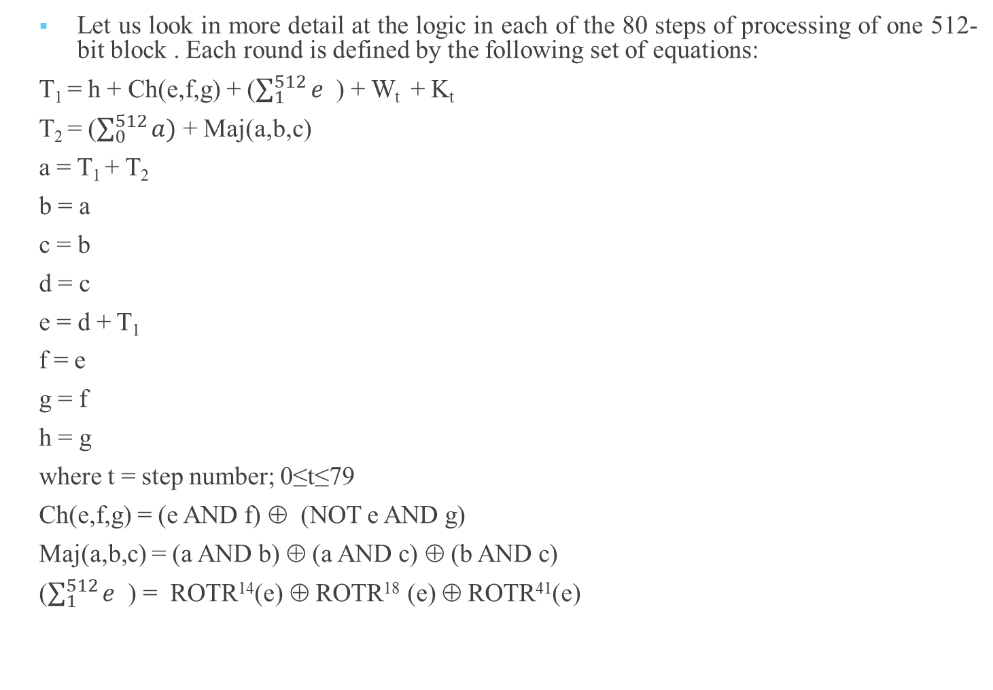
Let us look in more detail at the logic in each of the 80 steps of processing of one 512-bit block . Each round is defined by the following set of equations:
T₁ = h + Ch(e,f,g) + ($\sum_{1}^{512}{e}$ ) + W_{t} + K_{t}
T₂ = ($\sum_{0}^{512}{a)}$ + Maj(a,b,c)
a = T₁ + T₂
b = a
c = b
d = c
e = d + T₁
f = e
g = f
h = g
where t = step number; 0≤t≤79
Ch(e,f,g) = (e AND f) ⊕ (NOT e AND g)
Maj(a,b,c) = (a AND b) ⊕ (a AND c) ⊕ (b AND c)
($\sum_{1}^{512}{e}$ ) = ROTR¹⁴(e) ⊕ ROTR¹⁸ (e) ⊕ ROTR⁴¹(e)

Slide 16
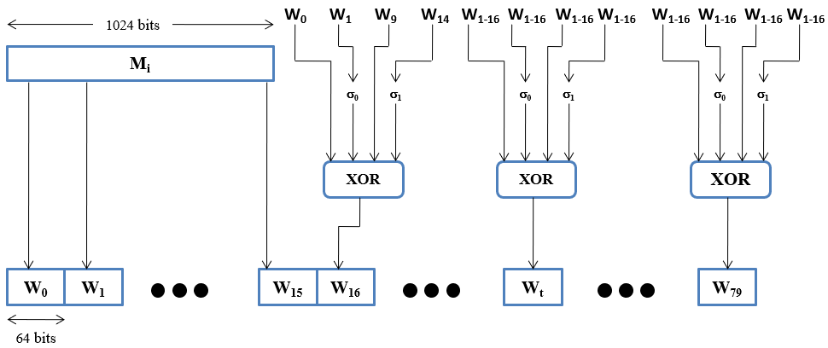
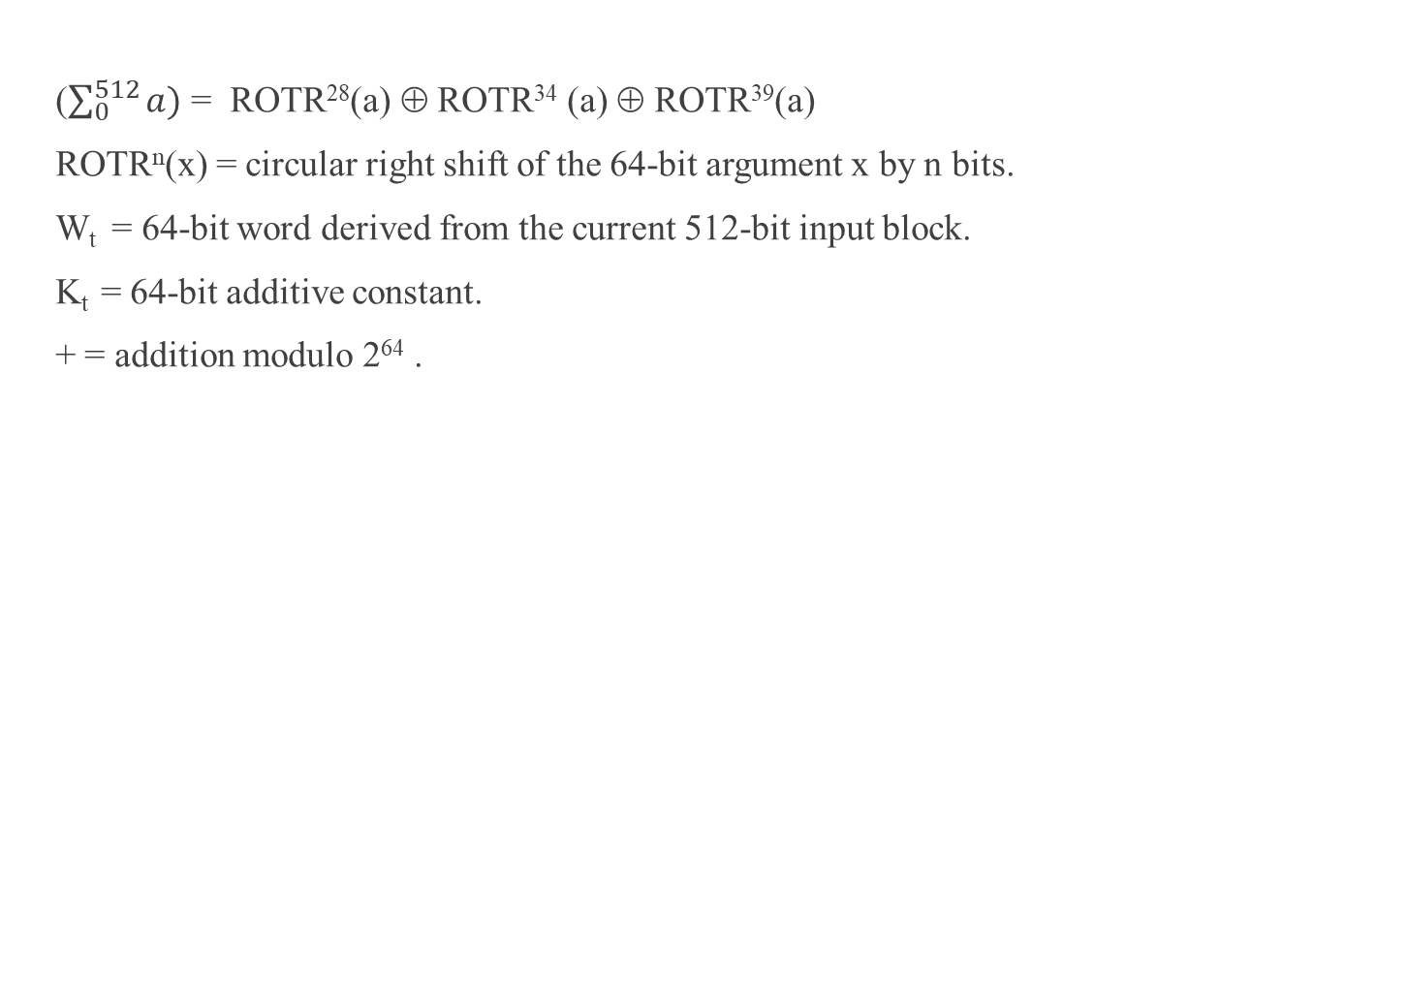
($\sum_{0}^{512}{a)}$ = ROTR²⁸(a) ⊕ ROTR³⁴ (a) ⊕ ROTR³⁹(a)
ROTR^{n}(x) = circular right shift of the 64-bit argument x by n bits.
W_{t} = 64-bit word derived from the current 512-bit input block.
K_{t} = 64-bit additive constant.
+ = addition modulo 2⁶⁴ .
Figure 4

Slide 17
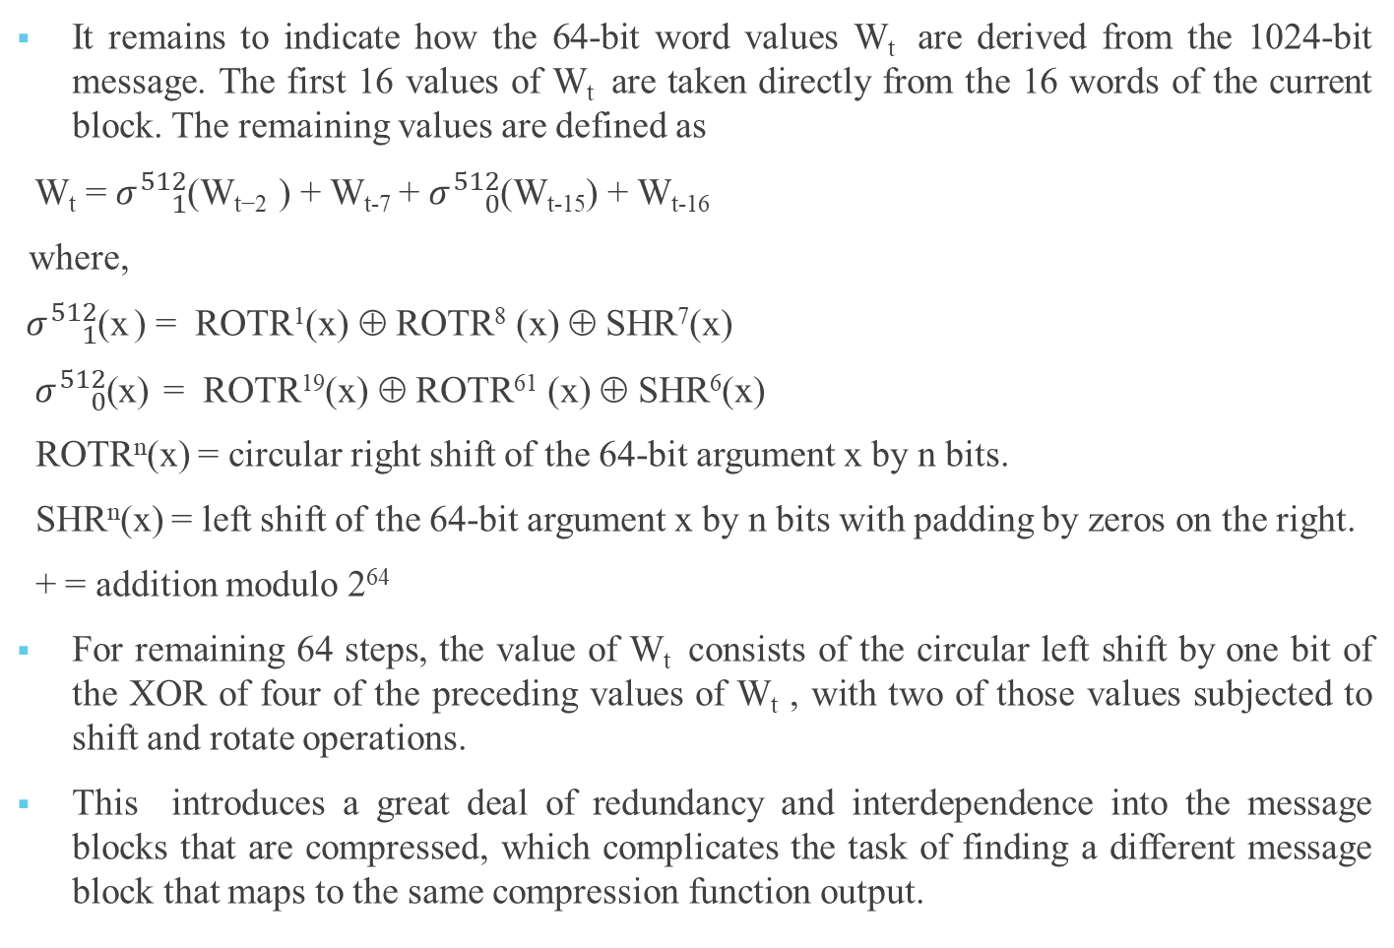
It remains to indicate how the 64-bit word values W_{t} are derived from the 1024-bit message. The first 16 values of W_{t} are taken directly from the 16 words of the current block. The remaining values are defined as
W_{t} = $σ{}_{1}^{512}{\text{(}\text{W}\text{t}\text{−2 }}$) + W_{t-7} + $σ{}_{0}^{512}{\text{(}\text{Wt}\text{−15) }}$+ W_{t-16}
where,
$σ{}_{1}^{512}{\text{(}\text{x} }$) = ROTR¹(x) ⊕ ROTR⁸ (x) ⊕ SHR⁷(x)
$σ{}_{0}^{512}{\text{(}\text{x}\text{) }}$ = ROTR¹⁹(x) ⊕ ROTR⁶¹ (x) ⊕ SHR⁶(x)
ROTR^{n}(x) = circular right shift of the 64-bit argument x by n bits.
SHR^{n}(x) = left shift of the 64-bit argument x by n bits with padding by zeros on the right.
+ = addition modulo 2⁶⁴
For remaining 64 steps, the value of W_{t} consists of the circular left shift by one bit of the XOR of four of the preceding values of W_{t} , with two of those values subjected to shift and rotate operations.
This introduces a great deal of redundancy and interdependence into the message blocks that are compressed, which complicates the task of finding a different message block that maps to the same compression function output.

Slide 18
SHA-3
Published in 2007.
Basic requirements are:
(1)It must be possible to replace SHA-2 with SHA-3 in any application by a simple drop-in substitution.
(2)SHA-3 must preserve the online nature of SHA-2. That is, the algorithm must process comparatively small blocks at a time instead of requiring that the entire message be buffered in memory before processing it.

Slide 19
References
W. Stallings, CRYPTOGRAPHY AND NETWORK SECURITY PRINCIPLES AND PRACTICE, Prentice Hall.[1]

Slide 20


