Slide 1




INDUSTRIAL SMART SAFETY HELMET USING IIOT
Presentation By,
ARJUN V
HARISH KUMAR S
KAVYA SRI R D
SAMHITA M
SHREE VARSHA R K
  SRIDHARSHINI K

Slide 2


Problem Statement
THE SAFETY CHALLENGE
Industrial environments like factories, mines, and construction sites are highly prone to critical accidents and severe health risks. Currently, operations suffer from a lack of real-time monitoring, leading to unmitigated worker falls, dangerous exposure to harmful gases, and unaddressed heat stress or fatigue. Because these hazards go unnoticed, emergency response is frequently delayed, escalating minor incidents into severe workplace tragedies.

Slide 3
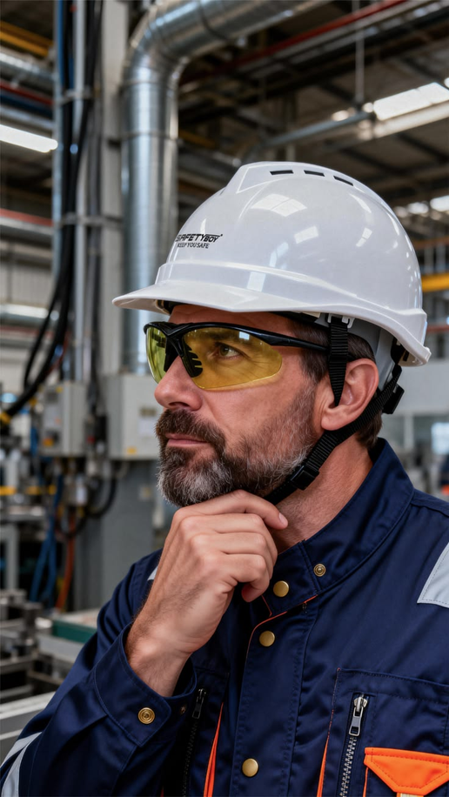
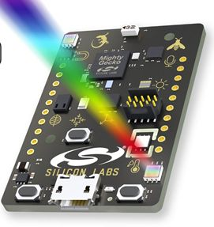

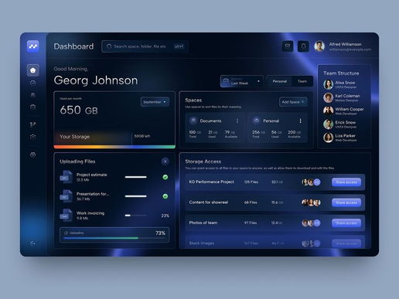
SYSTEM ARCHITECTURE
Architecture
Worker
SiWx917
  Cloud
  Dashboard
Equipped with Wearable Node
Local Processing & Analysis
Real-time Dashboard Upload
Supervisor Emergency Notify

Slide 4
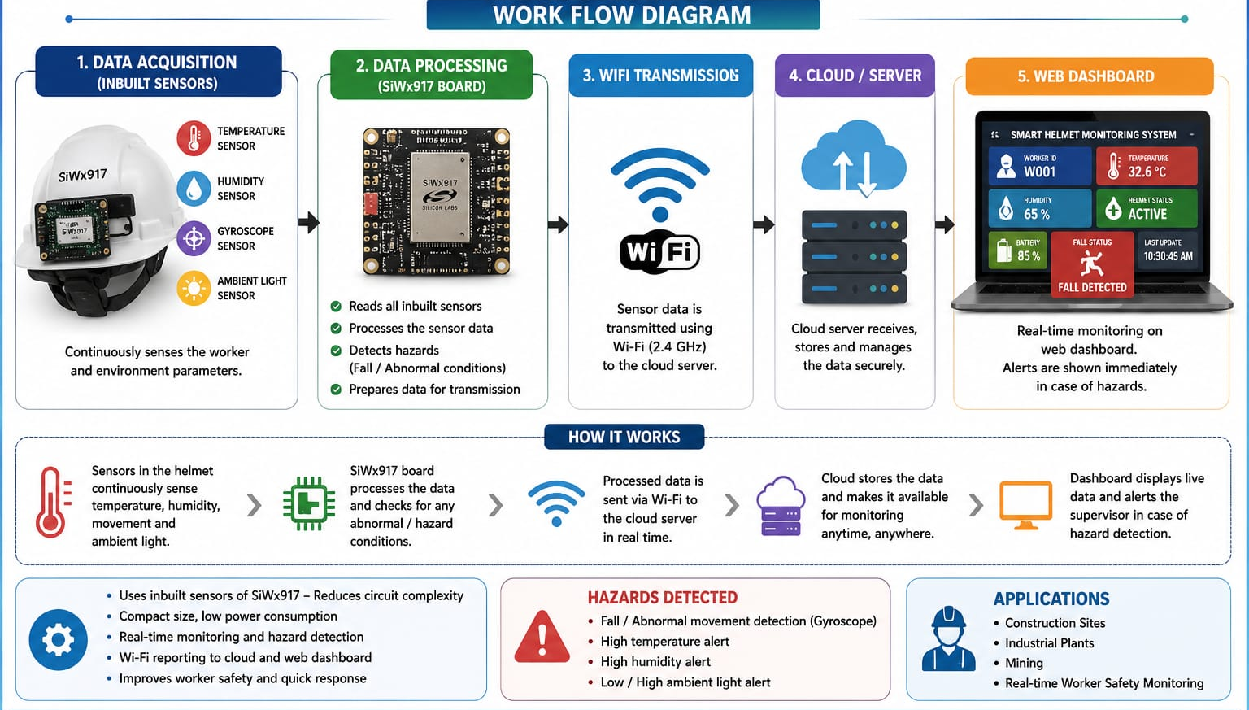
Work Flow Diagram

Slide 5
Firmware Structure
THE FIRMWARE
/1
/2
  THE FIRMWARE.
  Core Logic Functions
The firmware is designed around a lean, ultra-low-latency execution cycle optimized for real-time edge analytics. The processing pipeline manages four asynchronous operational mandates:
  Read Sensor Data: Constantly polls vital metrics and ambient environmental parameters.
  Analyze Safety Conditions: Parses data instantly against configured emergency thresholds.
  Generate Alerts: Spits out low-latency interrupt notifications upon anomaly detection.
  Upload Cloud Data: Pushes secure telemetry frames over wireless channels to the web terminal.
The system's core execution architecture is built natively inside the Simplicity Studio IDE, leveraging the official SiWx917 SDK. The software framework follows a modular structural layout:
  main.c – Main execution loop control
  sensors.c – Dynamic sensor polling & drivers
  wifi.c – Wi-Fi 6 wireless connectivity layer
  alert_system.c – Edge-level hazard logic
  cloud_upload.c – Dashboard synchronization

Slide 6
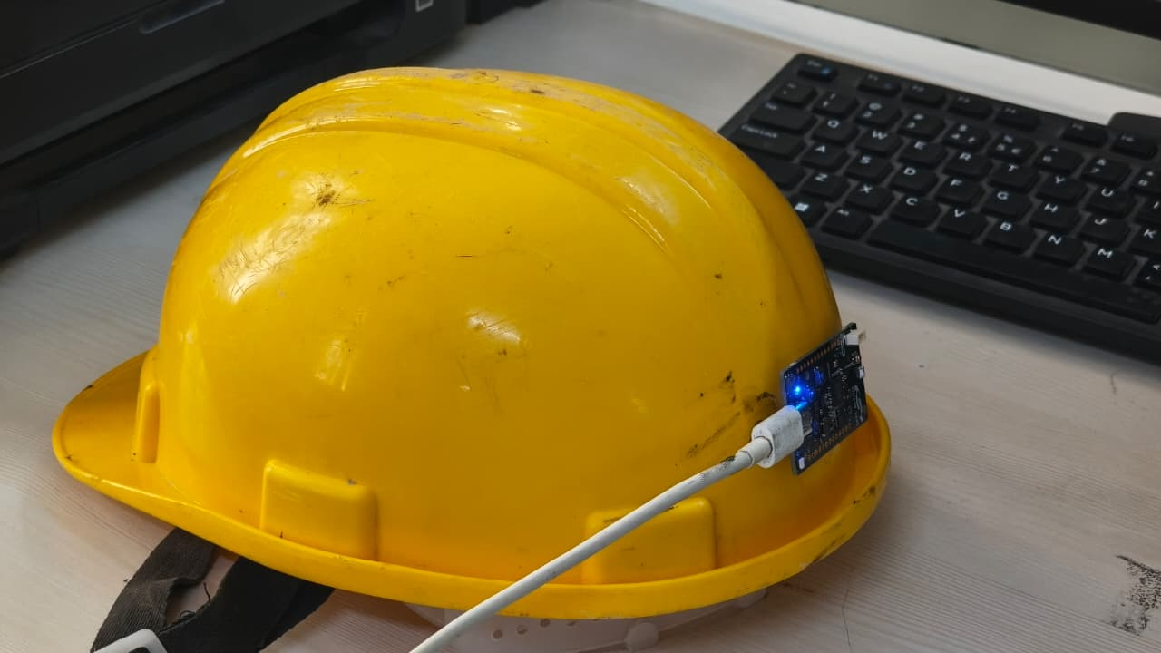
Alert Conditions
ALERT SYSTEM
The emergency alert system instantly detects hazards such as worker falls, abnormal temperature, or SOS activations. Alerts are immediately sent through supervisor dashboards. Mobile notifications, and SMS backup channels, ensuring rapid response and improved worker safety as future scope.

Slide 7
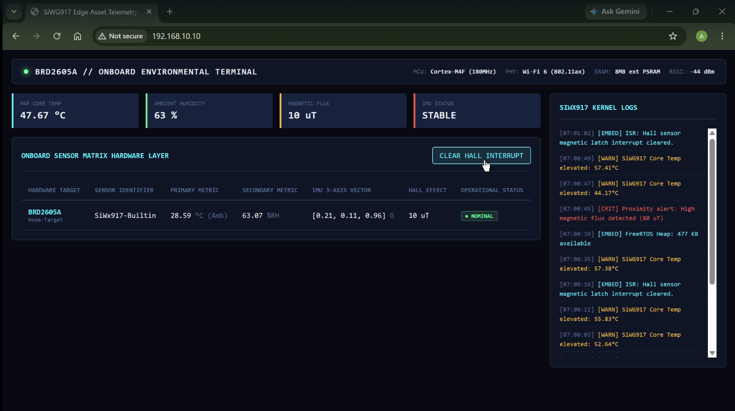
Sensor Data Processing
DATA COLLECTION &
SAFETY DETECTION
The continuous edge processing loop reads local environmental temperature and worker motion metrics to analyze real-time safety status. Telemetry is uploaded directly to the cloud dashboard while checking critical safety boundaries. The system flags fall detection by identifying sudden acceleration, tracks hazardous gas spikes, and generates an immediate supervisor alert when operational temperatures exceed safe thermal thresholds.

Slide 8

PROJECT VERIFICATION
Testing Plan
  /1
  /2
  /3
  Testing Plan
  Validation Matrix
  FINAL DELIVERABLES
Critical hazard thresholds are strictly verified. Fall detection is calibrated via controlled drops, gas detection is tuned using active sensor evaluation, heat thresholds are validated in high-temperature environments, and manual SOS protocols are tested for low-latency alerts.
Program validation is split into three distinct phases: initial hardware-level Sensor Testing, isolated Wi-Fi Communication Testing to secure data links, and rigorous Real Scenario Testing to check hardware ruggedness in actual deployment spaces.
The complete open-source package contains the Smart Safety Helmet Prototype hardware, the modular Embedded Firmware, the central web-connected Cloud Dashboard, the real-time automated Alert System, and thorough project documentation.

Slide 9
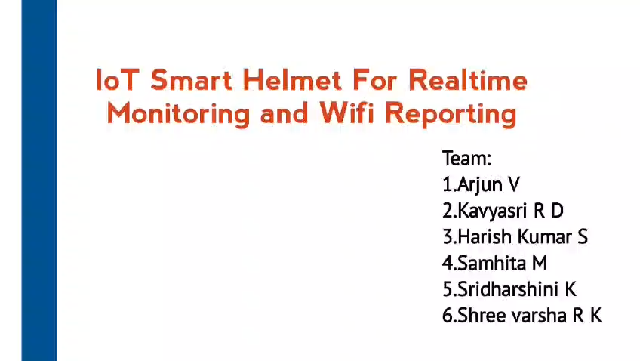
VIDEO PRESENTATION
Video
2026

Slide 10
CONCLUSION
The Industrial Smart Safety Helmet stands as a robust, IIoT-based safety solution engineered to safeguard workforce personnel in high-risk zones through continuous, automated environmental monitoring and immediate edge-level alert generation. By successfully achieving real-time health tracking, localized fall detection, toxic gas monitoring, and heat stress sensing, the wearable node maintains a critical lifeline with the central cloud platform to guarantee supervisor oversight during site anomalies. Moving forward, the future scope of this infrastructure will focus on expanding operational capabilities by integrating active GPS worker tracking, AI-powered predictive hazard analytics, advanced industrial data insights, and dedicated mobile application ecosystems.
IIoT Safety
2026
Silicon Labs SiWx917

Slide 11
THANK YOU
  Presented By

