Slide 1
FI
FIR Intelligence
& Crime Pattern Detector
Turning 3 crore unread FIRs into cross-district intelligence
EVENT
TRACK
PROBLEM
TEAM LEAD
IBM Bob AI Hackathon · NFSU
4 — AI & Predictive Analytics
Statement 10
Arjya Ghosh
Notes:
Opening. This is a working system, not a mock-up — everything in this deck comes from a live run over a 100-FIR corpus. The core claim: CCTNS already holds the data that would connect cases across districts; nothing reads it.

Slide 2
THE PROBLEM
Three crore FIRs. No layer that reads them.
3 crore+
0
Manual
Digitised FIRs in CCTNS
Automated NLP layer over them
How pattern analysis is done today
What that costs
The gap in one line
1
An FIR is a police record, not a searchable one.
The connection between two cases
already exists in the text.
No system reads the text.
Each is free-text prose. Nothing extracts who, where or how.
2
Every station investigates alone.
The same offender under two spellings in two districts is two strangers.
3
Serial offenders are found late, or by accident.
The Jamtara cyber-fraud network ran for years across state lines.
This project builds that reader.
FIR Intelligence & Crime Pattern Detector
2
Notes:
Frame the gap precisely: it is not a data-collection problem, it is a reading problem. UP Police already hold the records. The Jamtara example is the one the judges will recognise.

Slide 3
THE SOLUTION
Six things it does to every FIR it receives
1
Classify
2
Extract
3
Resolve identity
Sorts each FIR into one of 15 offence types — LLM first, keyword classifier as a guaranteed floor.
Pulls accused, victims, ages, parentage, addresses, IPC sections, weapons and modus operandi out of the prose.
Decides when "Bablu" in one district and "Bhura" in another are the same person — and when they are not.
4
Detect networks
5
Brief
6
Control access
Clusters a weighted co-offending graph into organised groups instead of loose name chains.
Writes a live intelligence report for the question the officer actually asked, grounded in the analysis.
Five roles, eight permissions, and identities redacted server-side for the roles that should not see them.
FIR Intelligence & Crime Pattern Detector
3
Notes:
Steps 1 and 2 are standard NLP. Steps 3 and 4 are where the real engineering is, and where a naive implementation quietly produces nonsense — that is the next two slides.

Slide 4
ARCHITECTURE
Four layers, one direction of trust
Presentation
Zero-build React dashboard (static/) — vendored, works offline
Floating AI assistant · role-filtered navigation · login
MCP server — IBM Bob CLI calls the same 8 tools
API & access control
FastAPI · 26 endpoints · SSE streaming for chat and reports
auth.py — 5 roles, 8 permissions, PBKDF2, HMAC session cookies
Server-side PII redaction before the response is built
Intelligence engine
nlp_engine — orchestrates the pipeline with bounded concurrency
entity_extractor — regex NER tuned to Indian FIR conventions
pattern_detector — union-find identity, capped graph clustering
intel_qa — deterministic answers and report construction
Models & storage
llm_client — Z.ai GLM (OpenAI-compatible) · watsonx.ai secondary
database.py — MongoDB when reachable, in-memory fallback otherwise
ncrb_seed — NCRB-distribution corpus generator
Every layer degrades instead of failing: no MongoDB → in-memory · no LLM key → computed answers · no CDN → vendored assets.
FIR Intelligence & Crime Pattern Detector
4
Notes:
The point to land: dependencies are optional, not assumed. The service starts and does useful work with no database, no API key and no internet — which matters for a police network.

Slide 5
PROCESSING FLOW
From raw FIR text to an actionable briefing
Ingest
Classify
Extract
Resolve
Cluster
Serve
Seeded corpus or
uploaded JSON batch
Crime type
(LLM → keyword floor)
Accused, victims, IPC,
location, weapons, MO
Union-find identity
across all FIRs
Weighted co-offending
graph → networks
Dashboard · assistant ·
live intel report
▶
▶
▶
▶
▶
CRIME TYPE
NAME MATCH
ANSWER
AI configured?
Exact full name?
LLM reachable?
Yes → model classifies
Yes → merge identity
Yes → grounded, streamed prose
No → 14-rule keyword classifier
Fuzzy ≥ 82% → merge only if corroborated
No → computed answer, labelled as such
FIR Intelligence & Crime Pattern Detector
5
Notes:
Walk the top row left to right, then explain that each decision below has a defined fallback. Nothing in the pipeline has a single point of failure that stops the officer getting an answer.

Slide 6
THE HARD PART
When are two names the same person?
Naive approach
What we built
Match names and aliases, merge anything similar.
Union-find over mentions, not over names.
86
of 100 FIRs collapsed into ONE fictitious offender.
Nicknames like "Chhotu" are shared by thousands of unrelated people.
An alias can corroborate a match — never create one
Exact full name merges; a bare first name does not
Fuzzy ≥ 82% needs a shared father, station or district
Links are transitive: A–B and B–C puts A, B and C together
Why the strict rule, and not the generous one
In policing, a false link is worse than a missed one. A wrongly merged identity puts an innocent person on an intelligence brief as a serial offender. So an approximate name match is only ever a candidate — it needs independent evidence before two records become one person.
28
repeat offenders
13
cross-district
82%
match threshold
credible, not chained
the hardest to spot manually
plus corroboration required
FIR Intelligence & Crime Pattern Detector
6
Notes:
This is the slide to spend time on. The 86-of-100 number is a real measurement from our own first implementation — we caught it, diagnosed it as alias chaining, and rebuilt the resolver. Judges respond to a team that found its own bug.

Slide 7
NETWORK DETECTION
Clusters, not chains
A shared offender links two FIRs. Following those links blindly linked 96 of 100 records into a single "network" that meant nothing. Networks are now grown from the strongest edges first and capped, so a common offence pattern cannot absorb unrelated cases.
EDGE WEIGHTS
Shared offender identity
6
Shared modus operandi
3
Same district
+2
Same offence type
+1
Edge accepted at
≥ 5
All five gangs seeded into the corpus are recovered by name, from the text alone — no gang list is hard-coded into the detector.
FIR Intelligence & Crime Pattern Detector
7
Notes:
Emphasise the last line: the detector is structural. The gang names are recovered because the FIR text contains them, not because we shipped a lookup table of known gangs.

Slide 8
THE AI LAYER
Grounded, streamed, and honest when it fails
1
Z.ai GLM
2
IBM watsonx.ai
3
Computed analysis
▶
▶
Primary. OpenAI-compatible endpoint, streamed token by token.
Secondary, and the crime classifier when configured.
Always available. Derived from the corpus, never invented.
How a question is answered
Why grounding, not
free generation
1
The detection pipeline computes the answer first
from the analysed corpus
2
That answer is handed to the model as authoritative context
A hallucinated offender in a police briefing is worse than no briefing at all.
Every finding is labelled as an automated correlation requiring verification by the investigating officer.
together with a corpus digest
3
The system prompt forbids inventing any FIR number, name or figure
the model writes prose, not findings
4
If the model is unreachable, the computed answer is returned
labelled, so a fallback is never passed off as AI
FIR Intelligence & Crime Pattern Detector
8
Notes:
If asked "how do you stop it hallucinating" — this slide is the answer. The model never sees the raw corpus and is never asked to find anything; it is given findings and asked to write them up.

Slide 9
ACCESS CONTROL
Five roles, eight permissions, real redaction
Viewer
Analyst
Investigator
Supervisor
Admin
Dashboards & analytics
●
●
●
●
●
Redaction is server-side
Without fir:read_pii the API strips names, addresses, parentage and the FIR narrative before the response is built.
FIR records
●
●
●
●
●
Repeat offender profiles
–
●
●
●
●
AI assistant & reports
–
●
●
●
●
Investigator sees
Bablu alias Bhura · Husainabad
Identities & narratives
–
–
●
●
●
Analyst sees
Ingest FIR batches
–
–
–
●
●
Accused #1 · address withheld
Manage accounts
–
–
–
–
●
A test asserts the real name leaks through no field at all.
PBKDF2-HMAC-SHA256
httpOnly session cookies
No shipped signing secret
Lockout + constant time
per-user salt, 240k rounds
HMAC-signed, SameSite=Lax
random per process if unset
5 attempts; no user enumeration
FIR Intelligence & Crime Pattern Detector
9
Notes:
The distinction that matters: an analyst can study crime patterns without being handed every accused person's name and address. That is a policy decision enforced in code, not a UI toggle.

Slide 10
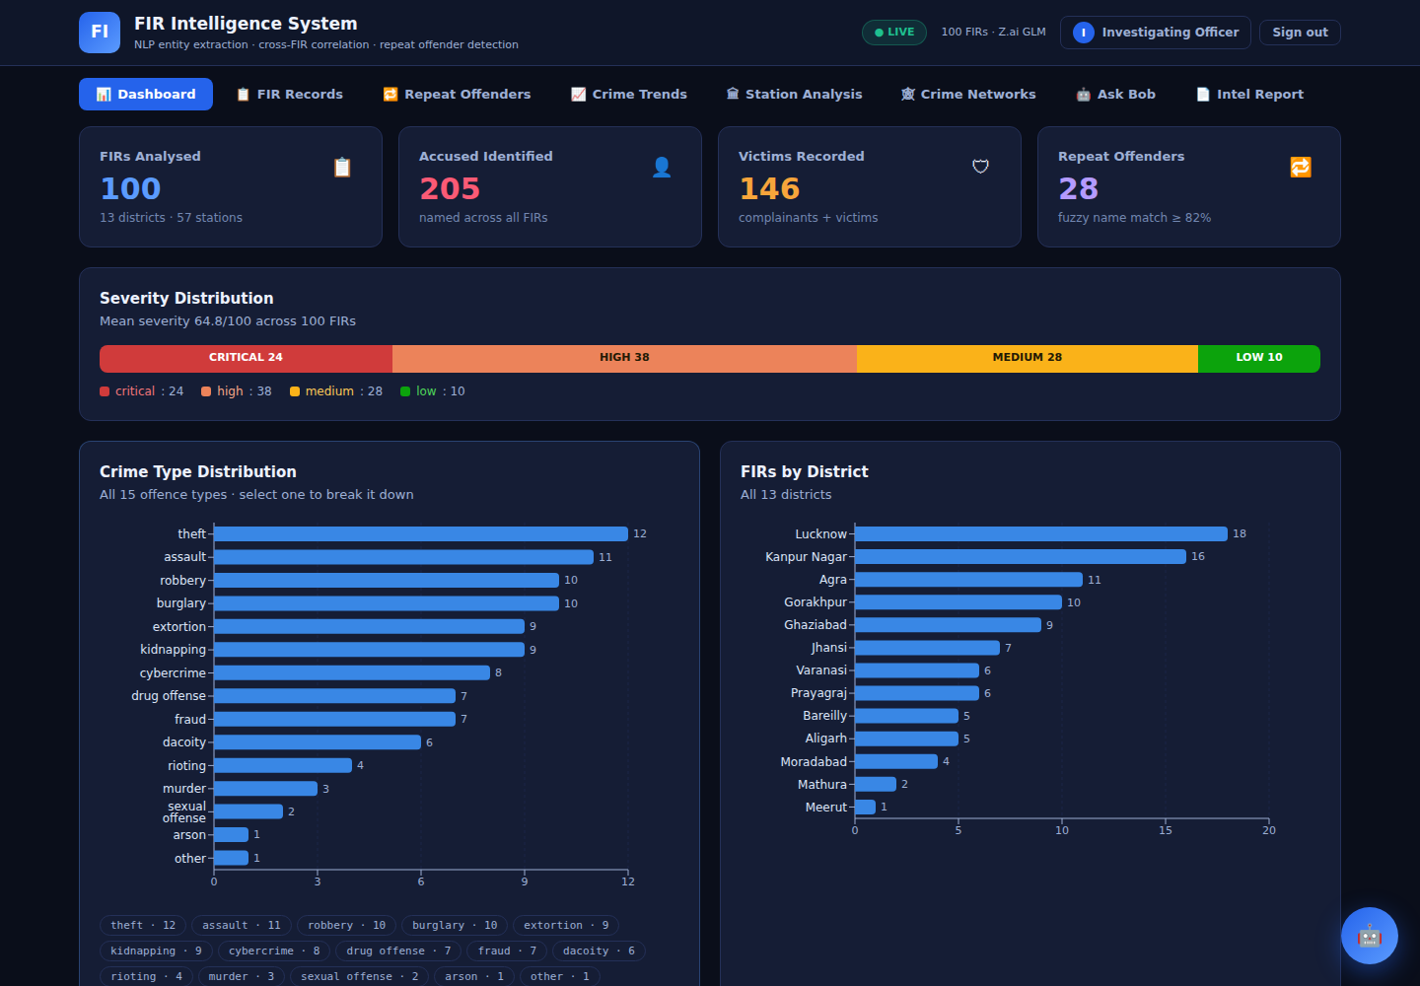
WHERE IT STANDS
A working system, measured
100
28
14
230
FIRs analysed
repeat offenders
networks
tests passing
Verified end to end
13 districts · 57 stations · 205 accused · 146 victims extracted
26 API endpoints, every one covered including its error paths
Full role-permission matrix and PII redaction under test
All 9 dashboard views driven in a real browser, zero console errors
Known limits
Matching is name-based — two people with the same recorded full name will merge. Batch analysis, not live CCTNS streaming. The corpus is generated to NCRB distributions, not real FIR data.
Next: live CCTNS ingestion · geospatial hotspot mapping · Aadhaar-free biometric linkage · officer feedback loop on every link
FIR Intelligence & Crime Pattern Detector
10
Notes:
Close on measurement, not ambition. State the limits before a judge asks — naming the name-collision limit yourself is far stronger than being caught by it. Then offer the live demo.

