Slide 1










Customer Segmentation Project

Slide 2
INTRODUCTION TO MAIN PROJECT
• The main aim of this project is to divide customers into groups according to common characteristics like gender, age, interests, and spending habits so they can market to each group effectively.
• Customer Segmentation is a popular application of unsupervised learning. Using clustering, we can identify segments of customers to target the potential user base.

Slide 3
TOOLS AND LIBRARIES USED
Tools used:-
Anaconda
Spyder 4.1.3
Libraries used:-
1. Matplotlib 3.1.3
2. pandas 1.0.1
3. sklearn 0.22

Slide 4
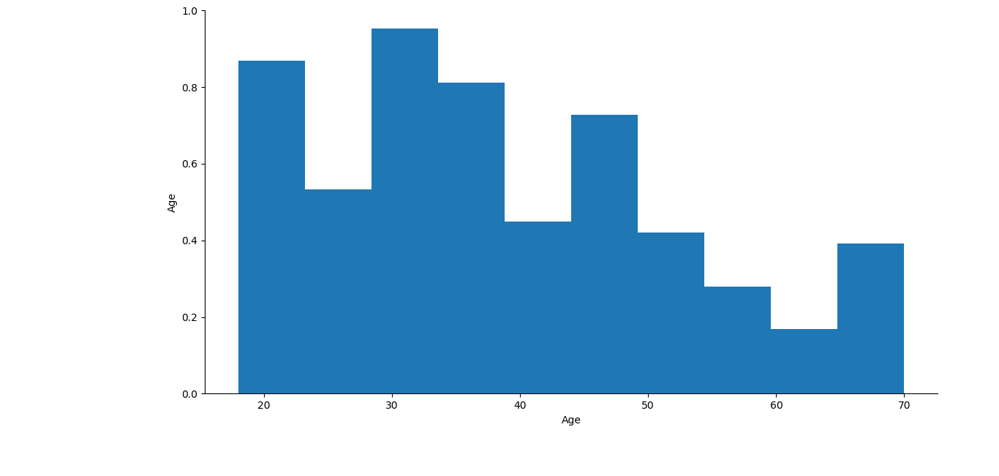
Age-Gender Distribution Graph

Slide 5
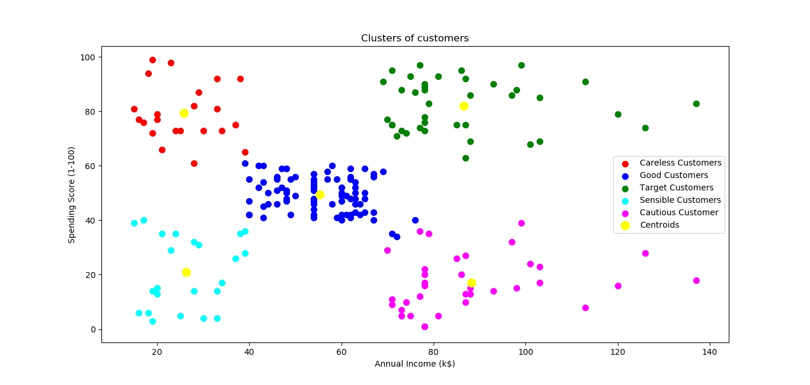
Graph of Customer Segmentation

Slide 6
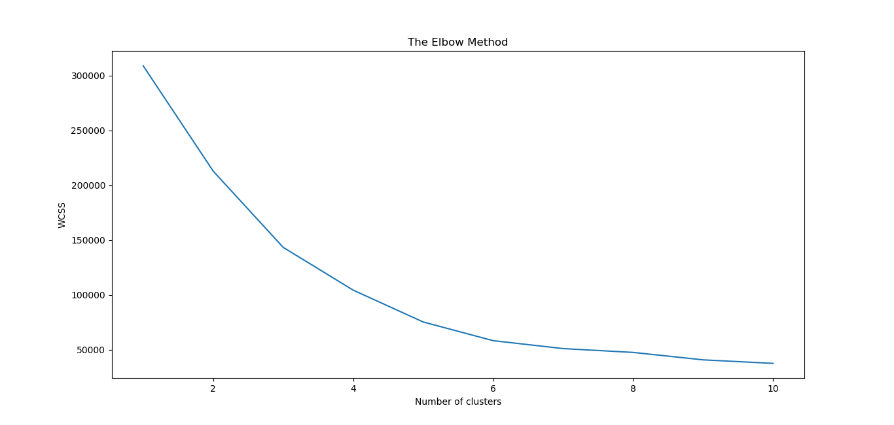
Graph of Elbow Plot

Slide 7
CONCLUSION
• In this project, we clustered the customers into 5 groups with each group having it’s own specialty. The names of the groups are Sensible customers, Good customers, Target customers, Cautious customers and Careless customers respectively. Now the marketing team can easily show the right advertisements to their customers and hence increasing their revenues. This will also become a great recommendation system of products for the customers thus becoming a loyal buyer of products from the company.

Slide 8
CONTACT US:
Website
http://www.exposysdata.com/
Industries
Computer Software
Company size
11-50 employees
Headquarters
Bengaluru, Karnataka
Type
Public Company
Founded
2019
Locations
•Primary
P.M R. Residency Ground Floor
Singanayakanahalli, Yelahanka Bengaluru, Karnataka 560064
Bengaluru, Karnataka 560064, IN

Slide 9
THANK YOU!
• By : ARJYA BASU

