Slide 1
Seasonality-Aware
Customer Segmentation
GROUP MEMBERS
Aditya Vardhan Sharma
Aryan Yadav
Arin Ajay Lale
Hemank Bhardwaj
Dynamic RFM Metrics & Machine Learning
for Holiday Value Migration
Data Analytics & Data Mining · CSC 1144
Dataset: Dunnhumby Retail · 245M transactions · ~500k customers

Slide 2
OBJECTIVE
Research Questions
Track and predict the Value Migration of VIP customers across the Christmas holiday peak using dynamic RFM metrics and machine learning.
RQ1
Segment Stability
RQ2
Retention Prediction
Do RFM-defined segments remain stable, or does the holiday peak force migration into a temporary "Holiday VIP" cluster? Do true VIPs behave differently during November–December?
What features distinguish a long-term VIP from a seasonal surge shopper? Can we accurately predict which VIPs maintain post-holiday status using pre-holiday behavioural signals?

Slide 3
LITERATURE REVIEW
From Static Snapshots to Predictive Models
01
02
03
The Problem
Dynamic Migration
The Shift
Traditional RFM frameworks generate static snapshots. They fail to capture the volatility of seasonal retail behaviour — high-value shoppers during Christmas may be ordinary customers in January.
Customer value is fluid. Modelling cluster transitions — rather than single-period assignments — separates Temporary Spenders from Long-term Assets, enabling proactive intervention.
Moving from observation to predictive analytics by integrating probabilistic retention modelling with temporal features. GMM enables soft cluster membership, reflecting real-world ambiguity.

Slide 4
DATASET
Dunnhumby Retail Dataset
245M
~500k
~5,000
117
Valid Transactions
Distinct Customers
Distinct Products
Weeks of Data
Source & Scope
Merge & Clean
Outlier Capping
Large-scale grocery transaction data from the
Dunnhumby retail dataset, spanning Apr 2006 – Jul 2008.
Millions of valid records across customers and stores.
Transactions joined to temporal data on SHOP_WEEK.
Records filtered: quantity > 0, spend > 0.
Invalid dates coerced then dropped.
Spend and Quantity capped at the 99th percentile
to remove B2B / wholesale noise.
Spend cap: £16.29 · Qty cap: 10 units

Slide 5
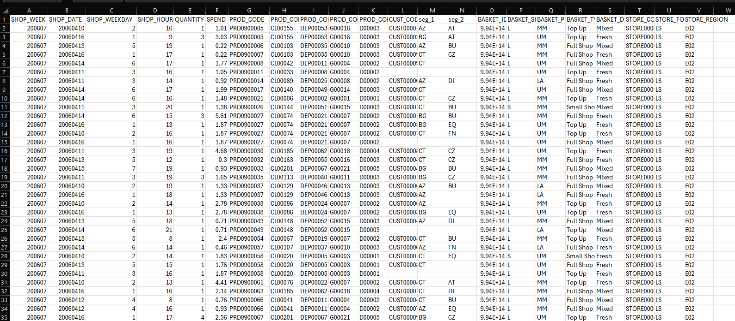
Raw DATA
245M
~500k
~5,000
117
Valid Transactions
Distinct Customers
Distinct Products
Weeks of Data
Source & Scope
Merge & Clean
Outlier Capping
Large-scale grocery transaction data from the
Dunnhumby retail dataset, spanning Apr 2006 – Jul 2008.
Millions of valid records across customers and stores.
Transactions joined to temporal data on SHOP_WEEK.
Records filtered: quantity > 0, spend > 0.
Invalid dates coerced then dropped.
Spend and Quantity capped at the 99th percentile
to remove B2B / wholesale noise.
Spend cap: £16.29 · Qty cap: 10 units

Slide 6
PROJECT ROADMAP
Five Stages from Raw Data to Insight
A
B
C
D
E
Pre-processing
Feature Engineering
Segmentation
Predictive Modelling
Evaluation
Dask-powered loading, merging, cleaning, date parsing for 245M transactions
14 seasonality-aware features: Spend Share, Uplift Ratio, Pre-Loyalty Score
GMM clustering (n=3) to mathematically isolate 80,908 True VIP shoppers
Logistic Regression & XGBoost trained to flag Value-Churned VIPs
Threshold calibration; F1-Score optimised for Churn class (class 0)

Slide 7
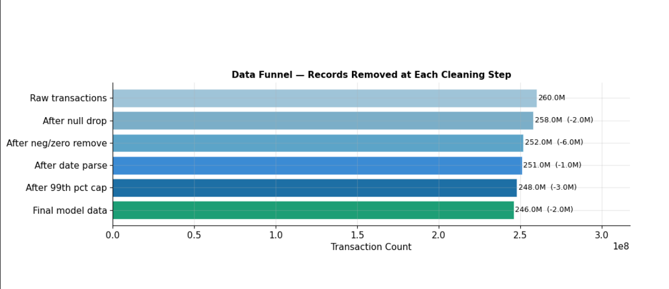
PRE- processing
245M
~500k
~5,000
117
Valid Transactions
Distinct Customers
Distinct Products
Weeks of Data
Source & Scope
Merge & Clean
Outlier Capping
Large-scale grocery transaction data from the
Dunnhumby retail dataset, spanning Apr 2006 – Jul 2008.
Millions of valid records across customers and stores.
Transactions joined to temporal data on SHOP_WEEK.
Records filtered: quantity > 0, spend > 0.
Invalid dates coerced then dropped.
Spend and Quantity capped at the 99th percentile
to remove B2B / wholesale noise.
Spend cap: £16.29 · Qty cap: 10 units

Slide 8
FEATURE ENGINEERING
The 14 Seasonality-Aware Features
Holiday RFM (6 features)
KEY INSIGHT
· Holiday_Recency · Holiday_Frequency · Holiday_Monetary
The "Holiday Spike" Test
· Holiday_ProductDiversity · Avg_Basket_Size
· Holiday_Spend_Velocity (log Dec/Nov ratio)
A customer with Holiday_Spend_Share > 0.7 spent the majority of their annual budget in just two months.
A high Frequency_Ratio but low Pre_Loyalty_Score is the fingerprint of a seasonal-only shopper — not a true VIP.
These cross-window features capture what raw RFM cannot.
Pre-Holiday Loyalty (4 features)
· Pre_Frequency · Pre_Monetary
· Pre_Recency · Pre_Monthly_Rate
· — normalised by actual observation months —
Cross-Window Signals (4 features)
· Holiday_Uplift_Ratio (holiday vs. normal spend rate)
· Holiday_Spend_Share (% of annual spend in Nov–Dec)
· Frequency_Ratio · Pre_Loyalty_Score

Slide 9
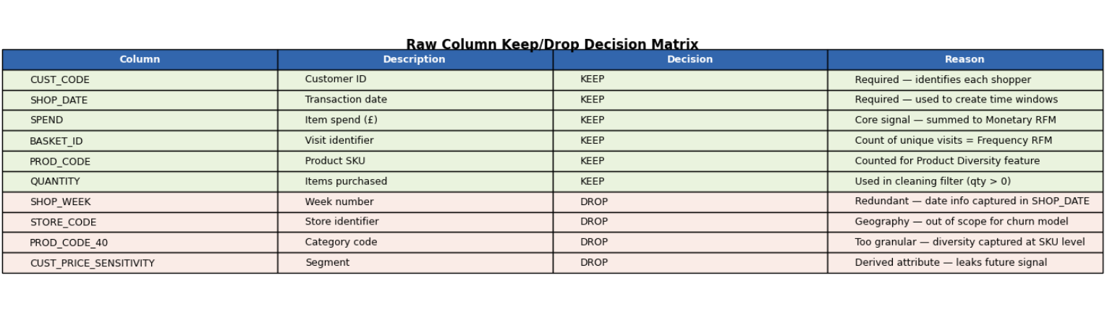
FEATURE ENGINEERING
245M
~500k
~5,000
117
Valid Transactions
Distinct Customers
Distinct Products
Weeks of Data
Source & Scope
Merge & Clean
Outlier Capping
Large-scale grocery transaction data from the
Dunnhumby retail dataset, spanning Apr 2006 – Jul 2008.
Millions of valid records across customers and stores.
Transactions joined to temporal data on SHOP_WEEK.
Records filtered: quantity > 0, spend > 0.
Invalid dates coerced then dropped.
Spend and Quantity capped at the 99th percentile
to remove B2B / wholesale noise.
Spend cap: £16.29 · Qty cap: 10 units

Slide 10
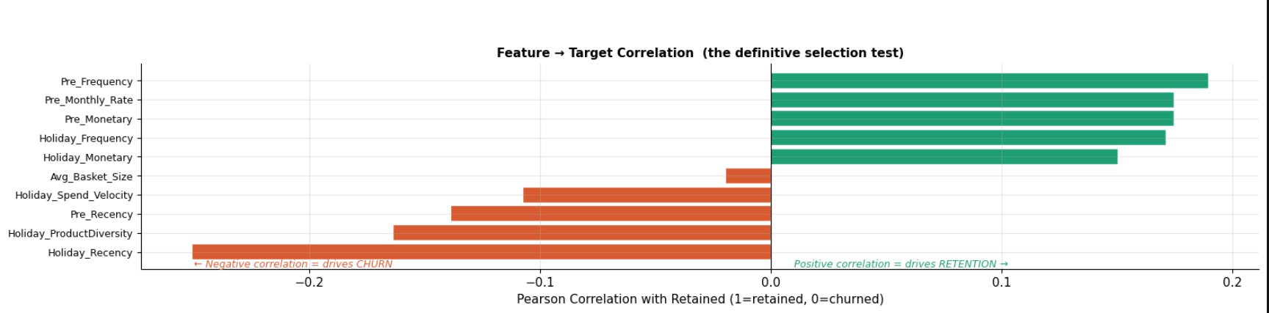
FEATURE ENGINEERING
245M
~500k
~5,000
117
Valid Transactions
Distinct Customers
Distinct Products
Weeks of Data
Source & Scope
Merge & Clean
Outlier Capping
Large-scale grocery transaction data from the
Dunnhumby retail dataset, spanning Apr 2006 – Jul 2008.
Millions of valid records across customers and stores.
Transactions joined to temporal data on SHOP_WEEK.
Records filtered: quantity > 0, spend > 0.
Invalid dates coerced then dropped.
Spend and Quantity capped at the 99th percentile
to remove B2B / wholesale noise.
Spend cap: £16.29 · Qty cap: 10 units

Slide 11
METHODOLOGY
GMM Clustering — Identifying True VIPs
Why GMM over K-Means?
K-Means
GMM ✓
K-Means assumes spherical, equal-size clusters — a poor fit for retail spending data where VIP patterns form elongated, tilted distributions.
GMM uses full covariance matrices to fit elliptical cluster shapes, matching how spending actually clusters in the wild.
✗ Spherical clusters
✓ Elliptical clusters
✗ Hard assignments
✓ Soft probabilities
✗ Equal variance
✓ Full covariance matrix
✗ Brittle on skew
✓ Handles skewed spend
VIP Cluster Result
80,908
£247
19.5
✗ No confidence score
✓ Membership probability
True VIPs identified
Avg holiday spend
Avg holiday visits
BIC/AIC analysis confirmed n=3 as optimal cluster count.

Slide 12
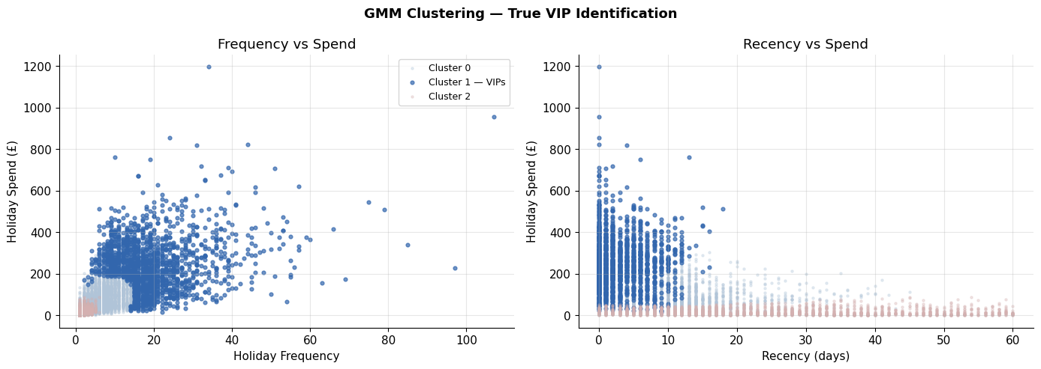
Cluster Visualization
245M
~500k
~5,000
117
Valid Transactions
Distinct Customers
Distinct Products
Weeks of Data
Source & Scope
Merge & Clean
Outlier Capping
Large-scale grocery transaction data from the
Dunnhumby retail dataset, spanning Apr 2006 – Jul 2008.
Millions of valid records across customers and stores.
Transactions joined to temporal data on SHOP_WEEK.
Records filtered: quantity > 0, spend > 0.
Invalid dates coerced then dropped.
Spend and Quantity capped at the 99th percentile
to remove B2B / wholesale noise.
Spend cap: £16.29 · Qty cap: 10 units

Slide 13
METHODOLOGY
Value Churn: The 70% Maintenance Rule
"Hard churn" (0% spend) is extremely rare in grocery retail.
Instead, we measure Value Churn — whether a VIP maintains VIP-level spending post-holiday.
Holiday
Monthly Run-Rate
Minimum
Retention Threshold
Retained (1)
74.5% · 60,259 VIPs
✕ 70%
compare
Holiday_Monetary ÷ 2
Run-Rate × 0.70
(Nov–Dec = 2 months)
Must achieve ≥70%
of holiday monthly spend
Downgraded (0)
25.5% · 20,649 VIPs
Grocery hard-churn is rare — redefining churn as downgrade creates a realistic, naturally imbalanced label that mirrors actual business risk.

Slide 14
MODELLING
Predicting Value Churn
Model 01 — Logistic Regression
Model 02 — XGBoost
Baseline · Interpretable · GridSearchCV
Ensemble · Non-linear · RandomizedSearchCV
ColumnTransformer with log1p on monetary features — fixes right-skew that naive scaling cannot handle
compute_sample_weight('balanced') — directly weights class 0 rows to correct class imbalance
GridSearchCV: 12 combos × 5 folds · L1/L2 tested · C range: 0.001–100
RandomizedSearchCV: 40 combos × 3 folds · gamma, reg_alpha, reg_lambda included
class_weight='balanced' · churn_f1_scorer optimised for class 0
Params searched: max_depth, learning_rate, subsample, colsample_bytree, min_child_weight
Best params: penalty=L2, C=100, solver=liblinear
Same churn_f1_scorer ensures fair head-to-head comparison with LR

Slide 15
EVALUATION & RESULTS
Key Metrics — Churn Class (Class 0)
0.63
0.77
0.54
0.78
Churn Class F1-Score
Churn Recall
Churn Precision
Overall Accuracy
Confusion Matrix (optimal threshold)
Model Head-to-Head (Churn class, class 0)
Predicted: Downgraded
Predicted: Retained
Model
F1
Recall
Precision
Accuracy
Actual: Downgraded
3,924 TP
1,238 FN
Logistic Regression
0.6306
0.7590
0.54
0.77
Actual: Retained
3,426 FP
11,639 TN
XGBoost ★ Winner
0.6344
0.7451
0.55
0.78
The model correctly flags 77 in every 100 VIPs who are about to downgrade — enabling proactive retention before revenue is lost.

Slide 16
KEY FINDINGS
What the Data Revealed
56%
25.5%
Pre-Holiday Behaviour Dominates
Holiday VIP Downgrade Rate
Over 56% of a VIP's churn probability is determined by Pre_Monetary and Pre_Frequency — behavioural signals from September and October. True loyalty cannot be bought in December.
1 in 4 VIPs fail to maintain 70% of their holiday monthly spend in the post-holiday period. 20,649 VIPs are actively bleeding revenue — this is the business problem the model solves.
30,685
High Uplift = High Risk
At-Risk VIPs Flagged
Surge ≠ Loyalty
The final model flags 30,685 VIPs for marketing intervention, with an average holiday spend of £248. These are the customers most likely to downgrade if not engaged in January.
A high Holiday_Spend_Share combined with a low Pre_Loyalty_Score is the clearest fingerprint of a seasonal-only shopper. Holiday spending intensity alone is not a retention predictor.

Slide 17
Thank-You

