Slide 1
ENTERPRISE ERP & VMS ROLLOUT
ERPNext & Vehicle Management System
Implementation Plan & Scope of Work
• Scope of Work: 7 Service Branches & 3 Central Warehouses Network
• Focus: Phase 1 Prototype Deployment at Automan Car Care Center
• Integrated Modules: VMS Operations, POS Cashiering, BIR Reports, Intercompany Hub, Bin Barcoding

Slide 2
EXECUTIVE BRIEFING
Strategic Objectives & Enterprise Value Proposition
Transitioning from fragmented branch silos to a centralized, real-time automotive service & warehouse ecosystem.
01
02
03
04
Unified Multi-Branch Operations
Consolidates 7 branches and 3 warehouses under a single PostgreSQL/Frappe ERP core with standardized pricing, vehicle history, and service catalog.
Real-Time Inventory & Stock Control
Live bin-level tracking, automated intercompany supply chain from Dau/Mexico central warehouses, and mobile barcode put-away & picking.
BIR Reports
Built-in Philippine BIR CAS modules: Sales Journal, Purchases Book, Cash Receipts (CRJ), Cash Disbursement (CDJ), and General Ledger.
Role-Based Branch Security & Analytics
Branch staff are strictly scoped to their assigned company while Executives (CEO, COO, CFO, Auditor) maintain full consolidated performance visibility.

Slide 3
DEPLOYMENT TOPOLOGY
Multi-Entity Network Scope: 7 Branches & 3 Central Warehouses
Hub-and-spoke inventory distribution connecting central fulfillment centers with branch service bays.
📦 3 Central Fulfillment Warehouses (Hubs)
• Ultra MRF Warehouse Dau
Main Central Distribution Hub (Bulk Tires, Parts & Consumables)
• San Fernando Warehouse
Regional Hub for Pampanga South & Bataan Supply
• Ultra MRF Mexico Warehouse
Heavy Storage, Containerized Tires, Rims & Alloy Wheels
🚗 7 Service & Retail Branches (Spokes)
• Automan Car Care Center
⭐ Phase 1 Prototype Center (Full Suite Pilot)
• Ultra MRF Dau Main
High-Volume Service, Mechanical & Tire Center
• Ultra MRF Dau Annex
Express Quick Service, Oil Change & Underchassis
• Ultra MRF San Fernando
Flagship Service Center (Mechanical, Tires, Alignments)
• Wheel Core
Wheels, Mags & Performance Tire Center
• The Wheelhub
Boutique Alignment, Suspension & Wheels Center
• Ultra MRF Telebastagan
Multi-Bay Quick Service & Preventive Maintenance

Slide 4
IMPLEMENTATION ROADMAP
Phased Rollout Strategy: Prototype-First Methodology
De-risking the enterprise deployment by perfecting all workflows in Automan before expanding network-wide.
PHASE 1: PROTOTYPE PILOT
Weeks 1 – 4
PHASE 2: WAREHOUSE HUBS
Weeks 5 – 7
PHASE 3: CLUSTER 1 BRANCHES
Weeks 8 – 10
PHASE 4: CLUSTER 2 & GO-LIVE
Weeks 11 – 12
Target: Automan Car Care Center
Target: 3 Central Warehouses
Target: Dau Main, Dau Annex, SF
Target: Wheel Core, Wheelhub, Tele
• Full pilot of Front Desk & Job Order lifecycle
• Vehicle POS cashiering & receipt printing
• Item catalog & Bin location barcode setup
• BIR Invoicing & Philippine tax validation
• Staff training & operational sign-off
• Dau, San Fernando, Mexico warehouse setup
• Bulk inventory count & bin mapping
• Intercompany automated purchase/sales flow
• Mobile barcode receiving & dispatch
• Deployment to 3 high-volume branches
• Master vehicle registry linking (38k+ units)
• Local branch cashiers & POS profile rollout
• Branch user permission & role isolation
• Final 3 specialty branches onboarding
• Consolidated Executive BI & Analytics launch
• Final BIR CAS audit trail sign-off
• Hypercare support & steady-state handoff

Slide 5
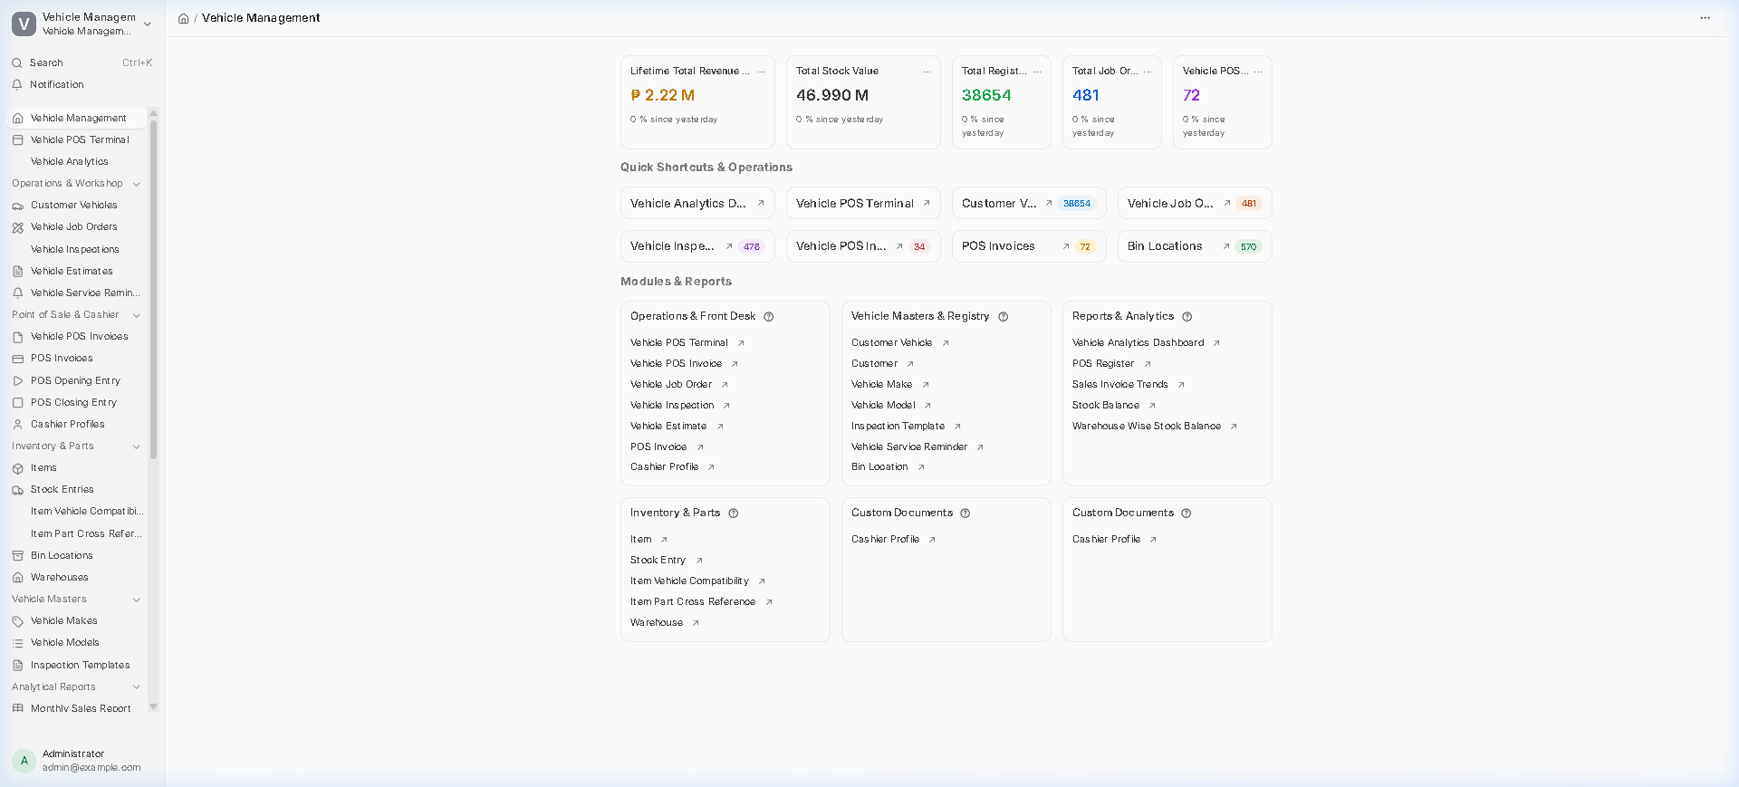
LIVE SYSTEM HIGHLIGHTS
Module 1: Vehicle Management & Operations Control Center
Complete front desk, service bay, and vehicle registry command center running on live VPS.
Operational Capabilities
✔ Registered Vehicles
Complete vehicle master registry with VIN, engine, chassis, and make/model tracking.
✔ Lifetime Revenue
Live tracking of completed service job orders and counter retail transactions.
✔ Stock Valuation
Consolidated inventory valuation across 11 warehouse and branch entities.
✔ Structured Front-Desk Workflow
One-click access from Vehicle Estimate > Inspection >Job Order > Invoicing.
✔ Vehicle History Card
Every service, part replaced, and inspection logged under the vehicle plate number.

Slide 6
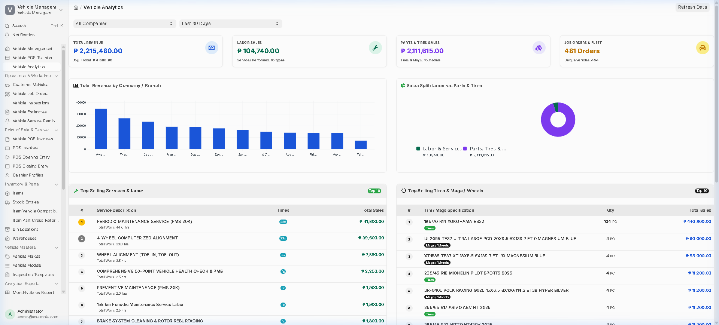
LIVE SYSTEM HIGHLIGHTS
Module 2: Vehicle Management Analytics & Branch-Level Access Control
Executive multi-company analytics combined with strict branch isolation for branch staff.
Business Intelligence & Security
✔ Role-Based Branch Scoping
Branch staff only see data for their assigned company (e.g. Automan only).
✔ Executive Consolidated View
Admins, CEO, CFO, and Operations Directors see all 11 companies consolidated.
✔ Labor vs Parts Breakdown
Visualizes service labor sales (₱104.7k) vs. tire/parts retail (₱2.11M).
✔ Top Selling Services & Labor
Ranks top revenue services (Periodic Maintenance, Wheel Alignment, Brake Service).
✔ Tires & Mags Sales Ranking
Automated tracking of top-selling tire sizes (185/65R14, 205/55R16) and alloy wheels.

Slide 7
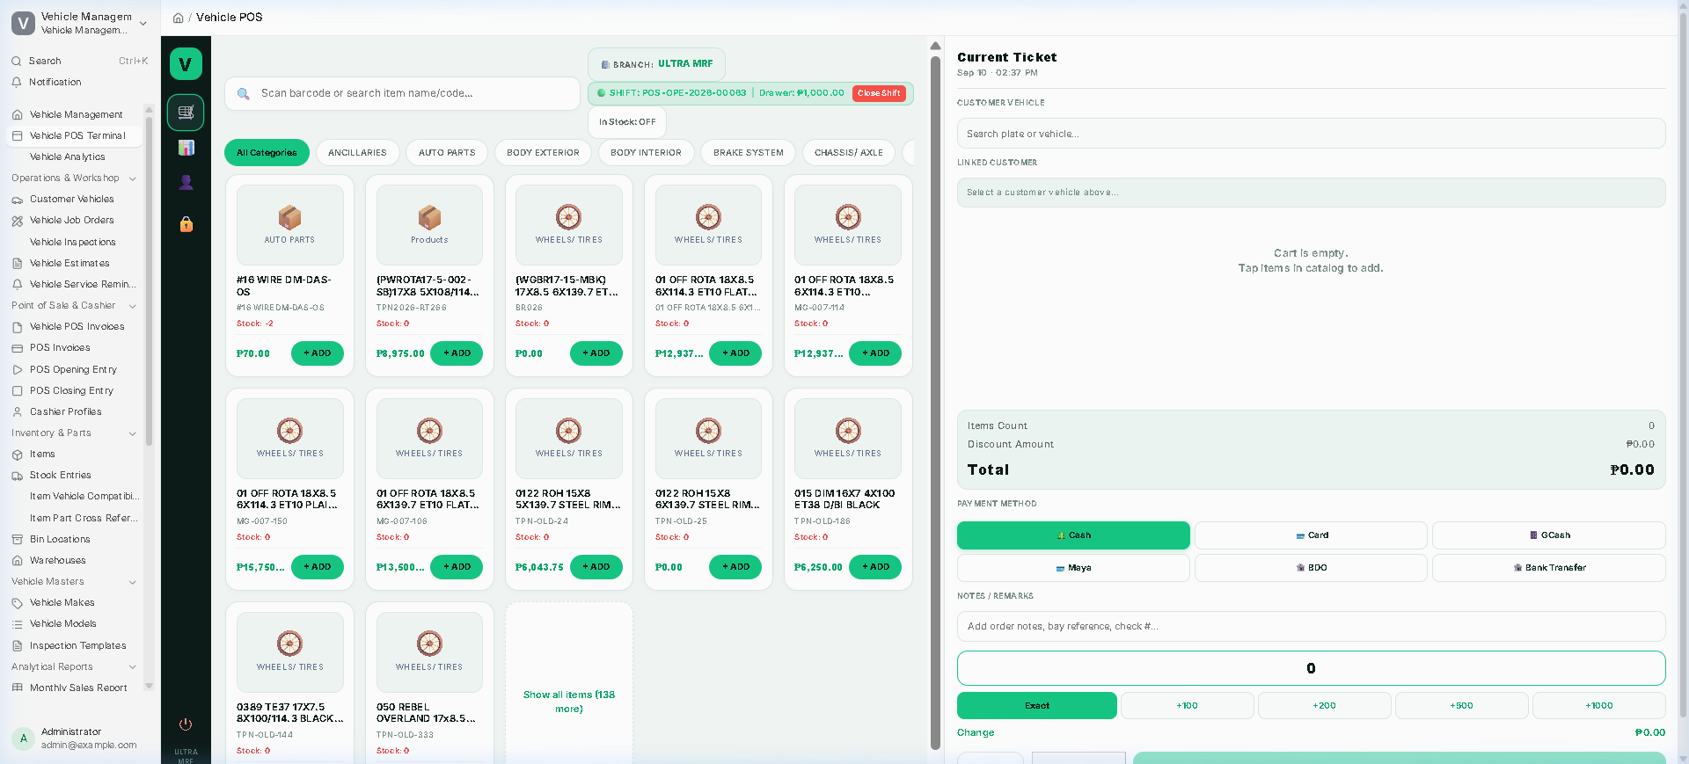
LIVE SYSTEM HIGHLIGHTS
Module 3: Fast Vehicle POS Terminal & Multi-Payment Checkout
High-speed front counter cashiering designed specifically for automotive bays and parts counters.
POS Cashiering Highlights
✔ Vehicle Plate Search & Tagging
Link every POS transaction to a customer vehicle plate for complete service history.
✔ Barcode & Category Filters
Instant search by barcode, part number, or category (Tires, Brakes, Chassis, Oils).
✔ Quick Cash Denominations
One-tap cash buttons (+100, +200, +500, +1000) for rapid counter checkout.
✔ Multi-Channel Digital Payments
Supports Cash, Credit/Debit Card, GCash, Maya, BDO Bank Transfer.
✔ Thermal Receipt Printing
Auto-prints 80mm/58mm thermal receipts with BIR transaction numbers.

Slide 8
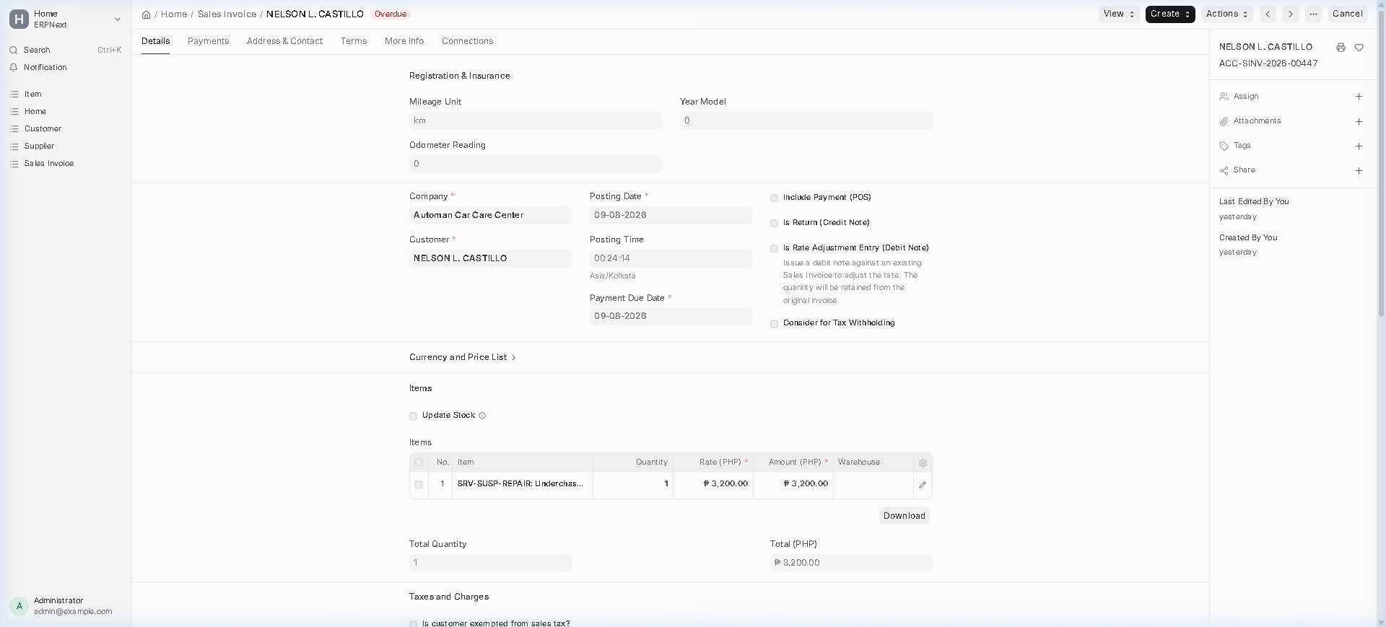
LIVE SYSTEM HIGHLIGHTS
Module 4: Automan Prototype Live Sales Invoicing & Workflow
Live submitted service transaction at Automan Car Care Center.
Automan Pilot Results
✔ Real Service Transactions
complete automotive service and repair invoices submitted on VPS .
✔ ACC Invoice Series
Official Automan numbering format .
✔ Customer & Vehicle Linkage
All invoices tagged with customer names, vehicle plates, labor hours, and parts.
✔ Automated Payment Entries
Instant reconciliation against Automan Cash/Bank accounts in Philippine Peso (PHP).
✔ Live Stock Deduction
Automatic inventory ledger impact on Automan local warehouse stock.

Slide 9
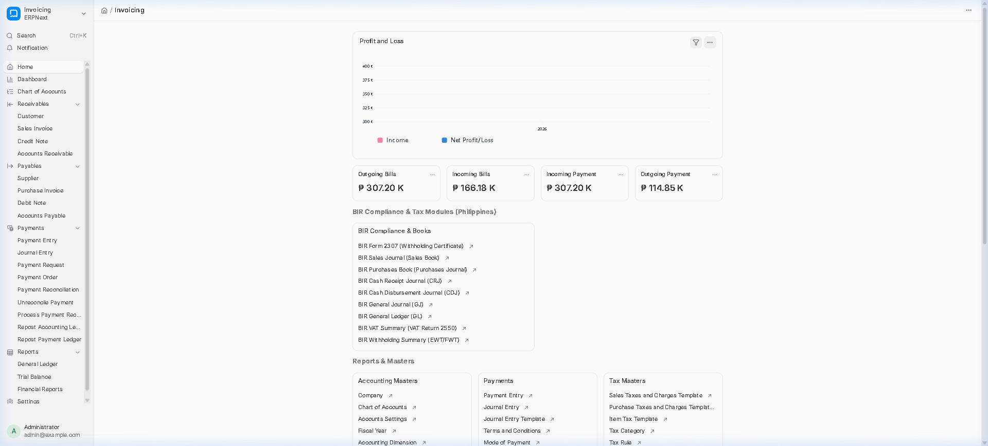
LIVE SYSTEM HIGHLIGHTS
Module 5: BIR Report Philippine Tax & Accounting Suite
Fully deployed compliance books, withholding certificates, and financial reporting on VPS.
BIR Compliance Highlights
✔ BIR Report Generation
Automated Certificate of Creditable Tax Withheld at Source for B2B transactions.
✔ BIR Sales & Purchase Books
One-click generation of Sales Journal and Purchases Book with official TIN headers.
✔ Cash Flow Journals (CRJ & CDJ)
Compliant Cash Receipts Journal and Cash Disbursements Journal.
✔ General Journal & General Ledger
Standardized accounting ledger with automated VAT 2550 computation.
✔ Real-Time Financial Dashboard
Live Profit & Loss, Accounts Receivable, and Payables tracking across all entities.

Slide 10
PROTOTYPE IMPLEMENTATION
Phase 1: Automan Car Care Center Detailed Scope of Work
Actionable 4-week execution blueprint for the prototype pilot.
Week 1: Setup & Master Data
Week 2: Operations & Front Desk
Week 3: Supply Chain & BIR Testing
Week 4: UAT & Prototype Sign-Off
• Configure Automan Company & Chart of Accounts
• Import Automan Service Master Catalog (PMS, Alignment, Brakes)
• Import Initial Stock Inventory & Barcodes
• Setup Bin Locations (Rack/Shelf QR tags)
• Setup Automan POS Profile & Cashier accounts
• Deploy Vehicle Estimate & Job Order flow
• Configure Service Advisor & Technician roles
• Deploy Mobile Camera & POS terminal at counter
• Test 30 real pilot service & retail transactions
• Validate thermal receipt layout & branding
• Link Automan replenishment to Dau Warehouse
• Test Intercompany PO > SO > DN >PI flow
• Generate BIR Sales Journal & CRJ for pilot
• Verify BIR Report withholding certificates
• Validate General Ledger & P&L balance accuracy
• Execute end-to-end User Acceptance Testing (UAT)
• Staff training (Advisors, Cashiers, Technicians)
• Evaluate prototype KPIs & bottleneck audit
• Formal Executive Prototype Sign-Off
• Freeze template for Phase 2 & 3 branch rollout

Slide 11
ORGANIZATIONAL READINESS
Change Management, Training Framework & Governance
Ensuring high user adoption, operational discipline, and zero downtime during transition.
👥 Role-Based Training Matrix
• Service Advisors & Bay Front Desk
Vehicle check-in, estimate creation, inspection reports, labor allocation, and customer communication.
• Cashiers & Counter Staff
POS terminal, barcode scanning, payment reconciliation (Cash/GCash/Card), closing cash shifts.
• Warehousemen & Stock Keepers
Mobile barcode put-away, shelf bin scanning, material receipt, intercompany stock fulfillment.
• Accountants & Finance Staff
BIR compliance generation, BIR Reports, journal posting, daily sales reconciliation, VAT filing.
• Executives & Branch Managers
Vehicle Management Analytics, branch performance tracking, margin analysis, multi-company consolidation.
🛡 Project Governance & Support Model
• Executive Steering Committee
Weekly milestone review with CEO, Operations Head, and Lead Consultant.
• Daily 15-Minute Standup
Branch project champion + technical team resolving operational issues.
• Hypercare Support (2 Weeks Post Go-Live)
Dedicated on-site & remote support engineer per branch during first 14 days.
• Standardized SOP Manuals
Illustrated step-by-step visual SOPs provided to each branch station.
• Automated Database Backups
Nightly automated PostgreSQL and Frappe file backups with off-site redundancy.

Slide 12
MILESTONE TIMELINE
12-Week Master Implementation Schedule & Key Deliverables
Clear stage-gate milestones with tangible deliverables at each phase.
Weeks 1 - 4
Phase 1: Automan Prototype Pilot
Deliverable: Automan Live Go-Live & Sign-Off
COMPLETED / VALIDATED
Weeks 5 - 7
Phase 2: 3 Central Warehouses Rollout
Deliverable: Dau, SF, Mexico Warehouse Bins & Hub
READY FOR EXECUTION
Weeks 8 - 10
Phase 3: Cluster 1 Branches Rollout
Deliverable: Dau Main, Dau Annex, San Fernando
SCHEDULED
Weeks 11 - 12
Phase 4: Cluster 2 & Enterprise Go-Live
Deliverable: Wheel Core, Wheelhub, Telebastagan + BI
FINAL MILESTONE

Slide 13
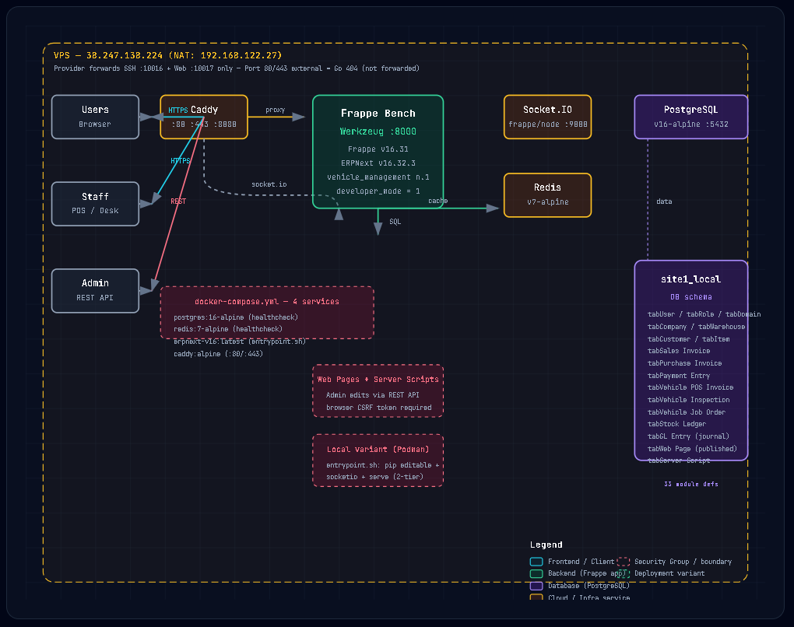
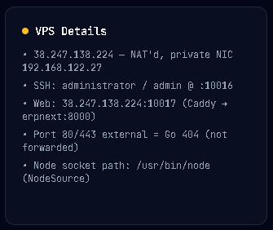
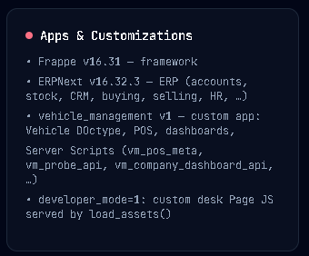
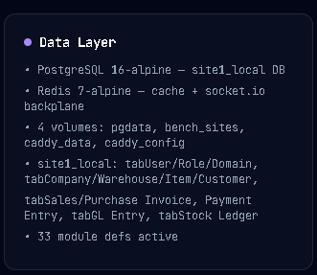
MILESTONE TIMELINE
ERPNext VPS Architecture
38.247.138.224:10017 · Frappe v16.31 · ERPNext v16.32.3 · PostgreSQL 16 + Redis 7 · Docker Compose (4 services)

