Slide 1

Team Ark Meeting
2020.02.08

Slide 2
To Do…
Schedule Managing
Projects introduction
Concept Explanation of 1st Project

Slide 3
Time Scheduling
Trello
Git
Webpage Posting

Slide 4
Main projects
1
2
3
~6 month
~6 month
~12 month

Slide 5
Main projects
2
3
1

Slide 6
Main projects
2
3
1
Doodle
Doodle

Slide 7
High Concept
‘Doodle Doodle’ is 2D platform game. Player will be a painter who can draw pictures on the screen. Player has many different drawing tools such as brush, pencil, eraser, etc. Also, player can change the color of brush to change the type of attack. Player needs to drawing lines or pictures to fight with other monsters. Doodling to fight!

Slide 8
Summary
‘Doodle Doodle’ is 2D platform game. The world of ‘Doodle Doodle’ is in a large white paper, and player will be a painter who can draw lines or pictures on the screen. Player can collect many different drawing tools such as brush, pencil, eraser, etc. Each tool has different attack form and effects. Also, there are colors of the brush tools and player can change the type of attack with it.
There are many different monsters and landmarks to interact, so player need to plan different tactics according to diverse situations. Player will spend a certain amount of ink while drawing, so player can fulfill it at the fountain of ink.

Slide 9
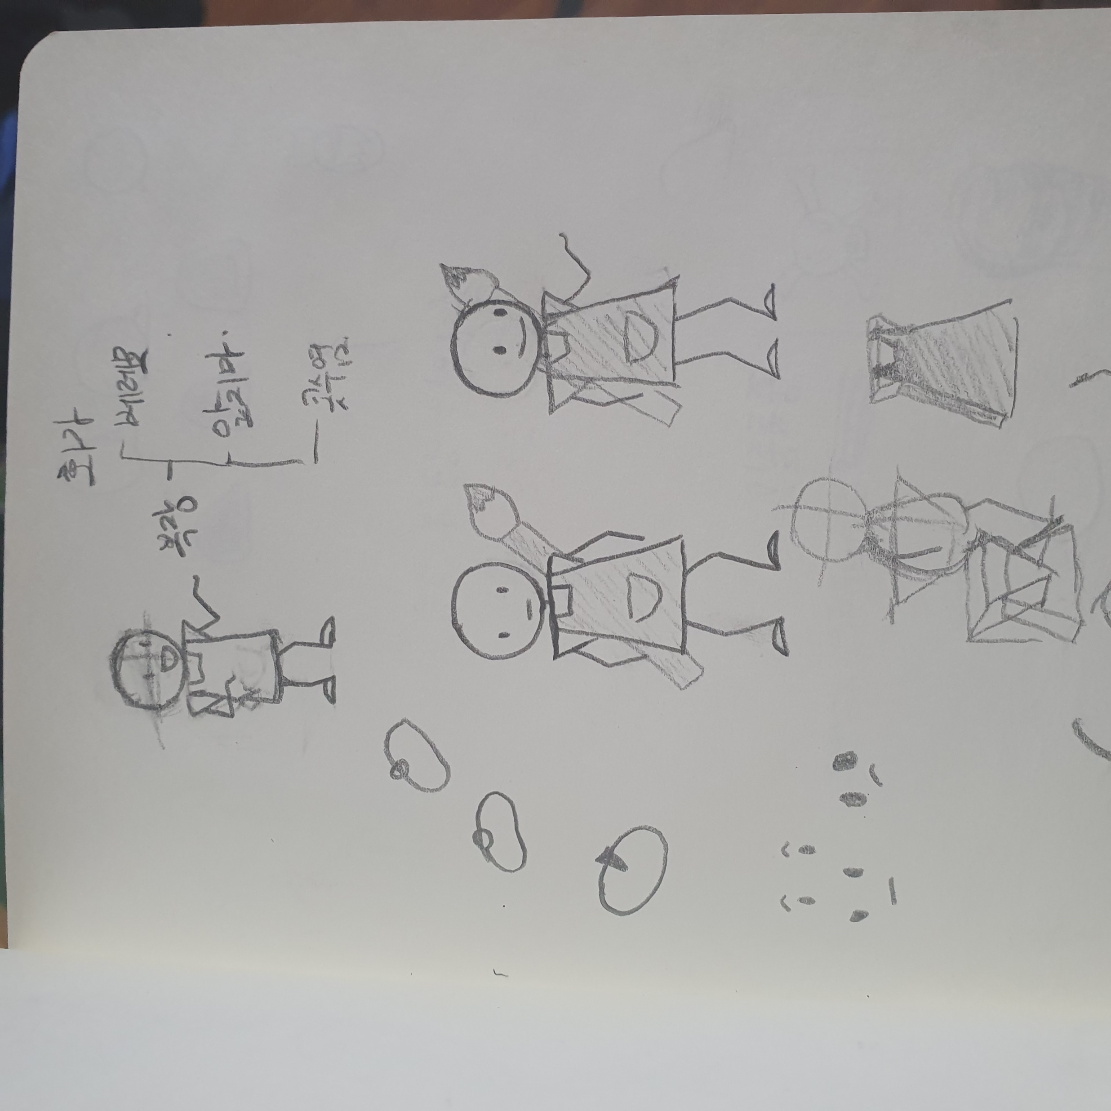

Slide 10
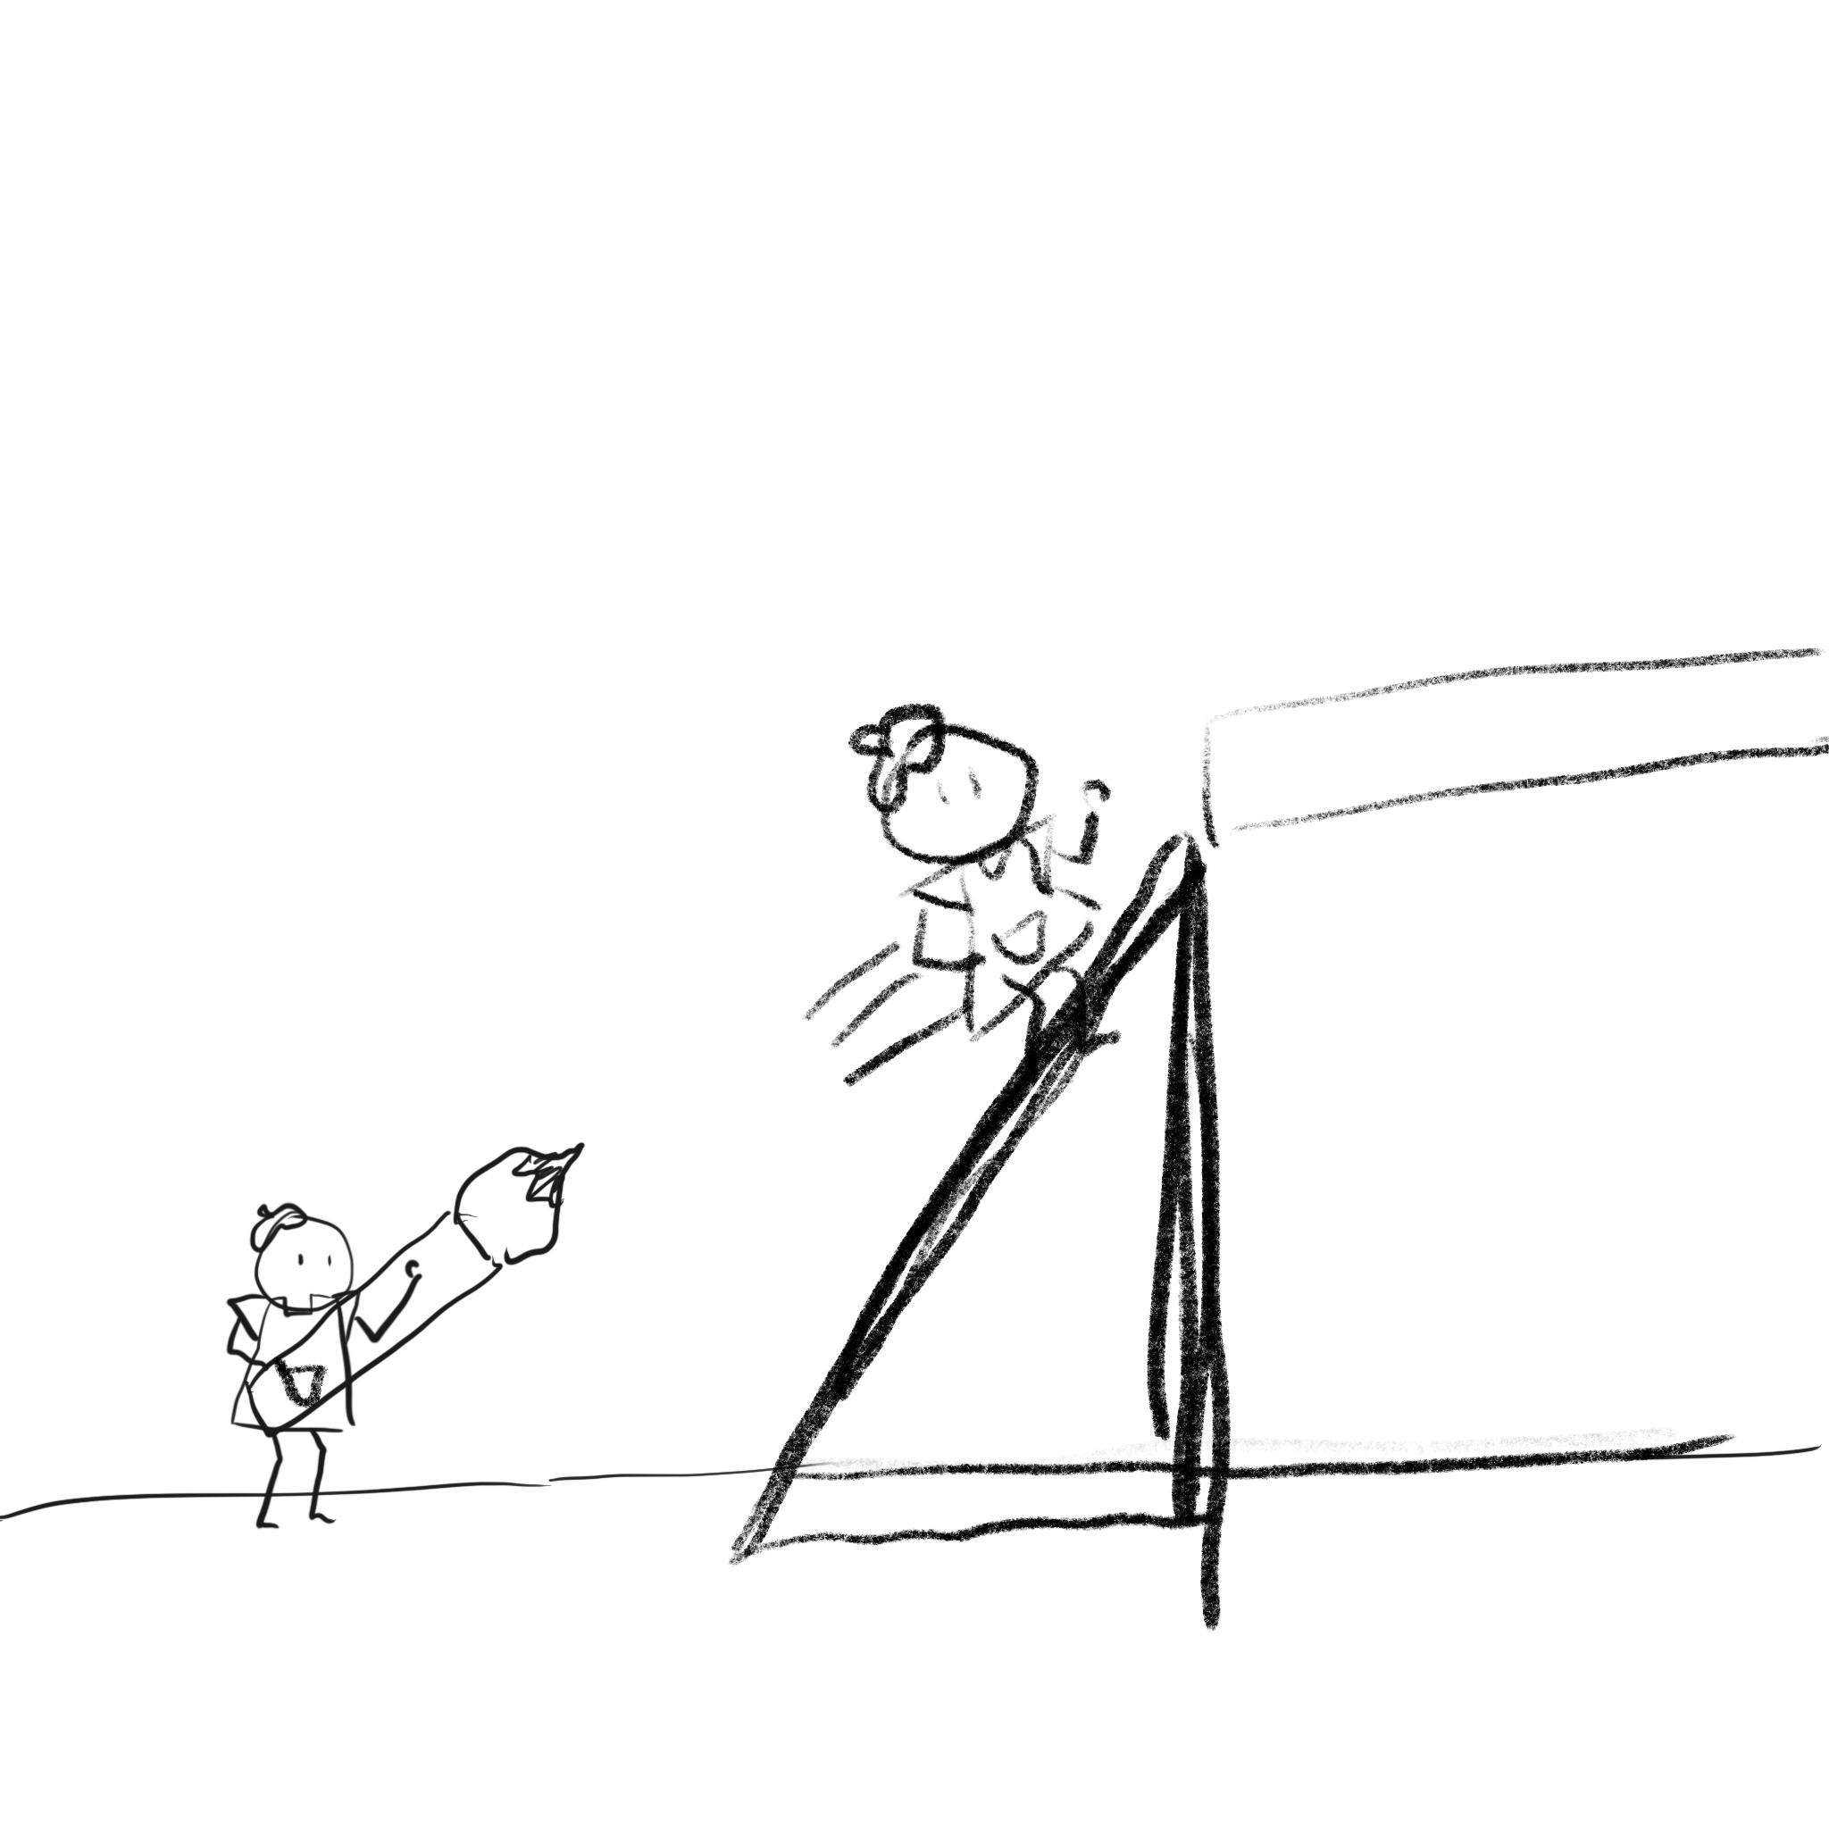
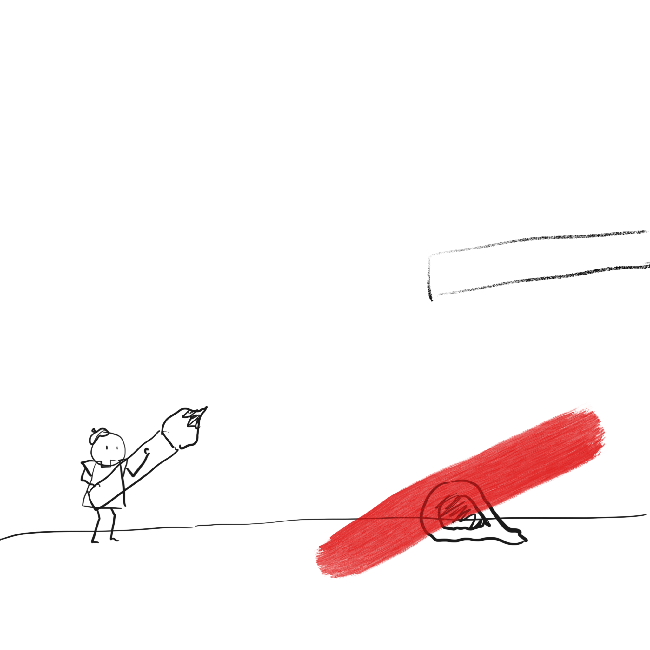

Slide 11
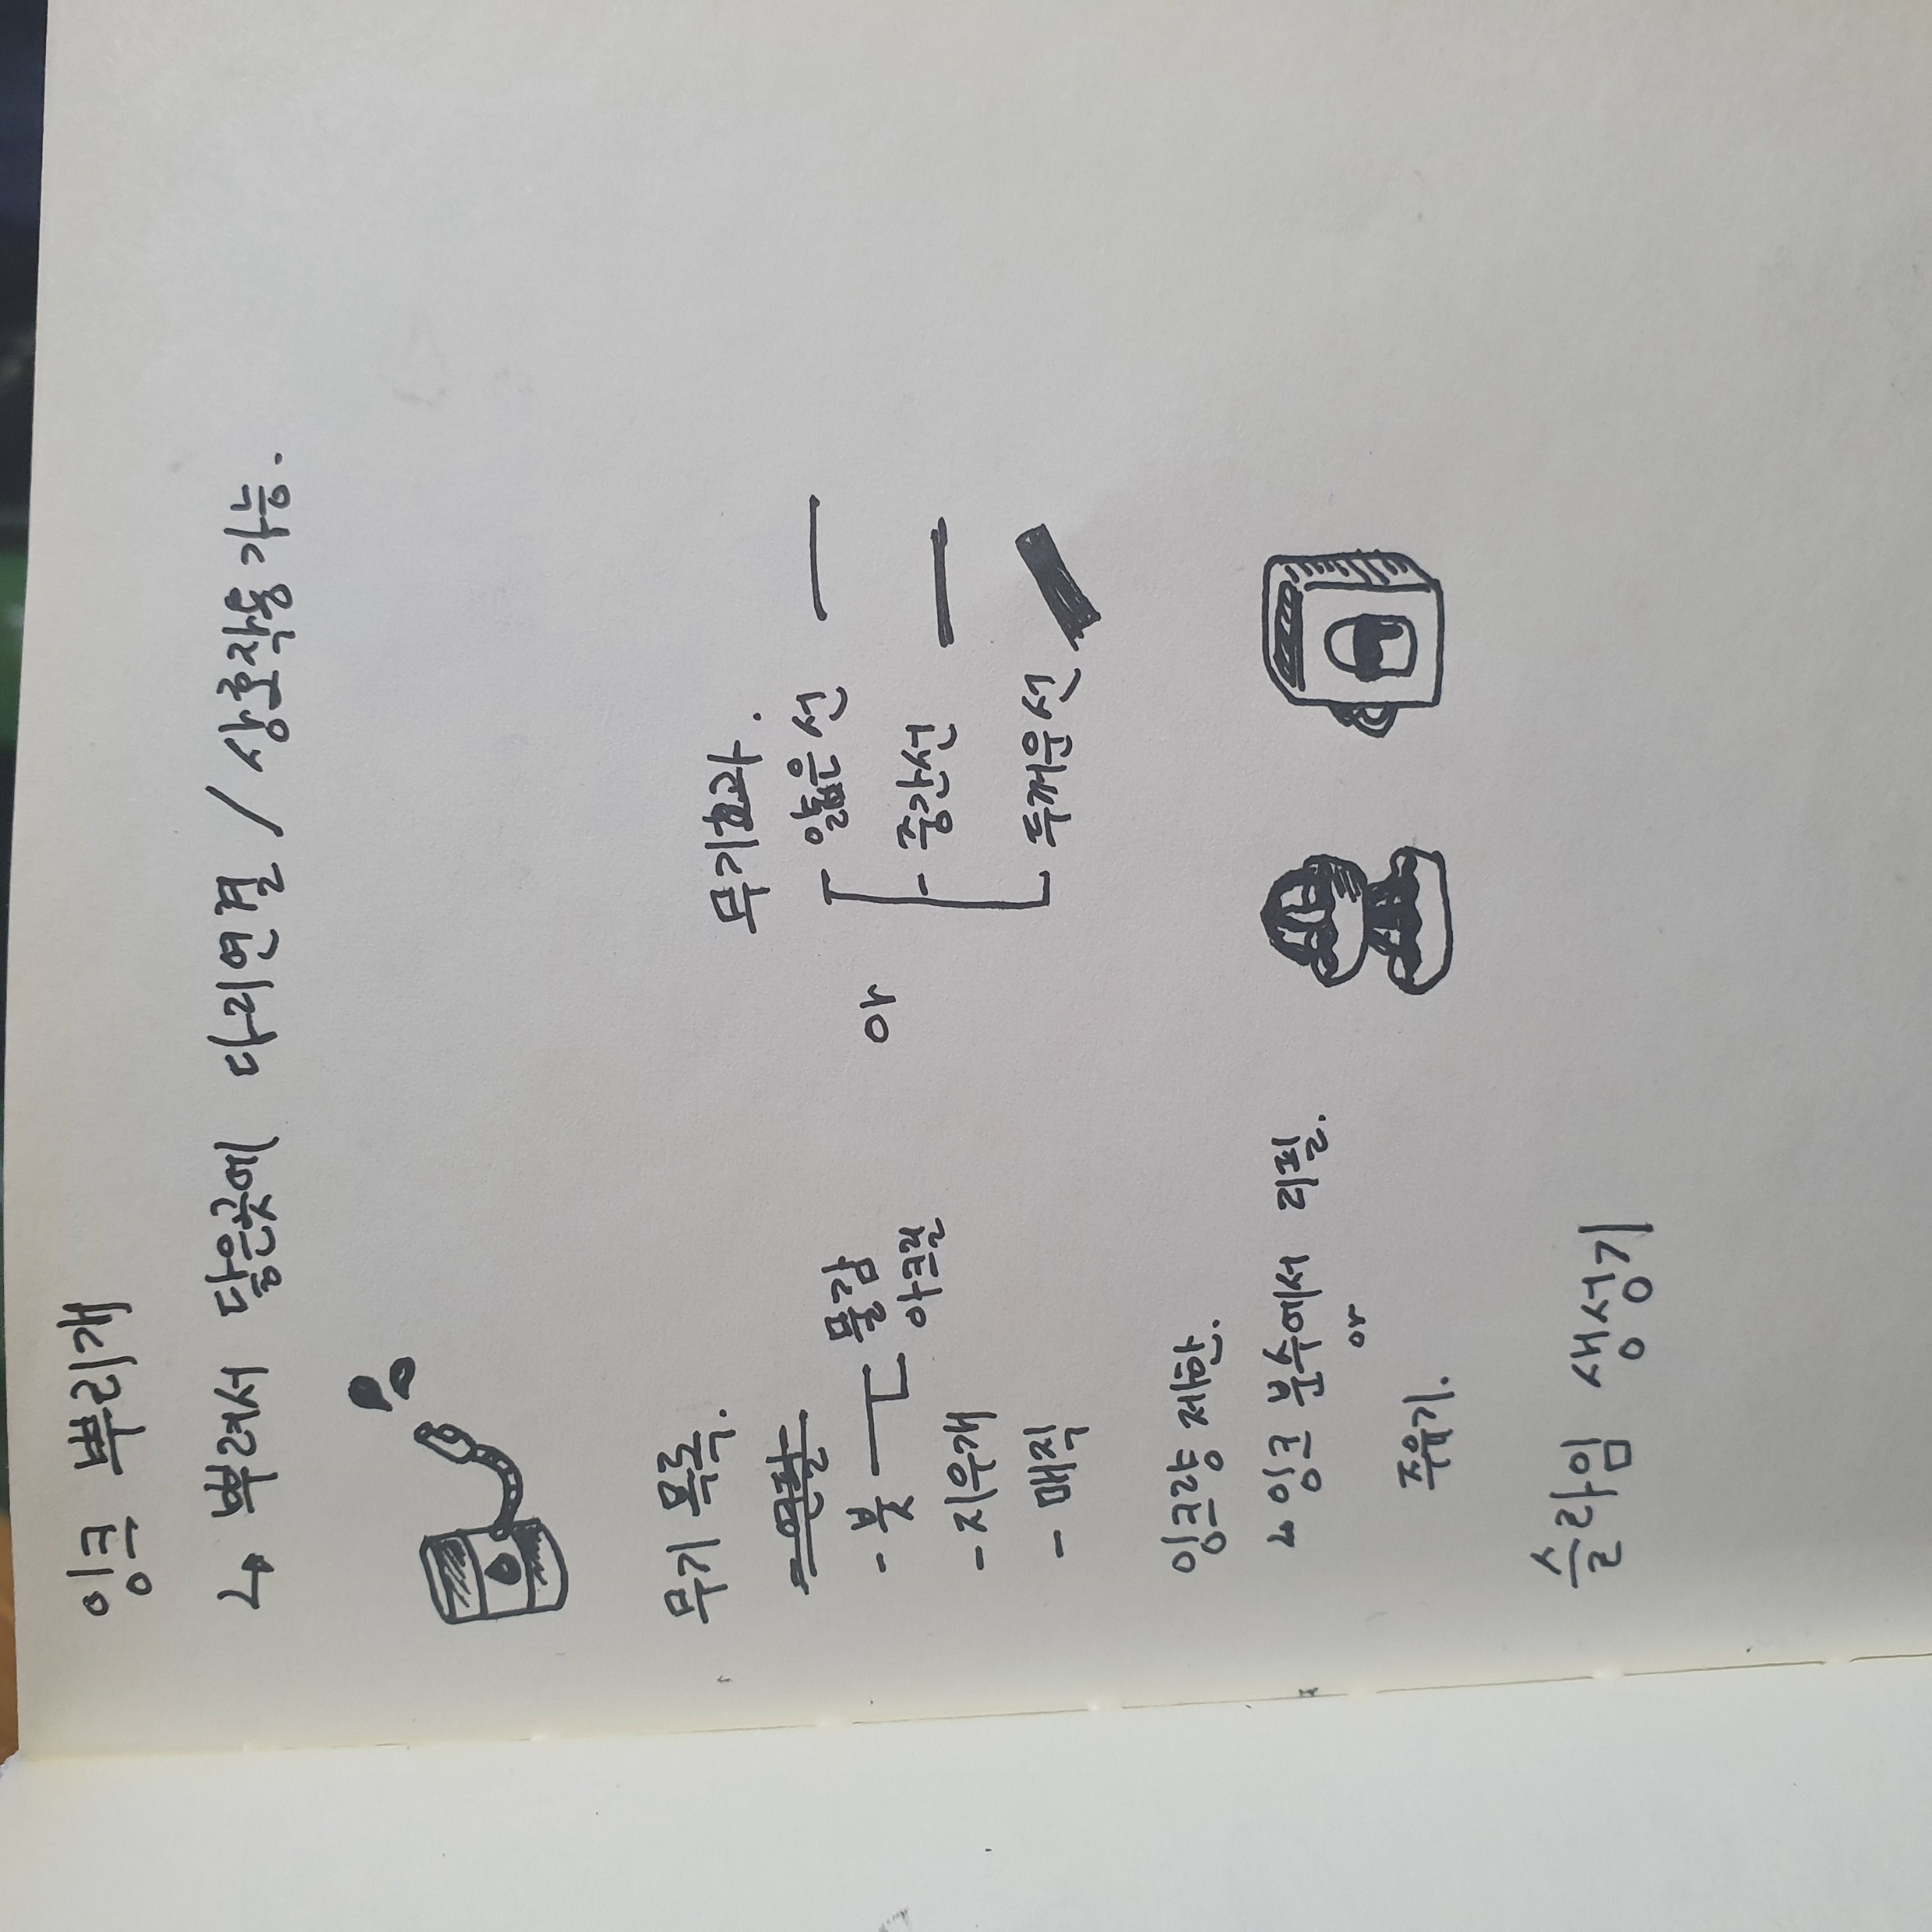

Slide 13
Question

