Slide 1
GUJARAT POLICE HACKATHON 2026
Statewide CCTV Integration & Vehicle Intelligence
An edge-first federated architecture: Model 1 registry as control plane, Model 2 feed access, Model 3 adapter spine.
80
CAMERAS ONBOARDED
26 ms
VEHICLE TRACE
1.04 s
DETECTION → ALERT
869
AUTOMATED TESTS
Working platform. Every figure in this deck is measured on the running system, or arithmetic from a measured figure with the calculation shown.
Gujarat Police Hackathon 2026 · Statewide CCTV Integration
01

Slide 2
THE CONSTRAINT THAT SHAPES EVERYTHING
“Participants will be provided with a designated vehicle registration number.”
By the time that number is handed over, the vehicle has already driven past the cameras. There is no opportunity to go and look for it.
CONSEQUENCE
We persist every read, not just watchlist hits
This moves the system's cost from the query path to the write path. Every sizing decision in this deck follows from it.
The only thing that can answer is an index of every plate already read.
The distinction that matters: a watchlist alerter answers questions asked in advance. An index answers a question nobody had asked yet, which is exactly what the evaluation is.
FRAMING · Gujarat Police Hackathon 2026 · Statewide CCTV Integration
02

Slide 3
PROPOSED MODEL, WITH JUSTIFICATION
Hybrid: a registry control plane, direct feed access, an adapter spine
We adopt Model 4's analytics outcomes through distributed edge inference rather than centralised video ingest.
MODEL | ROLE IN THE HYBRID | DEMONSTRATED BY
M1: Registry & GIS mandatory | The control plane, not a side deliverable. Adapter choice, RBAC scope, health, coverage and route plausibility all resolve through it | 80 cameras onboarded (50 simulated, 30 government); GIS map; corridor gap analysis
M2: Unified viewing | The feed-access and operator layer. Direct RTSP/ONVIF is genuinely right for cameras with no VMS in front of them, which is most of them | Live view, searchable sightings, alert console
M3: Federation | The spine that makes M2 survive scale. A new vendor is a plugin, not a redesign | One interface; adding a source type changes no other file
M4: Analytics outcomes | Its goals adopted in full. Its centralised ingest rejected on cost and on the Core Goal | Journey reconstruction, watchlist correlation, real-time alerts
The organising idea: move the analytics to the edge, move only metadata to the centre, move video only on demand.
ELEMENT 1 OF 8 · Gujarat Police Hackathon 2026 · Statewide CCTV Integration
03

Slide 4
PROPOSED MODEL, WITH JUSTIFICATION
Why we rejected Model 4, and the arithmetic at 80,000 cameras
 | CENTRAL VMS | THIS PLATFORM
Sustained backhaul | 240 Gbit/s | ~40 Mbit/s
Central storage, 15 days | ~26 PB | ~5 GB/day
Existing VMS, storage, AMC | Replaced | Preserved
On WAN outage | Blind | Edge keeps detecting
REASON ONE
It contradicts the Core Goal
The brief asks for an approach that is cost-effective and uses existing infrastructure to the maximum practical extent. Model 4 discards 26 departments' investments and rebuilds them centrally.
0.5 kbit/s per camera is measured, not assumed, 104 sightings/minute across 71 contributing cameras, at ~300 bytes a row.
REASON TWO
It contradicts the bonus criteria
Which explicitly reward strong edge-processing, bandwidth-optimisation, or low-connectivity operation. Central ingest is the opposite of all three.
We decline one implementation choice, not a capability. Every functional outcome Model 4 lists is present. The transport is what differs.
ELEMENT 1 OF 8 · Gujarat Police Hackathon 2026 · Statewide CCTV Integration
04

Slide 5
SOLUTION OVERVIEW AND OBJECTIVES
Three capabilities, graded separately, all built
OBJECTIVE | WHAT IT MEANS | STATE
Onboard | Any camera, any brand, any protocol, without redesign | 80 cameras. 5.1 s each, against a 30 s budget
Read | Continuously read plates from every camera and store all of them | 82.4% exact on ANPR-grade cameras · 104 sightings/min
Trace & alert | A plate returns a route across the state; a wanted vehicle raises an alert in real time | 26 ms trace · 1.04 s detection→alert
ALSO BUILT, AND ALSO GRADED
Evidence export
CSV and PDF carrying plate, confidence, camera, geolocation, timestamp and the crop that proves the read.
Coverage & gap analysis
Which road segments no camera watches, the input to where the next cameras go.
Audit & access control
Role- and department-scoped access, with an immutable record of every search and export.
ELEMENT 2 OF 8 · Gujarat Police Hackathon 2026 · Statewide CCTV Integration
05

Slide 6
KEY INNOVATIONS
Five, each backed by a measurement rather than a claim
 | INNOVATION | THE MEASUREMENT BEHIND IT
1 | Edge-first metadata architecture, analytics beside the camera, ~250-byte events northbound | 0.5 kbit/s per camera against ~3 Mbit/s of video, four orders of magnitude
2 | Registry as control plane, not inventory, adapters, RBAC, health, geography and route plausibility all resolve through it | The organisers' grid changed hostname mid-build. It cost one environment variable
3 | Per-track confidence voting + derived confusable-character normalisation, the confusion table is generated, never typed in | Coercion is positional; a hand-written table cannot distinguish a considered omission from an oversight
4 | Travel-time plausibility scoring, an impossible hop splits the journey instead of being dropped | Cloned-plate detection as a by-product of route reconstruction
5 | Self-calibrating tamper detection, each camera judged against its own normal, not a global threshold | False positives 39 → 0
Innovations 3 and 4 share a principle: the anomaly is the signal. A system that quietly discards the outlier discards the crime.
ELEMENT 2 OF 8 · Gujarat Police Hackathon 2026 · Statewide CCTV Integration
06

Slide 7
HIGH-LEVEL ARCHITECTURE
Six layers, and one of them is mandatory by design
L5 PRESENTATION GIS console · Alert desk ·
Journey explorer · Registry
L4 INTELLIGENCE Watchlist matcher ·
Journey · Re-ID · Reports
L3 PLATFORM CORE Event store ·
★ CAMERA REGISTRY & GIS ·
RBAC · Audit · Stream broker
L2 FEDERATION Adapter framework ·
Credentials · Health prober
L1 EDGE ANALYTICS Decode · Sample · Detect ·
Track · OCR · Vote · Tamper
L0 SOURCES IP cams · Encoders ·
NVRs · Departmental VMS
★ mandatory Model 1, as the control plane
WHAT CROSSES THE DISTRICT → STATE LINK
Metadata always. Video only on demand.
A relay starts when an operator opens a camera and is reaped 45 seconds after the last viewer. That cost is per viewer, not per camera, an unwatched camera costs nothing beyond its metadata.
DEPLOYMENT TIERS
Edge → district → state
One container image, identical in all three placements. Scaling is a replica count, not a redeployment.
ELEMENT 3 OF 8 · Gujarat Police Hackathon 2026 · Statewide CCTV Integration
07

Slide 8
END-TO-END WORKFLOW
A vehicle passes a camera in Rajkot
① registry already knows the camera,
its position, and its adapter
② stream opened - timing from the video's
own PTS, never from arrival
③ vehicle detected and tracked; plate
located inside the vehicle box
④ OCR on each sampled crop
→ per-track vote → ONE plate string
⑤ sighting written - always, every
vehicle, ~300 bytes
in the same transaction: matched
against the watchlist, alert written
if it hits. Both rows commit, or neither
⑥ operator sees the alert with its
evidence bundle 1.04 s
⑦ later - a plate is typed, and its route
across the state returns 26 ms
Steps ⑤ and ⑦ are the product. ⑤ is what makes ⑦ possible on evaluation day.
NOT OBVIOUS, AND LOAD-BEARING
Plate search is confined to a vehicle
Every government feed burns a timestamp band and site label onto its own picture, at plate size and contrast. Whole-frame recognition reads the camera's own clock as a registration number, on every camera, forever.
NOT OBVIOUS, AND LOAD-BEARING
Timing comes from the video
A gateway replays its buffer on connect, so frames arrive faster than real time. Timed by arrival, every reconnect computes an impossible speed and reports a cloned plate.
ELEMENT 3 OF 8 · Gujarat Police Hackathon 2026 · Statewide CCTV Integration
08

Slide 9
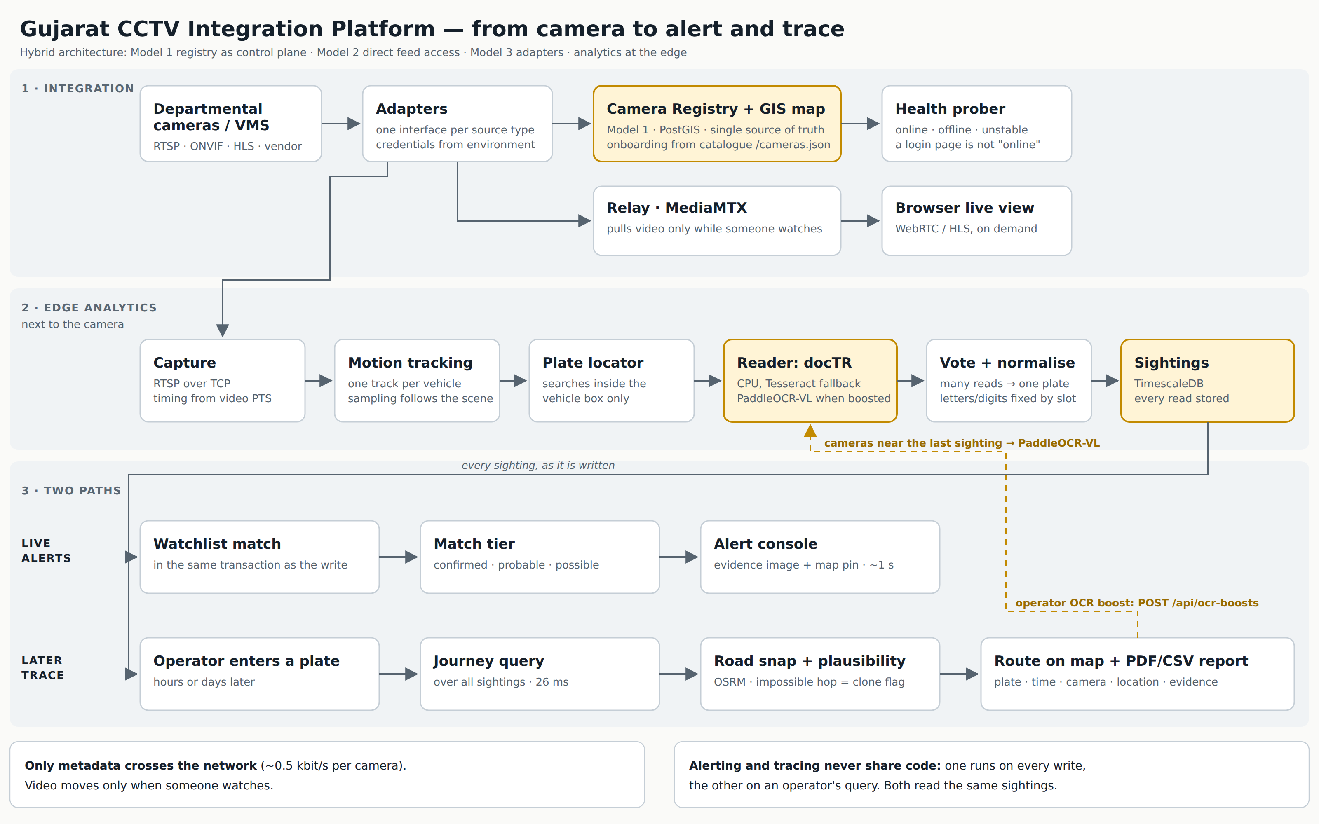
END-TO-END WORKFLOW, AS BUILT
Three stages: integration, edge analytics, and two paths that never share code
Read the bottom band first. Live alerting runs on every write; the retrospective trace runs on an operator's query. They read the same sightings table and share no implementation, because the evaluation grades both and building one does not deliver the other.
ELEMENT 3 OF 8 · Gujarat Police Hackathon 2026 · Statewide CCTV Integration
09

Slide 10
AI ANALYTICS APPROACH
Detection, recognition, and event analytics
decode → sample → detect + track → locate plate → OCR → reject overlay text → per-track vote → normalise → persist
STAGE | APPROACH | WHY IT IS THAT WAY
Sampling | Analysis rate follows scene activity | 80,000 × 15 fps = 1.2 M detections/s does not close. 81.3% of analysis avoided
Detect & track | Multi-object tracking, stable id per vehicle | Voting needs a track, not a frame
Plate localisation | Inside the vehicle box only | Removes the burnt-in-overlay error class entirely
Recognition | docTR on the CPU; PaddleOCR-VL on GPU for cameras an operator boosts | Night plates found 35% → 62% → 100% on the test clips
Voting | Whole-string and per-character, confidence-weighted | Per-frame emission duplicates records and discards many independent opinions
Normalisation | Positional, coerced by plate slot, at write and query time | A global O→0 merges different vehicles onto one key
Persistence | Unconditional, including format failures | A mis-read wanted vehicle is worse than a noisy record
Beyond ANPR: vehicle class and appearance attributes · a vehicle id on every sighting, joined by plate or by a learned appearance vector (DINOv2-small), so an unreadable vehicle can still be followed · self-calibrating tamper detection · per-camera health analytics · on-demand OCR boost for the cameras around a location.
ELEMENT 4 OF 8 · Gujarat Police Hackathon 2026 · Statewide CCTV Integration
10

Slide 11
AI ANALYTICS: WHAT THE MEASUREMENTS SAID
Accuracy is reported per condition, because one headline would average three problems
CONDITION | EXACT | WITHIN 2 CHARS
Daylight | 86.6% | 98.1%
Glare | 57.1% | 92.9%
Night | 58.6% | 75.9%
Overall, ANPR-grade | 82.4% | 95.1%
THE FINDING THAT SURPRISED US
Heavier was not better
Tesseract on Indian plates | 83% exact
A general hub OCR model, same crops | 1.1% exact
Single-image GPU inference | 24.4 ms
The CPU path it was meant to beat | 17.0 ms
docTR on the CPU, night plates found | 62% vs 35%
Night is the weak spot, and it is on the slide rather than in a footnote. Measured with Tesseract; docTR, the default reader since 14 Sep, finds 62% of night plates against Tesseract's 35% on the same clips.
Light models by default, heavy models as a measured per-camera fallback. A camera the light path demonstrably cannot read escalates on its own evidence, one rung at a time, budgeted, and rolled back if it does not help.
ELEMENT 4 OF 8 · Gujarat Police Hackathon 2026 · Statewide CCTV Integration
11

Slide 12
THE READER LADDER, MEASURED
Night is where readers separate, and it is the condition that matters
Plates found on the 12 generated traffic clips, 101 night and 69 day. Measured 14 Sep 2026. docTR is the default because it fits a CPU edge box at 37 ms per crop; PaddleOCR-VL needs a GPU and runs only on cameras an operator boosts.
Day hides the difference. Every reader is respectable in daylight, so a daylight-only benchmark would have justified the cheapest one and left the estate blind at night, which is when the vehicles we are asked about actually move.
ELEMENT 4 OF 8 · Gujarat Police Hackathon 2026 · Statewide CCTV Integration
12

Slide 13
WATCHLIST CORRELATION METHODOLOGY
A match is not a boolean
Matching happens on the write path, not in a downstream consumer. The watchlist is held in process and refreshed on a 2-second timer, at 104 sightings a minute, a per-sighting query puts a network round trip on the pipeline's hot path.
TIER | CONDITION | WHAT IT MEANS TO AN OPERATOR
confirmed | Exact key and confidence ≥ 0.85 | Act on it
probable | Exact key at lower confidence, or edit distance 1 | Verify against the evidence crop first
possible | Edit distance 2 | A lead, corroborate before acting
WHY NOT EXACT-ONLY
It misses the wanted vehicle whose plate came back one character wrong, 12.7% of reads. A system that misses one in eight is not working.
WHY NOT ANYTHING-CLOSE
The operator is flooded and stops reading alerts, which is worse than not alerting at all.
WHY CONFIDENCE SPLITS AN EXACT MATCH
The same string at 0.4 and at 0.95 is different evidence. The tier is how the operator is told which one they are looking at.
ELEMENT 5 OF 8 · Gujarat Police Hackathon 2026 · Statewide CCTV Integration
13

Slide 14
REAL-TIME ALERTING
Detection to an operator's screen in 1.04 seconds
sighting
tier confirmed probable possible
priority severity − tier demotion
dedup same plate, same camera, 120 s
×3 for `possible` - a low-tier repeat
is far more likely a re-read than a
second event worth waking someone for
alert row - SAME TRANSACTION as the sighting
evidence crop · plate read · confidence ·
matched record · case ref · camera ·
district · lat/lon · measured latency
states new → acknowledged → actioned
→ dismissed
1.04 s
MEASURED
5 s
BUDGET
CONSEQUENCE ONE
Both rows commit, or neither does
The time-series store cannot enforce that foreign key, so the transaction enforces it structurally: an alert can never point at a sighting that does not exist.
CONSEQUENCE TWO
There is no delete
dismissed and false_positive are statuses. An alert an operator judged wrong is itself evidence, of the error rate, and of the decision taken.
ELEMENT 5 OF 8 · Gujarat Police Hackathon 2026 · Statewide CCTV Integration
14

Slide 15
KEY TECHNOLOGIES, FRAMEWORKS AND TOOLS
Every choice has a reason, and the deviations are named
LAYER | CHOICE | WHY THIS ONE
Store | TimescaleDB (PostgreSQL + PostGIS) | Registry, geospatial and time-series in one database, removes a distributed-consistency problem we do not need
Plate search | pg_trgm | Sufficient at this scale; a search cluster is the scale path, not the starting point
Vectors | pgvector | Vehicle appearance search (DINOv2-small, 384 numbers) inside the database already present
Media | MediaMTX | RTSP in, WebRTC/HLS out, the relay the brief already anticipates
Events | Redpanda | Kafka wire protocol, single binary, no ZooKeeper
Routing | OSRM + Gujarat OSM extract | Road-network snapping and travel-time plausibility
API | FastAPI + OpenAPI | Documented and browsable, integration-ready by construction
Map | MapLibre GL | GPU-rendered. Leaflet's DOM markers do not survive statewide density, and 80,000 points is the claim
Justified deviations from the suggested stack: MapLibre over Leaflet, TimescaleDB + trigram over Elasticsearch, Redpanda over Kafka. Each is stated with its reason, because unexplained deviation is penalised and justified deviation is not.
ELEMENT 6 OF 8 · Gujarat Police Hackathon 2026 · Statewide CCTV Integration
15

Slide 16
SCALABILITY AT 80,000 CAMERAS
The sizing number is measured, and so is what breaks it
50 to 57 cameras per 20-core box. At 57 cameras, recognition p50 was 624 ms with a healthy 6.1% shed. At 76 cameras the same box shed 94.7% and p50 rose to 3.4 s.
QUANTITY | ARITHMETIC | RESULT
Nodes for 80,000 cameras | 80,000 ÷ 50 | 1,600
Per district | 1,600 ÷ 33 | ~48
Sightings/day | 80,000 × 1.5/min × 1,440 | ~173 M
Compressed rows/day | 173 M × 300 B ÷ 10 | ~5 GB
Metadata backhaul | 80,000 × 0.5 kbit/s | ~40 Mbit/s
WHY 1,600 IS NOT FRIGHTENING
Arithmetic, not a distributed-systems project
Workers claim a shard with a database advisory lock, no orchestrator, no leader election, no per-replica configuration, and a crashed worker returns its shard the instant its connection drops.
AND WHAT WOULD MOVE IT
Cross-camera GPU batching
Plausibly 3 to 5x per node, taking 1,600 toward ~400. It is an architecture change, not a flag, so it is named, not claimed.
ELEMENT 7 OF 8 · Gujarat Police Hackathon 2026 · Statewide CCTV Integration
16

Slide 17
INTEROPERABILITY, SECURITY, DEPLOYMENT
What is built, and what is designed, labelled
INTEROPERABILITY
SECURITY: BUILT
SECURITY: DESIGN
▪ ONVIF · RTSP · HLS · WebRTC
▪ OpenAPI, browsable on the running instance
▪ GeoJSON for everything geographic
▪ Kafka wire protocol
▪ One provider interface per watchlist source
▪ Credentials never in the registry; a URL with credentials embedded is rejected with 422
▪ Role- and department-scoped access derived from registry ownership, data-driven, not a code path per department
▪ Immutable audit of every view, search, query and export
▪ A case reference binding the purpose of each query
▪ Managed secret vault with rotation
▪ mTLS between services
▪ Camera-VLAN segmentation
▪ Active-passive DR
Named, not implied. A proposal that blurs built and specified cannot be trusted on either.
No proprietary interface between our own layers.
Privacy under the DPDP Act 2023. Metadata-by-default is the primary control: the platform's default state is that no personal video has moved anywhere. Facial recognition ships disabled, requires per-query case binding and audit to enable, and is demonstrated only on synthetic faces.
ELEMENT 7 OF 8 · Gujarat Police Hackathon 2026 · Statewide CCTV Integration
17

Slide 18
EXPECTED OPERATIONAL BENEFITS AND IMPACT ON POLICING
What changes in how the work is done
 | TODAY | WITH THIS PLATFORM
Time to locate a suspect vehicle | Camera-by-camera manual review, department by department, over hours | A plate query returns a timestamped route, 26 ms p50, 31 ms p95
Cross-department visibility | A Home Department investigator sees nothing from RTO or Food & Civil Supplies cameras | The registry makes coverage discoverable, you can learn a camera exists before negotiating access to it
Posture | Reactive: footage is reviewed after the incident | Proactive, a hit surfaces while the vehicle is still moving. 1.04 s
Manpower | Operators watch video walls | Operators triage prioritised alerts that carry their own evidence bundle
Infrastructure planning | Where the next camera goes is a judgement call | Gap analysis over the road network. Measured on NH-48: 1.27% of 237 km covered, 51 gaps, largest 4.76 km
The structural impact: the State gains a searchable index of vehicle movement that already contains the answer to a question nobody has asked yet. And a cost impact: ~26 PB and 240 Gbit/s of central infrastructure is not purchased, and 26 departments' existing investments keep running.
ELEMENT 8 OF 8 · Gujarat Police Hackathon 2026 · Statewide CCTV Integration
18

Slide 19
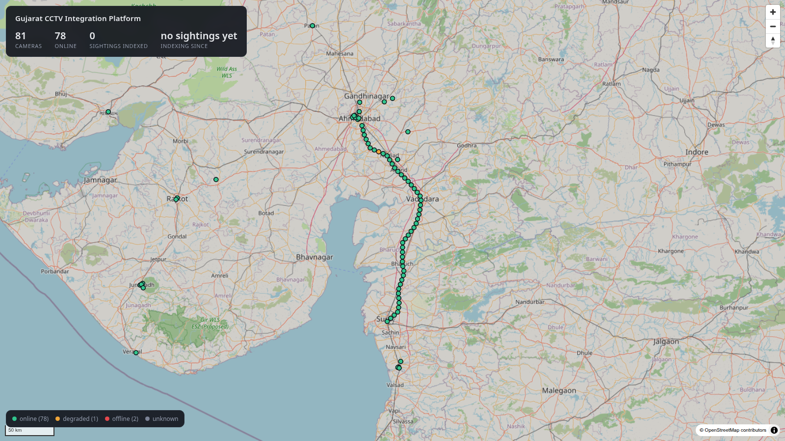
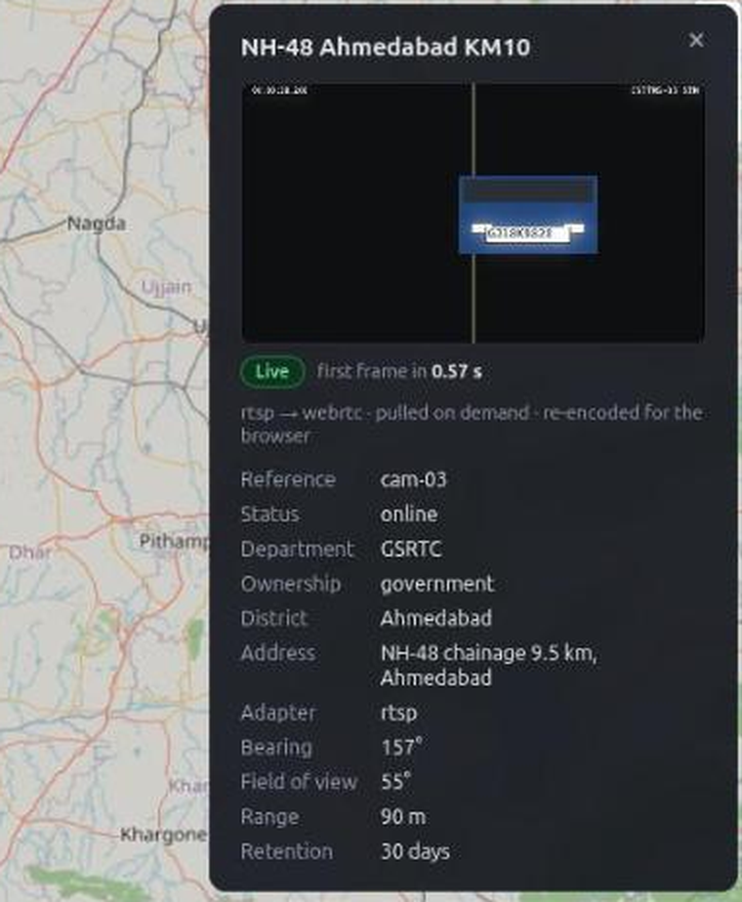
NOT A MOCK-UP
81 cameras onboarded statewide, every one resolved from the government catalogue
Registry and GIS console. Positions resolve from the catalogue's place names through a gazetteer, never from a camera number, because the reference says camera ids can change. Health is probed, so a login page does not count as online.
Live view, pulled on demand. First frame in 0.57 s. The relay starts when an operator opens the camera and is reaped 45 s after the last viewer, so an unwatched camera costs only its metadata.
WORKING PLATFORM · Gujarat Police Hackathon 2026 · Statewide CCTV Integration
19

Slide 20
MEASURED END-TO-END PERFORMANCE
Every number here is live in the platform's own UI, not a rehearsal figure
 | BUDGET | MEASURED | HEADROOM
Vehicle trace across the state | 2 s | 26 ms p50 · 31 ms p95 | 77×
Detection → alert | 5 s | 1.04 s | 4.8×
Camera onboarding | 30 s | 5.1 s | 5.9×
Click → live video, cold camera | n/a | 0.23 s | n/a
Concurrent streams held | 50 | 50 for 15 min, 0 restarts | n/a
Throughput | n/a | 104 sightings/min across 71 cameras | n/a
Plate accuracy, ANPR-grade | n/a | 82.4% exact · 95.1% within 2 | n/a
869 automated tests. Every figure traces to a dated entry recording the method that produced it, which is what makes it checkable rather than asserted.
EVIDENCE · Gujarat Police Hackathon 2026 · Statewide CCTV Integration
20

Slide 21
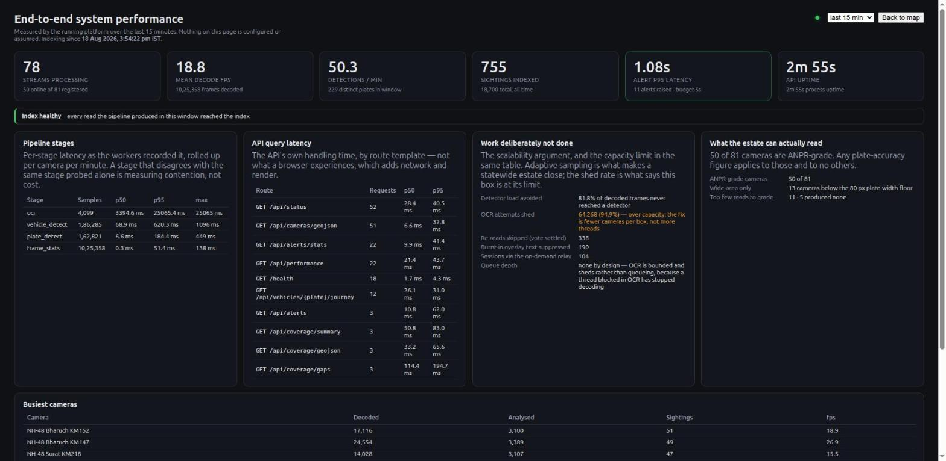
THE PLATFORM MEASURES ITSELF
The previous slide is a screen in the product, not a number we typed into a deck
The third panel is the one to read. It reports work deliberately not done: 94.9% of OCR attempts shed at 76 cameras on a 20-core box. That is the capacity limit stated as a measurement, and it is why the honest sizing figure is 50 to 57 cameras per box rather than 76.
EVIDENCE · Gujarat Police Hackathon 2026 · Statewide CCTV Integration
21

Slide 22
COMMON EVALUATION AREAS
The seven criteria, and where the evidence for each one sits
 | CRITERION | EVIDENCE IN THIS SUBMISSION
1 | Successful test case Onboarding and operation on the government feed | 81 cameras onboarded by catalogue reconciliation, 30 of them government. Live view and recorded playback both demonstrated; ANPR output written to the index.
2 | Solution presentation Problem understanding, model, justification | This deck. Element 1 states the model and why Model 4 was rejected with the arithmetic; slide 2 states the constraint the whole design follows from.
3 | Solution architecture Soundness, feasibility, security, interoperability | Six-layer HLD, the workflow diagram on slide 9, and the interoperability and security slide. Full design in the submitted HLD document.
4 | Working platform and demonstration | Slides 19 and 21 are screens from the running platform. Demonstrated on both our own simulated estate and the government feed.
5 | Video analytics output ANPR, detection, timestamps, reports | ANPR with per-condition accuracy, vehicle detection and tracking, tamper detection, appearance attributes, and CSV and PDF detection reports carrying the evidence crop.
6 | Scalability and PoC readiness Toward 80,000 cameras | Measured capacity per box, sharding by advisory lock with no orchestrator, and the shed rate published rather than hidden. Slides 16 and 21.
7 | Submission completeness | Deck, HLD, workflow diagram, demonstration video, public repository, live instance with a viewer account, and API documentation.
Nothing in this column is aspirational. Where a capability is designed rather than built, it is labelled as such on slide 17, and the limits we know about are stated on the final slide rather than left for an evaluator to find.
EVALUATION · Gujarat Police Hackathon 2026 · Statewide CCTV Integration
22

Slide 23
BONUS CONSIDERATIONS
Each of the six, and what we built against it
NOVEL HYBRID ARCHITECTURE
All three models, not a choice between them
Registry as control plane, direct feed access for analytics, adapters for everything that does not fit. The registry is mandatory; the other two are how it earns its keep.
CROSS-CAMERA CORRELATION
Route reconstruction in 26 ms
Road-snapped through OSRM, with per-hop plausibility. An impossible hop splits the journey and flags a probable cloned plate rather than being discarded.
ANALYTICS BEYOND ANPR
Four more, all shipped
Vehicle detection and tracking, camera tamper detection, appearance attributes for feeds that cannot resolve a plate, and face detection as a disabled plugin proving the pipeline takes modules.
EDGE AND BANDWIDTH
About 0.5 kbit/s per camera
Analytics run beside the camera and only metadata crosses the link. Video is pulled on demand and released 45 s after the last viewer, so cost is per viewer, not per camera.
SECURITY AND PRIVACY
Audited, role-split, crops not frames
Every view, search, trace and export is recorded in an append-only log. Two roles, and the evaluation account is read-only by API enforcement. One 8 kB evidence crop per sighting; no recorded video.
DASHBOARDS AND APIS
Integration-ready by default
GIS console, alert desk, journey explorer and a live performance page. Every capability is an OpenAPI-documented endpoint, with GeoJSON for anything geographic.
EVALUATION · Gujarat Police Hackathon 2026 · Statewide CCTV Integration
23

Slide 24
WHAT WE DO NOT CLAIM
A proposal that lists only strengths cannot be checked
▪ All 30 government cameras fall below ANPR grade, and none of the 50 simulated ones do, the platform grades this itself, from crops it measured. Their crops average 66 px across, about 7 px per character. They are correctly deployed situational-awareness views. Every accuracy figure here is scoped to ANPR-grade cameras. Measured live on 14 Sep with the learned detectors: 344 real vehicles in 10 minutes, boxes on real plates, median plate width 29 px and 0 valid plates from any reader we tested; the report lists detected vehicles with type, colour and time.
▪ Night accuracy was 58.6% exact with Tesseract. docTR, now the default, finds 62% of night plates against 35% on the same clips.
▪ A vehicle id joined by appearance is a lead, not an identification. 43 links checked by eye on the government cameras: 34 right, 7 wrong, 2 unclear; at the shipped threshold 16 of 17 were right. None crossed cameras, so there it re-finds a vehicle on one camera rather than following it between cameras. The plate trace never follows an appearance link.
▪ Edge autonomy, push notification routing, mTLS and the vendor VMS adapters are designed, not built. They are in the technical proposal because the architecture is incomplete without them, and labelled because a proposal that blurs built and specified cannot be trusted on either.
▪ Watchlist data is representative, not live. No team has live VAHAN access for a hackathon.
▪ The 1,600-node figure assumes traffic like the measured corridor's. A quiet road costs less, a toll plaza more, and the platform reports sightings-per-camera-per-minute per camera, so the model stays checkable at rollout rather than only at design time.
Saying this first is worth more than being asked. It is also what makes every other number in this deck credible.
CREDIBILITY · Gujarat Police Hackathon 2026 · Statewide CCTV Integration
24

