Slide 1


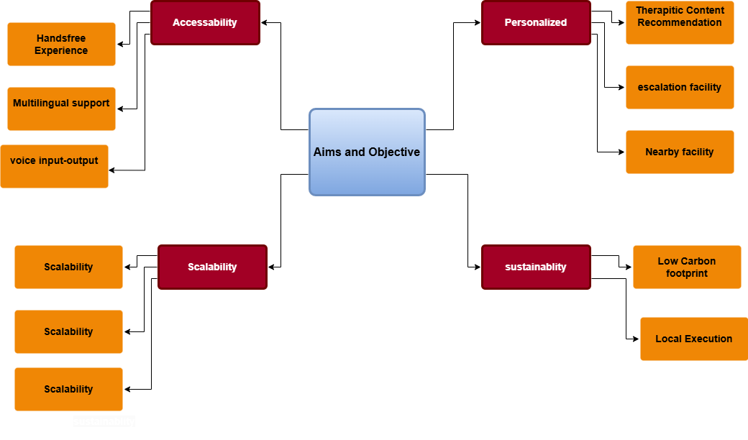
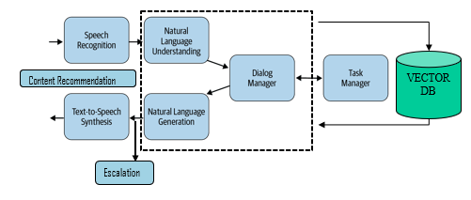
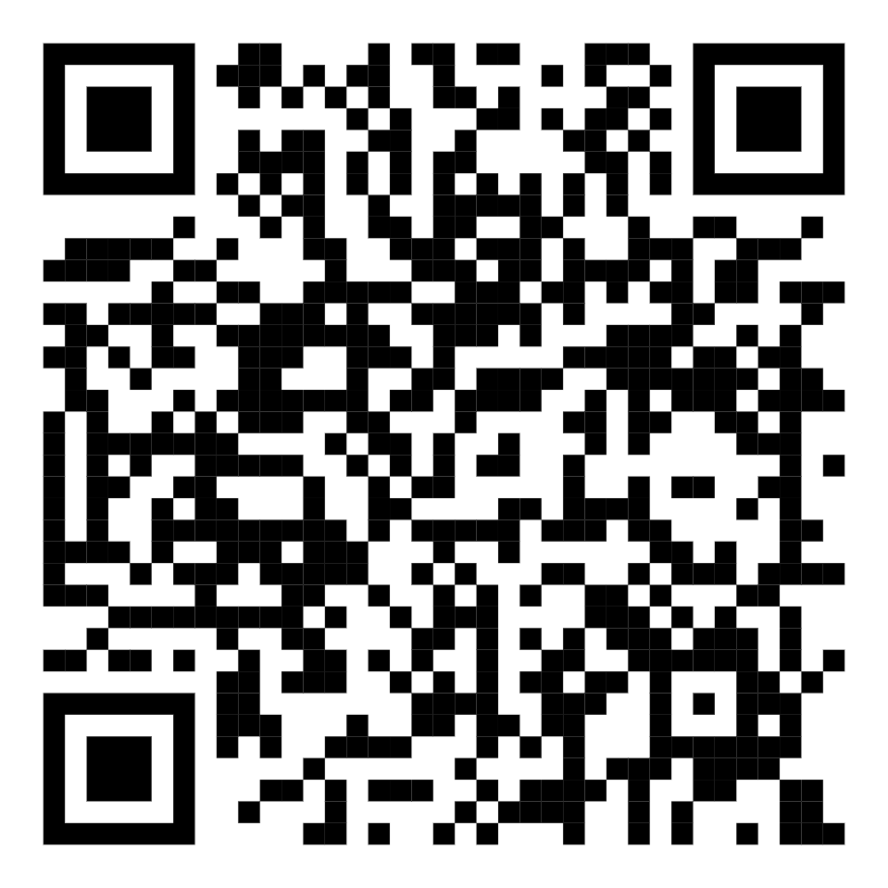


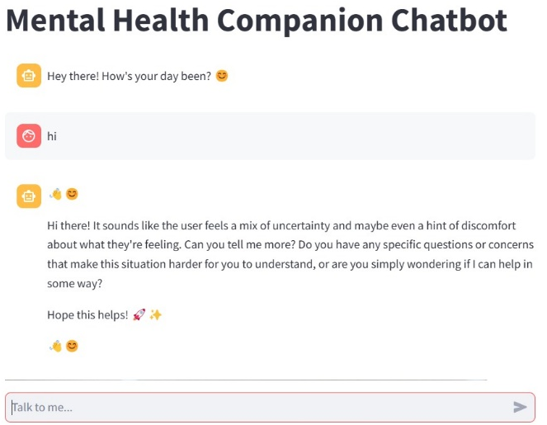
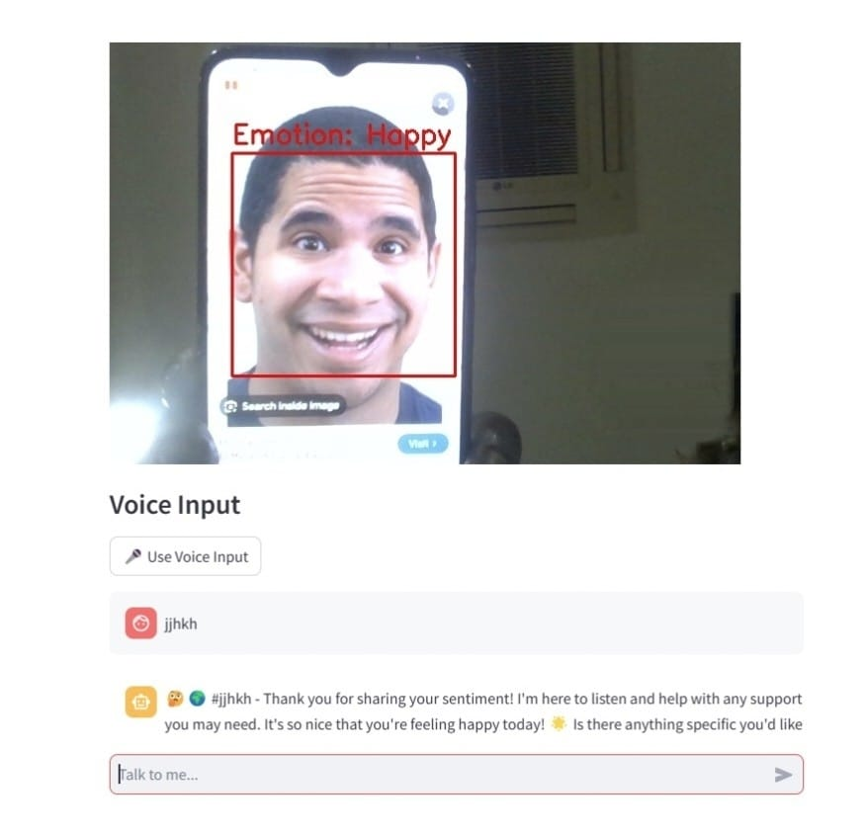
EmotiCare
A Mental Health Companion Chatbot
Mentored by,
Dr Sricheta Parui,
Assistant Professor(||),School
Of Computer Engineering
*Srinithi Mitra *Ranit Mukherjee *Arka Singha * Aditi Mehta *School Of Computer Science Engineering
Abstract
Our project, a Mental Heath AI Chatbot focuses on bridging the gap between people and their inability to address their emotions openly and provides emotional support through real-time sentiment analysis, mood tracking and adaptive responses.
Aim & Objectives
Methodology & Implementation
CNN
Model
Introduction
In the modern world, mental health is a serious issue that is neither treated properly nor given much importance. The main goal of our project is to create a personalized and friendly environment for the user through AI, to address their issues, get answers regarding their mental state, empathize with them, and serve as a friendly guide.
LLM Model
Result Analysis
The Mental Health Chatbot has been successfully developed and tested, ensuring user-friendliness, eco-friendliness, and effective interactions. Key features include multilingual support, voice input-output, emotion detection, personalized recommendations, and nearby help assistance, all with a low carbon footprint.
Conclusion
The project demonstrated how the mental health guide can reduce our stress, and anxiety thus, ensuring mental well-being and providing us with a healthy mind to live with.
Future works
Our aim will be to deploy this chatbot in daily use apps for easy access to it whenever required and to ensure empowerment and self-management.
Acknowledgments
We would like to express our heartfelt gratitude to our supervisor and mentor, Dr. Sricheta Parui. We also extend our thanks to KIIT University for allowing us to present our work.
References
https://registry.ollama.com/
https://medium.com/@rushing_andrei/function-calling-with-open-source-llms-594aa5b3a304

