Slide 1

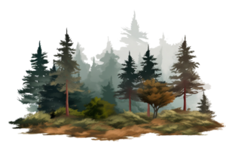
Green AI - ML/AI to compare drone images of an afforestation patch and point out casualties.
Team ID - 25KTJGREA746575
Name (Member 1) - Arka Singha
KTJ ID - 25KTJARK358809

Slide 2
Abstract
This project utilizes Green AI methodologies to analyze drone-captured images of afforestation patches, aiming to detect casualties and monitor tree growth. Initially, pits of dimensions 45×45×45cm times 45 times 45 cm are identified, and their geo-coordinates are extracted using feature matching from image metadata. The pixel-to-coordinate mapping is performed on the orthomosaics, and the center of the pits is saved in a lookup table. For subsequent ortho mosaics, 3D reconstructions via COLMAR software identify the highest local maxima (tree tips) using pixel-to-height mapping and 8-connectivity searches. Differences in tree height across orthomosaics are calculated, allowing for the identification of growth patterns: positive, negative, or neutral, indicating growing, decaying, or diseased conditions, respectively. Spatial filters, Difference of Gaussians (DoG), and region-growing algorithms refine green pixel clusters for individual tree analysis. Advanced models like U-Net and DeepLabV3+ are leveraged to segment greenery from the soil, while vegetation health indices (GCI and NDVI) are used for sapling evaluation, providing a robust framework for monitoring forest health dynamically and effectively.

Slide 3
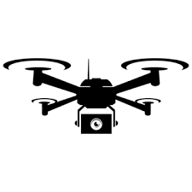

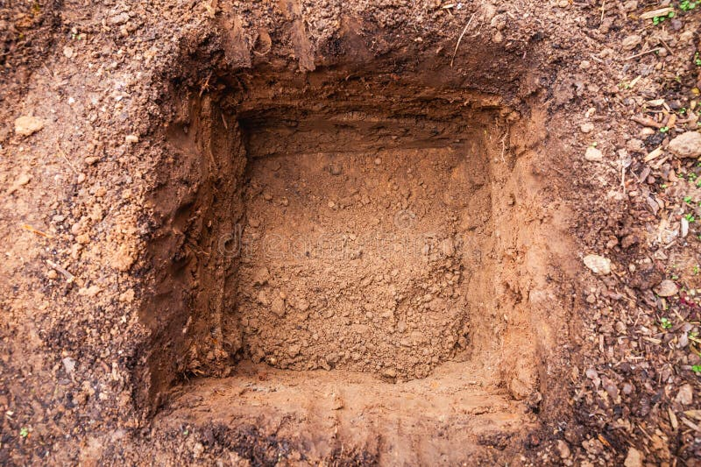
Flow of Algorithm on Drone Images 1 after OP1
Detect Pits of 45×45×45cmv
Pix4D
Orthomosaic 1
Drone Images 1
Select the center of the pits
Split it into Grids
Extract the Geo-Coordinates from the metadata of the small images after feature-matching
Save it as a LOOK UP TABLE
|Grid No.|Centre Pixel|Latitude|Longitude|Altitude|
pixel-to-coordinate
mapping on the Orthomosaic.

Slide 4
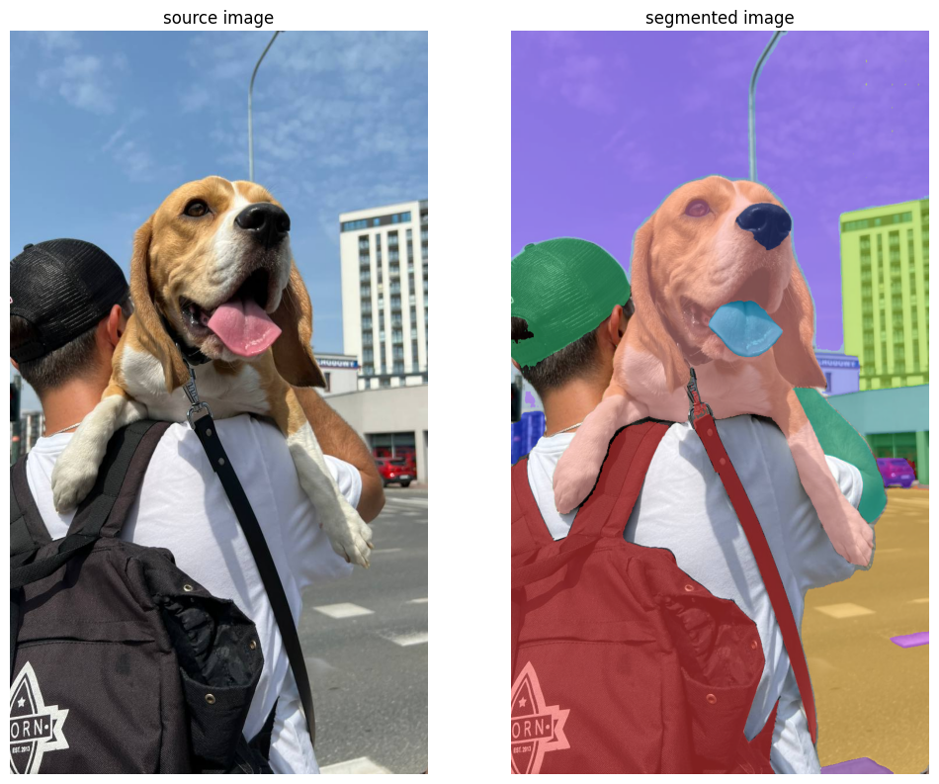
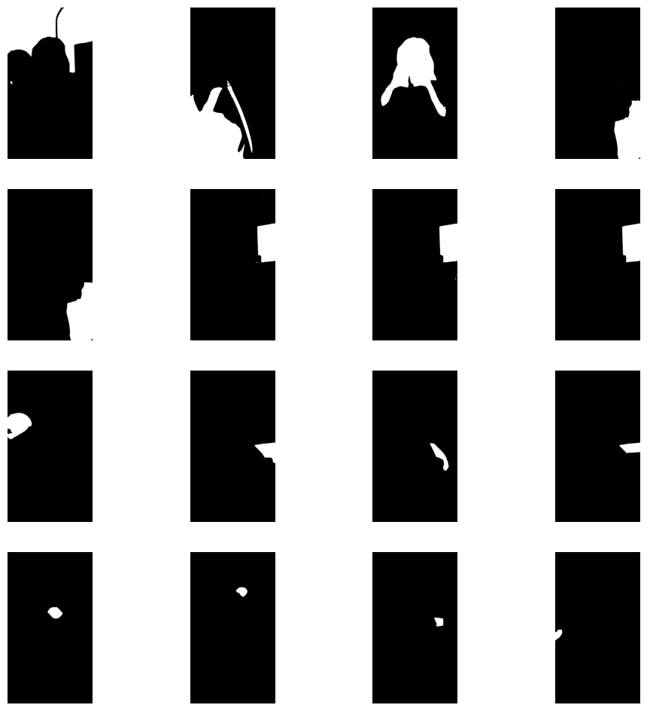
For detection we can use SAM2 model
Semantic Segmentation
Extracting and Displaying Individually Extracted Masks
Masks from where we can calculate the Area and Locate pixels of saplings
Extract features from those pixel locations of the real image
Search and traverse through images to find that sampling in raw images.
If found, extract the geo-coordinates from the metadata of the images
Add to the Look Up Table with that pixel number.

Slide 5
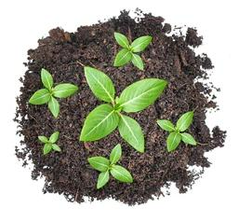
Flow of Algorithm on Drone Images 2 after OP2
Pix4D
Orthomosaic 2
Drone Images 2
COLMAR Software
3-D Reconstruction
Use 8-connectivity searches from the center of the pit value to the neighboring pixels to find the Tip of the Trees
Extract the Geo-Coordinates from the metadata of the small images after feature-matching
Eliminate maximums lesser than the highest maxima in a grid
Select local Maximums in Z axis
Fetch from the Look table of Previous Data
After OP 1
Tip of the Trees – TOP is detected for each image
pixel-to-coordinate
Pixel-to-height
mapping on the Orthomosaic.
Save it to a new LOOK UP TABLE
|Grid No.|Centre Pixel|Latitude|Longitude|Altitude |TOP Pixel | TOP Z-value|
Output 2

Slide 6
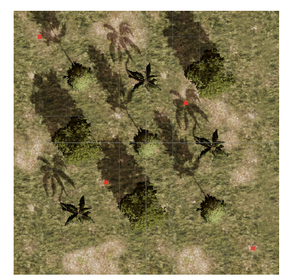
Steps for 3D Reconstruction:
FORSAT: UAV-Based Photogrammetry in Forestry to generate accurate Digital Terrain Models (DTMs)
3D photogrammetry
Try to find the local maximums at pit centers and if not found try for 8 connected pixels recursively to detect the tips.
Reference:
https://www.mdpi.com/1999-4907/13/2/173
https://www.mdpi.com/2072-4292/11/11/1271

Slide 7
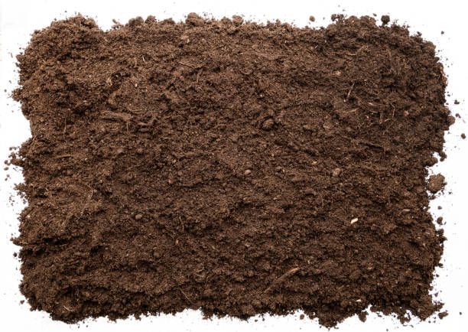
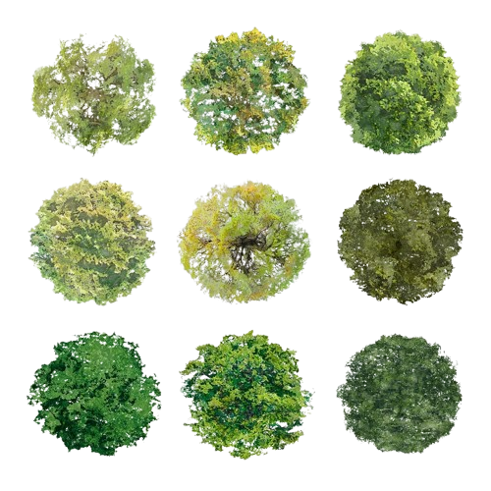
Flow of Algorithm on Drone Images 3 after OP3
Pix4D
Orthomosaic 3
Drone Images 3
COLMAR Software
3-D Reconstruction
Use 8-connectivity searches from the center of the pit value to the neighboring pixels to find the Tip of the Trees
Extract the Geo-Coordinates from the metadata of the small images after feature-matching
Eliminate maximums lesser than the highest maxima in a grid
Select local Maximums in Z axis
Fetch from the Look table of Previous Data
After OP 2
Tip of the Trees – TOP is detected for each image
pixel-to-coordinate
Pixel-to-height
mapping on the Orthomosaic.
Save it to a new LOOK UP TABLE
|Grid No.|Centre Pixel|Latitude|Longitude|Altitude |TOP Pixel | TOP Z-value|
OUTPUT 3

Slide 8
Analysis based on Difference
Spatial Filters and DoG (Difference of Gaussians) can also be used
Noises like trees already present before forestation can be removed easily.
For each Grid :
If diff1>0 :
+ve means growing rising
-ve means growth is slowing
0 means growth is constant
If diff1<0 :
+ve means it may survive
-ve means dead
0 means dead
Further Analysis is possible
with real values from real Data.
For each Grid
+ve means tree in growing,
-ve means the tree is dead or decayed
0 means no growth, either dead or diseased
OUTPUT 1
Difference 1
-
OUTPUT 2
+ve, -ve or 0
Difference 2
2nd Order Difference
-
-
OUTPUT 3

Slide 9


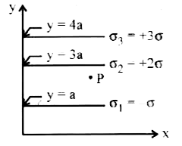
Individual Analysis based on Greenary
Apply the Region Growing Algorithm to add connected greens with the grid center pixel (Orthomosaic-1) or tip of the tree pixel (Orthomosaic-2) and eliminate green pixels that are not connected
Eliminate
Soil from
the Background
Apply the Region Growing Algorithm to add connected greens with the grid center of the tip of the tree pixel and eliminate green pixels that are not connected
Result for each tree or Sappling
Pretrained Model for Measuring Health with GCI and NDVI
Example: Unet, DeepLabV3+
Further Analysis
Calculate the number of Green pixels in each Grid
Relative Grading

