Slide 1
CASE 1: Victim task sampling period is 2
CASE 2: Victim task sampling period switched to 3 from 2 after a hyperperiod
Hyper
period 1
t=0
t=0
t=2
t=2
Attacker task Arrival Column
t=0
Observations:
Case 1: Attacker uses finds out that victim periodically arrives at first slot (since attacker does not execute there even once)
Case 2: Since the attacker task executes at both the columns, it confuses the attacker
t=2
t=4
Hyperperiod 2
t=6
t=8
t=10
t=12
Attacker task Arrival Column

Slide 2


Valid Randomized
Schedules
Task Set
All Possible
Randomized Schedules
With Multi-Rate
Analyse Victim Task Attack Probability constraints
Trusted
Tasks
Task m$(p_{m,1},e_{m},d_{m})$
($p_{m,2},e_{m},d_{m})$
Design time
Untrusted
Tasks
Task n$(p_{n},e_{n},d_{n})$
Attack-Aware Schedule Pool
Deploy Schedule Selection Algorithm after each hyperperiod
Secure-Multi-Rate Schedules
Change in Plant Residue Mean > Threshold
Run Time

Slide 3
Valid Randomized
Schedules
Task Set
All Possible
Randomized Schedules
With Multi-Rate
Analyse Victim Task Attack Probability constraints
Trusted
Tasks
Task m$(p_{m,1},e_{m},d_{m})$
($p_{m,2},e_{m},d_{m})$
Design time
Untrusted
Tasks
Task n$(p_{n},e_{n},d_{n})$
Attack-Aware Schedule Pool
Deploy Schedule Selection Algorithm after each hyperperiod
Secure-Multi-Rate Schedules
Change in Plant Residue Mean > Threshold
Run Time

Slide 4






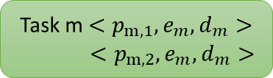

Task Set
Step 1
Step 2
Untrusted
Task 1$<p_{1},e_{1},d_{1}>$
Generate All Possible EDF Schedules
Select Schedule after each Hyperperiod
Anterior ${(S}_{A})$
Task n$<p_{n},e_{n},d_{n}>$
Posterior ${(S}_{P})$
Task 1$<p_{1},e_{2},d_{3}>$
Both ($S_{B}$)
Trusted
None($S_{N}$)
Schedule Pattern
Task m$<p_{m,1},e_{m},d_{m}>$
$<p_{m,2},e_{m},d_{m}>$
Schedule Pool
SBA-wise Categorization
The input is a finite task set. We consider a mixed critical system having both trusted and untrusted tasks.
Generate all possible EDF schedules online considering multi-rate of victim task and categorise them on their vulnerability type.
We pick schedules from each category such that the schedule pattern keeps changing the vulnerability type for each task.

Slide 5



Input Task and System Specifications
Deriving set of switchable periodicities for control tasks to maintain system stability
Task m$(p_{m1,}p_{m2,}..)$
1. Choose coprime periodicities from switchable periodicities of each control task.
2. Derive valid fixed-priority schedules for chosen set of co-prime periodicities.
Analyse attack success probability corresponding to each victim task given a valid schedule
Design time
Task m$(p_{m,},e_{m})$
Trusted
Task Set
Attack-Aware Schedule Pool
System Specification corresponding to trusted control tasks
Yes
Change in Plant Residue Mean > Threshold
Deploy Schedule Selection Algorithm after each hyperperiod
Untrusted
Tasks
Task n$(p_{n},e_{n})$
Run Time
No
Execute in fixed-priority sampling period

Slide 6

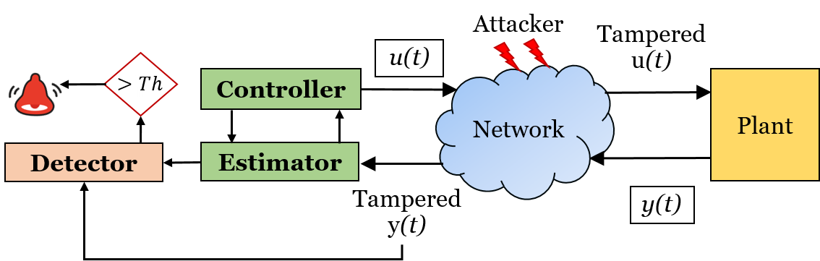
















Uniprocessor System
$$T_{3}$$
$$T_{1}$$
$$T_{2}$$
$$R$$
$$x[k+1]=Ax[k]+Bu[k]$$
$$u$$
$$y$$
$$+$$
$$y[k]=Cx[k]+Du[k]$$
Attacker Task $T_{2} i$njects Falsified Data in Shared Buffer with Task $T_{1}$
$$−$$
$(y−\hat{y}$)
$$+$$
K
L
$$−$$
$$\hat{x}$$
$$\hat{y}$$
$\hat{x}\left[k+1\right]=A\hat{x}\left[k\right]+Bu\left[k\right]+L(y−\hat{y}$)
C
Controller + Estimator

Slide 7


Slide 8
Control Task
>Th
Controller
..
Detector
Estimator

Slide 9



Physical Plant
Threshold
Sensor
Residue Statistics
Communication Channel
Actuator
$g_{k}>Th$ => Attack?
Control Task
>Th
Controller
Detector
Estimator
CPU
Scheduler

Slide 10



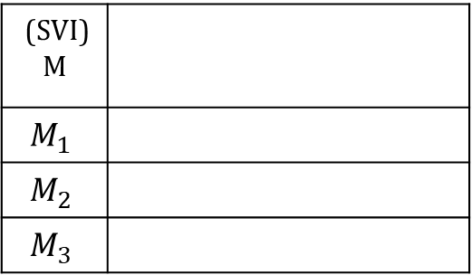



Look Up (LU) Table
(SVI) M
$$M_{1}$$
$$M_{2}$$
$$M_{3}$$
Critical Attack Probability
${[ τ}_{1}$, $τ_{2}$, $τ_{3}$, . . . . $τ_{m}$ ]
$$s_{1}$$
[0, 1, 0, . . . . . . . . ]
$$s_{2}$$
[1, 1, 0, . . . . . . . . ]
$$s_{3}$$
.
.
[1, 1, 1, . . . . . . . . ]
.
.
. . . . . . . . . .
$$s_{N}$$
[0, 0, 0, . . . . . . . . ]
$$M_{N}$$

Slide 11



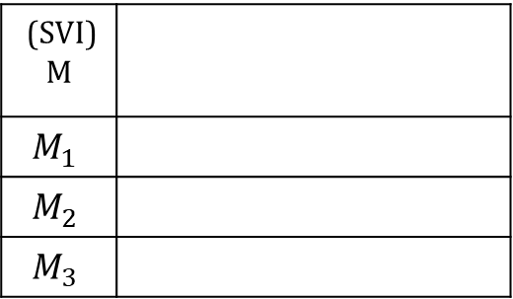



Look Up (LU) Table
ID | Start | End | WCET
1 | 0 | 1 | 1
2 | 1 | 2 | 1
3 | 2 | 3 | 1
1 | 3 | 4 | 1
2 | 4 | 5 | 1
3 | 5 | 6 | 1
1 | 6 | 7 | 1
0 | 7 | 8 | 1
2 | 8 | 9 | 1
1 | 9 | 10 | 1
3 | 10 | 11 | 1
0 | 11 | 12 | 1
(SVI) M
$$M_{1}$$
$$M_{2}$$
$$M_{3}$$
Critical Attack Probability
${[ τ}_{1}$, $τ_{2}$, $τ_{3}$, . . . . $τ_{m}$ ]
$$s_{1}$$
[0, 1, 0, . . . . . . . . ]
$$s_{2}$$
[1, 1, 0, . . . . . . . . ]
$$s_{3}$$
.
.
[1, 1, 1, . . . . . . . . ]
.
.
. . . . . . . . . .
$$s_{N}$$
[0, 0, 0, . . . . . . . . ]
$$M_{N}$$

Slide 12

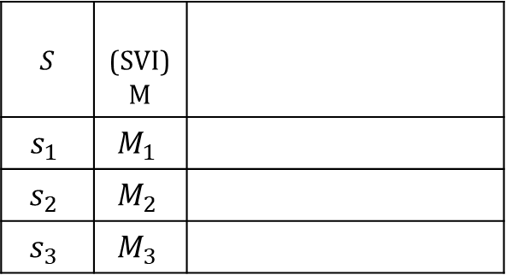

ID | Start | End | WCET
1 | 0 | 1 | 1
2 | 1 | 2 | 1
3 | 2 | 3 | 1
1 | 3 | 4 | 1
2 | 4 | 5 | 1
3 | 5 | 6 | 1
1 | 6 | 7 | 1
0 | 7 | 8 | 1
2 | 8 | 9 | 1
1 | 9 | 10 | 1
3 | 10 | 11 | 1
0 | 11 | 12 | 1
Look Up Table (LUT)
$$S$$ | (SVI) M
$$s_{1}$$ | $$M_{1}$$
$$s_{2}$$ | $$M_{2}$$
$$s_{3}$$ | $$M_{3}$$
Critical Attack Probability
${[ τ}_{1}$, $τ_{2}$, $τ_{3}$, . . . . $τ_{m}$ ]
[0, 1, 0, . . . . . . . . ]
[1, 1, 0, . . . . . . . . ]
.
.
[1, 1, 1, . . . . . . . . ]
.
.
. . . . . . . . . .
[0, 0, 0, . . . . . . . . ]
$$s_{N}$$ | $$M_{N}$$

Slide 13
Input Task and System Specifications
Deriving set of switchable periodicities for control tasks to maintain system stability
Task m$(p_{m1,}p_{m2,}..)$
1. Choose coprime periodicities from switchable periodicities of each control task.
2. Derive valid fixed-priority schedules for chosen set of co-prime periodicities.
Analyse attack success probability corresponding to each victim task given a valid schedule
Design time
Task m$(p_{m,},e_{m})$
Trusted
Task Set
Attack-Aware Schedule Pool
System Specification corresponding to trusted control tasks
Yes
Change in Plant Residue Mean > Threshold
Deploy Schedule Selection Algorithm after each hyperperiod
Untrusted
Tasks
Task n$(p_{n},e_{n})$
Run Time
No
Execute in fixed-priority sampling period

Slide 14
CASE 1: Victim task sampling period is 2
CASE 2: Victim task sampling period switched to 3 from 2 after a hyperperiod
Hyper
period 1
t=0
t=0
t=2
t=2
t=4
t=0
t=6
t=2
t=8
t=4
Hyperperiod 2
Observations:
Case 1: Attacker uses finds out that victim periodically arrives at first slot (since attacker does not execute there even once)
Case 2: Since the attacker task executes at both the columns, it confuses the attacker
t=10
t=6
Attacker task Arrival Column
t=8
t=10
t=12
Attacker task Arrival Column

Slide 15
CASE 1: Victim task sampling period is 2
CASE 2: Victim task sampling period switched to 3 from 2 after one hyperperiod
Hyper
period 1
t=0
Hyper
period 1
t=0
t=2
t=2
Hyper
period 2
t=4
t=0
t=6
t=2
t=4
Hyper
period 3
t=8
Hyperperiod 2
t=10
t=6
Observations:
Case 1: Attacker uses finds out that victim periodically arrives at first slot (since attacker does not execute there even once)
Case 2: Since the attacker task executes at both the columns, it confuses the attacker
Attacker task Arrival Column
t=8
t=10
Attacker never
arrives in
this column
Attacker task Arrival Column
Attacker task execution
Arrival column of
victim task

Slide 16





Input Task and System Specifications
Choose periodicities that obfuscate attacker’s analysis
Deriving set of switchable periodicities for control Tasks to maintain system stability
P=$\{p_{m1,}p_{m2,}..\}$
Analyse attack probability corresponding to each victim task in each schedule
Task m$(ID, p_{m,},e_{m})$
Task Criticality Level
Derive all feasible schedules
Design Time
Trusted Task Set $(Γ_{t})$
System Specification corresponding to trusted control tasks
Store all Attack-Aware Schedules in a Look Up table
Change in Plant Residue Mean
> Threshold
Select and execute schedules under critical schedule vulnerability Index
Deploy Schedule Selection Algorithm after each hyperperiod
Detector Threshold
Run Time
Untrusted Task Set ($Γ_{u})$
No
Select and execute schedules under critical attack probability of the task
Task n$(p_{n},e_{n})$
Yes

Slide 17

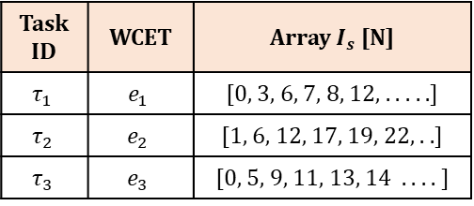
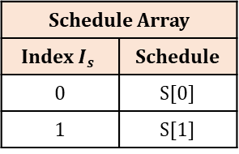

Schedule Array
Index $I_{s}$ | Schedule
0 | S[0]
1 | S[1]
Look Up Table
Task ID | WCET | Array $I_{s}$[N]
$$τ_{1}$$ | $$e_{1}$$ | [0, 3, 6, 7, 8, 12, . . . . .]
$$τ_{2}$$ | $$e_{2}$$ | [1, 6, 12, 17, 19, 22, . .]
$$τ_{3}$$ | $$e_{3}$$ | [0, 5, 9, 11, 13, 14 . . . . ]
. . . . . . .
K | S[K]
. . . . . . .
. . . . . . .
N | S[0]
$$τ_{3}$$ | $$e_{m}$$ | [0, 6, 15, 17, 30, 43 . . . . ]
Schedule S[0]
Schedule S[1]
Schedule S[N-1]
.…
ID | Start | End
1 | 0 | 1
2 | 1 | 2
3 | 2 | 3
1 | 3 | 4
2 | 4 | 5
3 | 5 | 6
1 | 6 | 7
0 | 7 | 8
2 | 8 | 9
1 | 9 | 10
3 | 10 | 11
0 | 11 | 12
ID | Start | End
1 | 0 | 1
2 | 1 | 2
ID | Start | End
2 | 0 | 1
1 | 1 | 2
ID | Start | End
3 | 0 | 1
2 | 1 | 2
.…
.…
. . . . . . .
. . . . . . .
. . . . . . .
4 | 11 | 12
0 | 7 | 8
.…
2 | 5 | 6
Increasing schedule vulnerability index M
$$τ_{m}$$ | $$M_{N}$$
[0, 5, 3, . . . . . . . . ]

Slide 18


Physical Plant
Threshold
$T_{X}$ task
Sensor
Residue Statistics
Control and Detector task
Other tasks
Actuator
$g_{k}>Th$ => Attack?
Attacker task
$R_{X}$ task
Communication Channel
. . . . . . . .
I/O Buffer
Controller Unit
Sensor Msg
Actuator Msg
Control Task
>Th
Controller
Detector
Estimator

Slide 19























$τ_{1}^{1}$, $τ_{2}^{1}$, $τ_{3}^{1}$
$$τ_{1}^{1}$$
$τ_{1}^{2}$, $τ_{2}^{1}$, $τ_{3}^{1}$
$$τ_{1}^{2}$$
$$s_{1}$$
$$τ_{3}^{1}$$
$$τ_{1}^{1}$$
$$τ_{1}^{2}$$
$$τ_{2}^{1}$$
$$τ_{1}$$
$$s_{2}$$
3 | 1 | 1 | 2
1 | 2 | 3 | 1
3 | 1 | 2 | 1
1 | 2 | 1 | 3
2 | 1 | 1 | 3
1 | 3 | 2 | 1
2 | 1 | 3 | 1
1 | 3 | 1 | 2
$$τ_{1}^{1}$$
$$τ_{2}^{1}$$
$$τ_{3}^{1}$$
$$τ_{1}^{2}$$
$$s_{3}$$
$$τ_{3}^{1}$$
$$τ_{1}^{1}$$
$$τ_{2}^{1}$$
$$τ_{1}^{2}$$
$$τ_{2}$$
$$s_{4}$$
$$τ_{1}^{1}$$
$$τ_{2}^{1}$$
$$τ_{1}^{2}$$
$$τ_{3}^{1}$$
$$τ_{3}$$
$$s_{5}$$
$$τ_{2}^{1}$$
$$τ_{1}^{1}$$
$$τ_{1}^{2}$$
$$τ_{3}^{1}$$
$$s_{6}$$
$$τ_{1}^{1}$$
$$τ_{3}^{1}$$
$$τ_{2}^{1}$$
$$τ_{1}^{2}$$
job
arrivals
$$s_{7}$$
$$τ_{2}^{1}$$
$$τ_{1}^{1}$$
$$τ_{3}^{1}$$
$$τ_{1}^{2}$$
$$s_{8}$$
$$τ_{1}^{1}$$
$$τ_{3}^{1}$$
$$τ_{1}^{2}$$
$$τ_{2}^{1}$$
deadlines
0 1 2 3 4

Slide 20
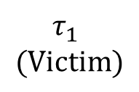
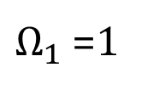
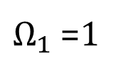
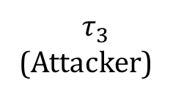

$$τ_{1}$$
$$(Victim)$$
$Ω_{1}$ =1
$Ω_{1}$ =1
$$τ_{2}$$
$$τ_{3}$$
(Attacker)
0 1 2 3 4

Slide 21















































$τ_{1}^{1}$, $τ_{2}^{1}$, $τ_{3}^{1}$
$$τ_{1}^{1}$$
$τ_{1}^{2}$, $τ_{2}^{1}$, $τ_{3}^{1}$
$$τ_{1}^{2}$$
$$s_{1}$$
$$τ_{3}^{1}$$
$$τ_{1}^{1}$$
$$τ_{1}^{2}$$
$$τ_{2}^{1}$$
$$τ_{1}$$
$$s_{2}$$
$$τ_{1}^{1}$$
$$τ_{2}^{1}$$
$$τ_{3}^{1}$$
$$τ_{1}^{2}$$
$$s_{3}$$
$$τ_{3}^{1}$$
$$τ_{1}^{1}$$
$$τ_{2}^{1}$$
$$τ_{1}^{2}$$
$$τ_{2}$$
$$s_{4}$$
$$τ_{1}^{1}$$
$$τ_{2}^{1}$$
$$τ_{1}^{2}$$
$$τ_{3}^{1}$$
$$τ_{3}$$
$$s_{5}$$
$$τ_{2}^{1}$$
$$τ_{1}^{1}$$
$$τ_{1}^{2}$$
$$τ_{3}^{1}$$
$$s_{6}$$
$$τ_{1}^{1}$$
$$τ_{3}^{1}$$
$$τ_{2}^{1}$$
$$τ_{1}^{2}$$
job
arrivals
$$s_{7}$$
$$τ_{2}^{1}$$
$$τ_{1}^{1}$$
$$τ_{3}^{1}$$
$$τ_{1}^{2}$$
$$s_{8}$$
$$τ_{1}^{1}$$
$$τ_{3}^{1}$$
$$τ_{1}^{2}$$
$$τ_{2}^{1}$$
deadlines
0 1 2 3 4

Slide 22














$τ_{1}^{1}$, $τ_{2}^{1}$, $τ_{3}^{1}$
$τ_{1}^{1},$ $τ_{1}^{2}$
$τ_{1}^{2}$, $τ_{2}^{1}$, $τ_{3}^{1}$
$$s_{1}$$
$$τ_{1}$$
$$s_{2}$$
$$s_{3}$$
$$τ_{2}$$
$$s_{4}$$
$$τ_{3}$$
$$s_{5}$$
$$s_{6}$$
job
arrivals
$$s_{7}$$
$$s_{8}$$
deadlines
0 1 2 3 4

Slide 23


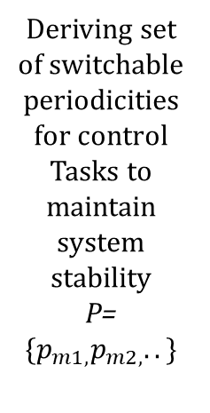


Input Task and System Specifications
Deriving set of switchable periodicities for control Tasks to maintain system stability
P=$\{p_{m1,}p_{m2,}..\}$
Choose periodicities that obfuscate attacker’s analysis
Analyse attack probability corresponding to each victim task in each schedule
Task m$(ID, p_{m,},e_{m})$
Task Criticality Level
Design Time
Derive all feasible schedules
System Specification corresponding to trusted control tasks
Store all Attack-Aware Schedules in a Look Up table
Trusted Task Set $(Γ_{t})$
Detector Threshold
Change in Plant Residue Mean > Th
Select and execute schedules under critical attack probability of the task
Deploy Schedule Selection Algorithm after each hyperperiod
Critical Attack Probability
Run Time
Untrusted Task Set ($Γ_{u})$
Yes
Select and execute schedules under critical schedule vulnerability Index
Task n$(p_{n},e_{n})$
No

Slide 24
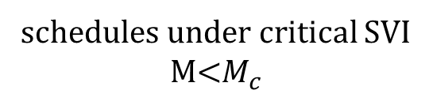

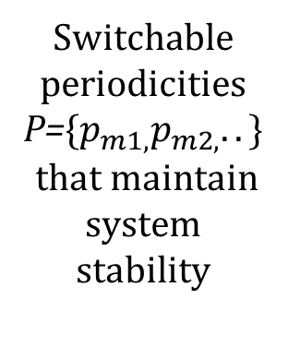


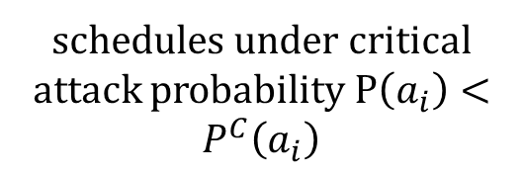


Input Task and System Specifications
Switchable periodicities P=$\{p_{m1,}p_{m2,}..\}$
that maintain system stability
Secure Sampling period selection
Attack probability Analysis
Task m$(ID, p_{m,},e_{m})$
Criticality Level
Design Time
All feasible schedules
Store all Attack-Aware Schedules in a Look Up table
System Specification
Trusted Task Set $(Γ_{t})$
Detector Threshold (Th)
Critical Attack Probability
$$χ^{2} stat of$$
$$residue>th$$
schedules under critical SVI
M<$M_{c}$
Deploy Schedule Selection Algorithm
No
schedules under critical attack probability P$\left(a_{i}\right)<P^{C}\left(a_{i}\right)$
Run Time
Untrusted Task Set ($Γ_{u})$
Task n$(p_{n},e_{n})$
Yes

Slide 25






1
Input Task and System Specifications
Switchable periodicities P=$\{p_{m1,}p_{m2,}..\}$
that maintain system stability
1
3
4
All feasible schedules
Attack probability Analysis
Task$(p_{m,},e_{m})$
Criticality Level
Design Time
2
Store all Attack-Aware Schedules
System Specification
Secure Sampling Period Selection
Trusted Task Set $(Γ_{t})$
Detector Threshold (Th)
$$χ^{2} stat of$$
$$residue>Th$$
Tolerable Attack Probability (TAP)
Schedules Under SVT
No
SCHEDSel()
Algorithm
Schedules Under Tolerable Attack Probability (TAP)
Run Time
Untrusted Task Set ($Γ_{u})$
Task $(p_{n},e_{n})$
Yes

Slide 26




Core-1
Tx
Tx
Data Buffer
Core-2
$$τ_{1}^{1}$$
$$τ_{2}^{1}$$
$$τ_{1}^{2}$$
$$τ_{3}^{1}$$

Slide 27




$$τ_{1}^{1}$$
$$τ_{2}^{1}$$
$$τ_{1}^{2}$$
$$τ_{3}^{1}$$
CASE 1: Victim task sampling period is 2
CASE 2: Victim task sampling period switched to 3 from 2 after one hyperperiod
Hyper
period 1
t=0
Hyper
period 1
t=0
t=2
t=2
Hyper
period 2
t=4
t=0
t=6
t=2
t=4
Hyper
period 3
t=8
Hyperperiod 2
t=10
t=6
Observations:
Case 1: Attacker uses finds out that victim periodically arrives at first slot (since attacker does not execute there even once)
Case 2: Since the attacker task executes at both the columns, it confuses the attacker
Attacker task Arrival Column
t=8
t=10
Attacker never
arrives in
this column
Attacker task Arrival Column
Attacker task execution
Actual arrival column of victim task

Slide 28
Control
Task
Tx Task
Other
Tasks
AEW
Tx
Data Buffer
AEW
AEW Start
AEW Start

Slide 29
CASE 2: Victim task sampling period switched to 3 from 2 after one hyperperiod
$$τ_{3}^{1}$$
Hyper
period 1
t=0
t=2
……
………
t=0
……
………
t=2
……
………
t=4
Hyperperiod 2
t=6
t=8
t=10
Attacker task Arrival Column

Slide 30
CASE 2: Victim task sampling period switched to 3 from 2 after one hyperperiod
……
………
……
………
……
………
………

Slide 31



Victim task execution
Attacker task execution
Attacker task pre-empted
Case 1: $p_{i}$=4
(minimum sampling rate)
Case 2: $p_{i}$=5
Case 3: $p_{i}$=6
t=0
t=4
t=8
t=12
t=16
t=20
t=24
t=28
t=32
t=40

Slide 32
Victim task execution
Attacker task execution
Attacker task pre-empted
Case 1: $p_{i}$=4
(minimum sampling rate)
Case 2: $p_{i}$=5
Case 3: $p_{i}$=6
t=0
t=4
t=8
t=12
t=16
t=20
t=24
t=28
t=32
t=40

Slide 33
Victim task execution
Attacker task execution
Attacker task pre-empted
Case 1: $p_{i}$=4
(minimum sampling rate)
Case 2: $p_{i}$=5
Case 3: $p_{i}$=6
t=0
t=4
t=8
t=12
t=16
t=20
t=24
t=28
t=32
t=40

Slide 34

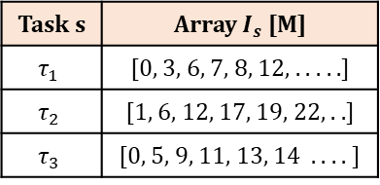


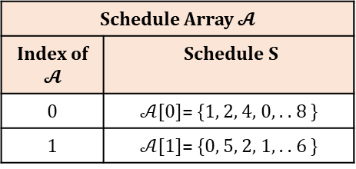
Look Up Table (LUT)
Schedule Array $𝓐$
Index of $𝓐$ | Schedule S
0 | $𝒜$[0]= {1, 2, 4, 0, . . 8 }
1 | $𝒜$[1]= {0, 5, 2, 1, . . 6 }
Task s | Array $I_{s}$[M]
$$τ_{1}$$ | [0, 3, 6, 7, 8, 12, . . . . .]
$$τ_{2}$$ | [1, 6, 12, 17, 19, 22, . .]
$$τ_{3}$$ | [0, 5, 9, 11, 13, 14 . . . . ]
SVI
. . . . . . .
. . . . . . .
SVT
K | $𝒜$[K]= {4, 4, 1, 1, . . 0 }
$$τ_{q}$$ | [0, 6, 15, 17, 30, 43 . . . . ]
M | $𝒜$[M]= {1, 1, 3, 5, . . 0 }
4

Slide 35

Victim task execution
Attacker task execution
Attacker task pre-empted
Case 1: $p_{i}$=4
(minimum sampling rate)
Case 2: $p_{i}$=5
Case 3: $p_{i}$=6
t=0
t=4
t=8
t=12
t=16
t=20
t=24
t=28
t=32
t=40

Slide 36

Victim task execution
Attacker task execution
Attacker task pre-empted
Case 3: $p_{i}$=6
Case 1: pa=4,pv=3,e=1
Case 2: pv=3,pa=5,e=1
Case 3: pv=3, pa=5, e=2
t=0
t=0
t=4
t=4
t=8
t=8
t=12
t=12
t=16
t=16
t=20
t=20
t=24
t=24
t=28
t=28
t=32
t=32
t=40
t=40

Slide 37
Victim task execution
Attacker task execution
Attacker task pre-empted
Case 3: $p_{i}$=6
Case 1: pa=4,pv=3,e=1
Case 2: pv=3,pa=5,e=1
Case 3: pv=3, pa=5, e=2
t=0
t=0
t=4
t=4
t=8
t=8
t=12
t=12
t=16
t=16
t=20
t=20
t=24
t=24
t=28
t=28
t=32
t=32
t=40
t=40

Slide 38
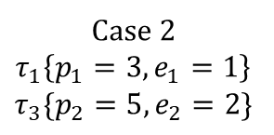

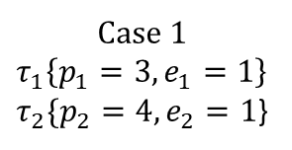




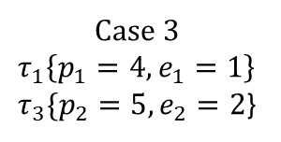
Victim task
Attacker task
Attacker task pre-empted
Task-Set 1 (Victim= $τ_{1}$, Attacker ={$τ_{2}$, $τ_{3}$}
Case 1
$$τ_{1}\left\{p_{1}=3, e_{1}=1\right\}$$
$τ_{2}\{p_{2}=4, e_{2}=1$}
Case 2
$$τ_{1}\left\{p_{1}=3, e_{1}=1\right\}$$
$$τ_{3}\{p_{2}=5, e_{2}=2\}$$
Case 3
$$τ_{1}\left\{p_{1}=4, e_{1}=1\right\}$$
$τ_{3}\{p_{2}=5, e_{2}=2$}
$$τ_{1}\left\{p_{1}=\left(3,4,5\right), e_{1}=1\right\}$$
$$, τ_{2}\left\{p_{2}=,4 e_{2}=1\right\}$$
$$τ_{3}\left\{p_{3}=5 e_{3}=2\right\}$$
t=0
t=0
t=3
t=4
$$τ_{1}\left\{p_{1}=3, e_{1}=1\right\}$$
t=6
t=8
t=9
t=12
Case 2
t=12
t=16
Case 3
$$τ_{2}\{p_{2}=4, e_{2}=1$$
AAI
Case 2
AEI
$$τ_{1}\left\{p_{1}=3, e_{1}=1\right\}$$
$$τ_{2}\{p_{2}=4, e_{2}=1$$
Schedules

Slide 39
t=0
t=3
t=6
t=9
t=12
t=15
t=18
t=21
t=24
t=27

Slide 40
t=0
t=3
t=6
t=9
t=12
t=15
t=18
t=21
t=24
t=27

Slide 41
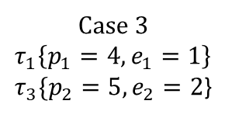
Victim task
Attacker task
Attacker task pre-empted
Task-Set 1 (Victim= $τ_{1}$, Attacker ={$τ_{2}$, $τ_{3}$}
Case 1
$$τ_{1}\left\{p_{1}=3, e_{1}=1\right\}$$
$τ_{2}\{p_{2}=4, e_{2}=1$}
Case 2
$$τ_{1}\left\{p_{1}=3, e_{1}=1\right\}$$
$$τ_{3}\{p_{2}=5, e_{2}=2\}$$
Case 3
$$τ_{1}\left\{p_{1}=4, e_{1}=1\right\}$$
$τ_{3}\{p_{2}=5, e_{2}=2$}
t=0
t=0
t=3
t=4
t=6
t=8
t=9
t=12
t=12
t=16
Case 3
AAI
AEI

Slide 42
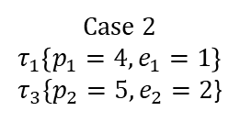
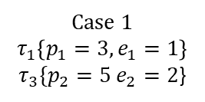
Victim task
Attacker
task
Attacker task
pre-empted
Case 1
$$τ_{1}\left\{p_{1}=3, e_{1}=1\right\}$$
$τ_{3}\{p_{2}=5 e_{2}=2$}
Case 2
$$τ_{1}\left\{p_{1}=4, e_{1}=1\right\}$$
$τ_{3}\{p_{2}=5, e_{2}=2$}
t=0
t=0
t=3
t=4
t=6
t=8
t=9
t=12
t=12
t=15
AAI
AEI

Slide 43
Task-Set 1 (Victim= $τ_{1}$, Attacker ={$τ_{2}$, $τ_{3}$})
Victim task
Attacker
task
Attacker task
pre-empted
t=0
Victim
task
Attacker
task
Attacker task pre-empted
t=3
t=0
t=6
t=4
t=9
t=12
t=8
t=12
t=16
t=15
AAI
t=20
AEI
t=24
t=28
AAI
AEI

Slide 44
Uniprocessor System
$$T_{3}$$
$$T_{1}$$
$$T_{2}$$
$$R$$
$$x[k+1]=Ax[k]+Bu[k]$$
$$u$$
$$y$$
$$+$$
$$y[k]=Cx[k]+Du[k]$$
Attacker Task $T_{2} i$njects Falsified Data in Shared Buffer with Task $T_{1}$
$$−$$
$(y−\hat{y}$)
$$+$$
K
L
$$−$$
$$\hat{x}$$
$$\hat{y}$$
$\hat{x}\left[k+1\right]=A\hat{x}\left[k\right]+Bu\left[k\right]+L(y−\hat{y}$)
C
Controller + Estimator

Slide 45
Input Task and System Specifications
Deriving set of switchable periodicities for control tasks to maintain system stability
Task m$(p_{m1,}p_{m2,}..)$
1. Choose coprime periodicities from switchable periodicities of each control task.
2. Derive valid fixed-priority schedules for chosen set of co-prime periodicities.
Analyse attack success probability corresponding to each victim task given a valid schedule
Design time
Task m$(p_{m,},e_{m})$
Trusted
Task Set
Attack-Aware Schedule Pool
System Specification corresponding to trusted control tasks
Yes
Change in Plant Residue Mean > Threshold
Deploy Schedule Selection Algorithm after each hyperperiod
Untrusted
Tasks
Task n$(p_{n},e_{n})$
Run Time
No
Execute in fixed-priority sampling period

Slide 46
CASE 1: Victim task sampling period is 2
CASE 2: Victim task sampling period switched to 3 from 2 after a hyperperiod
Hyper
period 1
t=0
t=0
t=2
t=2
t=4
t=0
t=6
t=2
t=8
t=4
Hyperperiod 2
Observations:
Case 1: Attacker uses finds out that victim periodically arrives at first slot (since attacker does not execute there even once)
Case 2: Since the attacker task executes at both the columns, it confuses the attacker
t=10
t=6
Attacker task Arrival Column
t=8
t=10
t=12
Attacker task Arrival Column

Slide 47
CASE 1: Victim task sampling period is 2
CASE 2: Victim task sampling period switched to 3 from 2 after one hyperperiod
Hyper
period 1
t=0
Hyper
period 1
t=0
t=2
t=2
Hyper
period 2
t=4
t=0
t=6
t=2
t=4
Hyper
period 3
t=8
Hyperperiod 2
t=10
t=6
Observations:
Case 1: Attacker uses finds out that victim periodically arrives at first slot (since attacker does not execute there even once)
Case 2: Since the attacker task executes at both the columns, it confuses the attacker
Attacker task Arrival Column
t=8
t=10
Attacker never
arrives in
this column
Attacker task Arrival Column
Attacker task execution
Arrival column of
victim task

Slide 48
Input Task and System Specifications
Choose periodicities that obfuscate attacker’s analysis
Deriving set of switchable periodicities for control Tasks to maintain system stability
P=$\{p_{m1,}p_{m2,}..\}$
Analyse attack probability corresponding to each victim task in each schedule
Task m$(ID, p_{m,},e_{m})$
Task Criticality Level
Derive all feasible schedules
Design Time
Trusted Task Set $(Γ_{t})$
System Specification corresponding to trusted control tasks
Store all Attack-Aware Schedules in a Look Up table
Change in Plant Residue Mean
> Threshold
Select and execute schedules under critical schedule vulnerability Index
Deploy Schedule Selection Algorithm after each hyperperiod
Detector Threshold
Run Time
Untrusted Task Set ($Γ_{u})$
No
Select and execute schedules under critical attack probability of the task
Task n$(p_{n},e_{n})$
Yes

Slide 49
Schedule Array
Index $I_{s}$ | Schedule
0 | S[0]
1 | S[1]
Look Up Table
Task ID | WCET | Array $I_{s}$[N]
$$τ_{1}$$ | $$e_{1}$$ | [0, 3, 6, 7, 8, 12, . . . . .]
$$τ_{2}$$ | $$e_{2}$$ | [1, 6, 12, 17, 19, 22, . .]
$$τ_{3}$$ | $$e_{3}$$ | [0, 5, 9, 11, 13, 14 . . . . ]
. . . . . . .
K | S[K]
. . . . . . .
. . . . . . .
N | S[0]
$$τ_{3}$$ | $$e_{m}$$ | [0, 6, 15, 17, 30, 43 . . . . ]
Schedule S[0]
Schedule S[1]
Schedule S[N-1]
.…
ID | Start | End
1 | 0 | 1
2 | 1 | 2
3 | 2 | 3
1 | 3 | 4
2 | 4 | 5
3 | 5 | 6
1 | 6 | 7
0 | 7 | 8
2 | 8 | 9
1 | 9 | 10
3 | 10 | 11
0 | 11 | 12
ID | Start | End
1 | 0 | 1
2 | 1 | 2
ID | Start | End
2 | 0 | 1
1 | 1 | 2
ID | Start | End
3 | 0 | 1
2 | 1 | 2
.…
.…
. . . . . . .
. . . . . . .
. . . . . . .
4 | 11 | 12
0 | 7 | 8
.…
2 | 5 | 6
Increasing schedule vulnerability index M
$$τ_{m}$$ | $$M_{N}$$
[0, 5, 3, . . . . . . . . ]

Slide 50
Physical Plant
Threshold
$T_{X}$ task
Sensor
Residue Statistics
Control and Detector task
Other tasks
Actuator
$g_{k}>Th$ => Attack?
Attacker task
$R_{X}$ task
Communication Channel
. . . . . . . .
I/O Buffer
Controller Unit
Sensor Msg
Actuator Msg
Control Task
>Th
Controller
Detector
Estimator

Slide 51
$τ_{1}^{1}$, $τ_{2}^{1}$, $τ_{3}^{1}$
$$τ_{1}^{1}$$
$τ_{1}^{2}$, $τ_{2}^{1}$, $τ_{3}^{1}$
$$τ_{1}^{2}$$
$$s_{1}$$
$$τ_{3}^{1}$$
$$τ_{1}^{1}$$
$$τ_{1}^{2}$$
$$τ_{2}^{1}$$
$$τ_{1}$$
$$s_{2}$$
3 | 1 | 1 | 2
1 | 2 | 3 | 1
3 | 1 | 2 | 1
1 | 2 | 1 | 3
2 | 1 | 1 | 3
1 | 3 | 2 | 1
2 | 1 | 3 | 1
1 | 3 | 1 | 2
$$τ_{1}^{1}$$
$$τ_{2}^{1}$$
$$τ_{3}^{1}$$
$$τ_{1}^{2}$$
$$s_{3}$$
$$τ_{3}^{1}$$
$$τ_{1}^{1}$$
$$τ_{2}^{1}$$
$$τ_{1}^{2}$$
$$τ_{2}$$
$$s_{4}$$
$$τ_{1}^{1}$$
$$τ_{2}^{1}$$
$$τ_{1}^{2}$$
$$τ_{3}^{1}$$
$$τ_{3}$$
$$s_{5}$$
$$τ_{2}^{1}$$
$$τ_{1}^{1}$$
$$τ_{1}^{2}$$
$$τ_{3}^{1}$$
$$s_{6}$$
$$τ_{1}^{1}$$
$$τ_{3}^{1}$$
$$τ_{2}^{1}$$
$$τ_{1}^{2}$$
job
arrivals
$$s_{7}$$
$$τ_{2}^{1}$$
$$τ_{1}^{1}$$
$$τ_{3}^{1}$$
$$τ_{1}^{2}$$
$$s_{8}$$
$$τ_{1}^{1}$$
$$τ_{3}^{1}$$
$$τ_{1}^{2}$$
$$τ_{2}^{1}$$
deadlines
0 1 2 3 4

Slide 52





$Ω_{1}$ =1
$Ω_{1}$ =1
$$τ_{1} (Victim)$$
$$τ_{2}$$
$τ_{3}$(Attacker)
0 1 2 3 4

Slide 53
$τ_{1}^{1}$, $τ_{2}^{1}$, $τ_{3}^{1}$
$$τ_{1}^{1}$$
$τ_{1}^{2}$, $τ_{2}^{1}$, $τ_{3}^{1}$
$$τ_{1}^{2}$$
$$s_{1}$$
$$τ_{3}^{1}$$
$$τ_{1}^{1}$$
$$τ_{1}^{2}$$
$$τ_{2}^{1}$$
$$τ_{1}$$
$$s_{2}$$
$$τ_{1}^{1}$$
$$τ_{2}^{1}$$
$$τ_{3}^{1}$$
$$τ_{1}^{2}$$
$$s_{3}$$
$$τ_{3}^{1}$$
$$τ_{1}^{1}$$
$$τ_{2}^{1}$$
$$τ_{1}^{2}$$
$$τ_{2}$$
$$s_{4}$$
$$τ_{1}^{1}$$
$$τ_{2}^{1}$$
$$τ_{1}^{2}$$
$$τ_{3}^{1}$$
$$τ_{3}$$
$$s_{5}$$
$$τ_{2}^{1}$$
$$τ_{1}^{1}$$
$$τ_{1}^{2}$$
$$τ_{3}^{1}$$
$$s_{6}$$
$$τ_{1}^{1}$$
$$τ_{3}^{1}$$
$$τ_{2}^{1}$$
$$τ_{1}^{2}$$
job
arrivals
$$s_{7}$$
$$τ_{2}^{1}$$
$$τ_{1}^{1}$$
$$τ_{3}^{1}$$
$$τ_{1}^{2}$$
$$s_{8}$$
$$τ_{1}^{1}$$
$$τ_{3}^{1}$$
$$τ_{1}^{2}$$
$$τ_{2}^{1}$$
deadlines
0 1 2 3 4

Slide 54
Input Task and System Specifications
Deriving set of switchable periodicities for control Tasks to maintain system stability
P=$\{p_{m1,}p_{m2,}..\}$
Choose periodicities that obfuscate attacker’s analysis
Analyse attack probability corresponding to each victim task in each schedule
Task m$(ID, p_{m,},e_{m})$
Task Criticality Level
Design Time
Derive all feasible schedules
System Specification corresponding to trusted control tasks
Store all Attack-Aware Schedules in a Look Up table
Trusted Task Set $(Γ_{t})$
Detector Threshold
Change in Plant Residue Mean > Th
Select and execute schedules under critical attack probability of the task
Deploy Schedule Selection Algorithm after each hyperperiod
Critical Attack Probability
Run Time
Untrusted Task Set ($Γ_{u})$
Yes
Select and execute schedules under critical schedule vulnerability Index
Task n$(p_{n},e_{n})$
No

Slide 55
Input Task and System Specifications
Switchable periodicities P=$\{p_{m1,}p_{m2,}..\}$
that maintain system stability
Secure Sampling period selection
Attack probability Analysis
Task m$(ID, p_{m,},e_{m})$
Criticality Level
Design Time
All feasible schedules
Store all Attack-Aware Schedules in a Look Up table
System Specification
Trusted Task Set $(Γ_{t})$
Detector Threshold (Th)
Critical Attack Probability
$$χ^{2} stat of$$
$$residue>th$$
schedules under critical SVI
M<$M_{c}$
Deploy Schedule Selection Algorithm
No
schedules under critical attack probability P$\left(a_{i}\right)<P^{C}\left(a_{i}\right)$
Run Time
Untrusted Task Set ($Γ_{u})$
Task n$(p_{n},e_{n})$
Yes

Slide 56
Core-1
Tx
Tx
Data Buffer
Core-2
$$τ_{1}^{1}$$
$$τ_{2}^{1}$$
$$τ_{1}^{2}$$
$$τ_{3}^{1}$$

Slide 57
$$τ_{1}^{1}$$
$$τ_{2}^{1}$$
$$τ_{1}^{2}$$
$$τ_{3}^{1}$$
CASE 1: Victim task sampling period is 2
CASE 2: Victim task sampling period switched to 3 from 2 after one hyperperiod
Hyper
period 1
t=0
Hyper
period 1
t=0
t=2
t=2
Hyper
period 2
t=4
t=0
t=6
t=2
t=4
Hyper
period 3
t=8
Hyperperiod 2
t=10
t=6
Observations:
Case 1: Attacker uses finds out that victim periodically arrives at first slot (since attacker does not execute there even once)
Case 2: Since the attacker task executes at both the columns, it confuses the attacker
Attacker task Arrival Column
t=8
t=10
Attacker never
arrives in
this column
Attacker task Arrival Column
Attacker task execution
Actual arrival column of victim task

Slide 58
Control
Task
Tx Task
Other
Tasks
AEW
Read from
buffer
Read from
buffer
Tx
Data Buffer
AEW
Write to
buffer
Write to
buffer
AEW Start
AEW End
AEW Start
AEW End

Slide 59
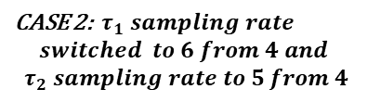

t=0
t=0
t=4
t=4
t=8
t=8
t=12
t=12
t=15
t=16
t=15
t=16
t=20
AAI
t=24
AEI
t=28
t=32
Victim
task
Attacker
task
Attacker task pre-empted
t=36
CASE 1: ${ τ}_{1} sampling rate is 4$
t=40
CASE 2: ${ τ}_{1} sampling rate$
$$switched to 6 from 4 and$$
$${ τ}_{2} sampling rate to 5 from 4$$
AAI
AEI

Slide 60
Victim
task
Attacker
task
Attacker task pre-empted
t=0
t=4
t=8
t=12
t=16
t=15
AAI
AEI

Slide 61
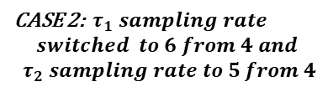

t=0
CASE 1: ${ τ}_{1} sampling rate is 4$
t=0
t=4
t=4
CASE 2: ${ τ}_{1} sampling rate$
$$switched to 6 from 4 and$$
$${ τ}_{2} sampling rate to 5 from 4$$
t=8
t=8
t=12
t=12
t=15
t=16
t=15
t=16
t=20
t=20
t=24
AAI
t=28
AEI
t=32
t=36
Victim
task
Attacker
task
Attacker task pre-empted
t=40
AAI
AEI

Slide 62



t
t+1
t+2
t+3
t+4
t=0
t=4
t=8
t=12
t=16
t=15
t=20
AAI
AEI
$$τ_{1}$$
(Victim)
$τ_{2}$
$$τ_{3}$$
(Attacker )

Slide 63















































$τ_{1}^{1}$, $τ_{2}^{1}$, $τ_{3}^{1}$
$$τ_{1}^{1}$$
$τ_{1}^{2}$, $τ_{2}^{1}$, $τ_{3}^{1}$
$$τ_{1}^{2}$$
$$s_{1}$$
$$τ_{3}^{1}$$
$$τ_{1}^{1}$$
$$τ_{1}^{2}$$
$$τ_{2}^{1}$$
$$τ_{1}$$
$$s_{2}$$
$$τ_{1}^{1}$$
$$τ_{2}^{1}$$
$$τ_{3}^{1}$$
$$τ_{1}^{2}$$
$$s_{3}$$
$$τ_{3}^{1}$$
$$τ_{1}^{1}$$
$$τ_{2}^{1}$$
$$τ_{1}^{2}$$
$$τ_{2}$$
$$s_{4}$$
$$τ_{1}^{1}$$
$$τ_{2}^{1}$$
$$τ_{1}^{2}$$
$$τ_{3}^{1}$$
$$τ_{3}$$
$$s_{5}$$
$$τ_{2}^{1}$$
$$τ_{1}^{1}$$
$$τ_{1}^{2}$$
$$τ_{3}^{1}$$
$$s_{6}$$
$$τ_{1}^{1}$$
$$τ_{3}^{1}$$
$$τ_{2}^{1}$$
$$τ_{1}^{2}$$
job
arrivals
$$s_{7}$$
$$τ_{2}^{1}$$
$$τ_{1}^{1}$$
$$τ_{3}^{1}$$
$$τ_{1}^{2}$$
$$s_{8}$$
$$τ_{1}^{1}$$
$$τ_{3}^{1}$$
$$τ_{1}^{2}$$
$$τ_{2}^{1}$$
deadlines
0 1 2 3 4

Slide 64
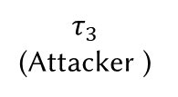
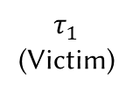

t
t+1
t+2
t+3
t+4
t=0
t=4
t=8
t=12
t=16
t=15
t=20
AAI
AEI
$$τ_{1}$$
(Victim)
$τ_{2}$
$$τ_{3}$$
(Attacker )

Slide 65
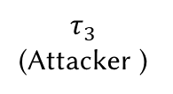
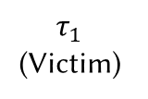
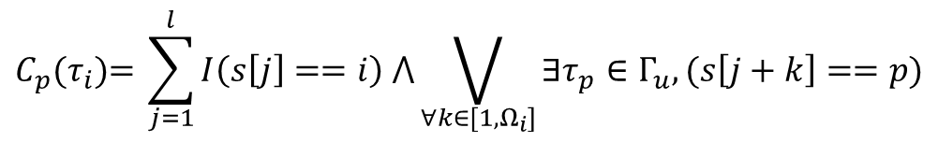

t
t+1
t+2
t+3
t+4
t=0
t=4
t=8
t=12
t=16
t=15
t=20
$$τ_{1}$$
(Victim)
$τ_{2}$
$$τ_{3}$$
(Attacker )
$$C_{p}\text{(}τ_{i}\text{)= }\sum_{j=1}^{l}{I\left(s\left[j\right]==i\right) ⋀\bigvee_{∀k∈[1,Ω_{i}]}{∃τ_{p}∈Γ_{u}, (s\left[j+k\right]==p)}}$$

Slide 66





0 1 2 3 4 5 6 7 8 9 10 11 12
$$τ_{1}$$
$$τ_{2}$$
$$τ_{3}$$
${TAP}_{2}= \frac{\left(1−1\right)×4}{3×4}$ = 0
0 1 2 3 4 5 6 7 8 9 10 11 12
${TAP}_{1}= \frac{\left(3−1\right)×2}{3×4}$ = 0.33

Slide 67
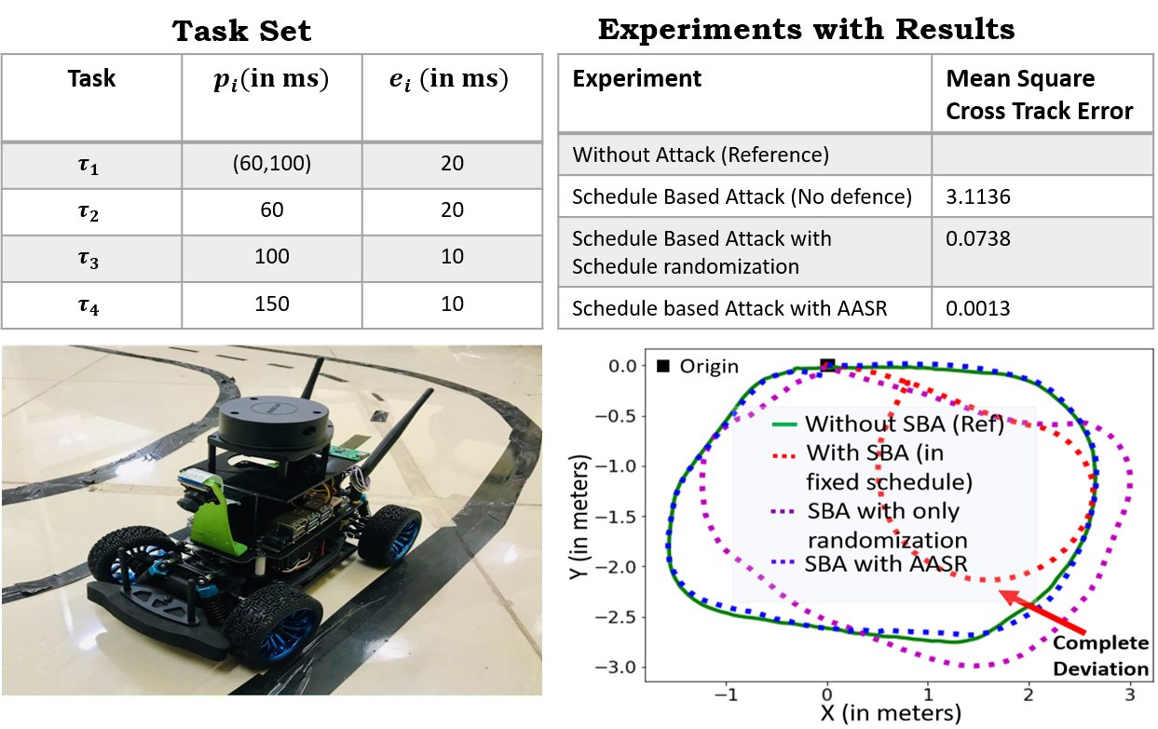
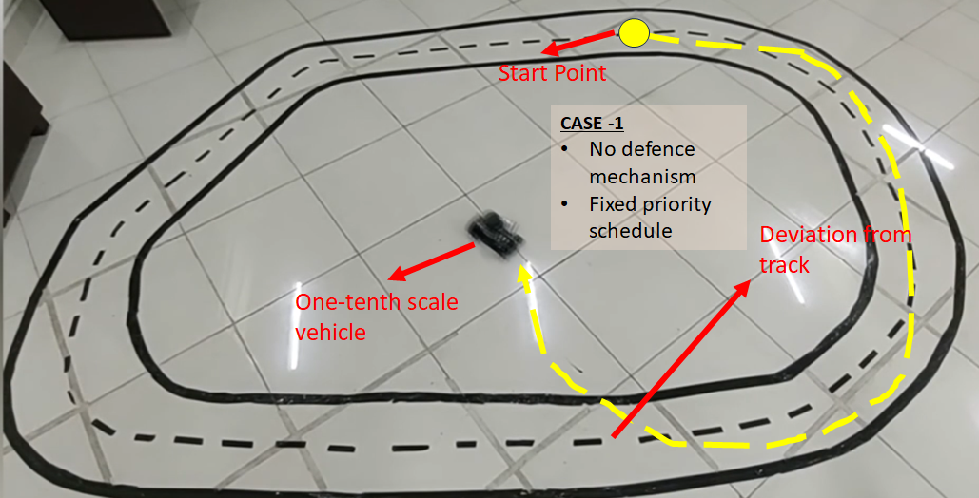
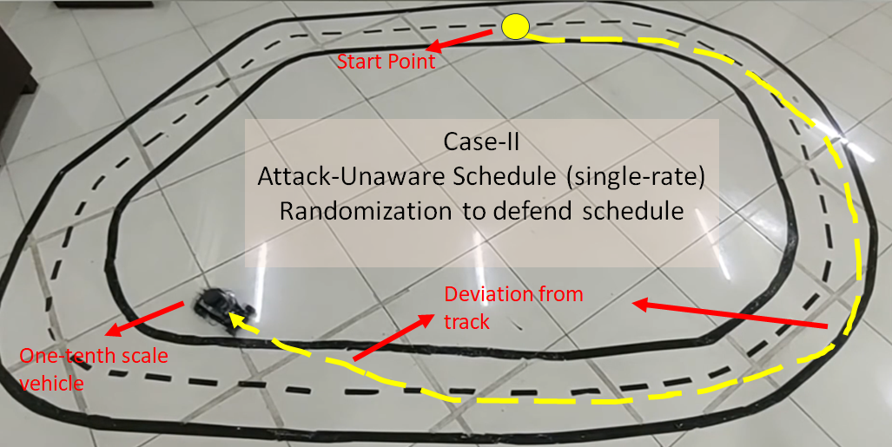
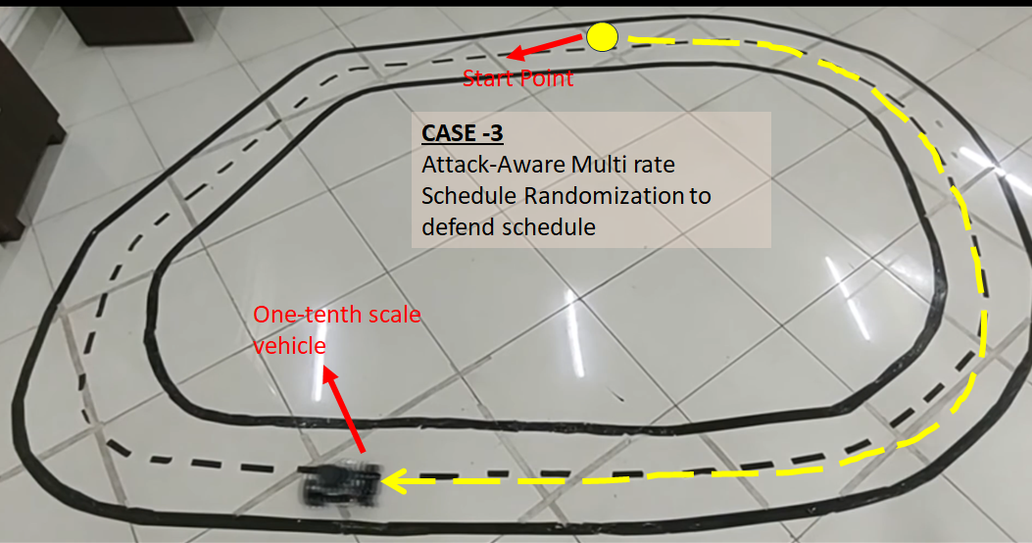
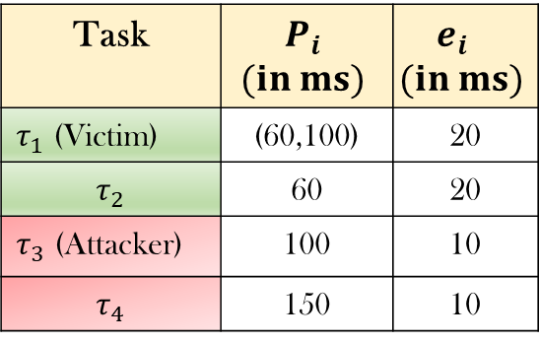
Experimental Evaluation
3. Lane-Keep-Assist-System (LKAS) on a 1/10-th Scale Autonomous Vehicle
A Jetson-Nano based autonomous car with sensors - Camera, IMU, and Lidar.
A PID controller is designed which is responsible for reducing the cross-track error, thus controlling the amount of steering to the vehicle.
Task | $$P_{i}$$ $$(in ms)$$ | $$e_{i}$$ $$(in ms)$$
$τ_{1}$ (Victim) | (60,100) | 20
$$τ_{2}$$ | 60 | 20
$τ_{3}$ (Attacker) | 100 | 10
$$τ_{4}$$ | 150 | 10
Attack Goal: Override the control input (steering angle) from PID controller using a posterior-type attack.
Fixed-Priority Scheduling
Attack- unaware Randomization
MAARS Framework

Slide 68




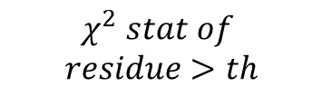
Input Task and System Specifications
Control Task Set
Task m$(ID, p_{m,},e_{m})$
System Specification
Design Time
Cost Threshold ($J^{Th}$)
No
Yes
Job Delay Sequence (
$$χ^{2} stat of$$
$$residue>th$$
Detector Threshold (Th)
schedules under critical attack probability P$\left(a_{i}\right)<P^{C}\left(a_{i}\right)$
Untrusted Task Set ($Γ_{u})$
Deploy Schedule Selection Algorithm
schedules under critical SVI
M<$M_{c}$
Run Time
Task n$(p_{n},e_{n})$

Slide 69
Physical Plant
Threshold
$T_{X}$ task
Sensor
Residue Statistics
Control and Detector task
Other tasks
Actuator
$g_{k}>Th$ => Attack?
Attacker task
$R_{X}$ task
Communication Channel
. . . . . . . .
I/O Buffer
Controller Unit
Sensor Msg
Actuator Msg
Control Task
>Th
Controller
Detector
Estimator

Slide 70
$$τ_{1}$$
Periodic task schedule Hyperperiod $H_{k}$
$$τ_{i}^{\left(j\right)}$$
$$τ_{i}^{\left(j+1\right)}$$
$$τ_{i}^{\left(j+2\right)}$$
$$T_{i}$$
$$T_{i}$$
$$T_{i}$$
EDF-s schedule with job-level delay application
$$δ_{j}$$
$$δ_{j+1}$$
$$δ_{j+2}$$
$$T_{i}$$
$$T_{i}$$
$$T_{i}$$

Slide 71











I/O
Buffer
Real-Time Scheduler
Physical Plant
Sensor
EDF scheduler
$$τ_{i}^{\left(j\right)}$$
$$τ_{i}^{\left(j+1\right)}$$
$$τ_{i}^{\left(j+2\right)}$$
Actuator
$$T_{i}$$
$$T_{i}$$
$$T_{i}$$
Anomaly Detector
EDF-s scheduler with job-level
delay application
Threshold
Residue
Statistics
$$τ_{i}^{\left(j\right)}$$
$$τ_{i}^{\left(j+1\right)}$$
$$τ_{i}^{\left(j+2\right)}$$
$g_{k}>Th$ => Attack?
. . . . . . . .
Communication
Channel
$$δ_{j}$$
$$δ_{j+1}$$
$$δ_{j+2}$$
$$Control Task (Victim)$$
$$T_{i}$$
$$T_{i}$$
$$T_{i}$$
Actuator Task
Attacker Task
Controller Unit

Slide 72
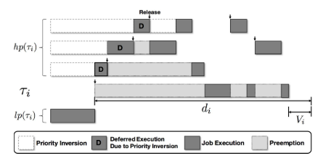
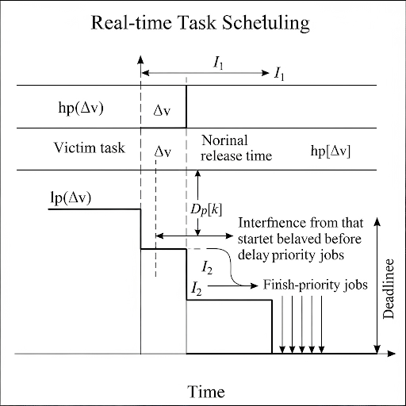
















$I_{0}(k)$
$$I_{1}(k)$$
$$I_{2}(k)$$
$I_{0}(k+1)$
$$I_{1}(k+1)$$
$$I_{2}(k+1)$$
$$hp(τ_{v})$$
$$r_{vk}$$
$$r_{vk}^{′}$$
$$r_{v(k+1)}$$
$$r_{v(k+1)}^{′}$$
$$D_{p}[k]$$
$$D_{p}[k+1]$$
$$τ_{v}$$
$$d_{vk}$$
$$lp(τ_{v})$$
Preemption
Execution
Job Release time
New Job Release time

Slide 73





SYSTEM INPUT
Task
Specifications
LTI Systems
(A,B,K)
State Error thresholds ($Θ$)
Initialize Delay $D_{p}$ for $p$-th hyperperiod
Simulate System for next hyperperiod
Compute Overlap $O_{p}$ and Cost $C_{p}$
Solve Optimization Problem
Minimize $O_{p} s.t$ $C_{p}$< $C_{Th}, {d<d}_{max}$
Optimization Output
Delay $D_{p+1}$ for (p+1)-th hyperperiod

Slide 74








$I_{0}(k)$
$$I_{1}(k)$$
$$I_{2}(k)$$
$I_{0}(k+1)$
$$I_{1}(k+1)$$
$$I_{2}(k+1)$$
Preemption
$$hp(τ_{v})$$
Execution
$$r_{vk}$$
$$r_{vk}^{′}$$
$$r_{v(k+1)}$$
$$r_{v(k+1)}^{′}$$
Job Release time
$$D_{p}[k]$$
$$D_{p}[k+1]$$
$$τ_{v}$$
$$d_{vk}$$
New Job Release time
$$lp(τ_{v})$$

Slide 75
I/O
Buffer
Real-Time Scheduler
Physical Plant
Sensor
PFP scheduler
$$τ_{i}^{\left(j\right)}$$
$$τ_{i}^{\left(j+1\right)}$$
$$τ_{i}^{\left(j+2\right)}$$
Actuator
$$T_{i}$$
$$T_{i}$$
$$T_{i}$$
Anomaly Detector
PFP-d scheduler with job-level
delay application
Threshold
Residue
Statistics
$$τ_{i}^{\left(j\right)}$$
$$τ_{i}^{\left(j+1\right)}$$
$$τ_{i}^{\left(j+2\right)}$$
$g_{k}>Th$ => Attack?
. . . . . . . .
Communication
Channel
$$δ_{j}$$
$$δ_{j+1}$$
$$δ_{j+2}$$
$$Control Task (Victim)$$
$$T_{i}$$
$$T_{i}$$
$$T_{i}$$
Actuator Task
Attacker Task
Controller Unit

Slide 76





$$ΔV_{i}$$
$$δ=0$$
$$δ=Δ_{i}^{max}$$
$${α_{i}V}^{(i)}$$
$$convex$$

