Slide 1
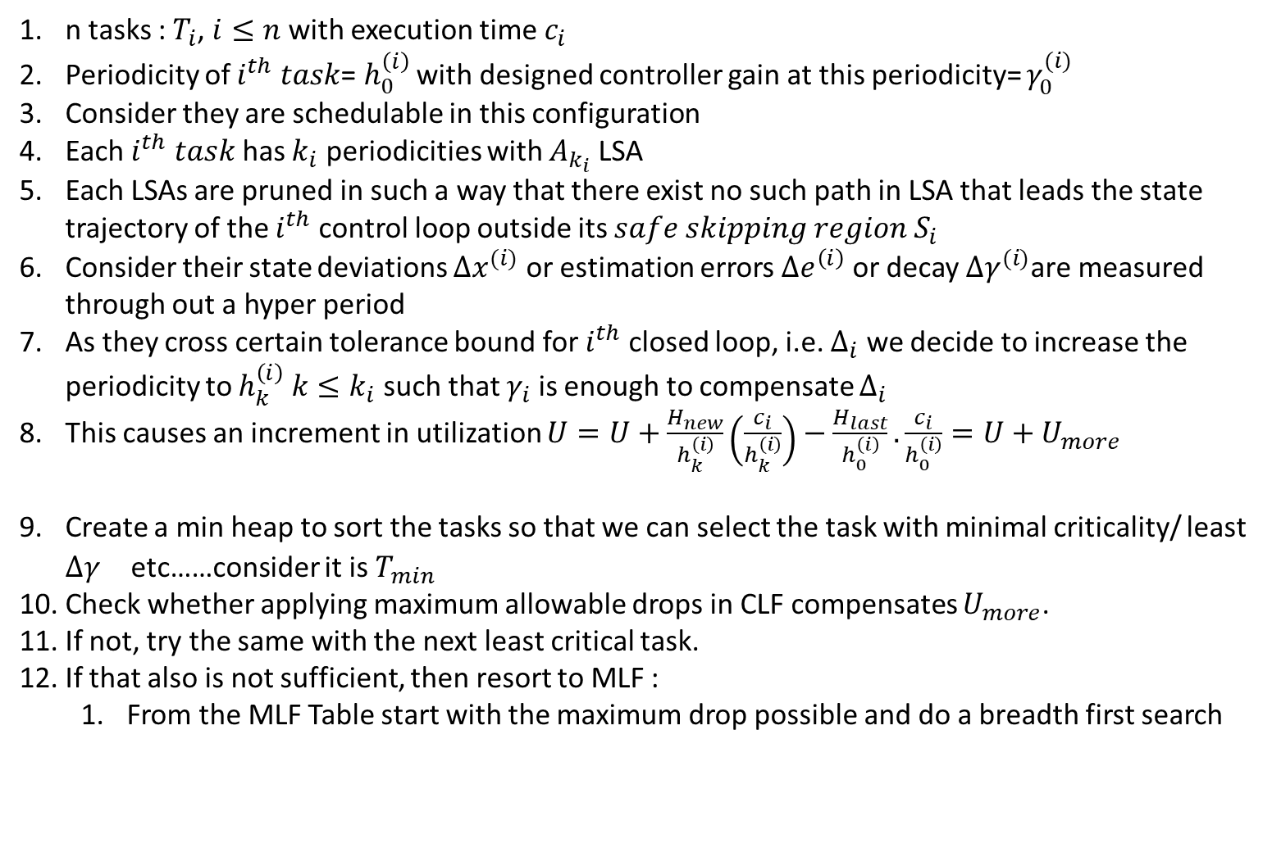
n tasks : $T_{i}$, $i≤n$ with execution time $c_{i}$
Periodicity of $i^{th} task$= $h_{0}^{\left(i\right)}$ with designed controller gain at this periodicity= $γ_{0}^{(i)}$
Consider they are schedulable in this configuration
Each $i^{th} task$ has $k_{i}$ periodicities with $A_{k_{i}}$ LSA
Each LSAs are pruned in such a way that there exist no such path in LSA that leads the state trajectory of the $i^{th}$ control loop outside its $safe skipping region S_{i}$
Consider their state deviations $Δx^{(i)}$ or estimation errors $Δe^{\left(i\right)}$ or decay ${Δγ}^{(i)}$are measured through out a hyper period
As they cross certain tolerance bound for $i^{th}$ closed loop, i.e. $Δ_{i}$ we decide to increase the periodicity to $h_{k}^{\left(i\right)} k≤k_{i}$ such that $γ_{i}$is enough to compensate $Δ_{i}$
This causes an increment in utilization $U=U+\frac{H_{new}}{h_{k}^{\left(i\right)}}\left(\frac{c_{i}}{h_{k}^{\left(i\right)}}\right)−\frac{H_{last}}{h_{0}^{\left(i\right)}}.\frac{c_{i}}{h_{0}^{\left(i\right)}}=U+U_{more}$
Create a min heap to sort the tasks so that we can select the task with minimal criticality/ least ${Δγ}^{}$ etc……consider it is $T_{min}$
Check whether applying maximum allowable drops in CLF compensates $U_{more}$.
If not, try the same with the next least critical task.
If that also is not sufficient, then resort to MLF :
From the MLF Table start with the maximum drop possible and do a breadth first search

