Slide 1
CAN Bus Signal Integrity
under High-Voltage Transients
Filtering and Shielding Techniques for EV CAN Communication
By: Arka Kar
CONTINUUM PS-2 | UDYAM '26
Electronics Engineering Society

Slide 2
The Problem
CAN Bus in EVs
EMI Coupling Mechanisms
CAN (Controller Area Network) is the backbone communication protocol in electric vehicles, connecting ECUs, motor controllers, BMS, and sensors.
In EVs, CAN wires are routed near:
Motor inverters (high dV/dt, dI/dt)
DC-DC converters
Onboard chargers
1
Conducted
Shared supply/ground paths carry noise directly
2
Capacitive
High-voltage switching nodes couple to CAN lines
3
Inductive
Magnetic fields from loop currents induce voltage

Slide 3
Target Performance Parameters
BER
CM Noise
Conducted
≤ 10⁻⁹
≤ 100 mV
≤ 50 mV
Bit Error Rate
Common-mode peak
Power circuit coupling (peak)
Reduction
Impedance
Rise/Fall
≥ 50%
120 Ω ±10%
≤ 20%
Noise improvement vs baseline
Differential termination
Degradation vs ideal

Slide 4
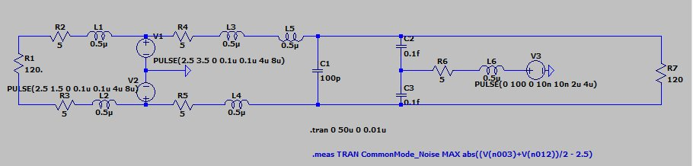
Baseline System Model
Component | Value | Role
R1, R7 (Termination) | 120 Ω | CAN bus impedance matching
R2–R5 (Wire resistance) | 5 Ω each | Harness parasitic resistance
L1–L5 (Wire inductance) | 0.5 µH each | Harness parasitic inductance
C1 (Inter-wire cap) | 100 pF | Baseline differential capacitance
C2, C3 (Coupling cap) | 0.1 fF each | HV-to-CAN parasitic coupling
V3 (Noise source) | 100 V pulse, 10 ns edge | Traction inverter switching transient

Slide 5
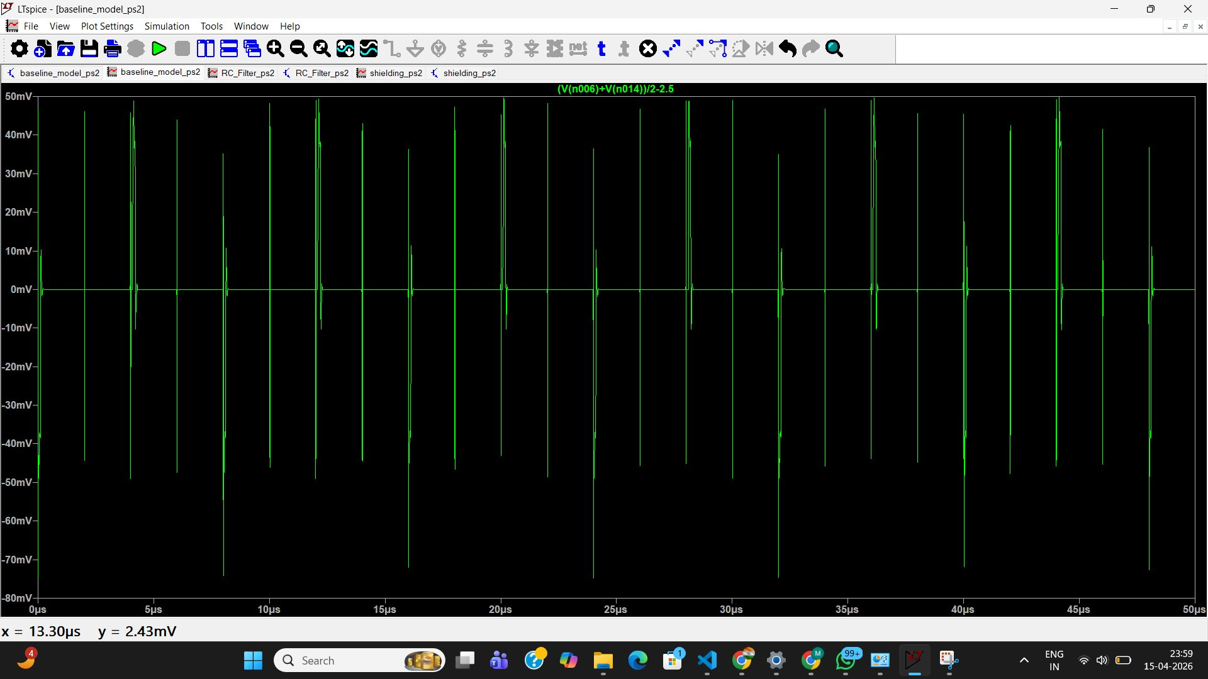
Baseline Result — Unmitigated Noise
⚠ Observation: Peak common-mode spikes reach ±70–75 mV (within limit, but highly erratic). Differential signal integrity is destroyed by inductive kickback from 0.5 µH wire inductance. Formula: V = L·(dI/dt). With 10 ns edges and 100 V transients, this generates catastrophic noise. BER threshold of ≤10⁻⁹ FAILS.

Slide 6
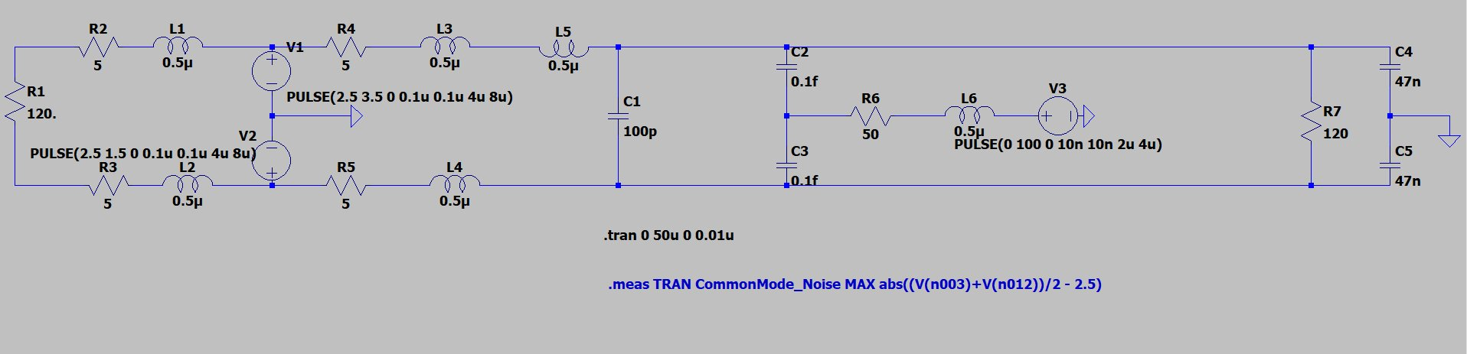
Mitigation A: Shielded Cable
Modified Components
Mechanism: Faraday Cage
R6 (Noise source damping): 5 Ω → 50 Ω (realistic motor output impedance) C4, C5 (Shield caps): 0.1 fF each, CAN_H and CAN_L to GND Position: Immediately before R7 (120 Ω termination)
The grounded copper braid/shield simulates a Faraday cage. The 0.1 fF capacitance models the shield's capacitance-to-ground inherent in a Shielded Twisted Pair (STP) cable.
High-frequency noise seeks the path of least impedance — it shunts to ground through C4/C5 before it can develop voltage across the 120 Ω termination.

Slide 7
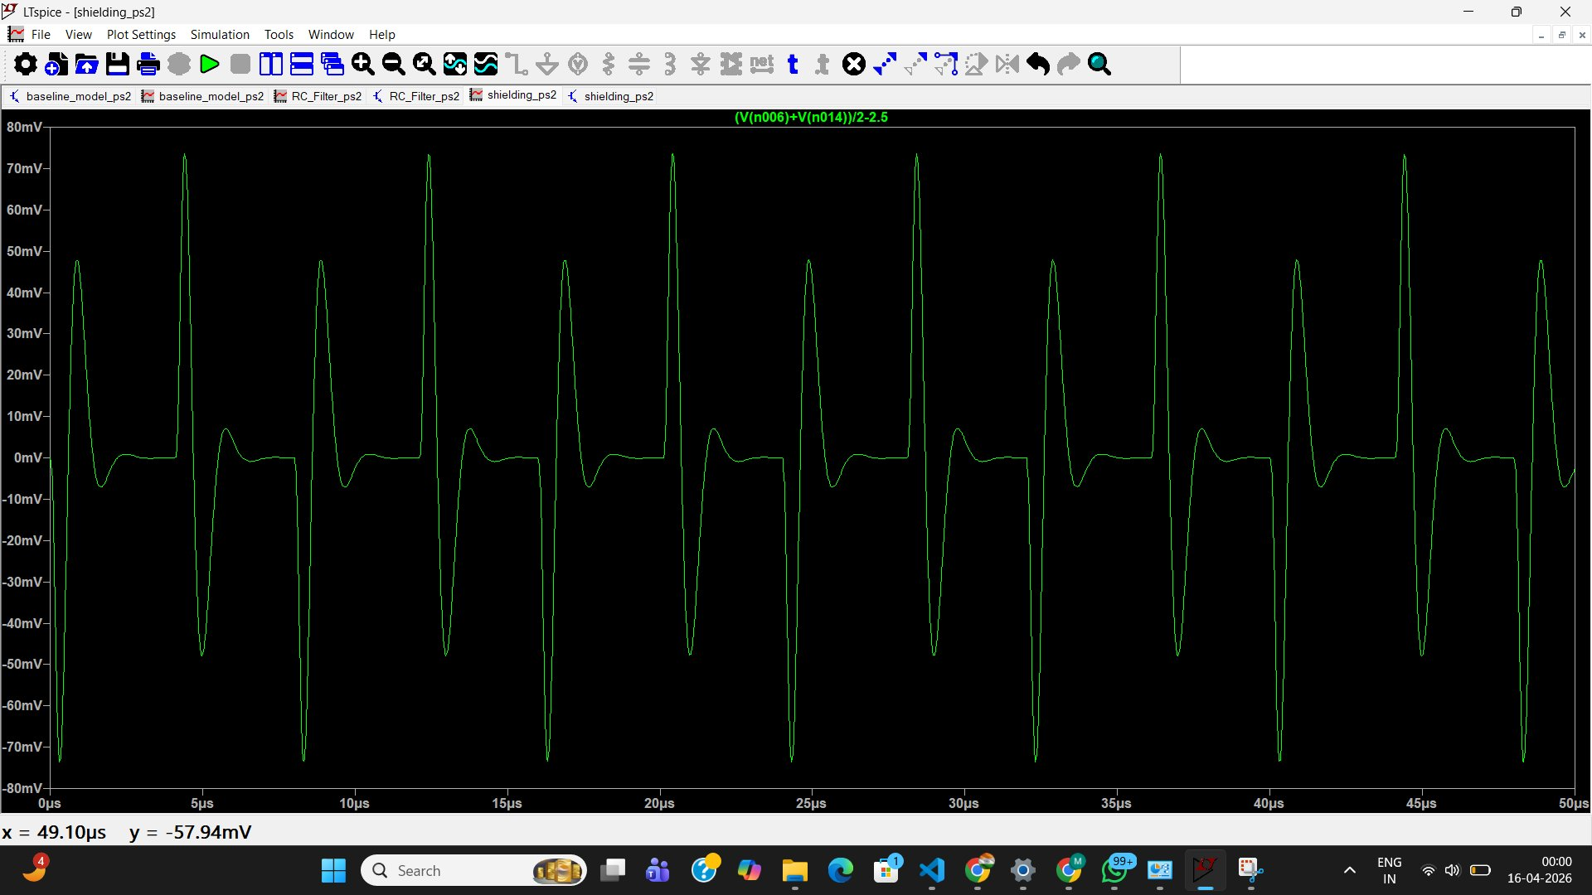
Approach A: Shielding — Simulation Result
✓ Result: Peak common-mode deviation ≈ 75 mV — within the ≤ 100 mV target. Signal waveform shows damped ringing (smooth envelope) — still clean enough for 1 Mbps CAN. Differential amplitude maintained at ~2.0 V. Near-ideal BER performance restored.

Slide 8
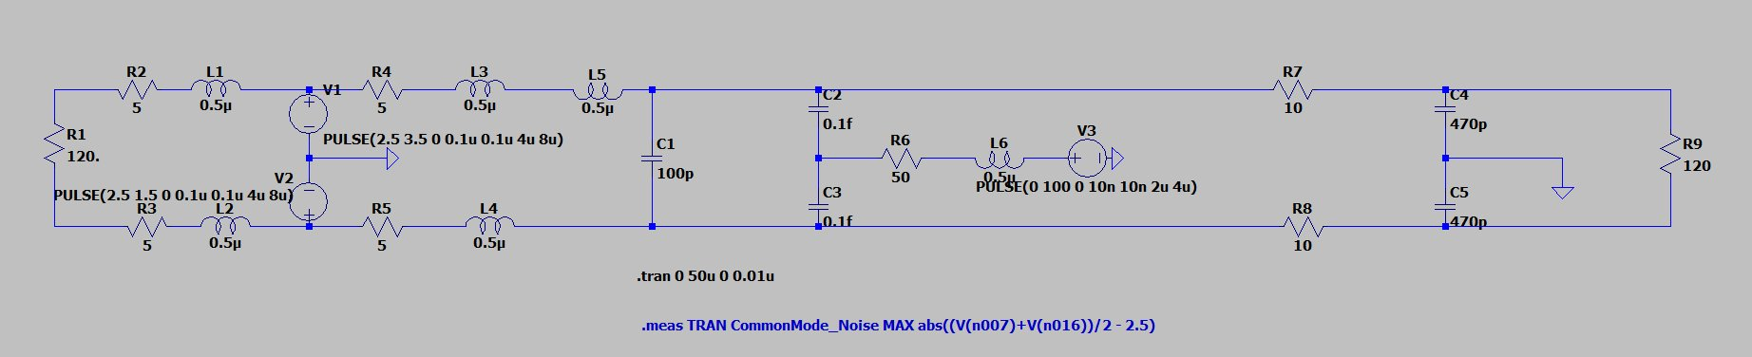
Mitigation B: RC Low-Pass Filter
Added Components
Mechanism: Low-Pass Filtering
R7, R8 (Series resistors): 10 Ω each, on CAN_H and CAN_L C4, C5 (Shunt capacitors): 470 pF each, to GND (after the 10 Ω resistors) R9 (Termination): 120 Ω at end of filter network
The 10 Ω + 470 pF network forms a low-pass filter. Cutoff frequency:
f_c = 1 / (2π × R × C) ≈ 33.8 MHz
High-frequency switching transients (GHz-range harmonics from 10 ns edges) are shunted to ground. The slower 1 Mbps CAN data passes with minimal attenuation.

Slide 9
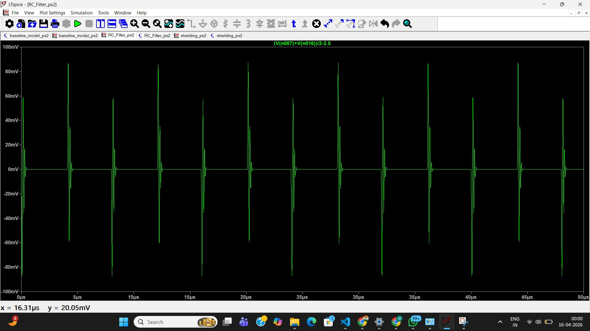
Approach B: RC Filter — Simulation Result
✓ Result: Peak common-mode deviation ≈ 70 mV — within the ≤ 100 mV target. Spike edges are narrower and more uniform. Slight edge rounding observed (acceptable for standard 1 Mbps CAN). Differential amplitude maintained at ~2.0 V. BER target met.

Slide 10
Comparative Analysis
Metric | Baseline | Shielded Cable | RC Low-Pass Filter
Peak CM Noise | Severe spikes (FAIL) | ~75 mV ✓ | ~70 mV ✓
Differential Amplitude | Highly erratic | ~2.0 V maintained | ~2.0 V maintained
Signal Shape | Destroyed | Near-ideal square wave | Damped ringing, slight rounding
BER Impact | Catastrophic FAIL | Meets ≤ 10⁻⁹ ✓ | Meets ≤ 10⁻⁹ ✓
Edge Preservation | N/A | Excellent | Slightly degraded
Key Advantage | — | Best signal quality | Cost-effective, PCB-level
Key Limitation | — | Weight, ground loops | CAN-FD edge rounding risk

Slide 11
Critical Discussion & Trade-offs
RC Filter — Limitations
Cable Shielding — Limitations
1. Sluggish Edge Rates: The RC time constant rounds CAN signal edges. At standard 1 Mbps this is acceptable, but for CAN-FD (2–5 Mbps), it collapses the eye diagram causing timing errors. 2. Tolerance Mismatch: If top and bottom RC filters drain at slightly different rates (±1–5% tolerance), common-mode noise converts into differential noise — creating data corruption. 3. Cutoff Frequency: f_c = 1/(2π×10×470pF) ≈ 33.8 MHz. Must stay well above 1 MHz CAN harmonics but below the noise band.
1. Weight & Cost: Copper braided shielding significantly increases harness weight — a direct conflict with EV lightweighting goals that maximize battery range. 2. Ground Loops: If shielded both at the Motor Controller and ECU ends, any voltage potential difference between chassis ground points drives large DC currents through the shield. This can melt the cable or induce magnetic noise onto data lines. 3. Connector Complexity: STP connectors are more expensive and require careful grounding strategy (single-point vs multi-point).

Slide 12
Conclusion
✓
Both techniques succeeded
Shielded cable (~75 mV peak) and RC low-pass filter (~70 mV peak) both meet the ≤ 100 mV common-mode noise requirement.
⊕
Shielding: best edge quality
Provides near-ideal square waveform. Preferred for high-speed CAN-FD buses (2–5 Mbps) where edge rate preservation is critical.
⊕
RC Filter: cost-effective
Lighter, PCB-level solution with no cabling overhead. Best suited for standard 1 Mbps CAN with tight weight budgets.
→
Choose based on system needs
Selection depends on bus baud rate, EV weight budget, harness routing constraints, and EMC certification targets (CISPR 25, ISO 11452).

