Slide 1


Hash Functions in Data Structures and Algorithms
Hash functions are essential tools in computer science, playing a vital role in efficient data storage and retrieval. They act as a bridge between keys and their corresponding locations in data structures, facilitating rapid access and manipulation of data. This presentation explores the fundamentals of hash functions, delves into collision avoidance techniques, and showcases their practical applications within the realm of data structures and algorithms (DSA).

Slide 2
Introduction to Hash Functions
At its core, a hash function transforms any arbitrary input, such as a string or integer, into a fixed-size output known as a hash value. This output, usually a numerical representation, acts as a unique identifier for the input. The ideal hash function ensures that distinct inputs produce unique hash values, reducing the likelihood of collisions where multiple inputs map to the same hash value. This property is crucial for efficient data retrieval, allowing us to quickly locate an item based on its hash value.
1
Key Concepts
2
Hash Table Illustration
Hash functions are a crucial component of various data structures, including hash tables, which rely on these functions to map keys to specific locations. This mapping process allows for efficient storage and retrieval of data, significantly improving search and lookup operations.
Imagine a hash table as a collection of buckets, where each bucket represents a unique hash value. When a new key is added, the hash function calculates its hash value, and the key is stored in the corresponding bucket. To retrieve a specific key, the same hash function is applied, directing us to the correct bucket, where we can then access the key and its associated data. This process eliminates the need for sequential searching, significantly speeding up data retrieval.

Slide 3
Properties of Hash Functions
A well-designed hash function should possess several key properties to guarantee its efficiency and effectiveness. These properties ensure that the function distributes input keys uniformly across the hash table, minimizing collisions and maximizing data retrieval speed.
Uniform Distribution
Deterministic
Efficiency
The hash function should distribute keys evenly across the entire range of hash values, preventing the clustering of data in specific buckets. Uniform distribution is essential for efficient collision handling, ensuring that collisions are scattered throughout the hash table, rather than concentrated in a few areas.
For a given input, the hash function should always produce the same output. This deterministic nature ensures that the hash function is consistent and predictable, allowing for reliable storage and retrieval of data.
The hash function should be computationally efficient, requiring minimal time and resources to calculate the hash value. Efficiency is critical for practical applications, ensuring that hash function operations do not become a performance bottleneck.

Slide 4
Collision Avoidance Techniques
Collisions are unavoidable in hash tables, as it's impossible to guarantee that every input will map to a unique hash value. Fortunately, collision avoidance techniques have been developed to handle these situations gracefully, minimizing the impact of collisions on performance.
Separate Chaining
Open Addressing
Separate chaining addresses collisions by creating linked lists within each bucket. When a collision occurs, the new key is simply added to the linked list associated with that bucket. This allows multiple keys to be stored in the same bucket without overriding each other.
Open addressing, on the other hand, attempts to find an empty slot in the hash table when a collision occurs. This involves probing for an empty slot using various techniques, such as linear probing, quadratic probing, or double hashing.

Slide 5


Separate Chaining
Separate chaining is a straightforward and intuitive approach to collision handling. It essentially creates a linked list for each bucket in the hash table. When a collision occurs, the new key is added to the linked list of the corresponding bucket. This allows multiple keys to coexist in the same bucket without overwriting each other.
1
2
3
Hash Function
Collision Detection
Linked List Insertion
The hash function calculates the hash value for the key, determining the bucket where the key should be stored.
If the bucket is already occupied, a collision occurs.
The new key is added to the linked list associated with the corresponding bucket.

Slide 6



Open Addressing
Open addressing tackles collisions by probing for an empty slot within the hash table. This involves iterating through the table until an unoccupied slot is found. Several probing techniques exist, each with its own advantages and disadvantages.
Linear Probing
Quadratic Probing
Double Hashing
Linear probing involves sequentially checking consecutive slots, starting from the initial hash location, until an empty slot is found. This method is simple but can lead to clustering, where occupied slots tend to group together, reducing search efficiency.
Quadratic probing uses a quadratic function to calculate the distance between consecutive probes, reducing the likelihood of clustering compared to linear probing.
Double hashing employs a second hash function to calculate the probe distance, ensuring that the probe sequence is not predictable, further reducing clustering.

Slide 7
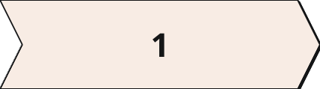
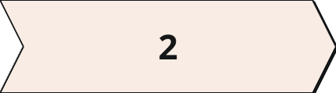
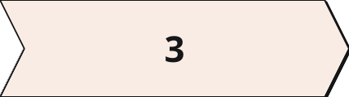
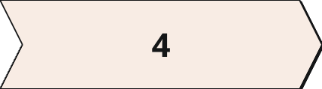
Linear Probing
Linear probing is a straightforward open addressing technique where, in the event of a collision, the algorithm checks consecutive slots in the hash table, starting from the initial hash location, until an empty slot is found. This method is relatively simple to implement, but it can suffer from primary clustering, where occupied slots tend to cluster together, leading to longer search times.
Initial Hash
Collision
Linear Probe
Repeat until Empty
The hash function calculates the initial hash value, determining the intended location for the key.
If the initial hash location is occupied, a collision occurs.
The algorithm checks the next consecutive slot in the table.
This process continues until an empty slot is found, where the key is then inserted.

Slide 8


Quadratic Probing
Quadratic probing aims to mitigate the clustering problem inherent in linear probing. When a collision occurs, quadratic probing calculates the probe distance using a quadratic function, which helps to distribute the probes more evenly across the hash table. This reduces the likelihood of clustering and improves the overall efficiency of search operations.
Probe Distance Formula
Probe Sequence
i^2 (where i is the probe number)
0, 1, 4, 9, 16, ...

Slide 9
Hash Function Applications in DSA
Hash functions are deeply ingrained in various aspects of data structures and algorithms, enhancing efficiency and enabling complex operations. Their applications range from data storage and retrieval to security and cryptography, making them an indispensable tool in computer science.
1
Hash Tables
2
Cryptography
3
Data Compression
Hash tables are perhaps the most prominent application of hash functions. They provide efficient data storage and retrieval, allowing for rapid lookups and insertions. Hash tables are widely used in various data-intensive applications, including databases, caching systems, and symbol tables in compilers.
Hash functions are central to cryptographic algorithms, particularly in digital signatures and message authentication codes (MACs). These functions ensure data integrity and authenticity, verifying that data has not been tampered with during transmission.
Hash functions play a role in data compression algorithms, helping to identify and compress recurring patterns within data. This reduces file sizes and optimizes data storage and transmission.

Slide 10


Conclusion and Key Takeaways
Hash functions are fundamental building blocks in the world of data structures and algorithms, enabling efficient data storage and retrieval. By understanding the principles of hash functions, collision avoidance techniques, and their diverse applications, we can harness their power to design and implement algorithms that are efficient, robust, and adaptable to the ever-growing demands of data processing in modern computing.
Hash Function Properties
Collision Avoidance
Uniform distribution, deterministic nature, and computational efficiency are key characteristics of well-designed hash functions.
Separate chaining and open addressing provide effective strategies for handling collisions, minimizing their impact on performance.
Applications
Hash functions find widespread use in various areas, including hash tables, cryptography, data compression, and more.

Slide 11
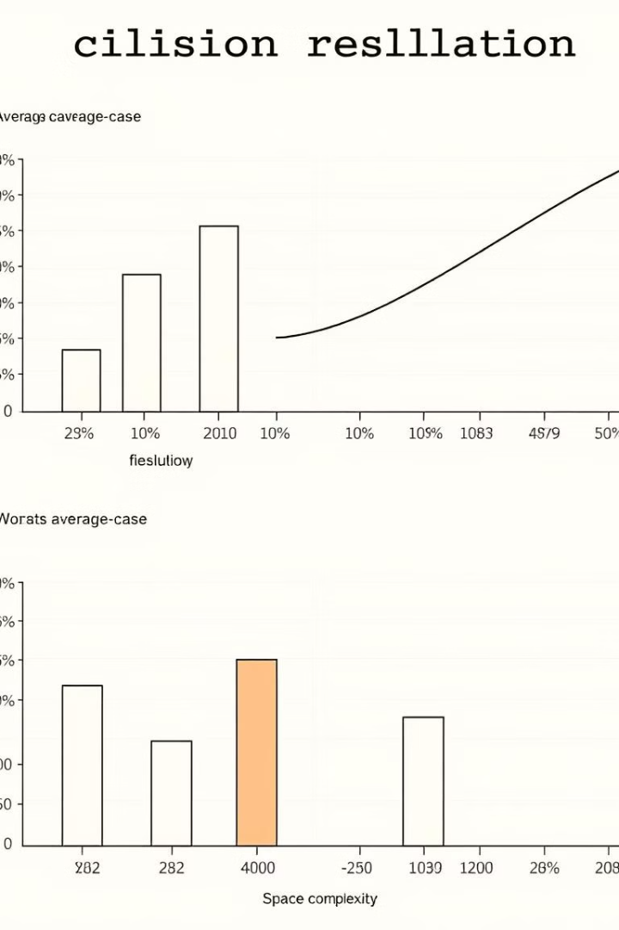
Performance Comparison
Understanding the performance characteristics of different collision resolution techniques is crucial for choosing the optimal approach for a given application.
Factors such as average case performance, worst-case performance, space complexity, and the impact of load factor on performance need careful consideration.

