Slide 1

AI Interior Design
Arkadi Doktorovich - 325118610
Elia Meerson - 211819750

Slide 2
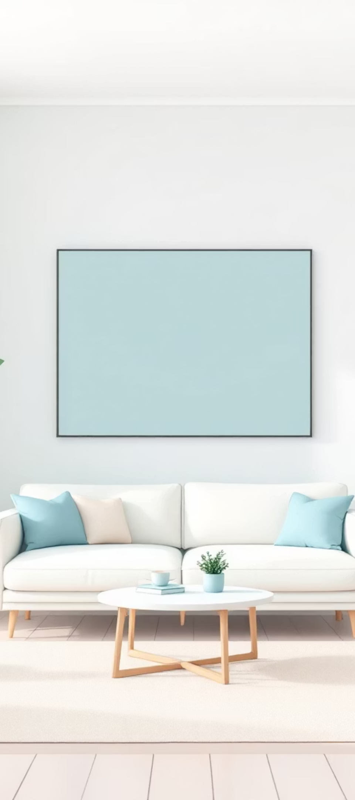
The Future of Interior Design
Interior design today is a slow and complex process that often relies on expensive professional designers and fragmented digital tools. Users struggle to visualize changes in real time and experiment with personalized styles.
Why It's Challenging
Combining image and text input.
Seamlessly integrating new elements.
Maintaining consistent lighting and geometry.
Current Approaches
Expensive and time consuming.
Lack customization and immediate visualization.
Often lack realism and editing capabilities.

Slide 3

Redefining Room Transformations
The system receives a room image and a text request describing furniture, style, or mood, and generates a redesigned room that aligns with the user’s intent. Optionally, approved designs include downloadable 3D furniture models.
Furniture Handling
Blueprint Generation
Smart Wall Repainting
Users can preserve selected objects while removing or replacing others.
Approved designs provide accurate, ready to build 3D models for each new item.
Wall colors are changed without affecting ceilings or architectural details.
This project offers unprecedented novelty by integrating multimodal input, object aware editing, and practical 3D model output in a single, intuitive workflow.

Slide 4
Models & Methods: Our Technical Pipeline
Our system uses a multi stage AI pipeline to deliver realistic and consistent interior transformations.
01
02
Image Segmentation
Semantic Generation
Models such as SAM or Mask2Former segment the room into walls, floor, ceiling, and furniture objects.
Diffusion models with ControlNet generate and edit furniture while preserving scene structure and lighting.
03
04
Inpainting & Layout Preservation
3D Reconstruction
Advanced inpainting ensures natural removal of objects and seamless integration of new elements.
Dedicated 3D reconstruction models transform generated furniture into accurate, production-ready 3D blueprints.

Slide 5
Data Specification & Generation
1
2
3
Interior Design Datasets
Segmentation Datasets
3D Object Datasets
Large scale datasets with room images, furniture types, and architectural styles.
Pixel level annotated masks for walls, floors, ceilings, and furniture.
High quality 3D furniture datasets for reconstruction and blueprint generation.
Labeling & Annotation
Synthetic Data Generation
Room segmentation: Walls, floors, ceilings, and objects.
AI generated room layouts, furniture variations, and paired image and text samples to expand training diversity and improve model robustness.
Furniture classes: Categorizing different furniture types.
Style & mood tags: Semantic labels for text prompts.

Slide 6
Metrics & KPIs: Measuring Success
Final Output Evaluation
CLIPScore
FID/KID Scores
SSIM/LPIPS
alignment between generated room and user prompt.
visual realism compared to real interiors.
preservation of original room structure.
Stage Specific Quality Metrics
3D Reconstruction
Rendering Quality
PSNR, SSIM for image to 3D accuracy
Geometric fidelity
Camera pose accuracy
Normal map consistency
Mesh completeness
Lighting accuracy
Room Editing/Inpainting
3D Furniture Models
Seam quality (no visible blending artifacts)
Chamfer Distance for shape similarity
Layout preservation
Mesh smoothness and watertightness
Furniture placement accuracy
Texture quality
Wall color fidelity
Blueprint accuracy
Measurement Protocols & Ground Truth
Comparison to Original User Images
Mask Annotations
Depth Maps
Use pixel level masks for walls, ceilings, and furniture as ground truth.
Validate spatial accuracy using depth map.
Compare generated images with original user images and prompts.

