Slide 1

RooMatch
Represented by: Arkadi Doktorovich, Elia Meerson, Shai Gigi

Slide 2
Motivation and Novelty
Online real estate and short-term rental platforms often contain duplicate or misleading listings of the same property presented with different furniture, decor, or staging. These appearance changes make it difficult for vision models to recognize that images depict the same physical room.
Since no public dataset captures the same room under controlled interior variations, this project introduces a novel synthetic dataset and retrieval framework that focuses on matching rooms based on invariant spatial and structural cues rather than superficial visual changes.

Slide 3

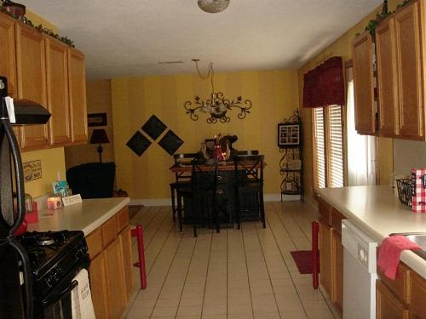
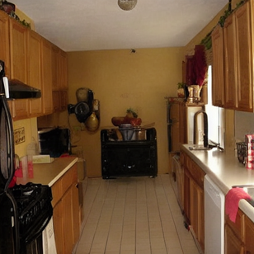
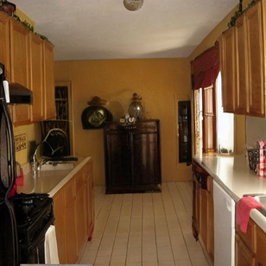
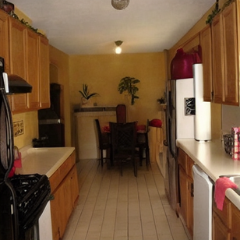
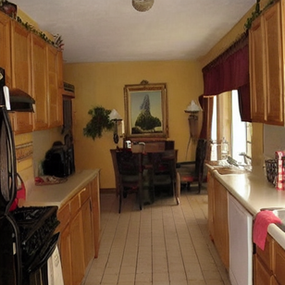
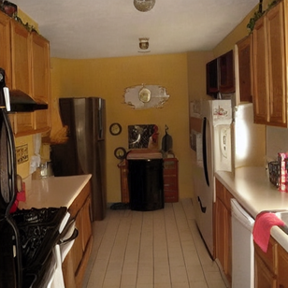
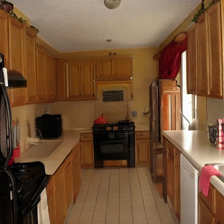
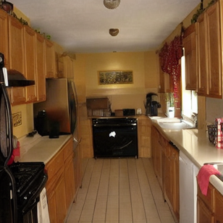
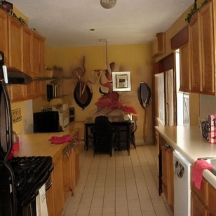
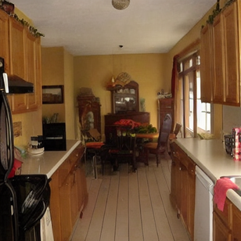
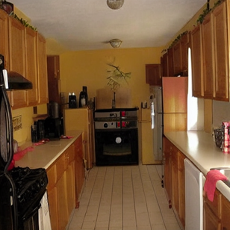
Real Image:
Dataset Example
Generated Synthetic:

Slide 4
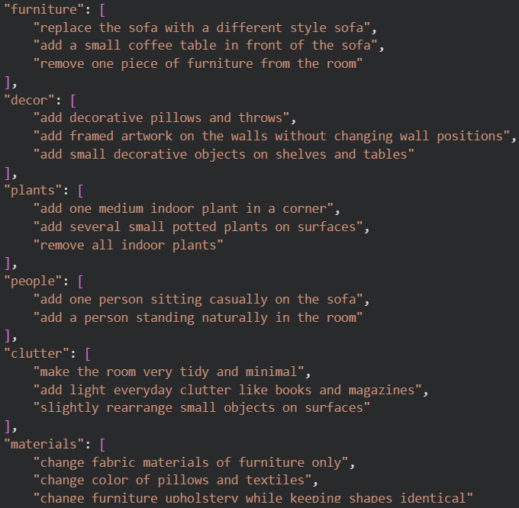
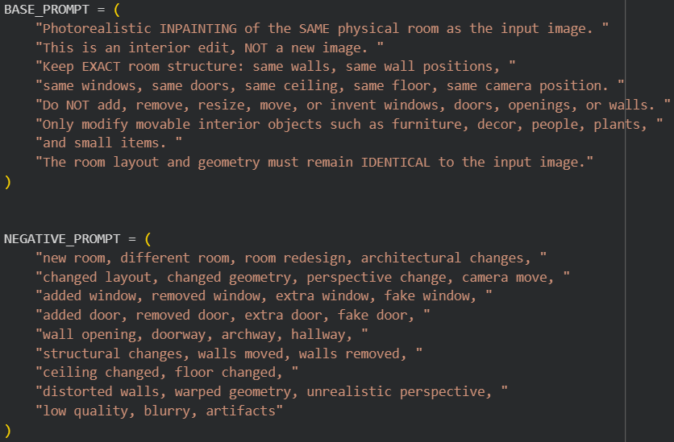
Dataset Room Generation Prompt Structure

Slide 5
Room Matching Dataset
Dataset Description
Dataset Preprocessing
The dataset contains 1000 real room images collected from various sources.
All images are converted to RGB and resized to a fixed resolution of 512×512 pixels to ensure consistency across the dataset.
For each real room image 10 synthetic variants were generated with Stable Diffusion Inpainting to increase diversity while preserving the same room layout.
Random masks focus on central and lower regions of the image, where furniture and decor typically appear.
Each image is assigned a room ID, which acts as the ground truth for evaluation.
Attribute modifications are randomly sampled.
Data Labeling
Room attributes include materials, people, furniture, decor, plants, and clutter.
For each room attribute there are 3 possible outcomes.
(we tried curtains, wall decor but they affected the room structure)
BASE_PROMPT ensures the same room geometry is preserved while decor, materials, and movable objects are varied.
NEGATIVE_PROMPT prevents generating entirely different rooms or altering the room layout.

Slide 6
Room Matching Model
We use DINOv2 (ViT-B/14), a self supervised vision transformer pretrained on large scale natural images, as the feature extractor for room embeddings. Images are embedded into a normalized latent space and compared using cosine similarity for image retrieval.
To adapt the model to room level matching, we fine-tune only the last transformer block using Triplet Loss. Each training sample consists of an anchor image, a positive image from the same room, and a negative image from a different room. This encourages embeddings of the same physical room to cluster tightly while pushing different rooms further apart.

Slide 7
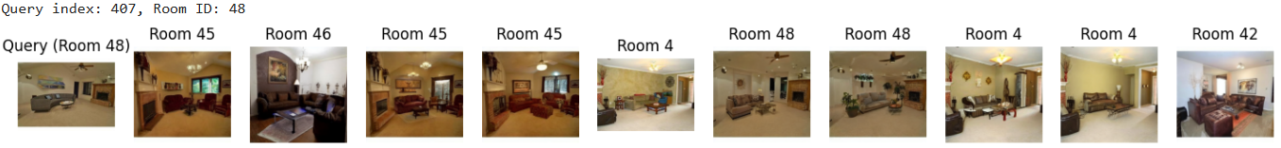
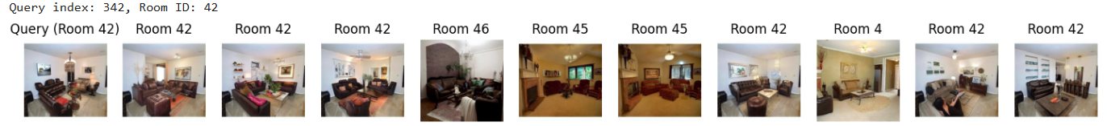
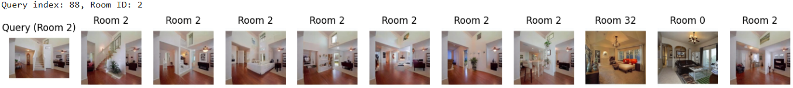
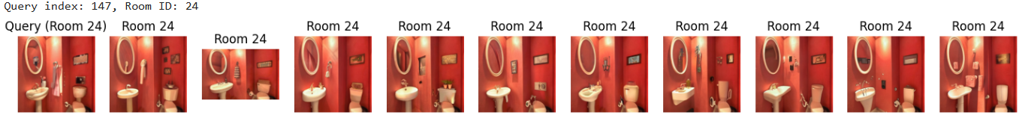
Results Examples:
Recall@0 (failure):
Recall@3:
Recall@7:
Recall@10:

Slide 8
Metrics & Accomplishments
Metrics:
Strict Recall@K measures the percentage of queries for which all top-K retrieved images belong to the same room ID as the query image, enforcing a strict requirement that every retrieved neighbor in a row must be correct.
Intra-mean is the average distance between different stylistic variations of the same physical room.
A lower value indicates better consistency and recognition of the core room identity despite changes.
Inter-mean The average distance between distinct physical rooms.
A higher value signifies that the model successfully differentiates between unique architectural spaces.
gap The critical separation margin between the Intra-mean and Inter-mean. (inter - intra)
A wider gap is the ultimate indicator of the model's success.
Achievements:
Demonstrated measurable improvement in room-level image retrieval through fine-tuning.
Increased embedding separability, achieving a significantly larger intra–inter distance gap.
Validated robustness using a strict evaluation protocol (Strict Recall@K).

Slide 9
Methodology
Project process:
Generated a controlled dataset: 1 real room image + 10 synthetic variants per room.
Built a room image retrieval pipeline using DINOv2 embeddings.
Fine-tuned the model using metric learning (Triplet Loss).
Extracted and normalized embeddings for all images.
Data & Evaluation:
Data: 1,000 real room images, 10,000 synthetic variants (same room, altered content).
Model: DINOv2 ViT-B/14 (base vs. fine-tuned).
Metrics:
Strict Recall@K
Intra-room vs. inter-room distance analysis
Embedding gap (inter − intra)
Efforts done:
Designed strict evaluation to avoid inflated performance.
Used controlled synthetic variations to enforce invariance learning.

Slide 10
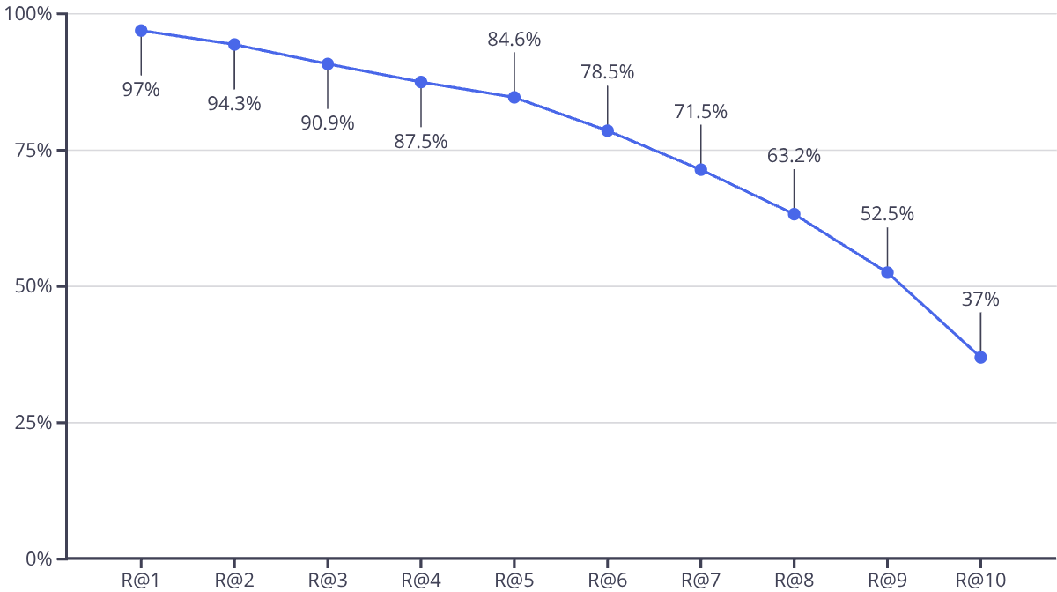
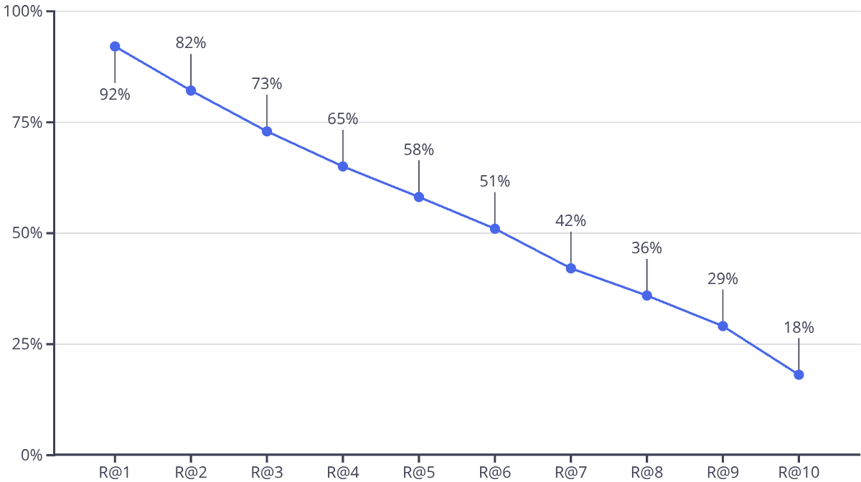
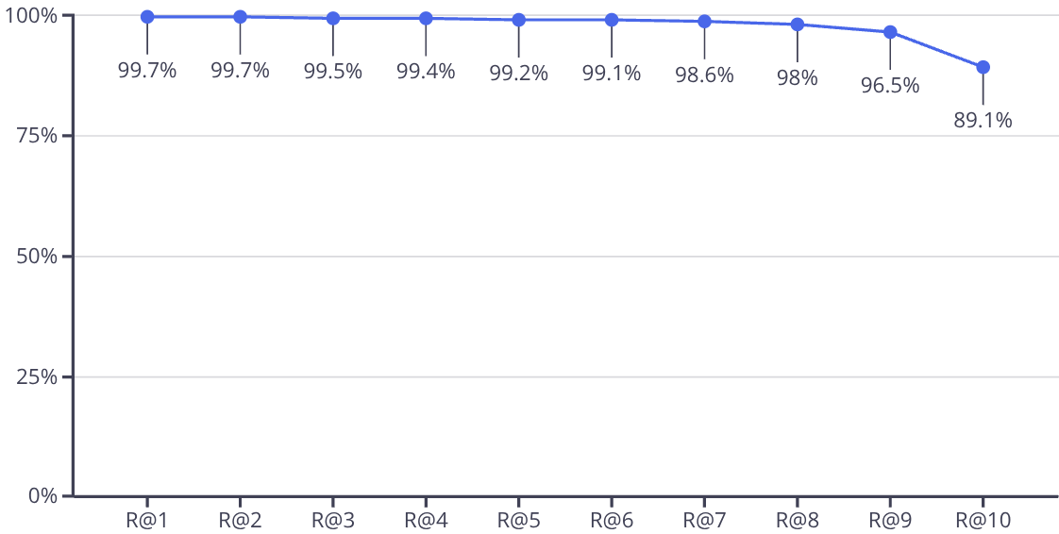
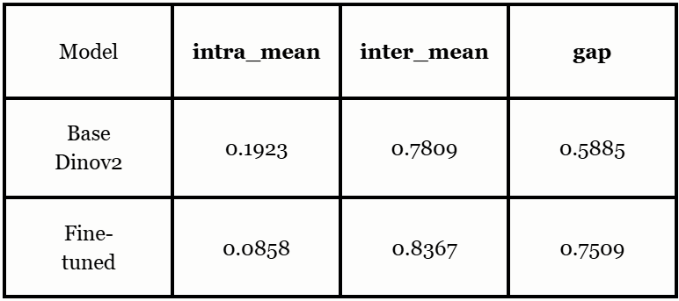
Results
Base Model Results:
Interm Results:
Fine-tuned Model Results:
Embedding separability:

Slide 11
Conclusions
Achieved results:
Fine-tuning significantly improved room level retrieval quality.
Achieved tighter intra-room clustering and stronger separation between rooms.
Improvements were consistent under Strict Recall@K, a highly challenging metric.
Things we learnt:
Generic pretrained embeddings were insufficient for room level retrieval without adaptation.
Some visually similar rooms remain challenging under strict evaluation.
Future Ideas:
Analyze performance differences across room categories (bedroom, kitchen, living room, bathroom).
Test synthetic-to-real retrieval as a robustness benchmark.

