Slide 1
Student Attendance Record Keeping Application
Jack Negus
Arkadiusz Nowacki
PG12

Slide 2
Introduction: What is the Application?
Our main objectives is to provide a web-based application hosted on AWS that will allow the attendance record of students to be viewed and updated.
The aim of this application is to create an alternative method of keeping this type of record and allowing it to be viewed/updated from anywhere.
The application is targeted at course providers who want to make it easier for lecturers/teachers/administrators at their institution to track their students' attendance.
The primary users of the application will be lecturers/teachers, who will be able to view and update the attendance records of their students from any browser using their own personal account information.

Slide 3
Design Specification and Architecture
Our architecture is based on six pillars: Browser, App Engine, Database, Notification Service, Authentication.
The application is programmed in Java and uses AWS Elastic Beanstalk as the web server host as well as the overall configuration starting point.
We use Spring Boot to run the Java application as a web-based service and the Thymeleaf template engine is used to serve HTML requests from the application backend.
Amazon Simple Notification Service (SNS) will wait to notify the data record owner of the new entry/update.
Amazon Cognito is going to be used for authentication, authorization, and user management.
The main reason for choosing these cloud services and language are:
All team members could program in Java.
Spring Boot is easy to use and well documented.
Elastic Beanstalk has range of configuration choices and can do a simple autoconfiguration for the app.
Cognito as it checks users before the can have access to information and makes sure the app is secure.

Slide 4
Implementation
For our application we chose to use AWS:
Easy to use.
Used for the module labs.
The application will use the following:
DynamoDB - A NoSQL database that can be structurally built in the Java backend (no additional software required). It is also predictable in performance and allows simple integration with Java. Additionally, it ensures application elasticity since this database system is known for seamless scalability adhering to demand.
Elastic Beanstalk - Creates EC2 instances designed specifically for web apps and the configuration is adjusted for this purpose, the group policies are chosen, takes care of the instance health/load balancing, it allows us to focus on other parts of the work and decrease the workload.
Simple Notification Service - Used to notify users of the success/failure of any update action of the database. Feedback to users reduces the potential for errors in record keeping.
Cognito – Handles user authentication and ensures only specified users can get access to certain resources, as well as have a direct impact on the data record since it integrates with DynamoDB well.
The steps we have taken to create this application started with implementation of the logic and creation of separate classes for each AWS service to make sure they have their own space. Subsequently, we have started work on the database and templates used for the web application to make sure user can have graphical user interface ready. Once we had minimum viable product we started to work more on the database as well as the security of the application.

Slide 5
Application Run-through
Users will access the web address the application is hosted on.

Slide 6
Application Run-through
Users will access the web address the application is hosted on.
The user will be presented with the Login GUI requesting their credentials.
They either successfully login with their credentials.
Or they do not input the correct credentials and are prompted that their account information is incorrect.

Slide 7
Application Run-through
Users will access the web address the application is hosted on.
The user will be presented with the Login GUI requesting their credentials.
They will be presented with a GUI containing several fields:
Query options allowing them to search attendance records.
Submissions fields for them to update/add attendance records.
They will be able to submit a query and receive information about student attendance.
They will be able to submit/alter existing records and receive a response from the page about its success/failure and why.

Slide 8
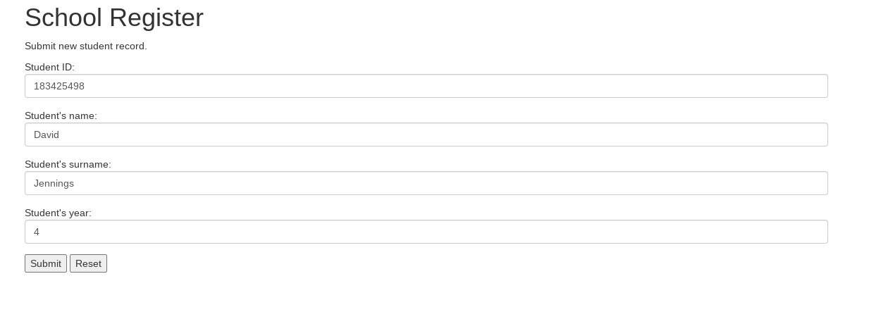
Results
Thus far we have completed deploying an initial version of the application into an EC2 instance using AWS Elastic Beanstalk, This initial version has a placeholder GUI that displays properly in a browser:

Slide 9
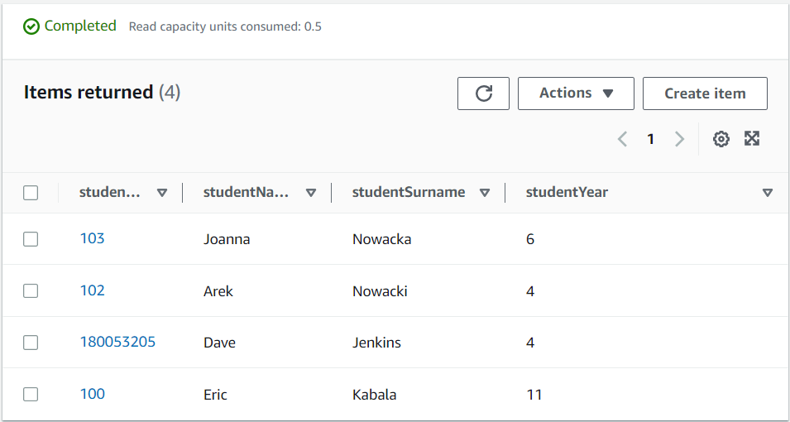
Results
The current version of the application can insert data into the DynamoDB database using the submit button on the web form:

Slide 10
Challenges
The problems we faced:
The common problem we had was that for long time our application JAR file would not function on the Elastic Beanstalk service due to wrongly packaged HTML templates (they should have separate directory called "templates" under the "resources" folder inside of the project) and second part of this issue was in wrongly used Thymeleaf objects inside of the HTML templates that caused web pages to display errors (error 502, error 404, instance health changed to Severe).
The primary key of the Spring Application did not match the primary key of the DynamoDB table, which caused data entries to be unsaved.
Using the AWS Root user has caused some issues in regards of running the instances for our web application.
To overcome these challenges, we have made sure our project is properly packed into directories as needed by Thymeleaf so the compiled JAR file functions correctly when deployed on Elastic Beanstalk. In addition, we used an easy to remember primary key throughout our application so the data will be sent correctly to the database. Lastly, we have switched to IAM user to make sure that account configuration will not affect the health of the application's instance.

Slide 11
Work to be done
Work we need to implement:
Authentication: A login page needs to be implemented and properly synced with Amazon Cognito so that users can be verified before accessing private information.
GUI: The current GUI is almost entirely a placeholder and easy access to query results needs to be implemented.
Database completion: The current database doesn’t effectively hold student records; the schema needs to be completed in the backend so that full query functionality can be implemented

Slide 12
Conclusion and Recommendations
Overall work on the project is progressing on schedule.
Most issues with the project have focused on technical problems with the applications deployment rather than the structure of the application itself.
For future projects we would recommend:
Establishing a more organized GitHub repository structure earlier would've prevented some bug fixing time getting the application to run on Elastic Beanstalk.
Building the project in smaller, separately defined modules to make debugging individual components easier.

