Slide 1
######### ### ######### ######### ######### ######### ######### ####### ######### 1 | 2 | 3 ######### ### ######### ######### ######### ######### ######### ######### ######### ------+------+----- ### ### ### ### ### ### ### ### ### ### ### A X | . | . ### ### ### ### ### ### ### ### ### ### ### ------+------+---- ### ### ### #### ### ######### ### #### ### ### ### ###### B . | O | . ### ### ### ### ### ### ### ### ### ### ### ------+------+----- ### ### ######### ### ### ### ######### ### ######### ######### C . | . | X ### ### ######### ### ### ### ######### ### ####### ######### ------+------+-----
by Paulina and Arek
CodeCool
WAW.2022.04

Slide 2



General INTRO
We are learning and it is our main goal !
Thinking about our solution we decided to practice as much as possible of wisdom provided by our mentor thus some „unnecessary” items from given task perspective were used.
Terminal parameters,
File handling with game statistic,
„Extra” first screen

Slide 3
Participants
Paulina from POZNAN
Student at Technical University
young,
brillant mind, always focus ect
Arek from WARSAW
Graduated at Technical University and postgraduate in Finance
was young couple of decades ago
hard worker

Slide 4




VISUAL STUDIO CODE
GITHUB
PYTHON
TOOLS
DISCORD

Slide 5
Tic – TAC - TOE
Following WIKIPEDIA - https://en.wikipedia.org/wiki/Tic-tac-toe?msclkid=464a4905d05d11ec88638b810a995cf3
Tic-tac-toe (American English),
noughts and crosses (Commonwealth English),
or Xs and Os (Irish English)
is a paper-and-pencil game for two players who take turns marking the spaces in a three-by-three grid with X or O.
The player who succeeds in placing three of their marks in a horizontal, vertical, or diagonal row is the winner.
It is a solved game, with a forced draw assuming best play from both players.
Games played on three-in-a-row boards can be traced back to ancient Egypt, where such game boards have been found on roofing tiles dating from around 1300 BC

Slide 6
Diagram simpliFY
START
TERMINAL
game_star()
game_initiation()
players.py
play
other
options with computer
IF COMPUTER
asigne_players()
Human only
help / stat
help
print(help)
PLAY HELP
QUIT
play
asigne_difficulty()
print(help)
print(stat)
quit
EASY HARD
WHO PLAY
human_entry_check.py
computer_moves.py
board.py
board.py
END
CHECK MOVE
status_empty()
WIN
CHECK WIN status()
NOT WIN
YES availlable
NO availlable

Slide 7
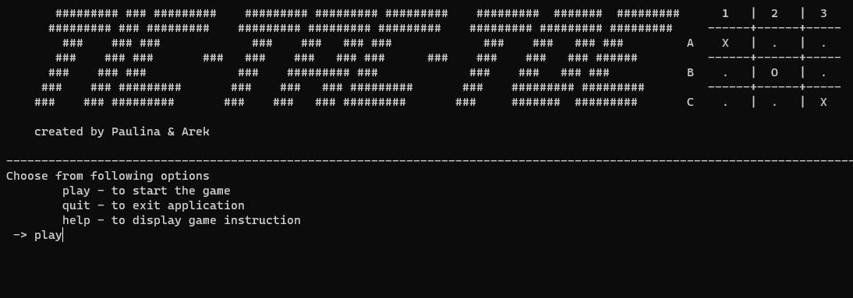
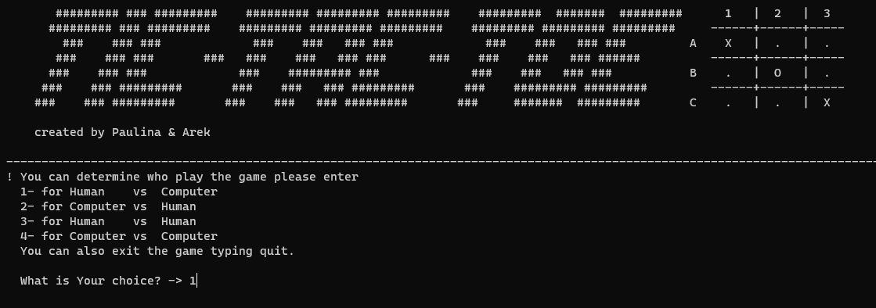
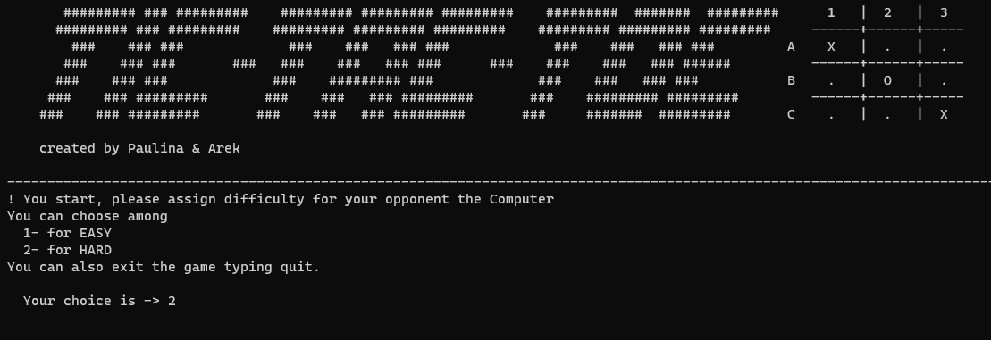
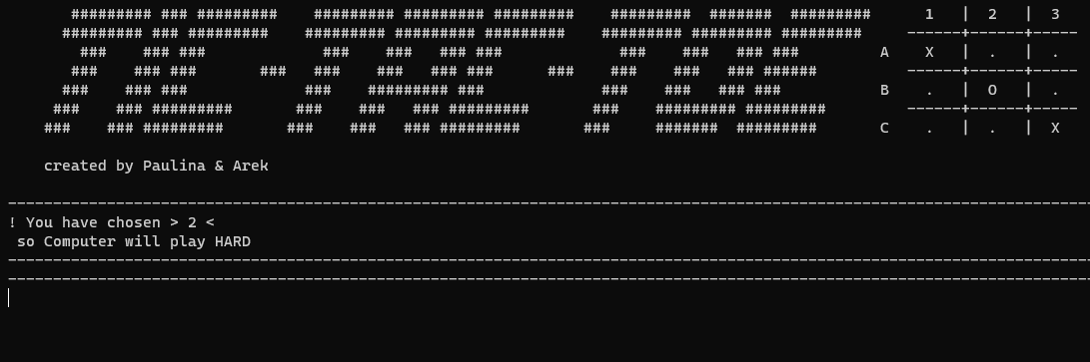
START

Slide 8
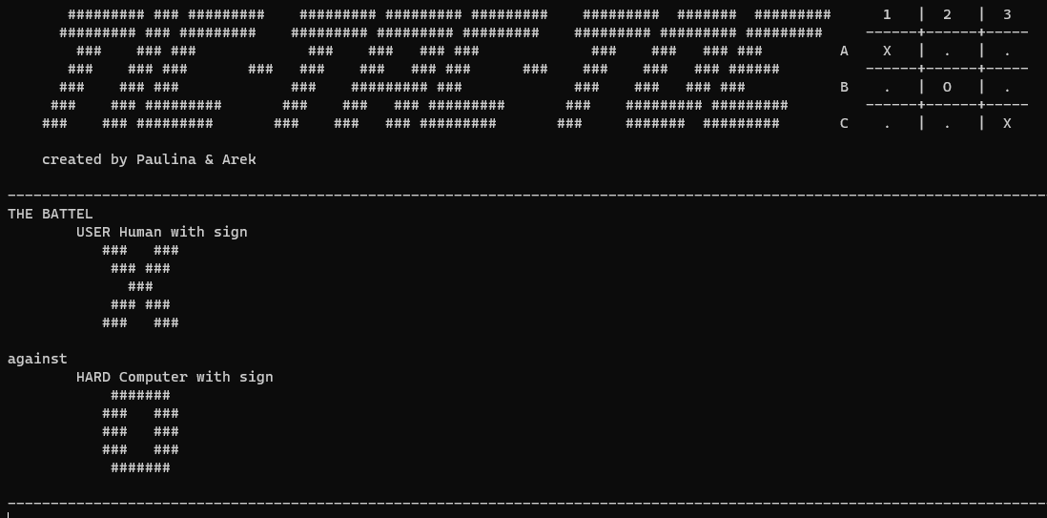
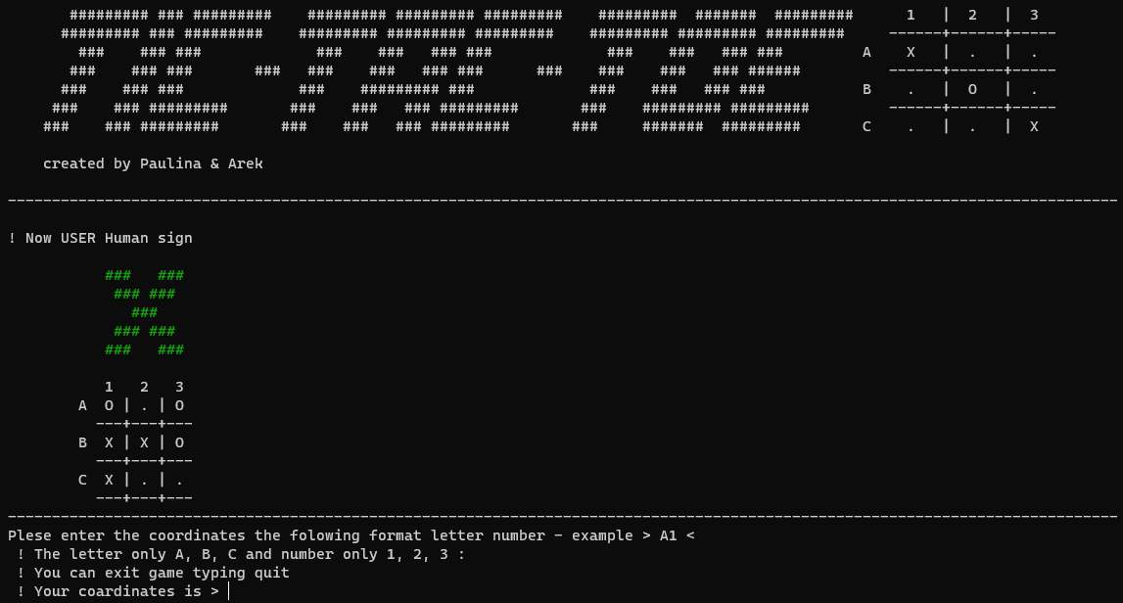
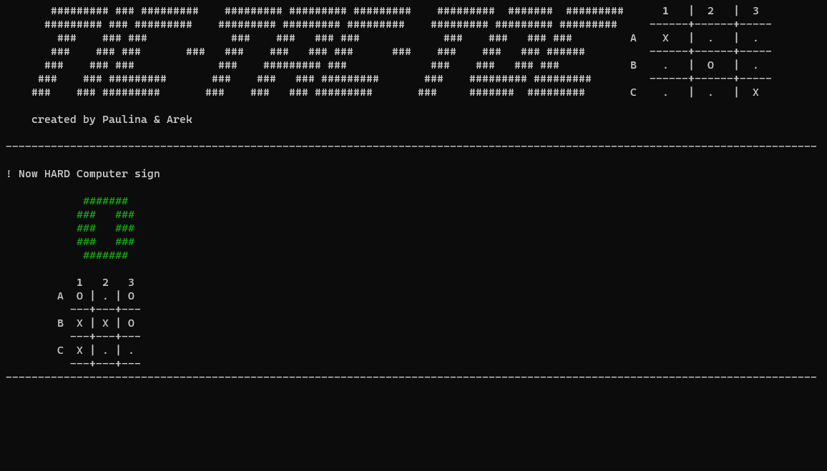
GAME PROCES

Slide 9
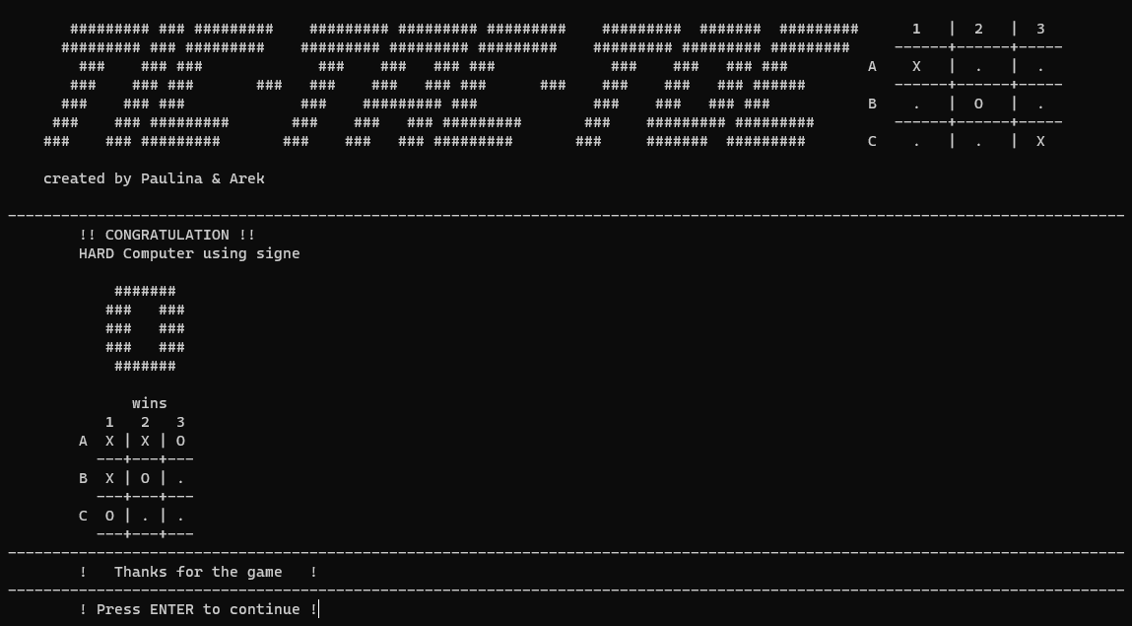
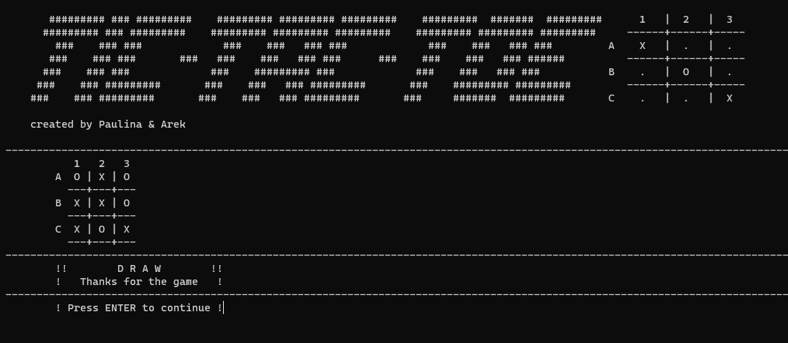
WIN or DRAW
WIN
DRAW

Slide 10
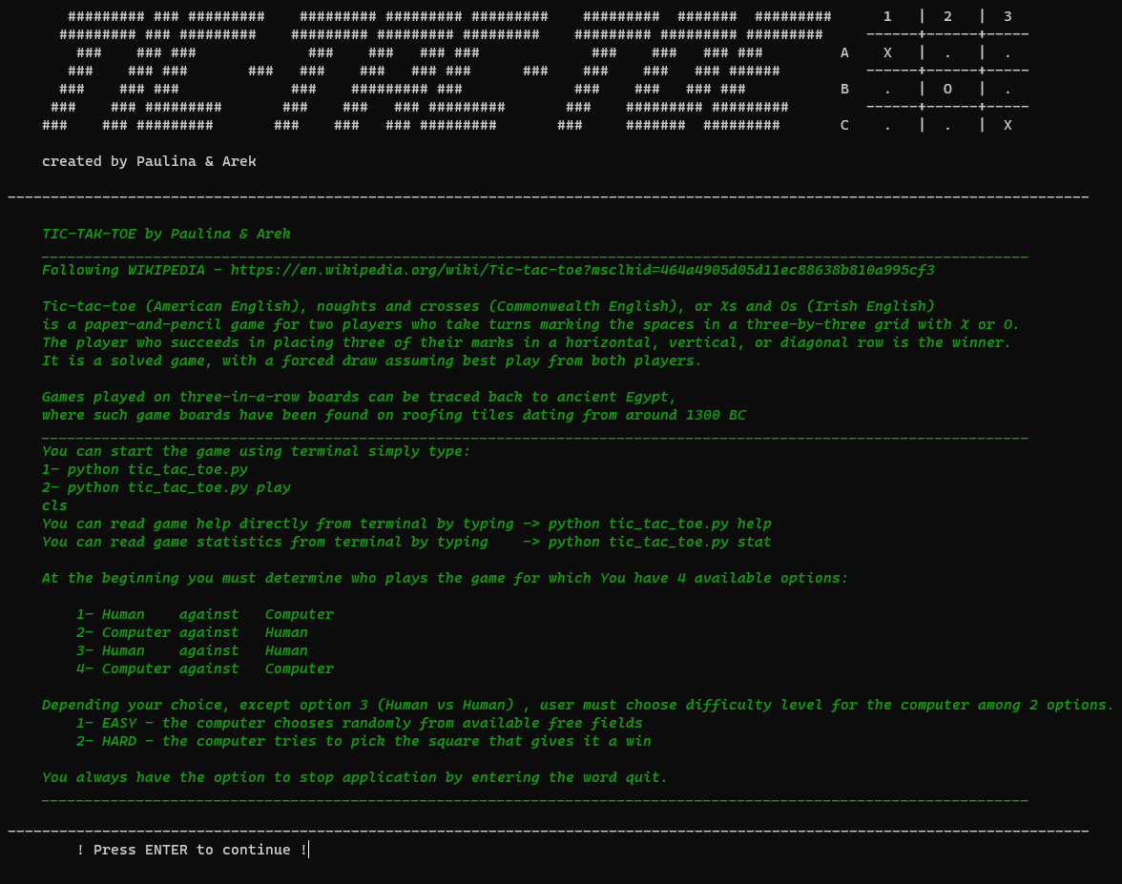
HELP

Slide 11
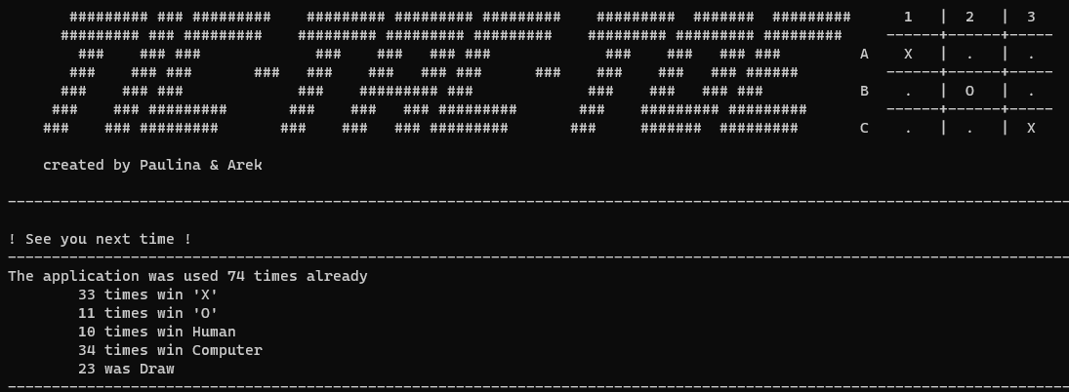
GAME stAtistisc

Slide 12
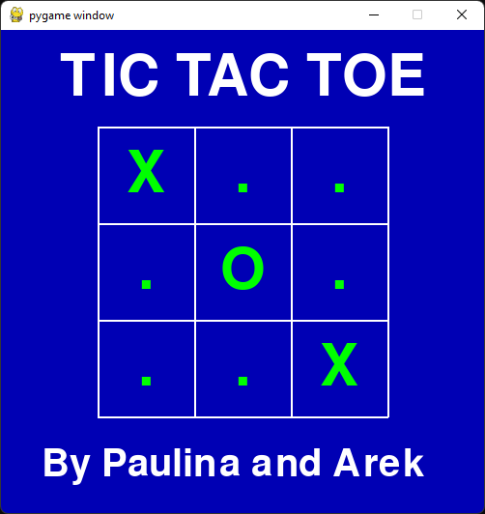
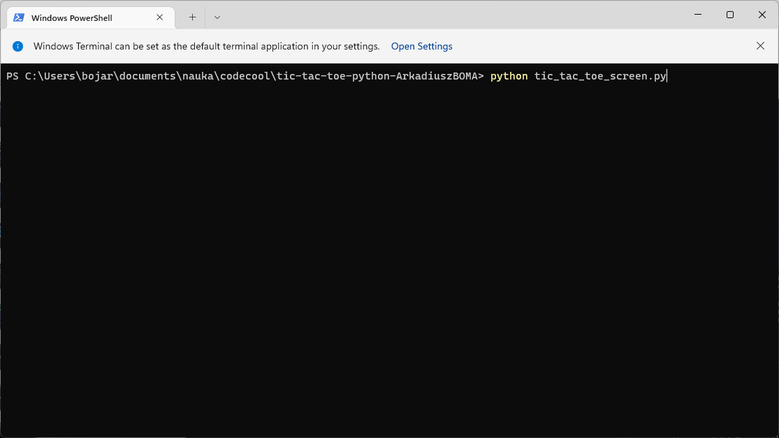
EXTRA
OUR first screen

Slide 13
THANK YOU

