Slide 1
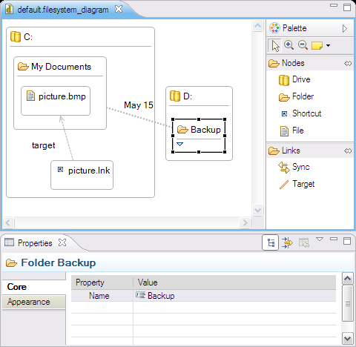
EuGENia: GMF for mortals
Dimitrios Kolovos
dkolovos@cs.york.ac.uk
Department of Computer Science
University of York

Slide 2
Aim: Implement a graphical
editor for a DSL

Slide 3
Technologies: Eclipse, EMF, GMF

Slide 4
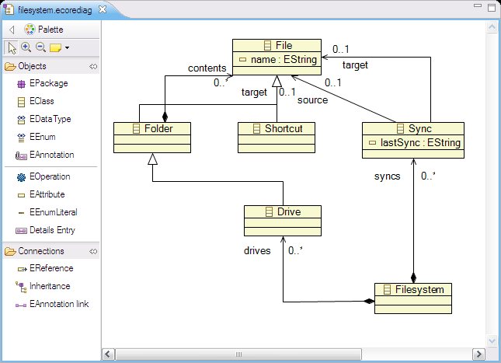
Our Metamodel (in EMF/XMI)
Notes:
Filesystem contains drives, Drives contain folders and files, Folders contain folders and files. Shortcuts are special types of files that point at another file and Sync show synchronization relationships between files/folders.

Slide 5
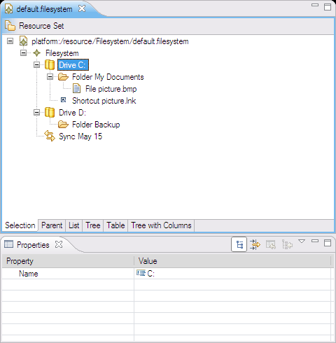
How EMF Works
Metamodel
Generator Model
Code Generator
Notes:
EMF can generate a Java implementation of our metamodel that supports serialization + de-serialization to XMI, and a basic tree-based model editor

Slide 6

How GMF Works
Meta
Model
Tooling Model
Graph Model
Mapping Model
Generator Model
Code Generator
Notes:
GMF builds atop EMF and requires us to specify a few more models so that it can generate a diagram-based editor for our metamodel.

Slide 7
How GMF Works
Meta
Model
Tooling Model
Graph Model
Mapping Model
Generator Model
Code Generator
Notes:
GMF builds atop EMF and requires us to specify a few more models so that it can generate a diagram-based editor for our metamodel.

Slide 8
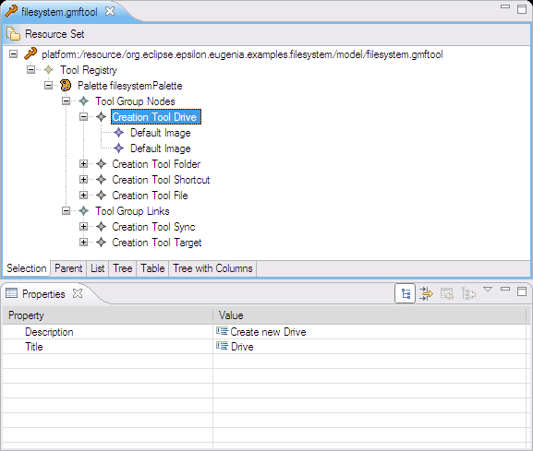
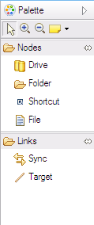
The GMF Tooling Model
Notes:
The tooling model specifies the tools (captions, icons and categorization) in the editor palette.

Slide 9
How GMF Works
Meta
Model
Tooling Model
Graph Model
Mapping Model
Generator Model
Code Generator
Notes:
GMF builds atop EMF and requires us to specify a few more models so that it can generate a diagram-based editor for our metamodel.

Slide 10
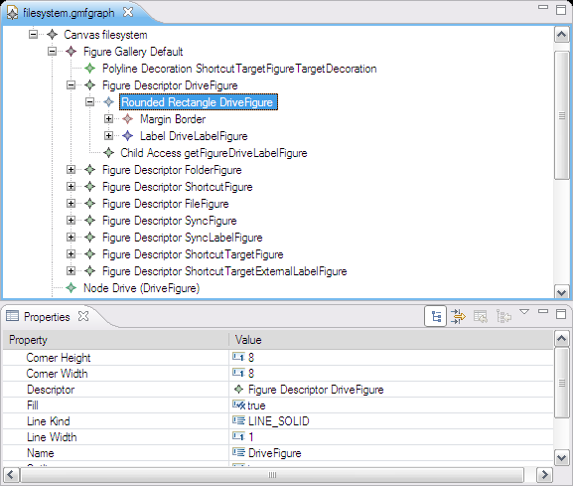
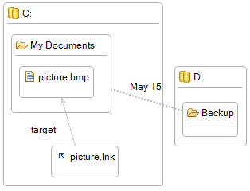
The GMF Graph Model
Notes:
The graph model specifies the figures and lines involved in the editor – without specifying which concepts of the metamodel these figures represent.

Slide 11
How GMF Works
Meta
Model
Tooling Model
Graph Model
Mapping Model
Generator Model
Code Generator
Notes:
GMF builds atop EMF and requires us to specify a few more models so that it can generate a diagram-based editor for our metamodel.

Slide 12
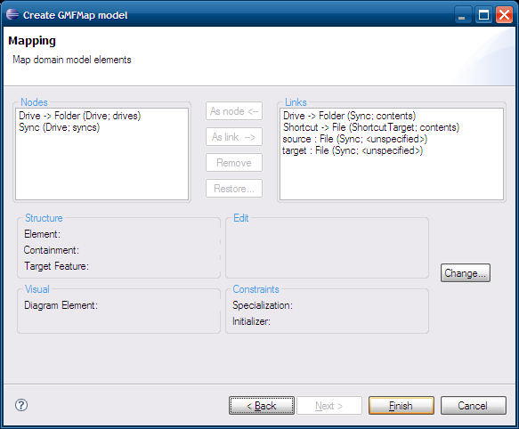
Mapping Model Wizard
Notes:
You can’t really blame the wizard as it has very little information at its disposal.

Slide 13
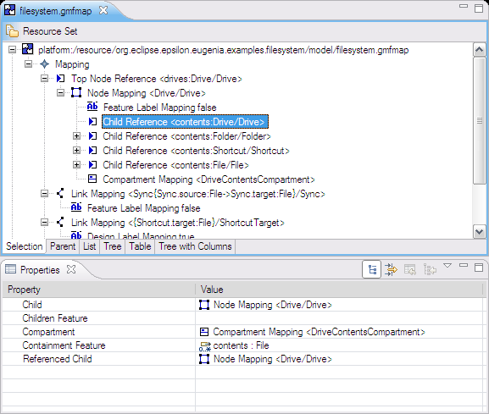
The GMF Mapping Model
Notes:
Since the wizard cannot produce anything useful, we need to hand-craft the mapping model. The mapping model is responsible for establishing mappings between the tools of the tool model, the figures of the graph model and the concepts of the metamodel.

Slide 14
How GMF Works
Meta
Model
Tooling Model
Graph Model
Mapping Model
Generator Model
Code Generator
Notes:
GMF builds atop EMF and requires us to specify a few more models so that it can generate a diagram-based editor for our metamodel.

Slide 15
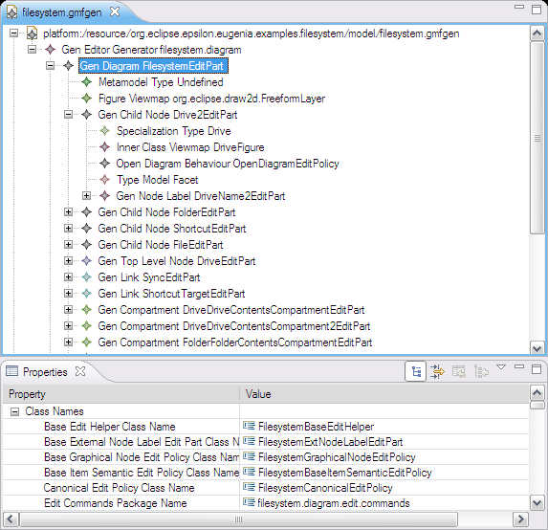
The Generator Model
Notes:
The graph model specifies the figures and lines involved in the editor – without specifying which concepts of the metamodel these figures represent.

Slide 16
How GMF Works
Meta
Model
Tooling Model
Graph Model
Mapping Model
Generator Model
Code Generator
Notes:
GMF builds atop EMF and requires us to specify a few more models so that it can generate a diagram-based editor for our metamodel.

Slide 17


Slide 18
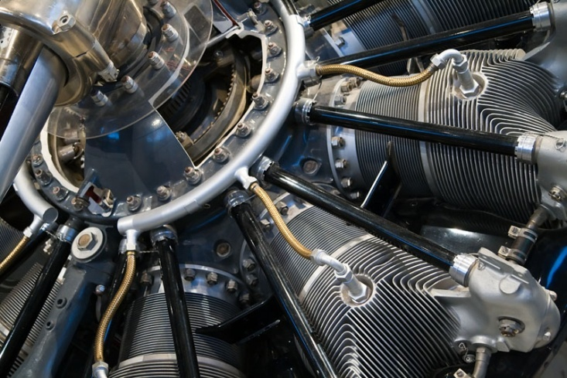
Powerful

Slide 19
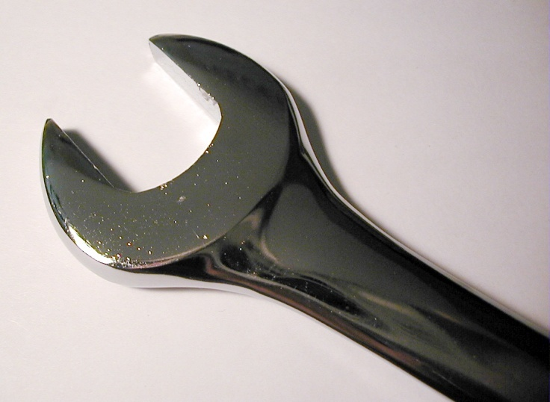
Configurable

Slide 20
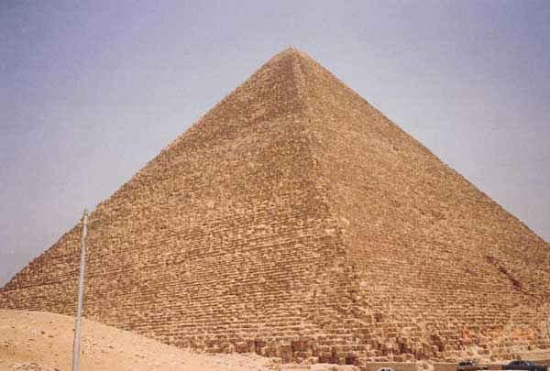
Labour intensive

Slide 21

Hard to master

Slide 22
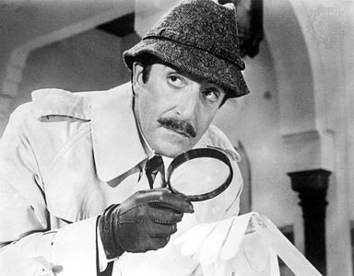
Error prone

Slide 23
Replace it
Make it easier

Slide 24
EuGENia

Slide 25
How EuGENia Works
Metamodel + Annotations
Graph Model Tooling Model Mapping Model
GMF

Slide 26
Our Metamodel

Slide 27
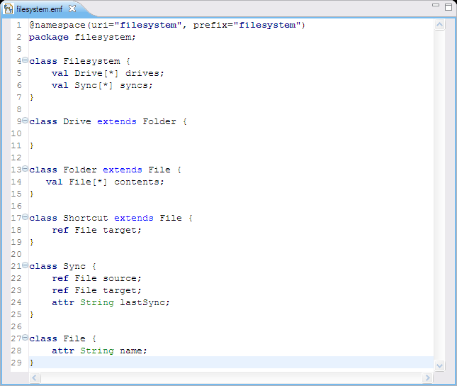
Our Metamodel (in Emfatic)

Slide 28
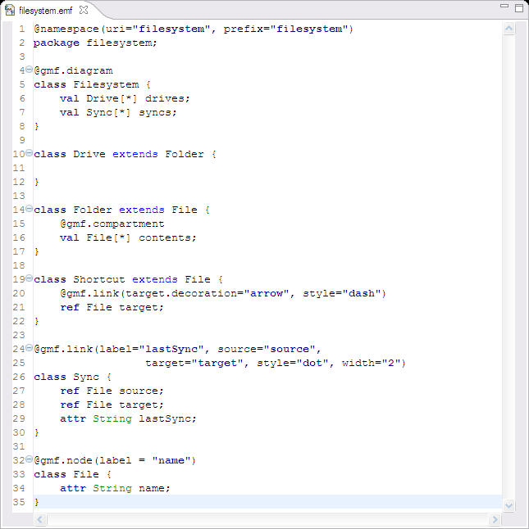

Our annotated metamodel

Slide 29
A closer look…

Slide 30
Filesystem
@gmf.diagram
class Filesystem {
val Drive[*] drives;
val Sync[*] syncs;
}

Slide 31
File
@gmf.node(label=“name”)
class File {
attr String name;
}

Slide 32
Shortcut
@gmf.node(label=“name”)
class Shortcut extends File {
attr String name;
@gmf.link(target.decoration="arrow",
style="dash")
ref File target;
}

Slide 33
Folder
@gmf.node(label=“name”)
class Folder extends File {
attr String name;
@gmf.compartment
val File[*] contents;
}

Slide 34
Drive
@gmf.node(label=“name”)
class Drive extends Folder {
attr String name;
@gmf.compartment
val File[*] contents;
}

Slide 35
Sync
@gmf.link(label="lastSync", source="source",
target="target", style="dot", width="2")
class Sync {
ref File source;
ref File target;
attr String lastSync;
}

Slide 36
How EuGENia Works
Metamodel + Annotations
Graph Model Tooling Model Mapping Model
GMF

Slide 37
Good stuff
Easy
High level
Hides GMF details
Change resilient
Can target different editor frameworks in the future

Slide 38
Not so good stuff
Not 1:1 GMF mapping
But we are adding features
Further customization with EOL
http://epsilonblog.wordpress.com/2009/06/15/eugenia-polishing-your-gmf-editor/
Pollutes metamodel
Trade-off for usability

Slide 39
Implementation Notes
2 Model-to-Model Transformations
1235 Lines of Code
Transformations in EOL
Epsilon Object Language (www.eclipse.org/gmt/epsilon)

Slide 40
Community
Well-received contribution
Newsgroup activity
news://news.eclipse.org/eclipse.epsilon
Requests for enhancements
Comments in Epsilon’s blog
http://epsilonblog.wordpress.com/2008/08/04/eugenia-kick-start-your-gmf-editor-development/

Slide 41
Resources
Download
www.eclipse.org/gmt/epsilon
Tutorial (+ list of annotations)
epsilonlabs.wiki.sourceforge.net/EuGENia
Screencasts
www.eclipse.org/gmt/epsilon/cinema

Slide 42
Acknowledgements
ModelPlex EU Project
www.modelplex.org

