Slide 1
FINAL YEAR PROJECT · FINAL PRESENTATION · LEVEL 4
AI-Powered Harvest Yield Prediction
for Non-Cash Crops (Big Onion) in Sri Lanka
214019K Arkam B.H.M. · ML / DL modelling and serving
214192G Sharuja B. · Data engineering and features
214193K Shathurya P. · Dashboard and visualisation
Supervised by Dr. Firdhous M.F.M.
Group Agro AI · Faculty of Information Technology, University of Moratuwa · 2026

Slide 2
AGENDA
What we will cover
▸ The problem no pre-harvest yield forecast exists for big onion in Sri Lanka
▸ Related work what others have done, and the five gaps we target
▸ Our approach multi-source data, real daily weather, one honest protocol
▸ The method PADR — an agronomic model whose crop constants are estimated, not assumed
▸ Results what we found when we audited our own data, and what 28 records support
▸ Two findings we withdraw and why reporting them is the point
▸ Contributions, limitations and what comes next
Notes:
Keep this to 30 seconds. Signal early that we will report negative results as well as positive ones — that framing protects us later.

Slide 3
THE PROBLEM
Sri Lanka cannot see its onion harvest coming
220,000
0
After
metric tons of big onion consumed nationally each year
crop-cutting surveys for big onion — unlike paddy, none exist
harvest is when the yield figure finally arrives
Import volumes must be committed months before the domestic crop reaches market. Today that decision is made against last year's outcome and a subjective field assessment with no quantified error.
Notes:
The key line: this is not an improvement to an existing service. There is no existing service. Yield estimates for big onion come from agricultural instructors' judgement, not measurement, and they arrive too late to act on.

Slide 4
THE PROBLEM
Why this is technically hard
What drives yield
What we can actually observe
• Soil water availability and irrigation scheduling
• Thermal accumulation across the growing season
• Canopy development and radiation interception
• Pest and disease pressure
• Cultivar choice and fertiliser regime
• Daily weather (reanalysis, spatially complete)
• Satellite vegetation indices and land surface temperature
• Static soil properties from global grids
• District yield history — itself subjectively estimated
• Nothing about management decisions
Most of what determines yield is unobserved. That places a ceiling on achievable accuracy before any model is chosen.
Notes:
Anticipate the 'why is your R² low' question here, early, on our own terms. The unobserved-driver argument is the honest answer and it is better made in the setup than in the defence.

Slide 5
SCOPE
Aim and objectives
▸ Aim forecast big onion yield by district and season, before harvest, from open data — with honest, calibrated uncertainty
▸ 1 Data foundation integrate yield, weather, satellite and soil to one clean grain
▸ 2 Feature engineering derive agronomically meaningful predictors
▸ 3 Comparative modelling classical, deep, symbolic and physics-hybrid under one protocol
▸ 4 Honest evaluation leakage-free cross-validation, significance tests, conformal intervals
▸ 5 Attribution and ablation quantify what each data source and predictor contributes
▸ 6 Delivery REST service and a decision-support dashboard
Notes:
Objective 4 is the one to emphasise. The evaluation protocol is a deliberate design decision, not a formality, and it is why our numbers are lower than papers that use random splits.

Slide 6
01
Review of others' work
Four traditions — classical ML, deep and hybrid architectures, mechanistic crop models, and the Sri Lankan literature — and what none of them covers.

Slide 7
RELATED WORK
Where the literature stands
Work | Crop / region | Method | Limitation for our problem
Jabed et al. (2024) | Multiple / global | Review of ML and DL | No small-sample guidance
Chikwendu et al. (2025) | Multiple | RF, XGBoost, SVR, ANN | Random split leaks temporal information
Rajpoot & Chandrakar (2025) | Cereals | Hybrid CNN-LSTM | Validated only at large sample size
Shahhosseini et al. (2021) | Corn / US | Crop model + ML | Needs a full APSIM-class simulator
Amarasinghe et al. (2024) | Rice / Sri Lanka | Feature-engineered ML | Paddy has crop-cutting surveys
Iqbal et al. (2023) | Onion / Bangladesh | Supervised ML | Climate only; no satellite, no seasons
Sutharsan & Yogendran (2023) | Red onion / Sri Lanka | Multiple regressors | Predicts price, not yield
No published work predicts big onion yield for Sri Lankan districts.
Notes:
Do not read the table. Point at the last two rows: the closest Sri Lankan onion work is about price, and the closest onion yield work is Bangladeshi and climate-only.

Slide 8
RELATED WORK
Five gaps we target
▸ Gap 1 no big onion yield prediction system exists for Sri Lanka
▸ Gap 2 no guidance on model choice under severe data scarcity for vegetables
▸ Gap 3 mechanistic and learned components are rarely combined at this scale
▸ Gap 4 bimodal Yala/Maha seasonality is not represented architecturally
▸ Gap 5 no decomposition of which data source is worth paying for
Each gap maps to one contribution in this project — we return to this map at the end.
Notes:
Set up the callback. Slide 24 repeats these five and shows what we delivered against each.

Slide 9
02
Our approach
Four data streams reduced to one grain, 37,988 real daily weather records, and an evaluation protocol built to not flatter us.

Slide 10
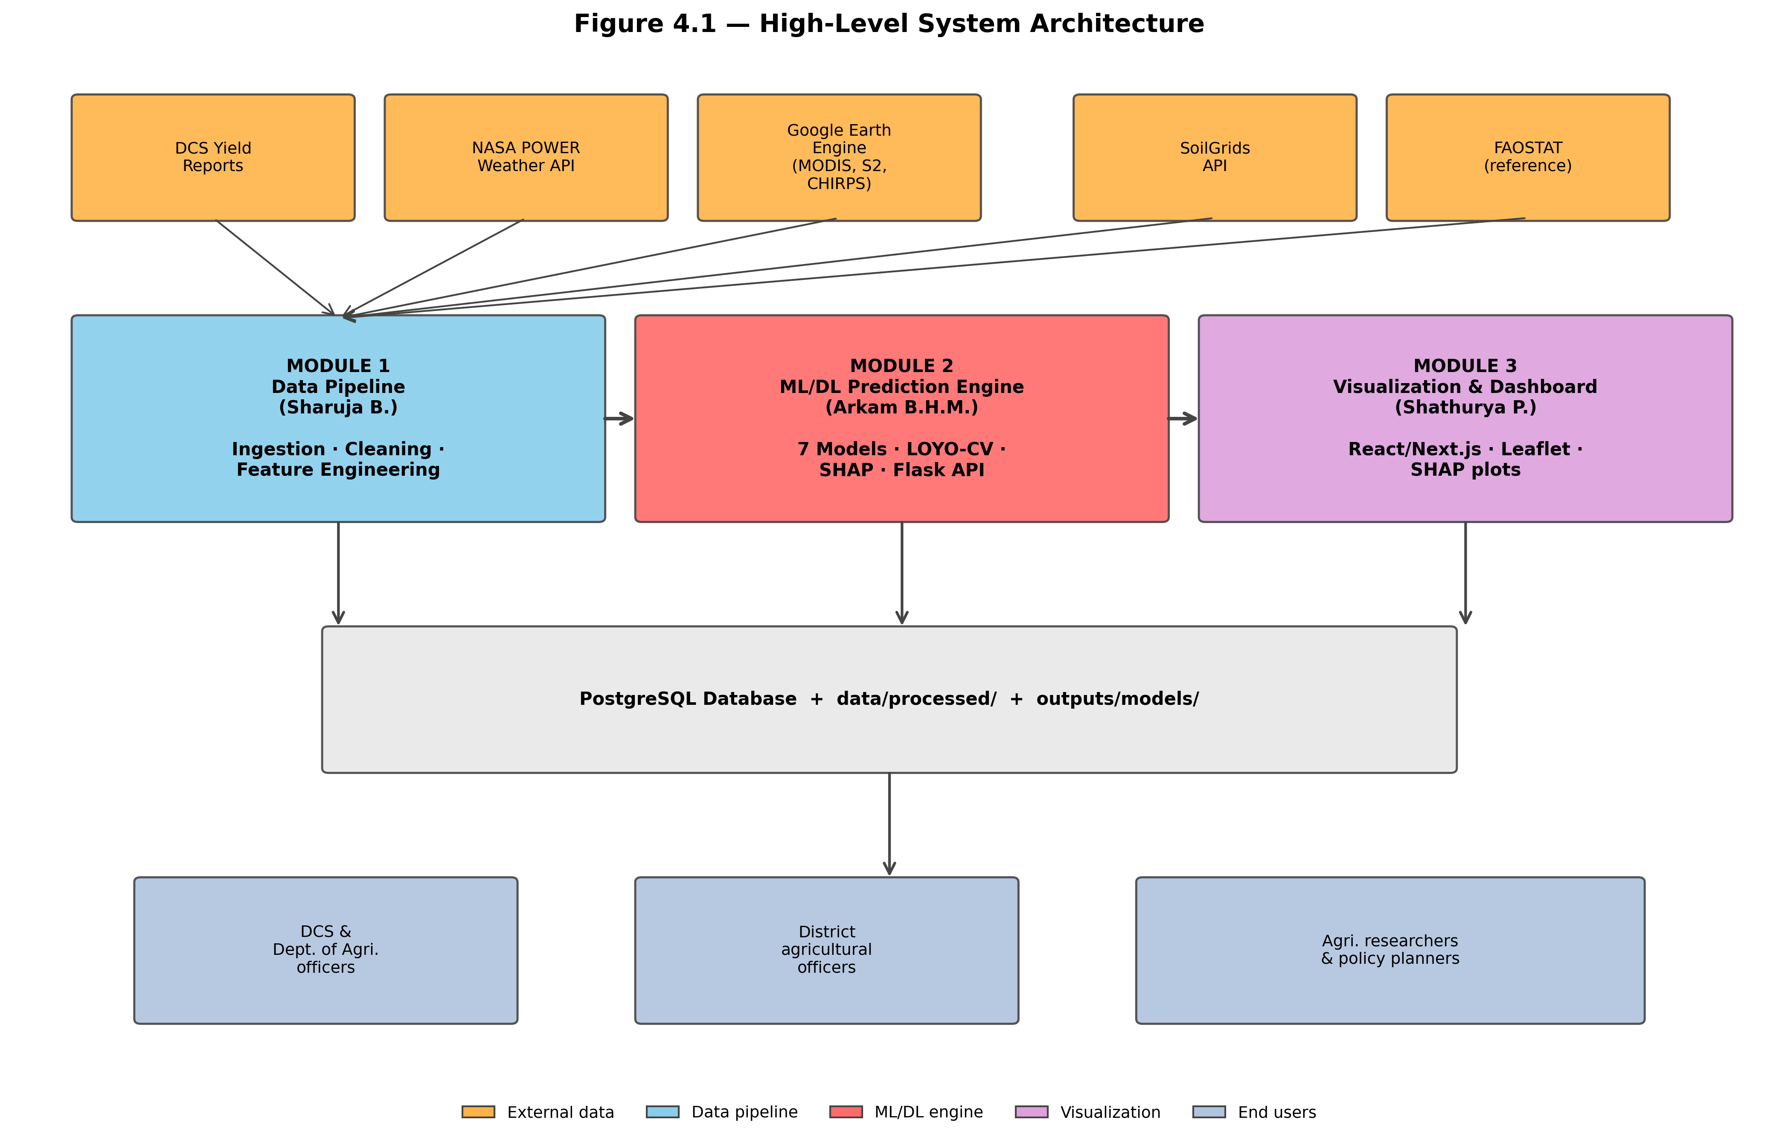
OUR APPROACH
Top-level system architecture
Data integration → modelling and evaluation → REST serving → dashboard. Modules are separated by file and HTTP interfaces.
Notes:
Emphasise that the serving layer never trains. Models can be retrained without touching the service, and the service restarts without retraining.

Slide 11
OUR APPROACH
Four data streams, one grain
Stream | Source | Native grain | Role
District yield | DCS Sri Lanka; FAOSTAT | District · season · year | Target and yield-history predictors
Daily weather | NASA POWER; CHIRPS | Daily | Temperature, rainfall, humidity, radiation
Vegetation indices | MODIS, Sentinel-2 via Earth Engine | 5–16 day composite | Canopy vigour, anomaly, growth rate
Land surface temp. | MODIS MOD11A1 | Daily, 1 km | Day and night thermal regime
Soil properties | ISRIC SoilGrids250m | Static, 250 m | pH, organic carbon, clay, sand
Everything is reduced to one record per district, season and year.
Notes:
Mention the Maha boundary problem: the season runs October to March, so a naive calendar-year grouping splits one season into two records. We define season as an explicit month list.

Slide 12
OUR APPROACH
Engineered predictors, after the cull
Measured and derived
Interaction terms — encoded hypotheses
• Weather (9) — growing degree days, heat stress days, SPI drought index, rainfall totals and extremes
• Satellite (11) — NDVI mean/max/min, anomaly, time-to-peak, growth rate, EVI, NDWI, day and night LST
• History (5) — previous season, previous year, three-year average, season indicator, previous extent
• Soil (4) — pH, organic carbon, clay and sand fraction
• rainfall × NDVI — rain only helps when there is a canopy to use it
• temperature × humidity — evaporative demand and fungal disease pressure
• NDVI × LST — is the green canopy also thermally stressed?
• These three are the only features built from hypothesis rather than measurement — and two of them top the SHAP ranking
Yield-history features are shifted within district so a record never sees its own target.
Notes:
The leakage point is worth saying out loud: an early version used an unshifted rolling average and produced R² above 0.99. We caught it by disbelieving the number.

Slide 13
OUR APPROACH
What we compare, and against what
Model | Family | Why it is in the comparison
Train mean | Naive | THE BAR — best available without knowing the held-out year
Oracle year-mean | Reference | NOT ACHIEVABLE — bounds what perfect year knowledge buys
Random Forest | Bagged trees | Variance reduction; robust small-sample baseline
XGBoost | Boosted trees | Bias reduction under explicit regularisation
SVR | Kernel method | Capacity independent of sample size
District mean / persistence | Naive | Do district identity or last year carry the signal?
PADR | Mechanistic, estimated | THE METHOD — 17 parameters, constants fitted from data
Notes:
The two reference rows matter more than the models. Without the oracle row nobody can tell whether a negative score is the model's fault or the protocol's.

Slide 14
03
The method
A seventeen-parameter agronomic response model whose crop constants are estimated from data rather than assumed.

Slide 15
THE METHOD
PADR — phenology-aligned differentiable response
▸ The shape yield = attainable yield × ∫ β(τ) · f_temp · f_water · f_waterlog dτ
▸ What is new the FAO-33 and thermal constants are ESTIMATED, not fixed — existing hybrids freeze the crop model and fit ML on its residual
▸ Shrinkage to physics each constant is penalised toward its textbook value, so it moves only when the data pay for the move
▸ Seventeen parameters against 44,929 in the CNN-LSTM it replaces — a model this small is the only kind 24 training rows can support
▸ Fitted by L-BFGS-B multi-start, agronomic box bounds, refit from scratch inside every fold
The fitted constants are the scientific output. They survive even when the prediction does not.
Notes:
The distinction to hammer: Shahhosseini et al. run a crop model with published coefficients and fit a learner to the residual. We estimate the coefficients. That is a method claim, not a domain claim, and it is what the supervisor asked for.

Slide 16
THE METHOD
Weather on a thermal clock, not a calendar
▸ The problem 'September rainfall' means a different developmental moment in each district-year
▸ Satellite could not solve it onion is 0.002–0.89% of any district's land area, so district-mean NDVI measures paddy and scrub — 25 of 28 district-years failed to anchor
▸ What worked instead harvest date from the DCS monthly production distribution — genuinely crop-specific, and it moves across 51 days
▸ Thermal time backwards planting located by accumulating degree-days back from harvest; 28 of 28 anchored, zero fallbacks
▸ It behaves like physics hot Anuradhapura completes a season in 78–86 days; cooler Matale needs 90–99 for the same heat
Notes:
If asked why not NDVI: it is an area argument, not a sensor argument. A crop on 0.1% of the pixels cannot move a district mean. We tried it, measured the failure, and report it.

Slide 17
PROTOCOL
How we evaluate — and why it lowers our score
▸ Leave-one-year-out hold out a whole year; every fitted quantity, including all scaling, estimated inside the fold
▸ Why not a random split records from one year share a weather regime; a random split would report a far more flattering and entirely misleading number
▸ Four leaks found and removed anomalies had been standardised on the full panel; the target had been winsorised at full-sample percentiles
▸ Yield lags dropped, not repaired under LOYO the row for year k+1 carries year k's observed yield — no clean fix inside this protocol
▸ Observations weighted by area cells span 3.5 to 1,765 hectares; treating them as equally reliable is not defensible
An honest protocol is why our numbers are lower than published work using random splits.
Notes:
This slide is our insurance. Every low number later is a consequence of choices defended here.

Slide 18
04
Results
What we found when we audited our own data — and what the corrected panel can and cannot support.

Slide 19
RESULTS
We audited our own dataset. It did not survive.
40%
442
0.68
of the target variable was fabricated — 50 of 124 month-rows
MT/ha implied by one record; onion's world record is ~100
correlation between the old target and the corrected one
The fabrication reached the TARGET, not just the covariates: yield varies month to month within every cell and the target was their unweighted mean. Rebuilt from 87 genuine DCS records as total production over total harvested area.
Notes:
Lead with this. It is the least comfortable slide and the most credible one. A panel that sees us find and report our own contamination will trust everything that follows.

Slide 20
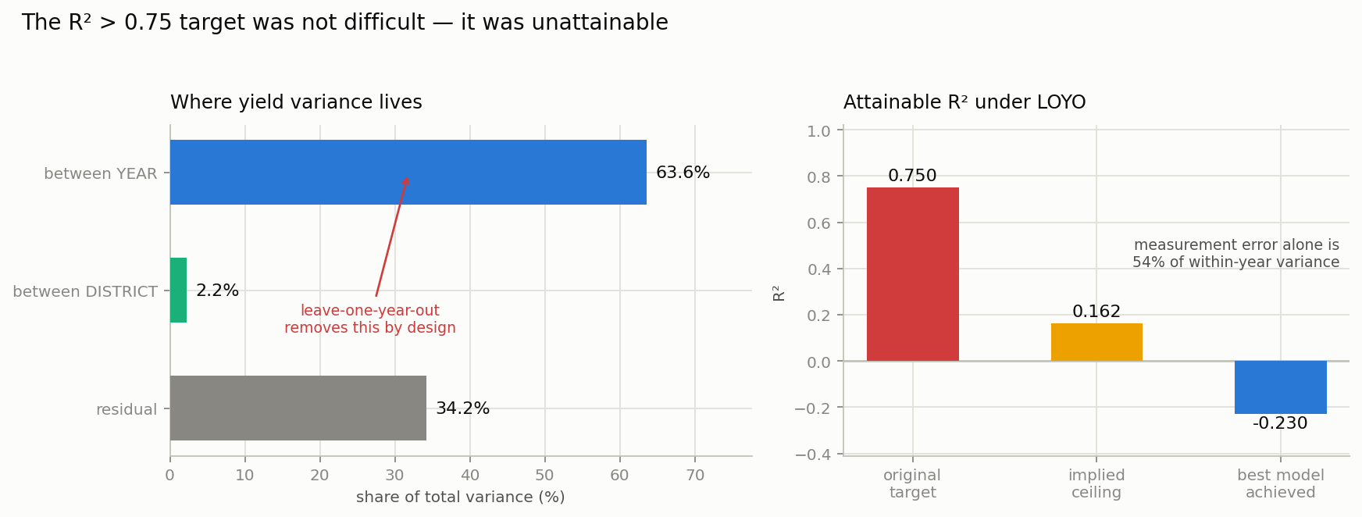
RESULTS
The 0.75 target was not difficult. It was unattainable.
64% of variance lies between years and leave-one-year-out removes it by construction; measurement error is 54% of what remains within a year.
Notes:
This is the single most important slide in the deck. The proposal target was set before anyone knew the structure of the record. No model of any architecture could have reached 0.75 here. Say the number: the ceiling is 0.162.

Slide 21
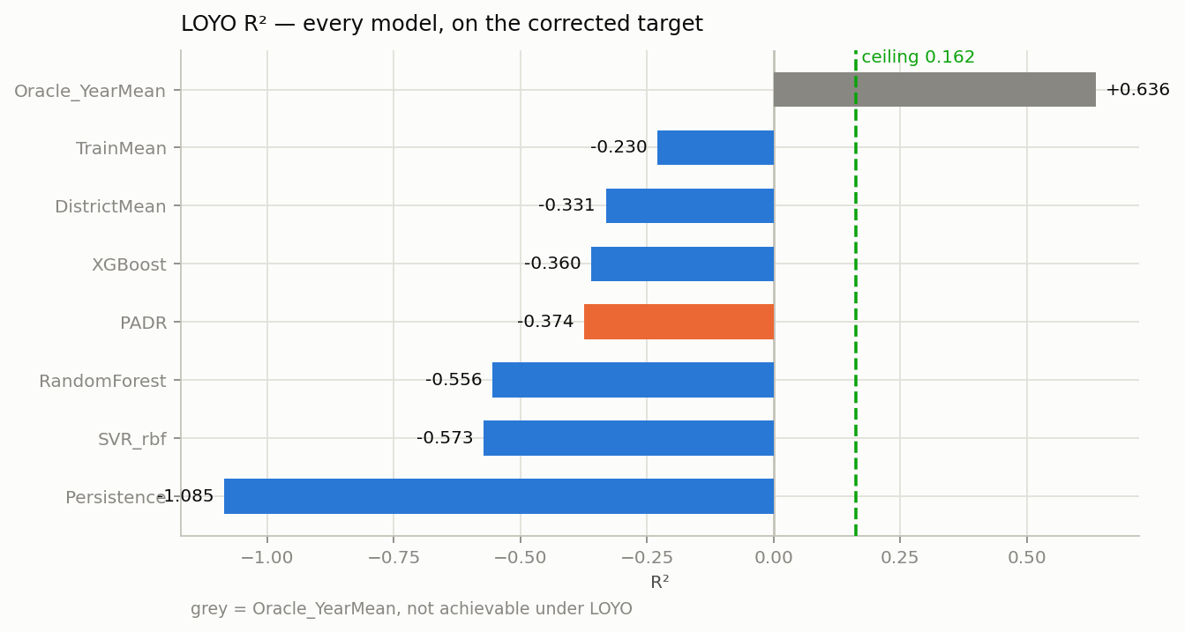
RESULTS
Every model loses to predicting the mean
Leave-one-year-out R² on the corrected target. The oracle row uses the held-out year's own mean and is not achievable — it bounds what perfect knowledge of the year effect would buy.
Notes:
Do not apologise for this slide. Read against the ceiling it is the expected outcome, and the next slide explains the mechanism.

Slide 22
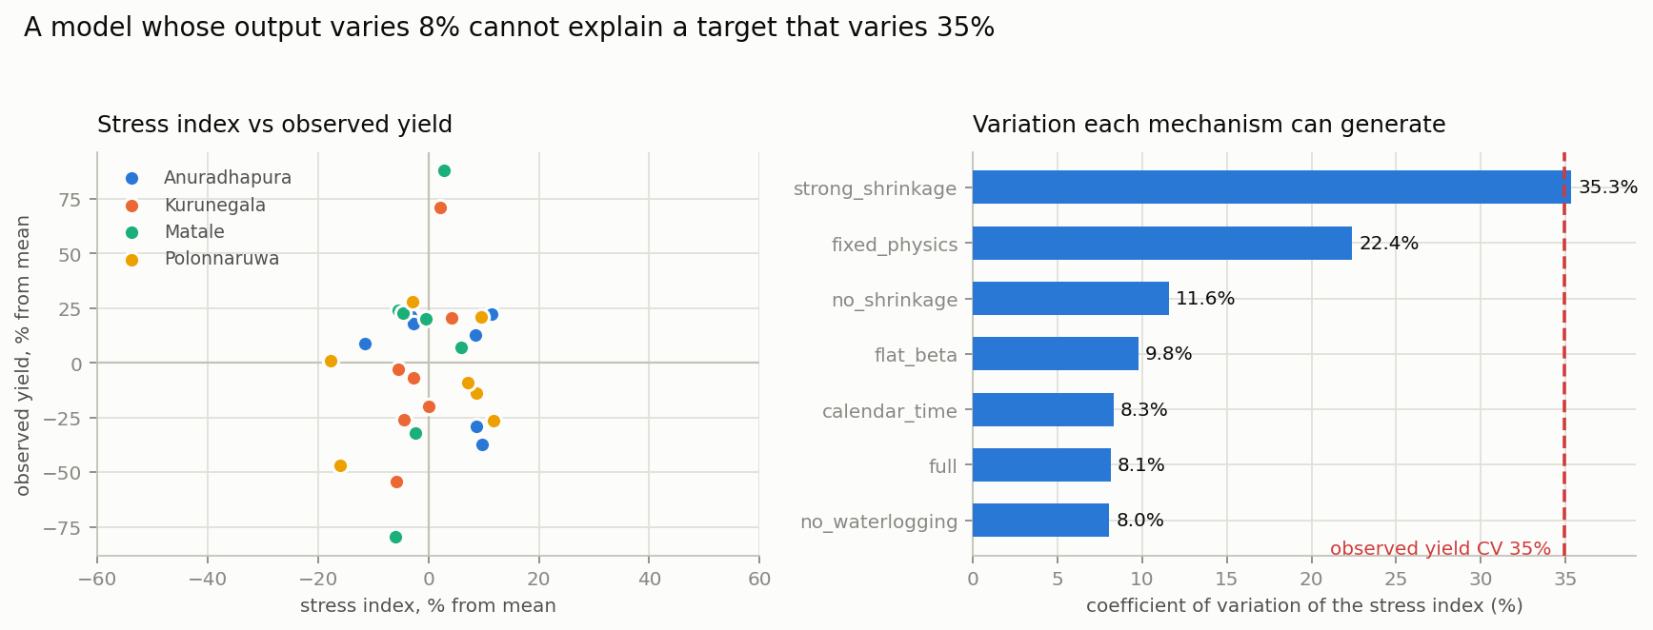
RESULTS
Why: the stress index cannot move far enough
Stress index varies 8%. Observed yield varies 35%. Thermal stress is near-constant in the tropics, and water deficit almost never binds under tank irrigation.
Notes:
The key sentence: a model whose output varies eight per cent cannot explain a target that varies thirty-five, whatever coefficients you give it. This is structural, not a tuning failure. And removing 2022 and 2024 makes it relatively WORSE, so the signal is absent, not masked.

Slide 23
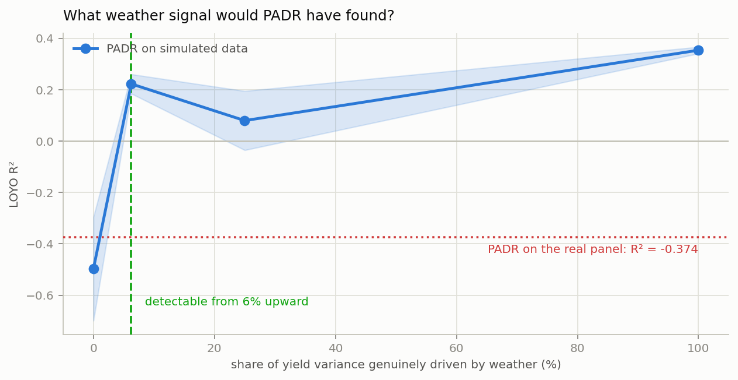
RESULTS — THE LINCHPIN
Would we have found a signal if one were there?
On simulated panels PADR recovers a weather signal driving as little as 6% of yield variance at n=28. It recovered none from the real data — so the true signal is below 6%.
Notes:
This is the slide that turns 'our model failed' into 'the signal is not there'. A negative result from an underpowered instrument says nothing about the world; this measures the instrument. Two honesty points if pressed: the curve is non-monotonic because we ran only two replicates per amplitude, and we used a single optimiser start from the literature values — which is deliberately OPTIMISTIC, so failing to detect under those conditions errs the safe way.

Slide 24
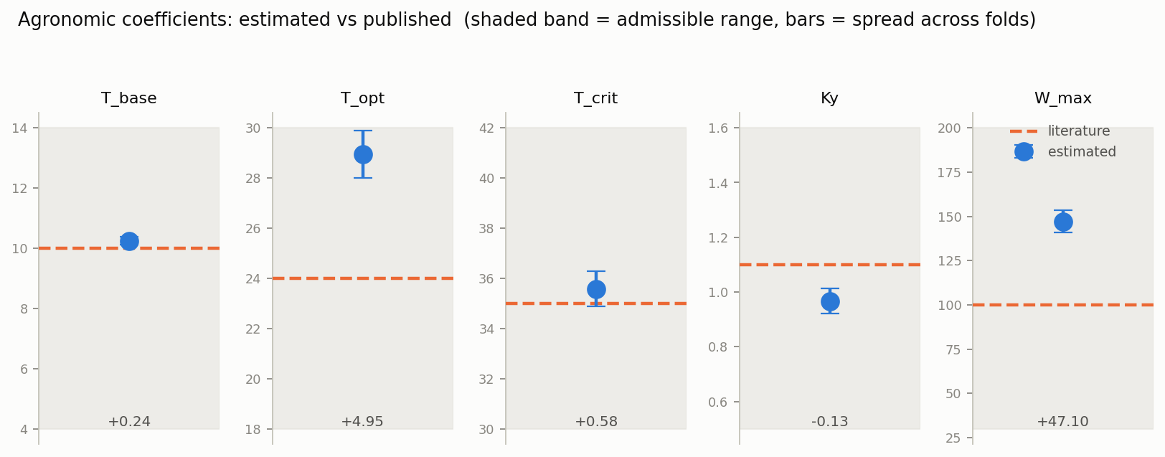
RESULTS — THE POSITIVE FINDING
FAO-33 overstates weather sensitivity for this crop
Pinning the coefficients to published values produces the right amount of variation (35%) but the worst score of any configuration (R² −1.54). T_opt and W_max are recovered to within 3%; Ky and T_crit are NOT identifiable at n=28 and are not claimed.
Notes:
Strongest positive result, and transferable: learning the constants does not add explanatory power so much as REMOVE spurious sensitivity — stress CV falls 22.4% to 8.1% while R² improves 0.57. IMPORTANT CAVEAT: our recovery experiment shows Ky returns its prior (1.108) when fitted to data generated with 0.966. The tight fold spread on Ky was the shrinkage prior, not evidence — precision without accuracy. So we claim T_opt and W_max, not Ky. The FAO-overstatement finding survives because it rests on the ablation contrast, not on any single point estimate.

Slide 25
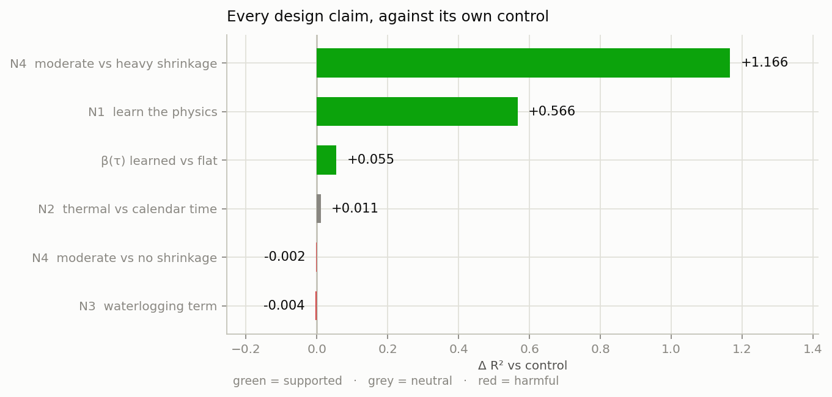
RESULTS
Two claims survived. Two did not.
Each design claim tested against its own control. Learning the physics and moderate shrinkage are supported; thermal-time indexing and the waterlogging term are not.
Notes:
Volunteer the nulls. An ablation in which every proposed component happens to help is not a credible ablation, and a panel knows it. Thermal time is negligible because temperature barely varies here; waterlogging binds in 3.5% of intervals in one year.

Slide 26
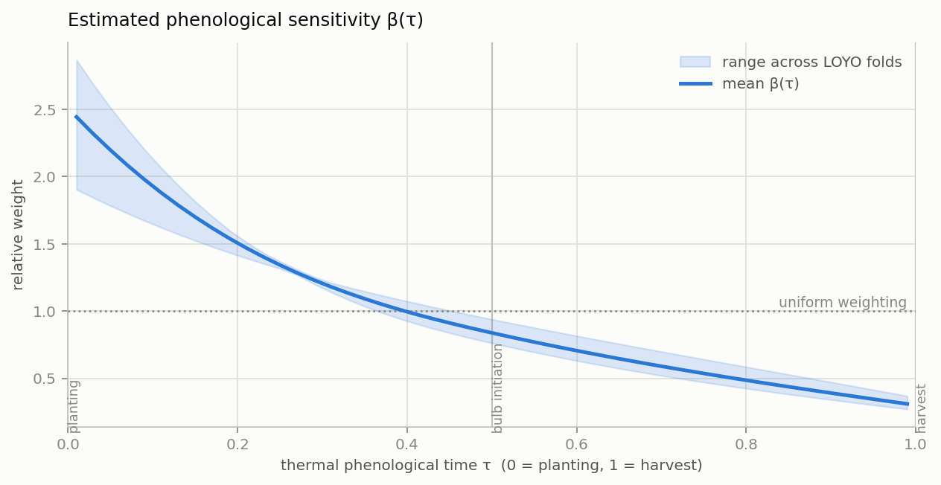
RESULTS
When does weather matter for onion?
Estimated sensitivity declines monotonically — roughly seven times more weight on establishment than on harvest. Band shows the range across folds.
Notes:
Hedge this one appropriately: the underlying stress signal is weak, so the curve is estimated from little information. The shape is stable across folds and agronomically plausible for a crop whose bulb is set early, but it is not a well-identified estimate.

Slide 27
RESULTS
Honest intervals — and what they reveal
Model | Coverage | Half-width (MT/ha)
Oracle year-mean (not achievable) | 0.929 | 6.70
Train mean | 0.893 | 14.90
PADR | 0.893 | 15.29
XGBoost | 0.929 | 16.42
Random Forest | 0.929 | 17.63
Notes:
The interim report said coverage was 1.000 for all twelve models. That was a tautology — the quantile was computed from the same residuals it was then measured on. Year-blocked cross-conformal gives 0.911 against a nominal 0.90. But the width is the finding: plus or minus 15.3 on a mean of 17.9 is plus or minus 85%. These forecasts are not decision-useful, and the interval is the evidence for saying so.

Slide 28
CORRECTIONS
Two findings we are withdrawing
▸ Withdrawn — 'deep learning fails at this scale' the sequence tensor fed to the LSTM and CNN models was manufactured from the seasonal aggregates through a fixed sine curve; it was a deterministic, invertible function of the tabular features the classical models already had, carrying zero extra information
▸ Withdrawn — 'synthetic R² 0.842 validates the architecture' that data was generated by a known functional form inside our own data loader, with the vegetation index built as a function of the yield it later predicted — recovering it proves only that an estimator can invert a function it was handed
▸ What replaced them 37,988 genuine daily NASA POWER records now feed the sequence models; a proper comparison is stated as further work rather than claimed here
Reporting this is better than letting a convenient negative result stand unexamined.
Notes:
Expect a question here. The answer: we found these ourselves, before submission, by auditing our own inputs. That is the process working.

Slide 29
CONTRIBUTIONS
What this work contributes
Contribution | Evidence
Data integrity finding | 40% fabricated target identified and rebuilt from 87 genuine DCS records
A quantified account of what the panel supports | 64% year / 2% district variance split; measurement error 54% of within-year; attainable R² bounded at 0.162
Locally estimated agronomic coefficients | +0.566 R² over fixed physics; FAO-33 shown to overstate weather sensitivity ~4×
Diagnosis that the agro-climatic channel is inactive | 8% stress variation against 35% in yield; removing anomalous years worsens the fit
Methodological corrections | four leaks removed, fabricated sequences replaced, tautological conformal fixed, extent weighting introduced
Notes:
Note that four of five contributions are things we found by being sceptical of our own pipeline. That is the story of this project.

Slide 30
LIMITATIONS
What bounds these conclusions
Limitations
Further work, in priority order
• 28 records, 4 districts, 7 years, Yala only — no Maha data exists
• Kurunegala and Matale share one weather grid cell — identical daily series
• Kurunegala's NDVI is a Matale proxy; its soil profile is absent entirely
• Six records excluded on an agronomic bound, not source verification
• The 2022 fertilizer-ban attribution is timing, not established causation
• No fertilizer, irrigation, cultivar or price data was available
• Collect input and management data — this is where the signal actually is
• Re-run the ML vs DL comparison properly on the real daily sequences
• Mask satellite aggregation to cultivated onion parcels
• Finer reanalysis to separate Kurunegala from Matale meteorologically
• Verify the six flagged records against the DCS publication
• Apply the ceiling calculation across published short-panel yield studies
Notes:
The first item is the real conclusion. Our finding tells the next person exactly what to collect, and it is not more weather data.

Slide 31
WRAPPING UP
Conclusion
▸ We asked whether weather predicts onion yield here and answered it: it does not, at district-season resolution
▸ The target was unattainable, and we proved it 64% of variance is removed by the protocol; measurement error takes half the rest; the ceiling is 0.162
▸ The mechanistic model is what made the answer possible a random forest scoring −0.56 tells you nothing; PADR reports which mechanisms are inactive and by how much
▸ One transferable positive result FAO-33 coefficients overstate weather sensitivity for big onion under tank irrigation — calibrate locally
▸ We corrected our own record a fabricated target, a manufactured input tensor and a tautological uncertainty calculation, all found and reported
A well-diagnosed negative result, with its errors stated openly, is worth more than a favourable number that cannot be defended.
Notes:
Land here. We did not get the number we wanted. We got something more useful: an explanation of why that number was never available, and a clear statement of what the next person should collect.

Slide 32
Thank you
Questions and discussion
Full report, source code, trained models and all result artefacts are available in the project repository.
Group Agro AI · Arkam B.H.M. · Sharuja B. · Shathurya P. · University of Moratuwa 2026

