Slide 1
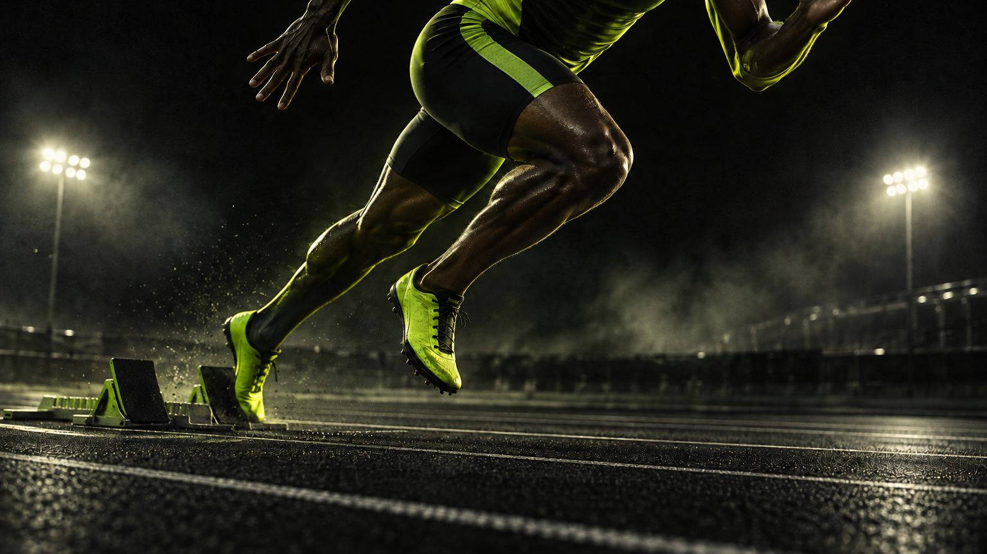
SERIES C — CONFIDENTIAL
KINETIQ
MEASURED IN
MILLISECONDS.
Performance sportswear & equipment, validated on force plates before it touches a starting line. Founded 2019, Portland, Oregon.
0.01s
REACTION DELTA
212g
SHOE WEIGHT
34
COUNTRIES
FY2025 REVENUE $210M · +68% YOY

Slide 2
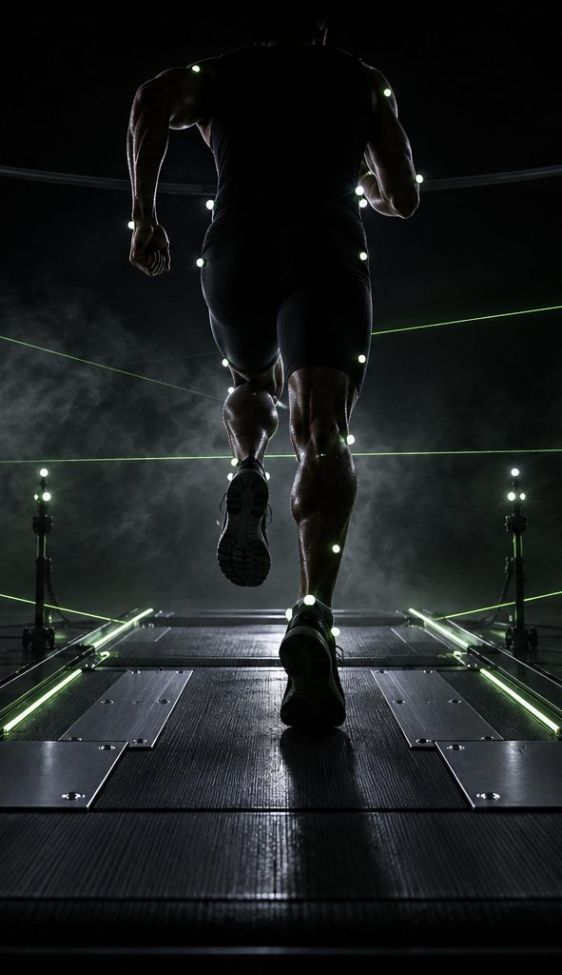
01 — BRAND STORY
BORN IN A
PORTLAND LAB.
In 2019, a biomechanics researcher and a sprint coach kept seeing the same failure: gear that looked fast but measured slow. Marketing claimed milliseconds; force plates said otherwise. So they built a company where the stopwatch outranks the mood board.
2019
FOUNDED IN PORTLAND
68%
YoY GROWTH FY2025
$210M
FY25 REVENUE
34
COUNTRIES SERVED
“EVERY GRAM, EVERY MILLIMETER, EVERY MILLISECOND — ON THE RECORD.”
KINETIQ — SERIES C — 2026
02 / 14

Slide 3
02 — THE MARKET PROBLEM
THE TRUST GAP
IN PERFORMANCE GEAR.
Brands sell hero narratives. Athletes buy verified numbers — and can't get them.
$4.1B
RUN & TRACK FOOTWEAR, US + EU, 2026E
62%
OF SERIOUS RUNNERS DISTRUST PERFORMANCE CLAIMS
2.1×
GROWTH OF 'SUPER SHOE' CATEGORY SINCE 2019
THE KINETIQ ANSWER — PUBLISH THE LAB SHEET WITH EVERY PRODUCT: FORCE CURVES, DUROMETERS, GRAMS.
KINETIQ — SERIES C — 2026
03 / 14

Slide 4
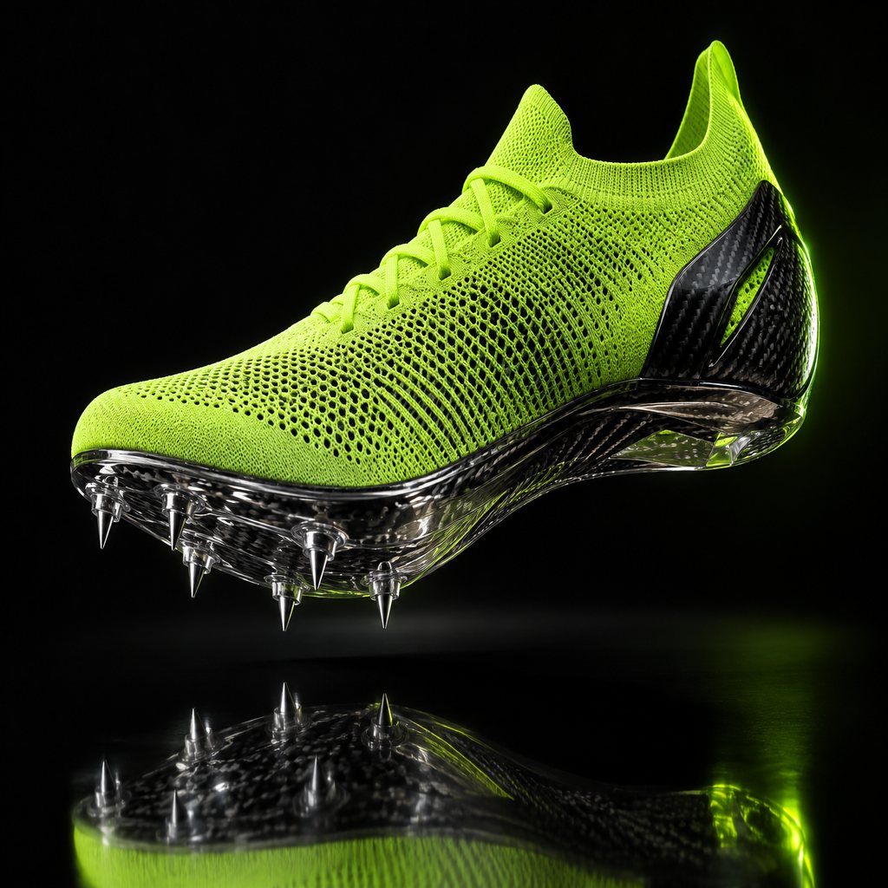
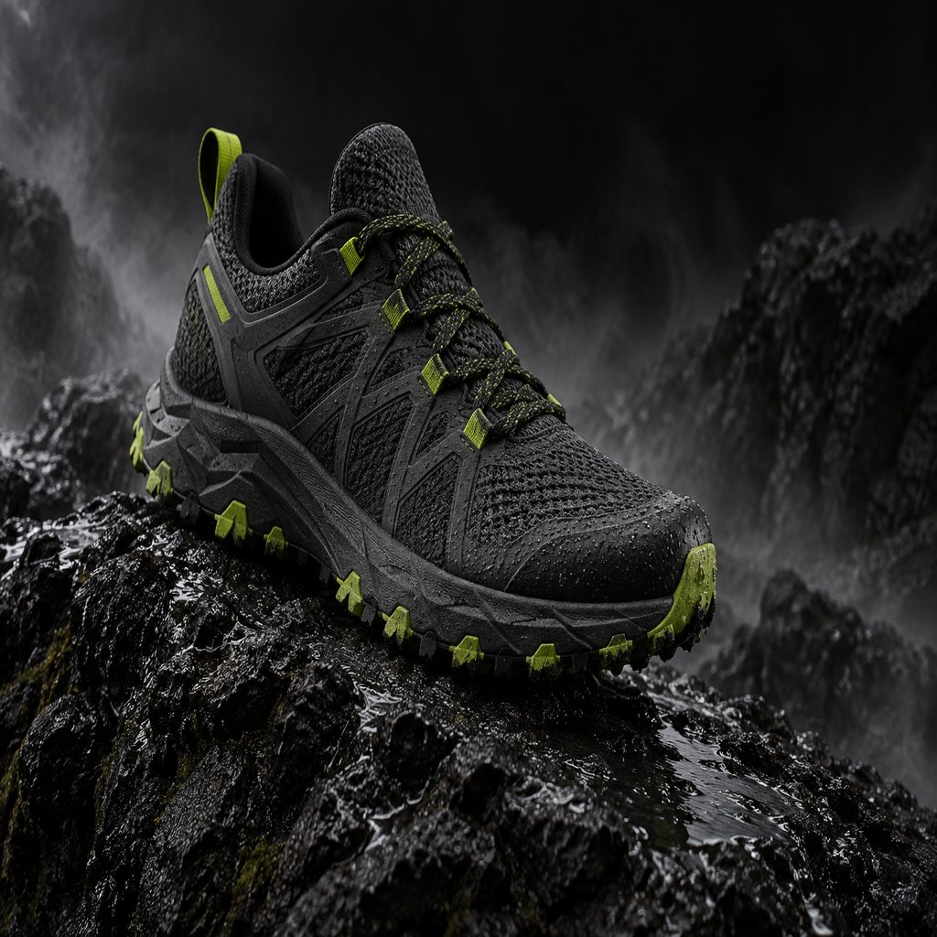
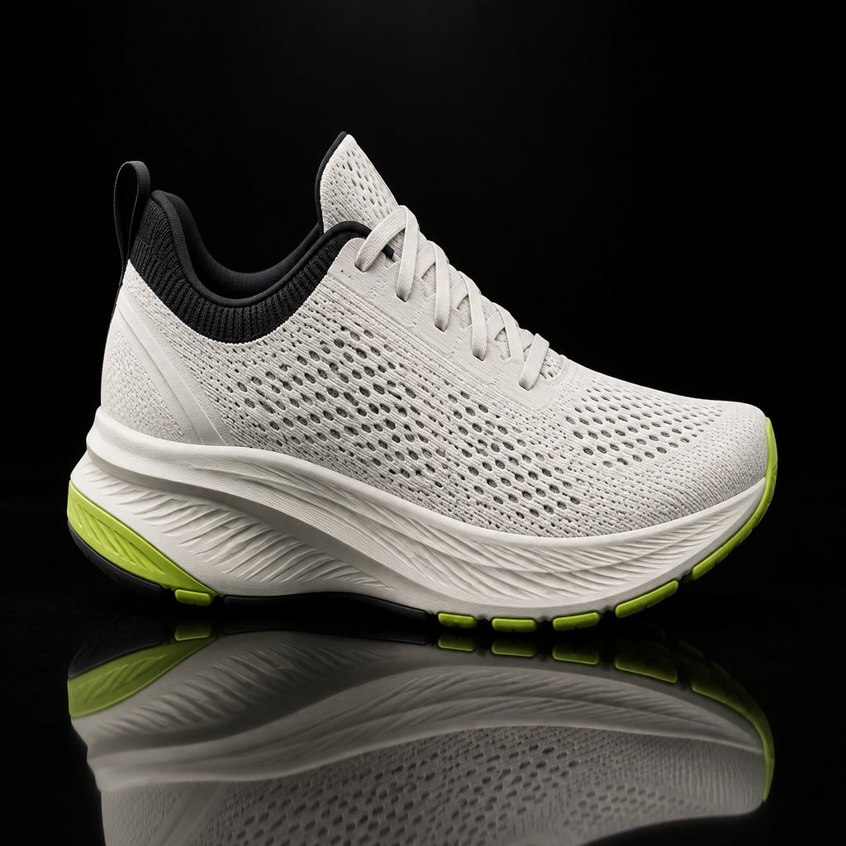
03 — PRODUCT ARCHITECTURE
THREE PLATFORMS. ONE CLOCK.
TRACK SPIKE
TRAIL
DAILY TRAINER
VOLT SPRINT
TRAIL APEX
DAILY GRID
212G · CARBONDRIVE R/11 · 6-PIN
289G · 4.5MM LUGS · ROCKLOCK SHANK
268G · KINETICFOAM™ · 1,200KM RATED
$240
$189
$129
COMPRESSION LINE — $38–85 GRADUATED 20–28 MMHG · 34% OF UNITS
ELITE GLOVES — $65 SILICONE GRIP MAP · 8% OF UNITS
KINETIQ — SERIES C — 2026
04 / 14

Slide 5

04 — TECHNOLOGY
THE LAB
STACK.
KINETICFOAM™
CARBONDRIVE PLATE
AEROKNIT UPPER
NITROGEN-INFUSED SUPERCRITICAL MIDSOLE, TWIN-FOAMED FOR REBOUND WITHOUT COLLAPSE.
ONE-PIECE AEROSPACE CARBON ON A VARIABLE-STIFFNESS MAP. TUNED PER EVENT.
ZONAL KNIT MAPPED FROM 27,000+ LAB SCANS. LOCKED WHERE FORCE DEMANDS IT.
ENERGY RETURN
87.2%
STIFFNESS
9.2 N/MM²
WEIGHT (EU 42)
212G
DENSITY
0.11 G/CM³
RUNNING ECONOMY
+4.2%
AIRFLOW VS WOVEN
+38%
CONTACT-TIME Δ
−3.4%
PLATE MASS
38G
RECYCLED YARN
72%
HEAT DRIFT @40°C
<2%
GEOMETRY
R/11
STRETCH RECOVERY
96%
VALIDATED ON A 12-CAMERA MOTION-CAPTURE ARRAY AND INSTRUMENTED TREADMILL — 27,412 TESTS LOGGED SINCE 2019.
KINETIQ — SERIES C — 2026
05 / 14

Slide 6
05 — BUSINESS MODEL
DTC-FIRST,
WHOLESALE FOR REACH.
CHANNEL MIX — FY2025
DTC 61%
WHOLESALE 39%
$128M GMV · 47% REPEAT RATE · 4.2x LTV/CAC
118 DOORS · NO DISCOUNT LEAKAGE
UNIT ECONOMICS — FY2025
METRIC | VALUE | VS. 2023
GROSS MARGIN | 58% | +14 PTS
CONTRIBUTION MARGIN | 41% | +9 PTS
BLENDED CAC | $74 | -22%
LTV : CAC | 4.2x | 3.1x -> 4.2x
REPEAT RATE (12-MO) | 47% | +11 PTS
KINETIQ — SERIES C — 2026
06 / 14

Slide 7
06 — TRACTION
COMPOUNDING
AT 68% A YEAR.
KEY SIGNALS
CAGR 2021–26E
64%
DTC SHARE
61%
MARKETS LIVE
34
AVG ORDER VALUE
$142
2026E = QUARTERLY RUN-RATE × SEASONALITY INDEX. AUDITED THROUGH FY2025.
KINETIQ — SERIES C — 2026
07 / 14

Slide 8
07 — UNIT ECONOMICS
THE NUMBERS BEHIND
THE MARGIN.
METRIC | VOLT SPRINT | TRAIL APEX | DAILY GRID
MSRP | $240 | $189 | $129
COGS (50K-UNIT RUN) | $71 | $62 | $47
GROSS MARGIN | 70% | 67% | 64%
FIRST-PASS YIELD | 96.4% | 95.1% | 97.8%
RETURN RATE | 2.1% | 3.4% | 2.9%
CONTRIB. MARGIN / UNIT | $118 | $77 | $49
COGS AT 50K-UNIT RUNS · FY2025 BLENDED FULFILLMENT · YIELD & RETURNS FROM Q1–Q2 2026 PRODUCTION
KINETIQ — SERIES C — 2026
08 / 14

Slide 9
08 — ATHLETE ROSTER
WORN BY PEOPLE
WHO COUNT.
MO
MARIAM OKONKWO
DS
DIEGO SALAS
YT
YUKI TANAKA
100M — LAGOS / PORTLAND
MARATHON — BOGOTÁ / FLAGSTAFF
400M HURDLES — OSAKA
10.89
2:04:51
48.20
100M PB · 0.148s RT
MARATHON PB · VALENCIA 2026
400MH PB · NATIONAL RECORD
“The first spike that came with its own force curve. I signed because the data was honest.”
“My splits at 35k were faster than my 30k splits the year before.”
“Ten strides between hurdles instead of eleven. I felt it in the first session.”
36 SPONSORED ATHLETES · 11 NATIONS · PBs CURRENT AS OF THE 2026 SEASON
KINETIQ — SERIES C — 2026
09 / 14

Slide 10
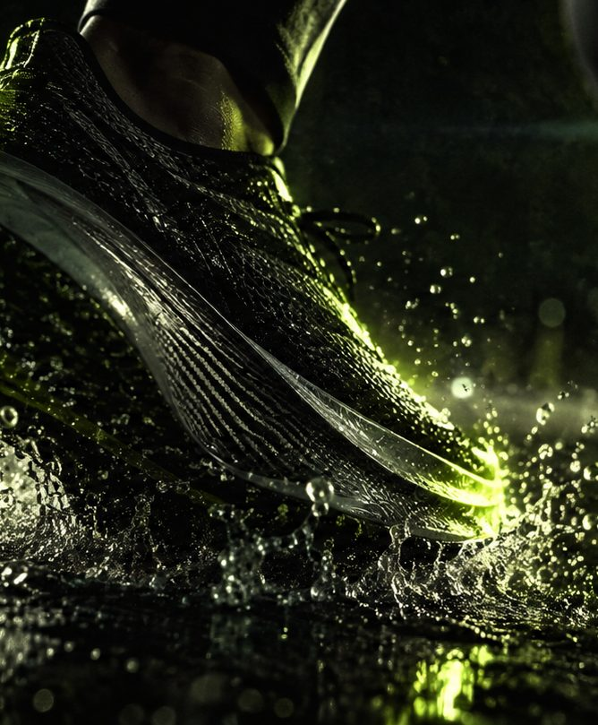
09 — CAMPAIGN STRATEGY
MEASURED,
NOT MARKETED.
A 4-minute film across 14 months of lab sessions, failure tests and starting lines — every on-screen claim backed by telemetry.
00:45
FORCE-PLATE OPEN — THE CLAIM, TESTED LIVE
02:10
FAILURE REEL — 14 PROTOTYPES THAT DIDN'T SHIP
03:30
RACE DAY — LAGOS · VALENCIA · OSAKA
04:12
CLOSE — 'EVERY NUMBER ON SCREEN IS REAL'
DIR. R. OKAFOR · PORTLAND, LAGOS & OSAKA · $2.1M BUDGET
KINETIQ — SERIES C — 2026
10 / 14

Slide 11
10 — MARKET EXPANSION
34 COUNTRIES,
FOUR REGIONS.
REGION | COUNTRIES | FY25 REVENUE | FY27 TARGET
NORTH AMERICA | US · CA | $96M | $128M
EUROPE | UK · DE · FR · NL · BE · ES · IT · PT · SE · NO · DK · FI · PL · CZ | $71M | $102M
ASIA-PACIFIC | JP · KR · AU · NZ · SG · TW · HK · IN | $31M | $68M
MIDDLE EAST & AFRICA | AE · ZA · KE | $12M | $22M
TOTAL | 34 | $210M | $320M
APAC ENTRY SEQUENCE 2027 — JAPAN, KOREA, AUSTRALIA FIRST WAVE; SINGAPORE, TAIWAN, INDIA SECOND WAVE.
KINETIQ — SERIES C — 2026
11 / 14

Slide 12
11 — SUSTAINABILITY
MEASURED HERE TOO.
72%
RECYCLED YARN IN CURRENT AEROKNIT — TARGET 90% BY 2027
12,000
PAIRS TAKE-BACK RECYCLED INTO TRACK SURFACES
100%
PLASTIC-FREE PACKAGING SINCE 2025
9/9
FACTORY PARTNERS AUDITED — RESULTS PUBLISHED
“A COMPANY THAT PUBLISHES FORCE CURVES HAS NO EXCUSE TO HIDE ITS FOOTPRINT.” — FOUNDER LETTER, 2025
KINETIQ — SERIES C — 2026
12 / 14

Slide 13
12 — TEAM & THE ASK
BUILT BY MEASURERS.
BACKED BY DATA.
DO
DR. DARA OKAFOR
JM
JONAS MEHTA
CO-FOUNDER · CHIEF SCIENCE OFFICER
CO-FOUNDER · HEAD OF PERFORMANCE
Biomechanics researcher, 11 years in gait-lab work; led the force-plate program that became KINETIQ's testing standard.
Sprint coach with two national-record athletes; owns the athlete lab program and every product sign-off.
ADVISORS
60%
APAC MARKET ENTRY — JAPAN, KOREA, AUSTRALIA
Dr. Elena Ruiz — Dir. Biomechanics, North Pacific University · M. Webb — 2× Olympian, 1500m · K. Sato — ex-Nike APAC supply
25%
PORTLAND LAB EXPANSION + 3RD TEST RIG
15%
WORKING CAPITAL & INVENTORY BUILD
$40M SERIES C
Q3 2026
CONTACT — PARTNERS@KINETIQ.EXAMPLE · KINETIQ.EXAMPLE/SERIESC · PORTLAND, OREGON
KINETIQ — SERIES C — 2026
13 / 14

Slide 14
THANK YOU
MEASURED,
NOT MARKETED.
KINETIQ LABS INC. — 2141 NW VAUGHN ST, STE 300, PORTLAND, OR 97210
PARTNERS@KINETIQ.EXAMPLE · KINETIQ.EXAMPLE
KINETIQ — SERIES C — 2026
14 / 14

