Slide 1
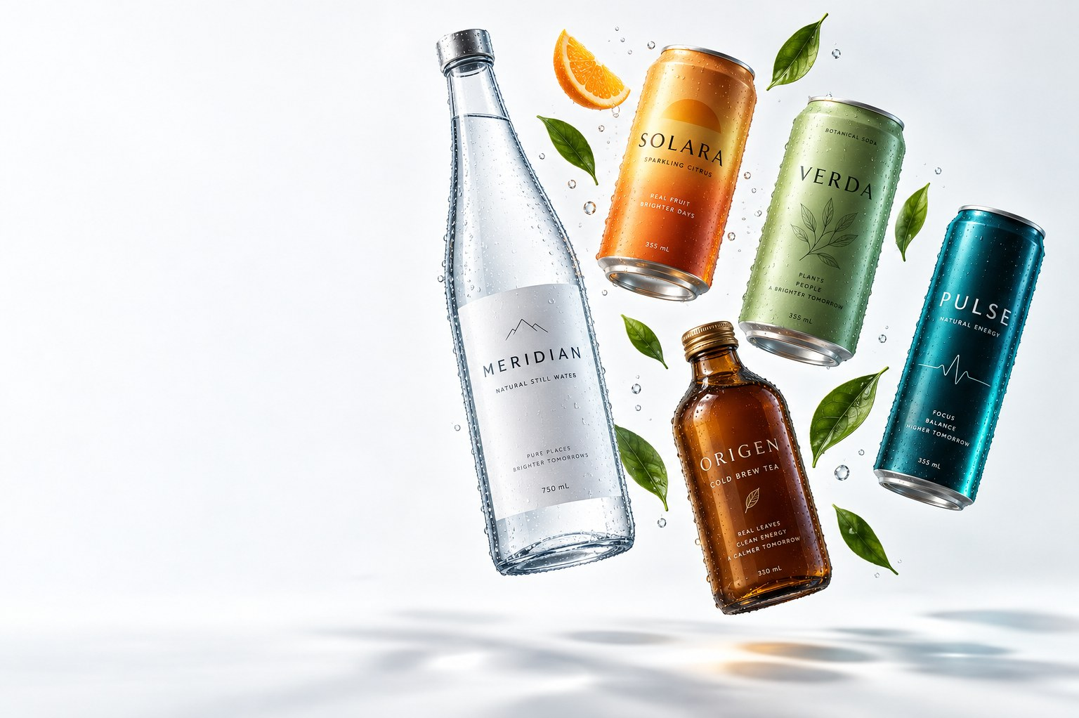
MERIDIAN BEVERAGE CO.
Drinks in tune
with the planet.
A 100% non-alcoholic house of brands — spring water, sparkling citrus, botanical sodas, natural energy and cold-brew tea — bottled in 11 hubs across 42 markets.
100% NON-ALCOHOLIC · HALAL-CERTIFIED
B-CORP · WATER-POSITIVE 120%
Investor Overview · FY2026
Valencia · est. 1987
Notes:
Meridian Beverage Co. — 100% non-alcoholic house of brands. Cover slide. Premium, airy, ocean teal with amber accents.

Slide 2
One spring, thirty-eight years
A house of brands built entirely without alcohol — by conviction, not by omission.
1987
2004
2016
2019–21
2023–26
The Costa family bottles a limestone spring in the Sierra Calderona and sells it to Valencia beach cafés from one van.
Solara launches — Valencia oranges pressed within 72 hours of harvest. The citrus house becomes a beverage house.
Verda brings Mediterranean botanicals to fine-dining zero-proof lists. Water-positive pledge work begins.
Pulse (2019) and Origen (2021) complete the house. B-Corp certified; water-positive at 120% replenishment.
Sharjah and Tangerang hubs open. The 100% non-alcoholic portfolio becomes the growth engine in GCC and ASEAN.
Today: €1.9B revenue · 42 markets · 11 hubs · 4,800 people · five brands, zero alcohol
Notes:
38-year story timeline. Five milestones from 1987 spring water to today's five-brand house.

Slide 3
Our house of brands
Five brands · one standard · not a drop of alcohol in any of them
MERIDIAN
SPRINGS
SOLARA
VERDA
PULSE
ORIGEN
Premium still water
Sparkling citrus
Botanical sodas
Natural energy
Cold-brew teas
31%
27%
16%
14%
12%
of revenue
of revenue
of revenue
of revenue
of revenue
1,240 SKUs · every line alcohol-free by design · every line halal-certified
Notes:
House of brands overview. Five brand blocks with sub-palettes and revenue share.

Slide 4
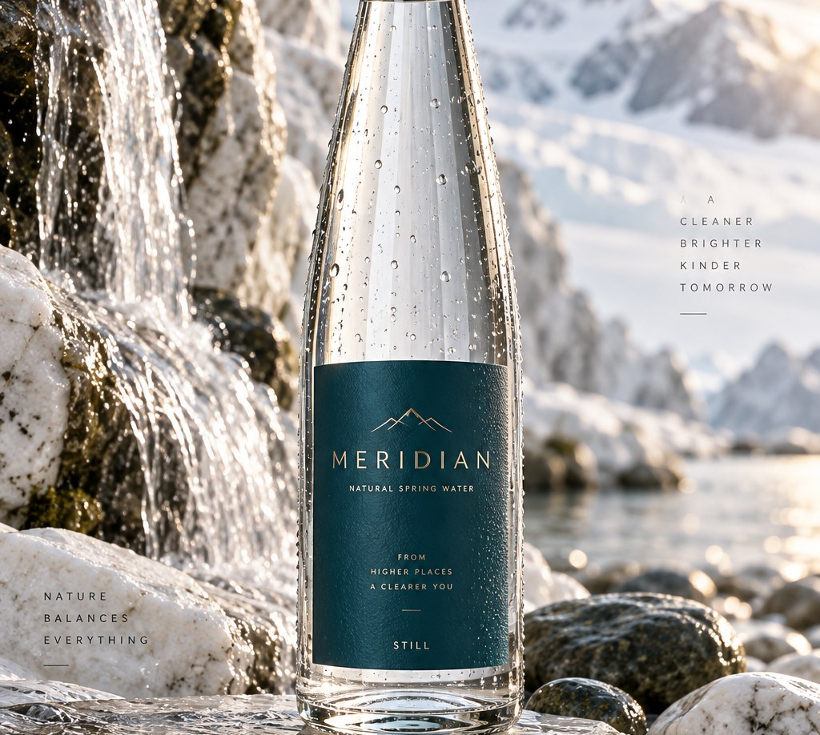
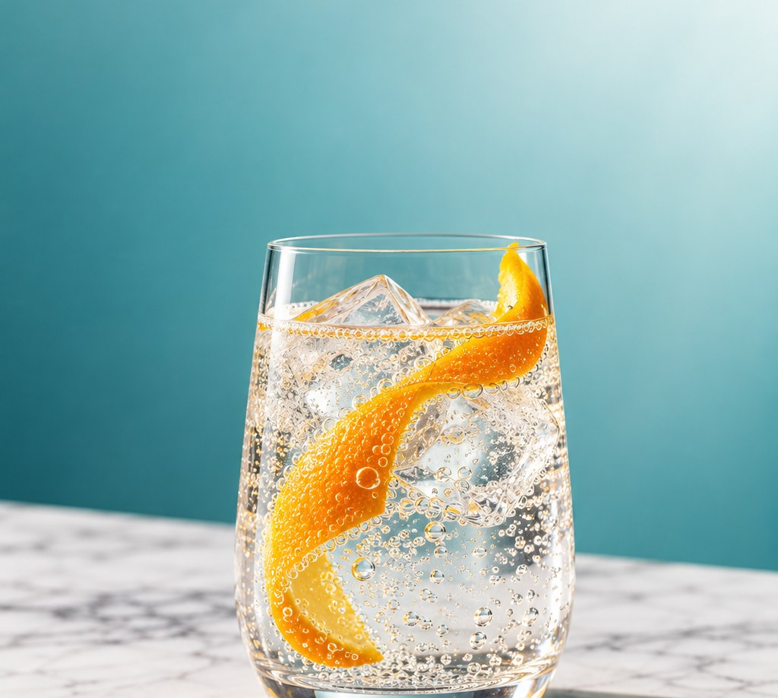
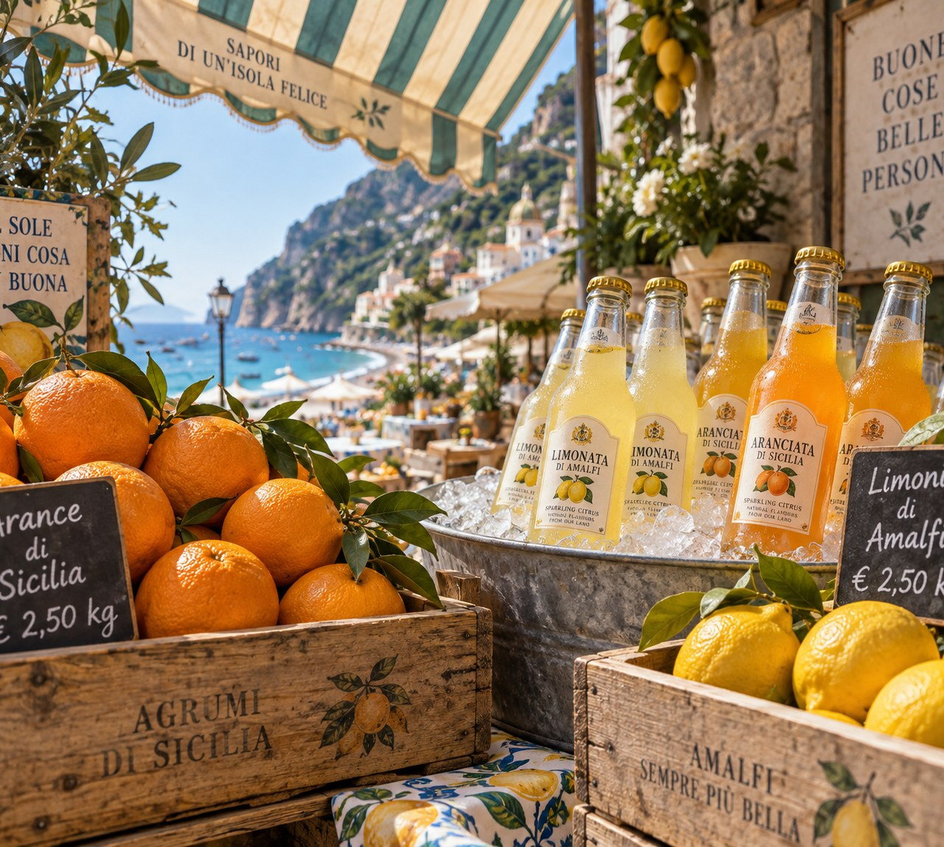
Portfolio deep-dive
Signature serves from three of the five brands
MERIDIAN SPRINGS
SOLARA
ORIGEN
TDS 118 mg/L, bottled at source, glass + rPET, sommelier-listed in 3,100 restaurants across Europe and the Gulf.
Pressed within 72 hours of harvest, never from concentrate, 26% less sugar than category — the toast of family tables.
Single-estate leaves, 16-hour cold brew, unsweetened by default; regenerative estates in Sri Lanka and Kenya.
Notes:
Portfolio deep-dive with imagery. Picture cards for Springs, Solara citrus and Origen market still.

Slide 5
Global footprint — 11 production hubs
Valencia to Tangerang: 1.4 billion units a year across three continents.
Hub | Region | Role | Since
Valencia (HQ) | Europe | Springs, Solara, press | 1987
Mersin | Türkiye | Citrus press | 2011
Beja | Portugal | Solara EU south | 2014
Agadir | Morocco | Citrus + solar bottling | 2016
Nairobi / Kericho | Kenya | Origen tea estates | 2018
Monterey | USA | Verda botanicals | 2021
São Paulo | Americas | Pulse, Verda Americas | 2022
Sharjah | UAE | GCC hub, halal lines | 2023
Tangerang | Indonesia | ASEAN hub, halal lines | 2024
Rotterdam | Europe | Distribution + rPET lab | 2009
42
markets served worldwide
1.4B
units bottled a year
3
continents
Notes:
Global footprint: 11 production hubs table.

Slide 6
Where the revenue pours
42 markets across three regions — EMEA anchors the base, APAC carries the growth.
52%
29%
19%
EMEA — 20 markets. Spain, France, Germany, UK, UAE, Saudi Arabia, Morocco, Türkiye.
Americas — 10 markets. Brazil, Mexico, USA, Canada, Chile, Colombia.
APAC — 12 markets. Indonesia, Malaysia, Singapore, Japan, South Korea, Australia.
Strategic growth: GCC + Indonesia/Malaysia
These markets grew 28% in FY2025 — more than double group average — because Meridian's 100% non-alcoholic, halal-certified portfolio is the default premium choice for family occasions, Ramadan gifting and faith-conscious hospitality. Pipeline: 2,400 new listings confirmed for FY2026.
Notes:
Global footprint continued: regional revenue split with the non-alcoholic GCC/ASEAN growth thesis. Dark slide for rhythm.

Slide 7
Financial trajectory
Nine straight years of growth; €2B in sight for FY2026.
14.8%
EBITDA margin FY2025 (up from 11.9% in 2021)
9.2%
Organic revenue growth FY2025
€400M
Sustainability-linked facility tied to rPET, water and solar targets
Notes:
Financials: revenue 2021-2026F line chart plus margin band stats.

Slide 8
Category strategy, brand by brand
Defend the core, ride the growth curves, seed the next decade.
MERIDIAN SPRINGS · DEFEND — Premiumise: glass return systems in 8 EU cities, sommelier programme to 4,000 doors, Gulf hospitality listings.
SOLARA · MONETISE — The family-occasion toast: Gulf Ramadan gifting packs, share-packs for Iberia/LatAm retail, zero-sugar line extension 2026.
VERDA · EXPAND — Fine-dining zero-proof credibility in premium grocery; new botanicals from Alpujarra and Serra da Estrela.
PULSE · SCALE — +34% CAGR since 2021: natural caffeine, no taurine; push US Southwest and GCC convenience while staying clean-label.
ORIGEN · SEED — Brew culture: single-estate storytelling, tea sommeliers, 16-hour cold-brew bars in Madrid, Dubai and São Paulo.
Portfolio rule: every strategy must hold at a family table and in a Michelin dining room — without a drop of alcohol.
Notes:
Category strategy per brand: one line of strategic intent each, with lifecycle stage.

Slide 9
Sustainability, with receipts
Water-positive since 2021 · B-Corp recertified 2024 · audited and published, gaps included.
120%
87% → 100%
19.4 GWh
Water replenished vs used — 2.9bn litres returned in FY2025; AWS Gold at 6 hubs.
rPET share of plastic today → 100% by January 2027. No virgin PET in any line from then.
Solar generated FY2025 (14.2 MWp installed); 41% of daytime production energy.
Roadmap to 2030
2027 — 100% rPET; 50% glass return in the Americas. 2028 — all 11 hubs AWS Gold. 2029 — regenerative agriculture on 2,000 hectares. 2030 — Scope 1+2 −75% vs 2019; Scope 3 measured at ingredient level (today's honest gap).
Notes:
Sustainability roadmap: water-positive metrics, rPET %, solar kWh.

Slide 10
Innovation pipeline
Four programmes, one filter: would a family pour it?
Functional botanicals — 2026-27
Regenerative groves — 2026-30
Calm and energy lines under Verda: lemon-verbena L-theanine, saffron citrus. Zero sugar, zero alcohol, zero gimmicks.
2,000 hectares converted by 2030 with 214 grower partners; a soil-carbon programme that pays growers per hectare, not per promise.
Zero-waste press — 2027
Gulf zero-proof craft — 2027-28
Peel and pulp become essential oils, pectin and cattle feed: 94% of fruit mass valorised today, 100% target 2027.
A premium zero-proof sparkling range co-developed with Emirati and Malaysian hospitality groups — grown from our right to exist: 100% non-alcoholic, halal-certified, made for celebration.
Notes:
Innovation pipeline: functional botanicals, regenerative groves, zero-waste press, Gulf zero-proof craft.

Slide 11
Distribution & retail channels
Share of FY2025 revenue by route to market
E-commerce is the fastest-growing route (+41% YoY) — subscription water and tea clubs now span 9 markets. Horeca credibility drives premium pricing everywhere else.
Notes:
Distribution and retail channels: horizontal bar chart with percentages.

Slide 12
Leadership & governance
MC
EC
AK
JV
Mateo Costa — CEO
Elena Costa — Chair
Amira Al-Khatib — CFO
João Vasques — Supply
Grandson of the founder; led the water-positive pledge.
Chief Purpose Officer; authored the no-alcohol house rule.
Ex-Danone MEA; architect of the GCC growth strategy.
Runs 11 hubs and the 72-hour grove-to-press guarantee.
Governance
Family-controlled 62% · employee trust 9% · institutional 29% · independent board majority (7 of 12) · sustainability-linked executive pay since 2022.
Notes:
Leadership and governance: four profiles plus governance facts.

Slide 13
ESG certifications & accountability
Certified B-Corporation — 98.4/200 (2024), top 5% of beverage B-Corps worldwide
Halal-certified production — every line alcohol-free by design; ESMA/GAC (UAE) and JAKIM-recognised (Malaysia) schemes, renewed annually
ISO 22000 food safety — all 11 hubs; FSSC 22000 at Valencia, Sharjah and Tangerang
Rainforest Alliance citrus — 100% of volume since 2022; AWS water standard, Gold at 6 hubs
Values we report against — including the misses
We are a 100% non-alcoholic company by conviction — it is our identity, our market advantage and our duty of care. We publish an annual water ledger and sustainability letter with our gaps named in plain text: two hubs not yet on certified-renewable grid power, Americas glass returns at 31% vs a 50% target, Scope 3 ingredient logistics unmeasured. Same letter, same place, every year.
Notes:
ESG certifications including halal certification and the honest-gaps statement.

Slide 14
Outlook: in tune, and ahead
€2B revenue in FY2026 · 100% rPET by January 2027 · GCC and ASEAN premium non-alcoholic segment compounding at 28% — the market moving toward what Meridian has always been: a full house of brands with not a drop of alcohol, built for every table.
Investor relations
invest@meridianbeverage.com · +34 961 202 787 · Camí de la Foia 14, 46112 Bétera, Valencia, Spain
FY2025 annual report, sustainability letter and water ledger: meridianbeverage.com/investors
MERIDIAN BEVERAGE CO. — 100% non-alcoholic since 1987
Notes:
Outlook and investor contact. Close with conviction and contact details.

