Slide 1

Presented by:
Harshwardhan Mukund Mohadikar · Shreyas Bhat K
Vision-Based Lane Inference for Unstructured and Structured Indian Roads
BSc Computer Science · 2025-26
Under the guidance of
Dr. Ashok Yemineni
Notes:
Fifteen minutes. Open on the trapezoid result, not the IoU.

Slide 2
Problem Statement
Lane detection assumes paint. Most of the Indian network has none.
What every method assumes
THE SHARED PREMISE
▪ Painted lane markings are present in the frame
▪ Trained and evaluated on TuSimple, CULane, BDD100K
▪ All of them marked highways and marked cities
What Indian roads give you
THE ACTUAL INPUT
▪ Paint is absent, worn, or hidden under traffic
▪ Yet the road still carries a structure drivers agree on
▪ The information is in the geometry, not the markings
And the failure is silent
A detector that finds nothing looks exactly like one that failed. Nothing downstream can tell the two apart, so the roads where lane information would help most are the ones that get none.
That is why this project infers structure instead of detecting it.

Slide 3
Objectives & Scope
Rebuild the pipeline so every claim it makes can be measured.
Primary objectives
WHAT TO BUILD
▪ Review lane detection and inference for Indian road settings
▪ Infer lanes on structured, semi-structured and unstructured roads, from geometry rather than markings
▪ Make that model optimised, effective and lightweight enough for video rate on commodity hardware
▪ Validate against ground truth and trivial baselines, with a confidence that predicts its own error
Secondary objectives
ATTEMPTED, OUTCOMES REPORTED
▪ Wrong-side driving from inferred lane direction: implemented, unvalidated
▪ Traffic flow in unorganised conditions: measured and rejected
▪ Feasibility for basic driver assistance: the limitations analysis
Scope
BOUNDARIES
▪ In: monocular forward-facing camera
▪ In: single image, video clip, live camera
▪ In: lane count and metric widths, both validated
▪ Also reported, not validated: ego lane, road-user distances
▪ Out: path planning and vehicle control
▪ Out: any sensor other than the camera
▪ Out: night and heavy rain
METHODS THIS RESTS ON
MobileNetV3
LR-ASPP
FPN
IPM
Kalman filter
IRC:86
Knowledge distillation

Slide 4
Existing Work
Mature field, built on an assumption this project cannot make.
Segmentation
SCNN · LANENET
▪ Label marking pixels, then cluster them into lane instances
Row anchor
ULTRA FAST LDD
▪ Select which cell in each image row holds a marking
Parametric
POLYLANENET · CLRNET
▪ Regress lane curves directly from features
The limitation they share
Each assumes markings exist. On an unmarked road the output is empty or arbitrary, and nothing in the formulation distinguishes the two.
Why IDD cannot fix it
NO LANE GROUND TRUTH
▪ IDD annotates drivable surface, not lanes
▪ An unmarked road has no lane to annotate
▪ So structure has to be inferred, not learned

Slide 5
System Design
Four tiers, one API surface, and one piece of state that matters.
Client
BROWSER AND CAMERA
▪ React interface, mobile camera, file upload
Server
FASTAPI
▪ Eleven endpoints. Every request enters the same way
Inference
STATELESS MODULES
▪ Segmentation, geometry, temporal tracker
Storage
READ ONLY
▪ Weights, sample data, measured results
The one piece of state, and what it costs
Temporal smoothing needs the previous frame, so filter state is kept per client between requests. That is why the system needs a long-running process and cannot be deployed as stateless serverless functions.
STACK USED
Python 3.12
PyTorch 2.13
OpenCV 5.0
FastAPI
Uvicorn
React 19
Vite 8
Tailwind
pytest

Slide 6
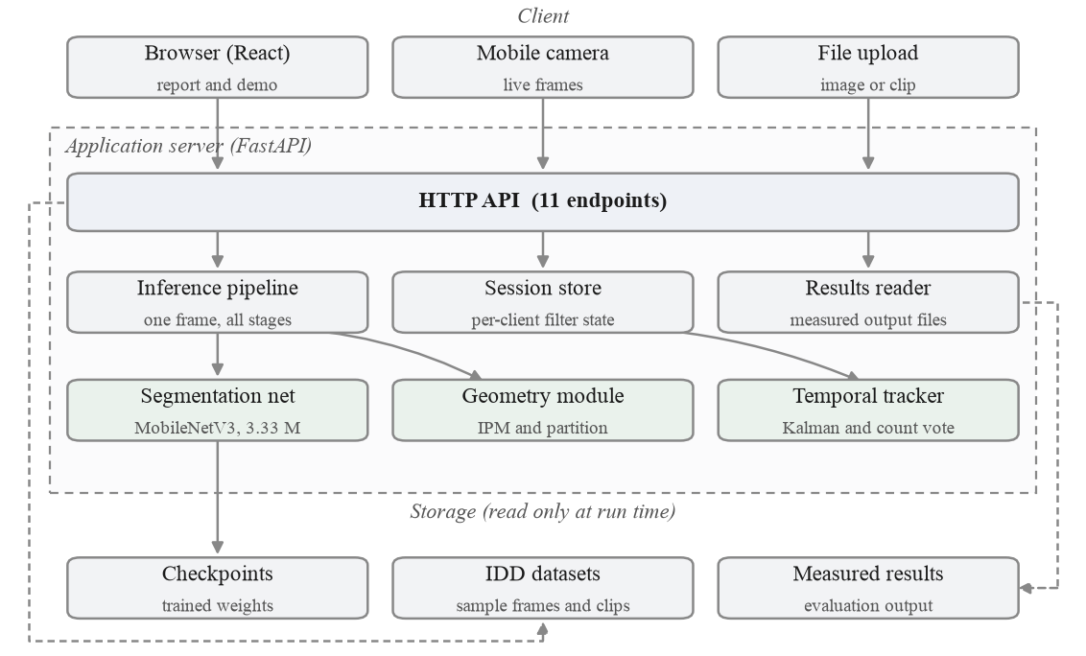
System Architecture
Four tiers. Everything inside the dashed box is one process.
Notes:
Everything inside the dashed box is one process.

Slide 7
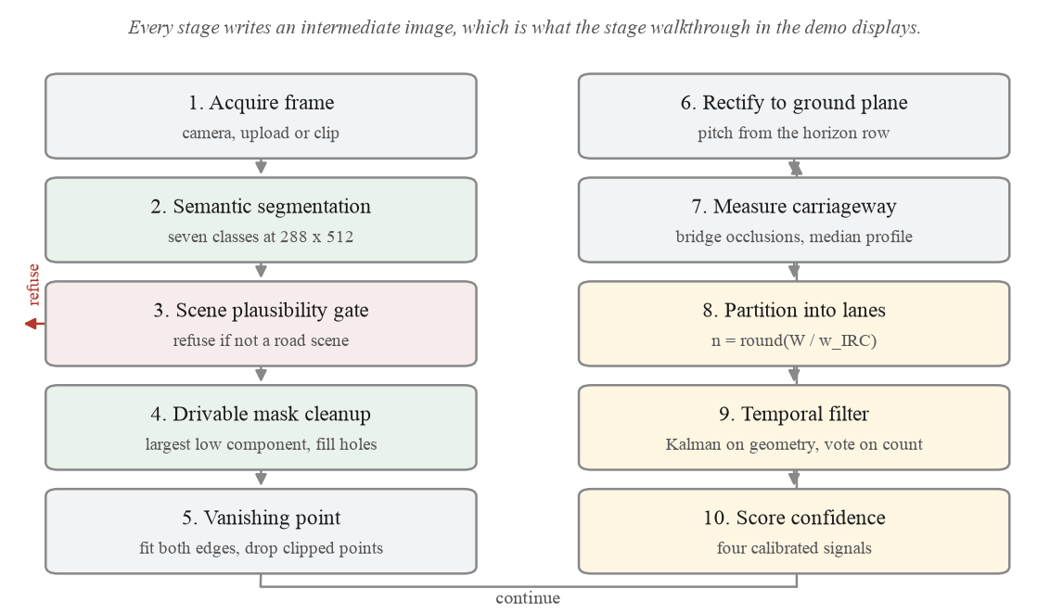
End-to-End Process Flow
Ten stages, including the path where the system declines to answer.
Notes:
Stage three is the refusal path.

Slide 8
Metric Scale, No Calibration
The dataset ships no camera metadata. It turns out not to need any.
dX = du · H / (v − v_horizon)
Lateral ground scale from image row alone. The focal length cancels.
Pitch is measured
NOT ASSUMED
▪ Recovered per frame from the vanishing point row
Why it cancels
THE HORIZON CARRIES IT
▪ The horizon row already encodes f·tan(θ), the same product that sets ground scale
What is left
ONE ASSUMPTION
▪ Lateral scale moves 1.0% across a 40° to 140° sweep. Only camera height remains
HOW IT IS RECOVERED
Inverse perspective mapping
Vanishing point
Pitch ±15°
First-order error < 1.6%

Slide 9
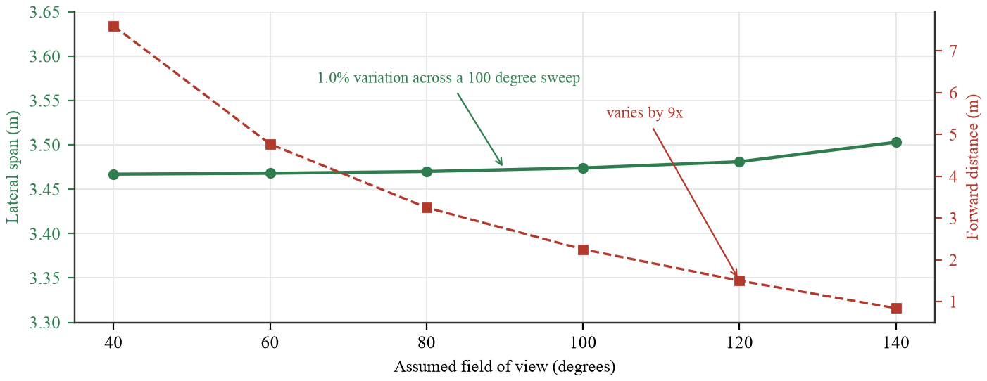
Focal Length Cancels
Rebuilding the transform across a hundred degrees of assumed field of view.
Notes:
Green flat across a hundred degrees, red moves nine-fold.

Slide 10
From Width to Lane Count
A published design width applied to a measurement, not an arbitrary split.
n = round( W / w )
W is the measured carriageway in metres, w the design lane width.
Choosing w
A THRESHOLD ON WIDTH
▪ 3.50 m when the carriageway is 6.0 m or wider
▪ 3.00 m below that
▪ A rule about width, not a judgement about the road
A floor at 2.5 m
AND A REFUSAL
▪ If the division gives narrower lanes, the count drops
▪ If even one lane falls below the floor, the frame is refused
▪ That is the largest single refusal cause
THE PARTITION RULE
IRC:86 urban 3.50 m
narrow road 3.00 m
floor 2.50 m
occlusion bridging
median profile

Slide 11
Tools & Technologies
Everything below is pinned in the repository and reproducible.
Model
3.33 M PARAMETERS
▪ MobileNetV3-Large backbone
▪ LR-ASPP context head, FPN decoder
▪ Seven semantic classes plus a lane head
Pipeline
GEOMETRY AND TRACKING
▪ Inverse perspective mapping
▪ Occlusion-bridged width profile
▪ Kalman filter and majority vote
Delivery
A RUNNING APPLICATION
▪ FastAPI backend, eleven endpoints
▪ React interface, report and demo routes
▪ 32 tests over geometry, metrics and API
STACK USED
Python 3.12
PyTorch 2.13
torchvision 0.28
OpenCV 5.0
NumPy 2.5
FastAPI 0.141
Uvicorn
React 19
Vite 8
Tailwind 3
Recharts
pytest
Apple MPS
127 min
training, 40 epochs on the laptop GPU
36.5 ms
end to end per frame, 27 fps
32
tests, all passing

Slide 12
Implementation
Four stages, and the defect each one exposed when it was measured.
Segmentation
ONE FORWARD PASS
▪ Two heads share the decoder, so lane markings cost no extra time
Geometry
PITCH PER FRAME
▪ Clipped edge points excluded. One frame gave 25.1° of pitch until they were
Measurement
SEE THROUGH TRAFFIC
▪ Occlusion handled per row. Bridging every row doubled the road across a median
Refusal
DECLINE, DO NOT GUESS
▪ The scene is checked first. The network calls a black frame 26% drivable
The largest single defect we found
Bridging vehicles into the road mask fixes parked vans and breaks medians. Choosing per row instead took relative width error at p90 from 151% to 47%. We found it by checking the lane model against the mask it was built from, not against ground truth.
SUPPORTING PIECES
CIELAB fallback
hole filling
bottom-connected component
polynomial edge fit
per-state Kalman noise

Slide 13
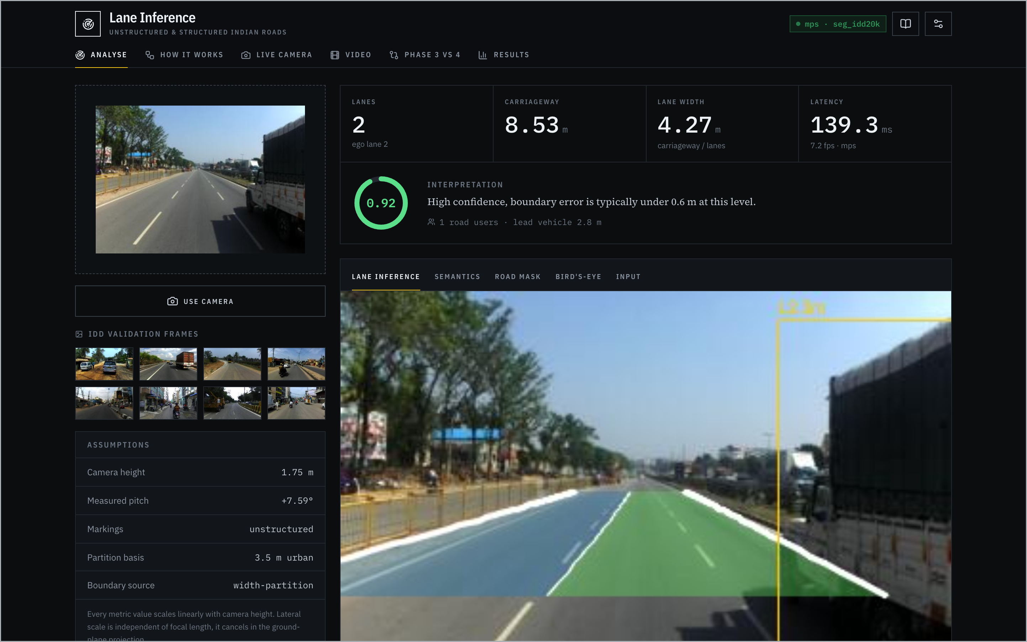
The Application
Two routes: the report, and a demo running the real pipeline.
Notes:
Live demo here. Upload a frame, read the cluster, step the five views.

Slide 14
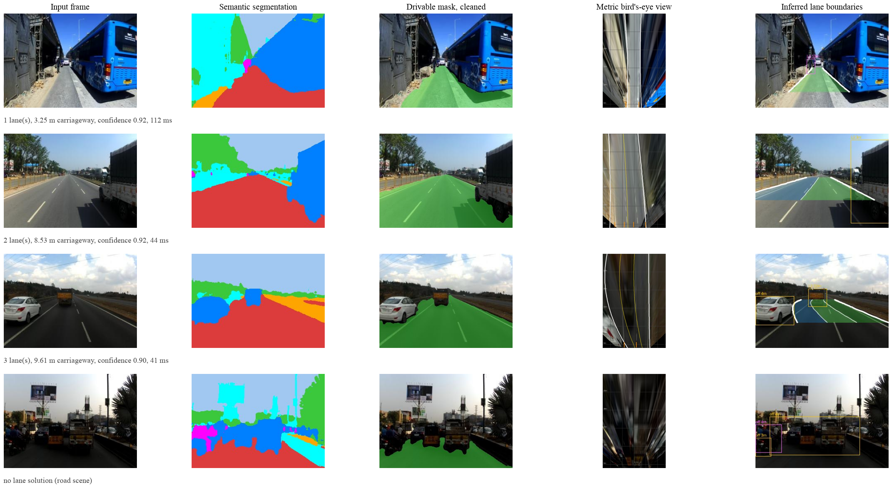
Pipeline Stages
A narrow road, a two-lane road, a painted three-lane road, and a refusal.
Notes:
Fourth row is a refusal, and that is correct behaviour.

Slide 15
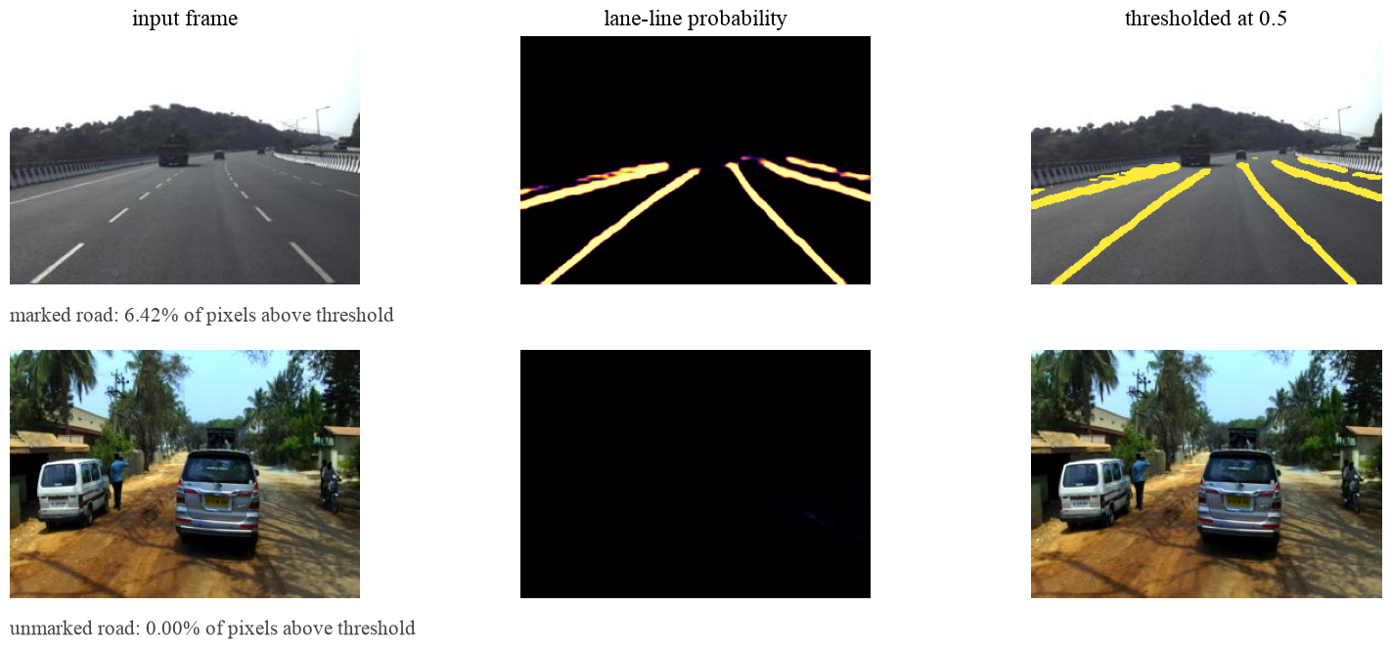
The Lane-Marking Head
IDD has no lane annotation, so YOLOP was used offline as a teacher.
Notes:
Marked road: all four lines. Unmarked road: 0.00 per cent. The second row is the one that matters.

Slide 16
Results & Analysis
Measured on the 204-frame IDD-Lite validation split.
0.9310
drivable IoU, deployed
0.7754
boundary F1, deployed
165/204
lane solutions, 80.9 per cent
27 fps
end to end, 36.5 ms per frame
Against what it replaces
THE FLOOR
▪ Study project pipeline 0.4270 drivable IoU
▪ Fixed trapezoid, which ignores the image, 0.6450
Ceiling versus deployed
AN HONEST DISTINCTION
▪ The segmentation head alone reaches 0.9403
▪ Mask cleanup costs 0.0093 IoU and buys three more lane solutions
Geometry accuracy
AGAINST GROUND TRUTH EDGES
▪ Median road-edge error 0.31 m
▪ Over 2,288 samples at 6 to 22 m ahead
The result that reframed the project
The pipeline this replaces scored below a fixed trapezoid that never looks at the image. That is what showed the problem was structural, not a tuning problem.

Slide 17
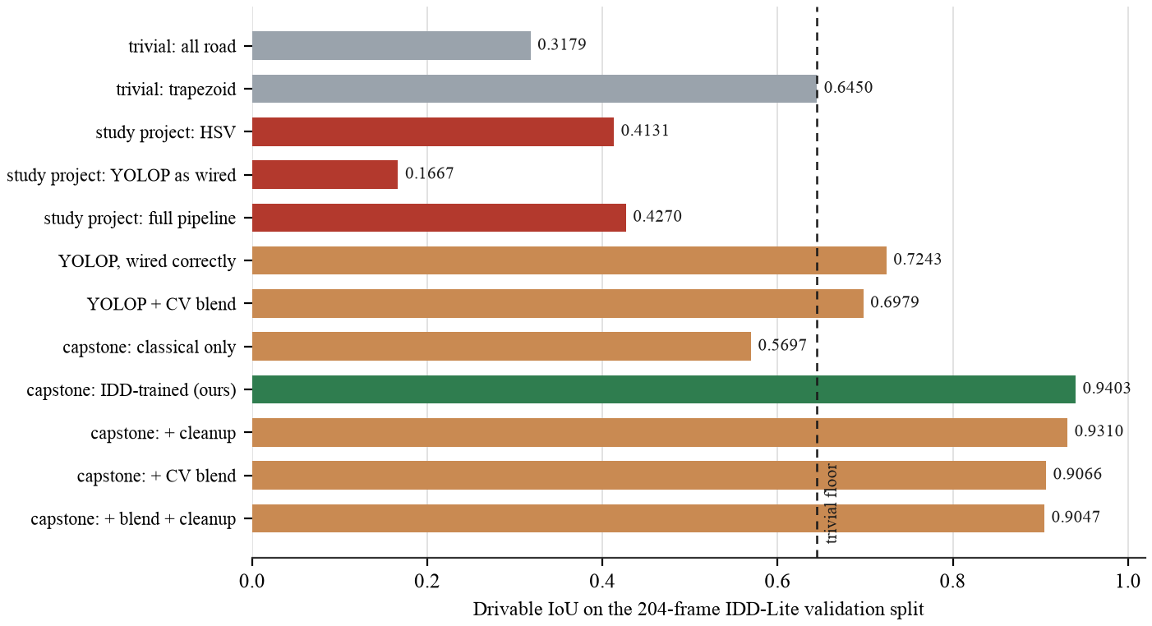
Measured Against a Floor
Twelve configurations, same frames, same harness. Two of them never look at the image.
Notes:
Open here if you can.

Slide 18
Is the Geometry Correct?
The hardest question in the project, and the easiest one to avoid.
There is no lane truth
THE CONSTRAINT
▪ No Indian dataset annotates lanes
▪ That absence is the premise of the project
But edges can be checked
WHAT IS VALIDATABLE
▪ The outermost inferred boundaries must match the real road edges
▪ Drivable ground truth gives those
And the tail is heavy
STATED PLAINLY
▪ Median 0.31 m, but p90 approaches 4 m
▪ Relative width error p90 is 151 per cent
So the confidence score was rebuilt
Correlation with measured error 0.272, against 0.187 before. Gating at 0.7 keeps 68 per cent of frames and removes 21 per cent of the median error.
Still not validated
INHERENT TO THE PROBLEM
▪ Interior lane divisions on unmarked roads
▪ No ground truth exists anywhere for them
SIGNALS THE REBUILT SCORE USES
fit residual +0.435
VP confidence −0.251
both edges valid −0.248
width CV +0.188

Slide 19
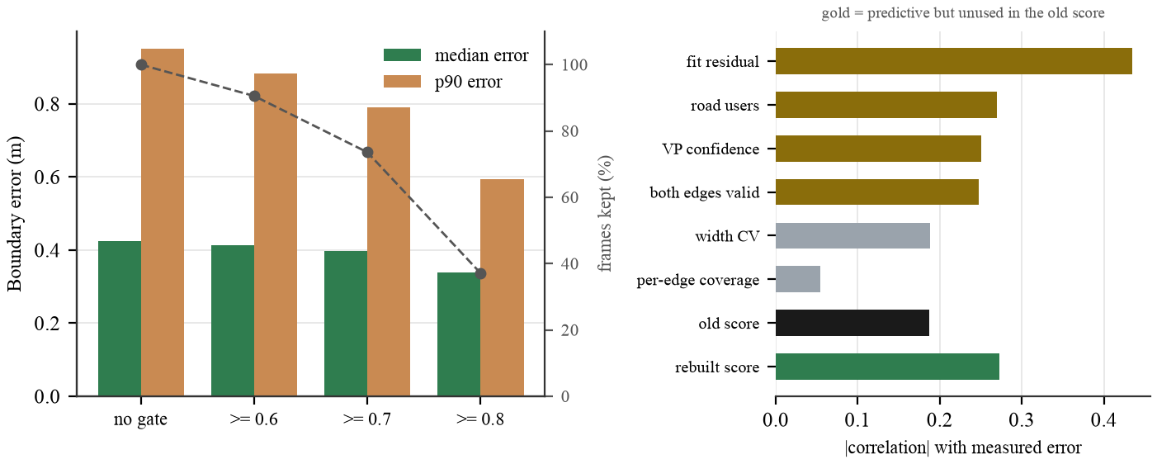
Confidence That Predicts Error
Gating on the rebuilt score removes most of the error tail.

Slide 20
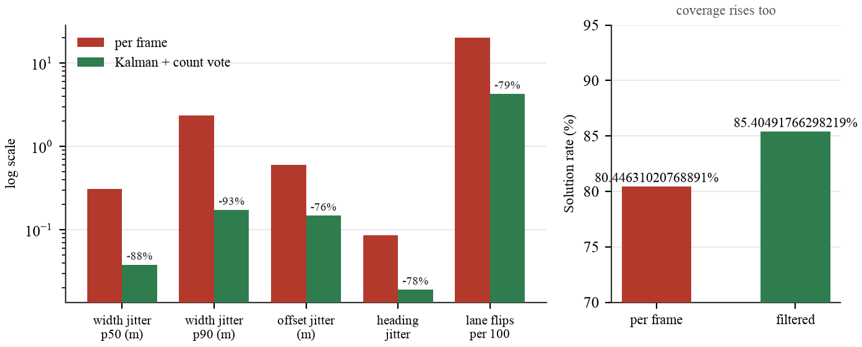
Temporal Stability
150 sequences, 4,526 frames, drawn from three drives.
Notes:
Right panel is the control: coverage rises with the filter, so it smooths rather than ignores.

Slide 21
Challenges & Limitations
Stated here rather than left for the viva to find.
One metric assumption
CAMERA HEIGHT 1.75 M
▪ Every distance scales linearly with it
▪ One known width removes it entirely
Unvalidatable interior
NO GROUND TRUTH EXISTS
▪ Carriageway extent is validated
▪ The divisions inside it cannot be
Half the data unused
A PREPARATION BUG
▪ Part II of IDD-20k was downloaded and never merged
▪ 6,993 of about 14,000 frames
Low light, wide angle
OUT OF DISTRIBUTION
▪ Trained on daylight, normal-lens footage
One run, one seed
NO INTERVALS
▪ Small differences between configurations are not significant
Optimistic epoch choice
VALIDATION ONLY
▪ Best epoch picked on the split it is reported on, since the test split is unlabelled
ALSO OUTSTANDING
ego lane unvalidated
road-user distance unvalidated
wrong-side detection off by default
narrow-road divisor to confirm

Slide 22
What Did Not Work
Four hypotheses implemented, measured and rejected.
Fusing classical and learned
0.9403 → 0.9066
▪ The hybrid premise the project started from is not supported by the data
Bridging before the vanishing point
90.2% → 74.5%
▪ Unioning vehicles recreates the frame-border clipping the fit already excludes
Lanes from observed traffic
AGREEMENT FLAT AT 34 TO 40%
▪ More evidence does not tighten the spacing. The modes are real and they are not lanes
Closing the dashcam gap at test time
FOUR REMEDIES, ALL REJECTED
▪ CLAHE works and cannot be applied: no image statistic separates the frames that need it
Measured self-correction
Three claims made confidently in earlier drafts did not survive re-measurement and are reversed in print.
Notes:
Strongest slide for a viva. Four measured negative results, kept in.

Slide 23
Conclusion & Future Work
The idea holds, and it is now measurable rather than plausible.
Conclusion
WHAT WAS SHOWN
▪ Lane structure can be inferred from road geometry where no paint exists
▪ 0.9310 drivable IoU deployed, 165 of 204 frames solved, 0.31 m median edge error, 27 fps
▪ The harness and its trivial baselines are what made every other result interpretable
Future work
IN ORDER OF VALUE
▪ Merge Part II of IDD-20k and retrain
▪ Train on IDD-AW for low light and adverse weather
▪ Retrain at 384 by 640 for thin markings
▪ Validate ego lane and road-user distances
▪ Confirm the narrow-road divisor against the standard
4
hypotheses tested and rejected
3
earlier claims reversed
20
figures, all from source

Slide 24
Thank You
Questions
Vision-Based Lane Inference for Unstructured and Structured Indian Roads
CAPSTONE PROJECT
▪ Harshwardhan Mukund Mohadikar · 2023EBCS353
▪ Shreyas Bhat K · 2023EBCS460
▪ Supervised by Dr. Ashok Yemineni
Everything here is reproducible
Every figure comes from the evaluation harness in eval/ and can be regenerated from source. No number in this deck is typed in by hand.

