Slide 1

Presented by:
Harshwardhan Mukund Mohadikar · Shreyas Bhat K
Vision-Based Lane Inference for Unstructured and Structured Indian Roads
BSc Computer Science · 2025-26
Under the guidance of
Dr. Ashok Yemineni
Notes:
Fifteen minutes. Open on the trapezoid result, not the IoU.

Slide 2
Problem Statement
Lane detection assumes paint. Most of the Indian network has none.
What every method assumes
THE SHARED PREMISE
▪ Painted lane markings are present in the frame
▪ SCNN and LaneNet label marking pixels, then cluster them
▪ Ultra Fast LDD picks which cell in a row holds a marking
▪ All trained on TuSimple, CULane and BDD100K
What Indian roads give you
THE ACTUAL INPUT
▪ Paint is absent, worn, or hidden under traffic
▪ Yet the road still carries a structure drivers agree on
▪ That structure is in the geometry, not the markings
And the failure is silent
A detector that finds nothing looks exactly like one that has failed. Nothing downstream can tell them apart, so on an unmarked road the honest output is a refusal, not a guess.
Notes:
Every method we found starts from paint. Our roads do not have it, and the structure is still there in the geometry.

Slide 3
Objectives & Scope
Rebuild the pipeline so every claim it makes can be measured.
Primary objectives
WHAT TO BUILD
▪ Review lane detection and inference for Indian road settings
▪ Infer lanes on structured, semi-structured and unstructured roads, from geometry rather than markings
▪ Make that model optimised, effective and lightweight enough for video rate on commodity hardware
▪ Validate against ground truth and trivial baselines, with a confidence that predicts its own error
Secondary objectives
ATTEMPTED, OUTCOMES REPORTED
▪ Wrong-side driving from inferred lane direction: implemented, unvalidated
▪ Traffic flow in unorganised conditions: measured and rejected
▪ Feasibility for basic driver assistance: the limitations analysis
Scope
BOUNDARIES
▪ In: monocular forward-facing camera
▪ In: single image, video clip, live camera
▪ In: lane count and metric widths, both validated
▪ Also reported, not validated: ego lane, road-user distances
▪ Out: path planning, vehicle control, any other sensor
▪ Out: night and heavy rain
METHODS THIS RESTS ON
MobileNetV3
LR-ASPP
FPN
IPM
Kalman filter
IRC:86
Knowledge distillation

Slide 4
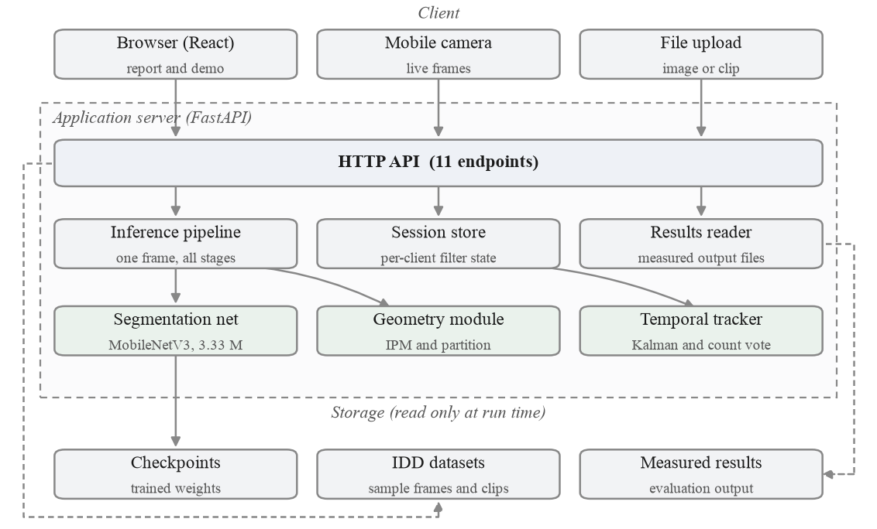
System Architecture
Four tiers, one API surface, and everything in the dashed box is one process.
React interface
FastAPI, 11 endpoints
Stateless inference
Read-only weights and results
Notes:
Four tiers. The only state that matters is the per-session tracker for the live camera.

Slide 5
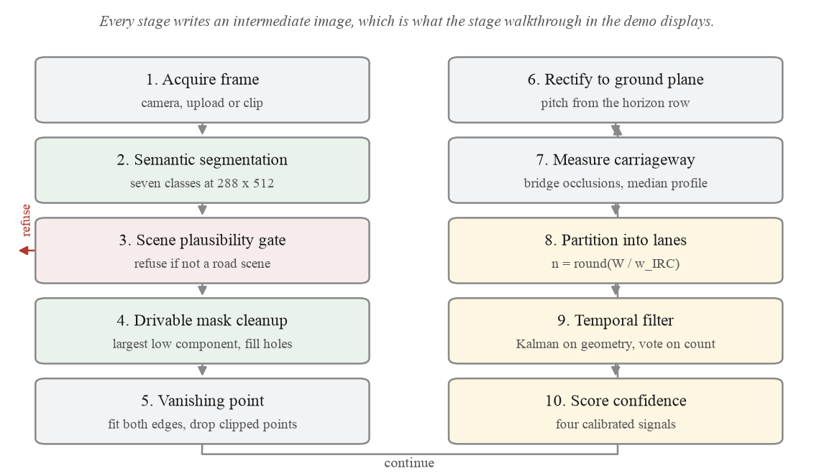
End-to-End Process Flow
Ten stages, including the path where the system declines to answer.
Notes:
Stage three is the refusal path, and stage ten is the confidence.

Slide 6
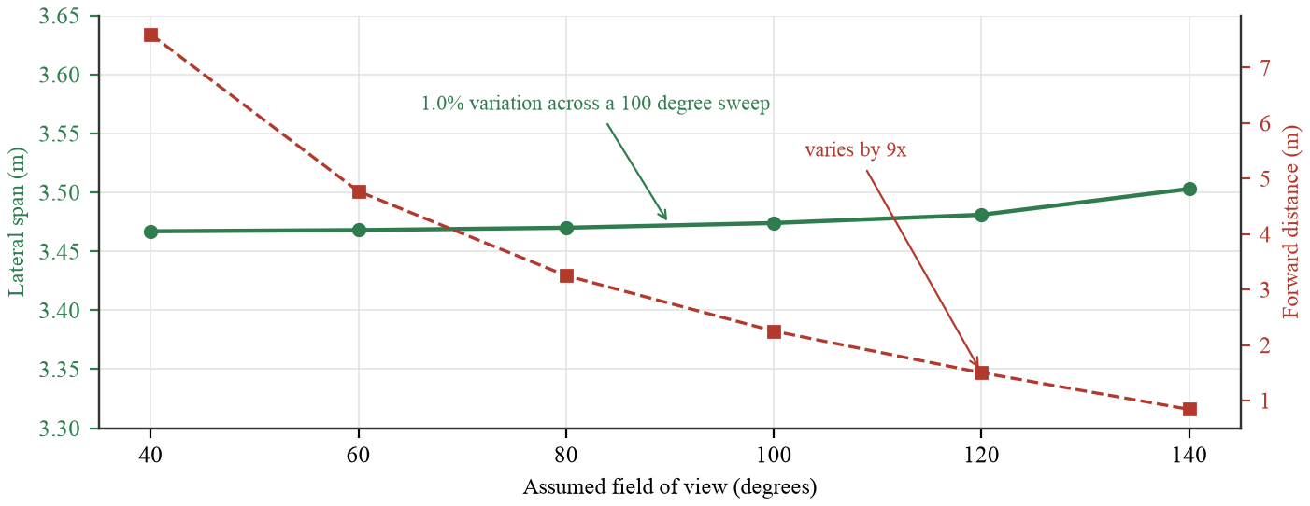
Focal Length Cancels
The dataset ships no camera metadata. It turns out not to need it.
The problem
NO CALIBRATION
▪ Metric output normally needs the focal length
▪ Arbitrary dashcam footage does not carry it
▪ Pitch is measured per frame from the vanishing point
The algebra
F DIVIDES OUT
▪ dX = du (f H / (v - v_h)) / f
▪ which is du H / (v - v_h)
▪ f appears above and below, and cancels
The evidence
MEASURED, NOT ASSERTED
▪ Field of view swept 40 to 140 degrees
▪ Lateral scale moves 1.0 per cent
▪ Against a 11.8 per cent median width error
Notes:
This is the result we are proudest of. One assumption is left, the camera height, and Section 3.5 sweeps it.

Slide 7
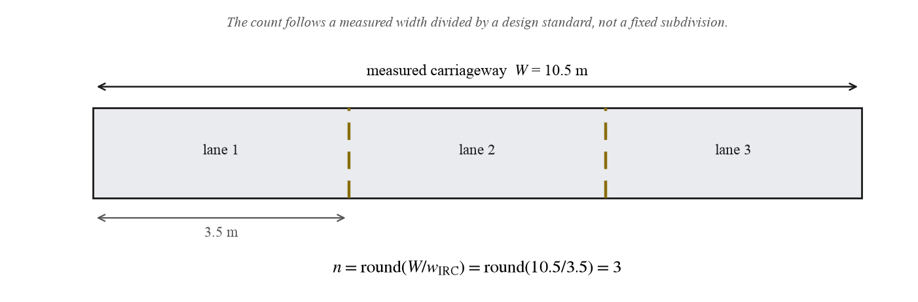
From Width to Lane Count
A published design width applied to a measurement, not an arbitrary divisor.
The rule
N = ROUND(W / W)
▪ w = 3.50 m at or above a 6.0 m carriageway
▪ w = 3.00 m below it, a narrower road
▪ A 2.5 m floor rejects a sliver of visible tarmac
Why a threshold, not a classifier
DELIBERATE
▪ No scene is labelled urban or rural anywhere
▪ The threshold is on the measured width itself
▪ Nothing has to be recognised for it to hold
Notes:
The count falls out of a measurement and a standard. Reducing n while a lane would be under 2.5 m stops a rounded-up count.

Slide 8
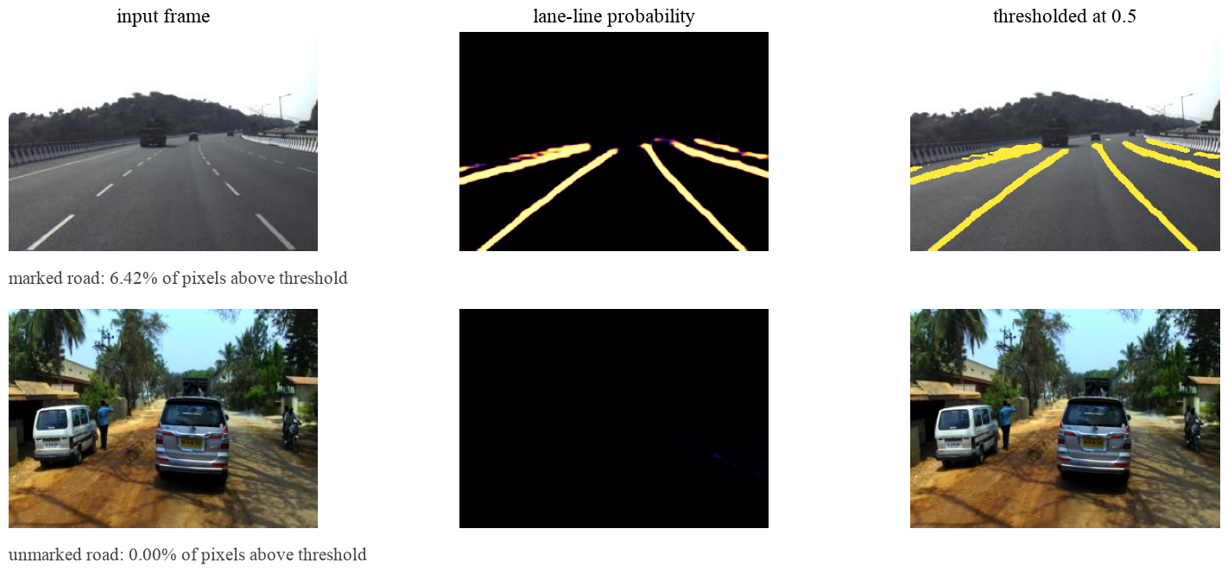
The Lane-Marking Head
IDD has no lane annotation, so YOLOP was used offline as a teacher.
Distillation
1,607 PSEUDO-LABELS
▪ YOLOP labelled IDD offline, never at run time
▪ A second head trained against those labels
▪ Shares one forward pass with segmentation
What it cost, and bought
BOTH REPORTED
▪ 0.011 mIoU on the semantic task
▪ Structured frames rose from 27 to 39
▪ YOLOP is 150 ms on CPU; our head is free
Notes:
The teacher is not shipped. Only the distilled head runs.

Slide 9
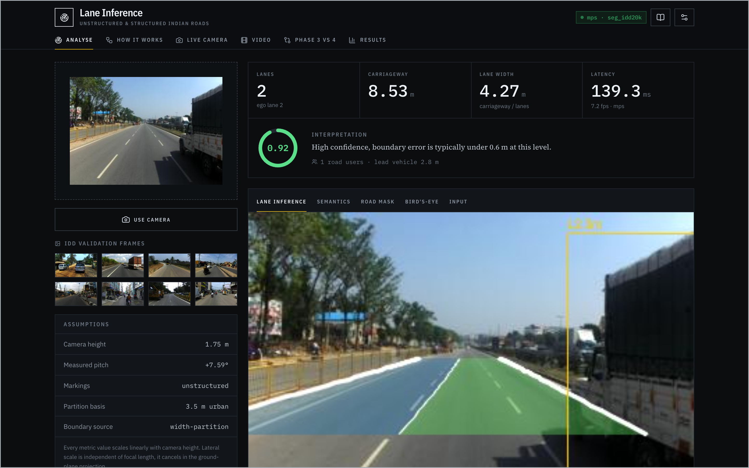
Implementation
A running application, not a set of scripts. Everything pinned and reproducible.
Model
3.33 M PARAMETERS
▪ MobileNetV3-Large backbone, LR-ASPP head, FPN decoder
▪ Seven semantic classes plus the distilled lane head
▪ IDD-20k: 6,993 train, 981 val, 40 epochs, AdamW
Pipeline
GEOMETRY AND TRACKING
▪ Vanishing point, inverse perspective mapping
▪ Per-row occlusion handling in the width profile
▪ Kalman filter over centreline and width, count vote
Delivery
SERVED AND TESTED
▪ FastAPI, eleven endpoints; React interface
▪ ONNX Runtime: 226 MB resident, no PyTorch
▪ 58 tests over geometry, metrics, API and export
Notes:
Two routes: the report, which reads its numbers live, and the demo running the real pipeline. The deployed image has no torch in it.

Slide 10
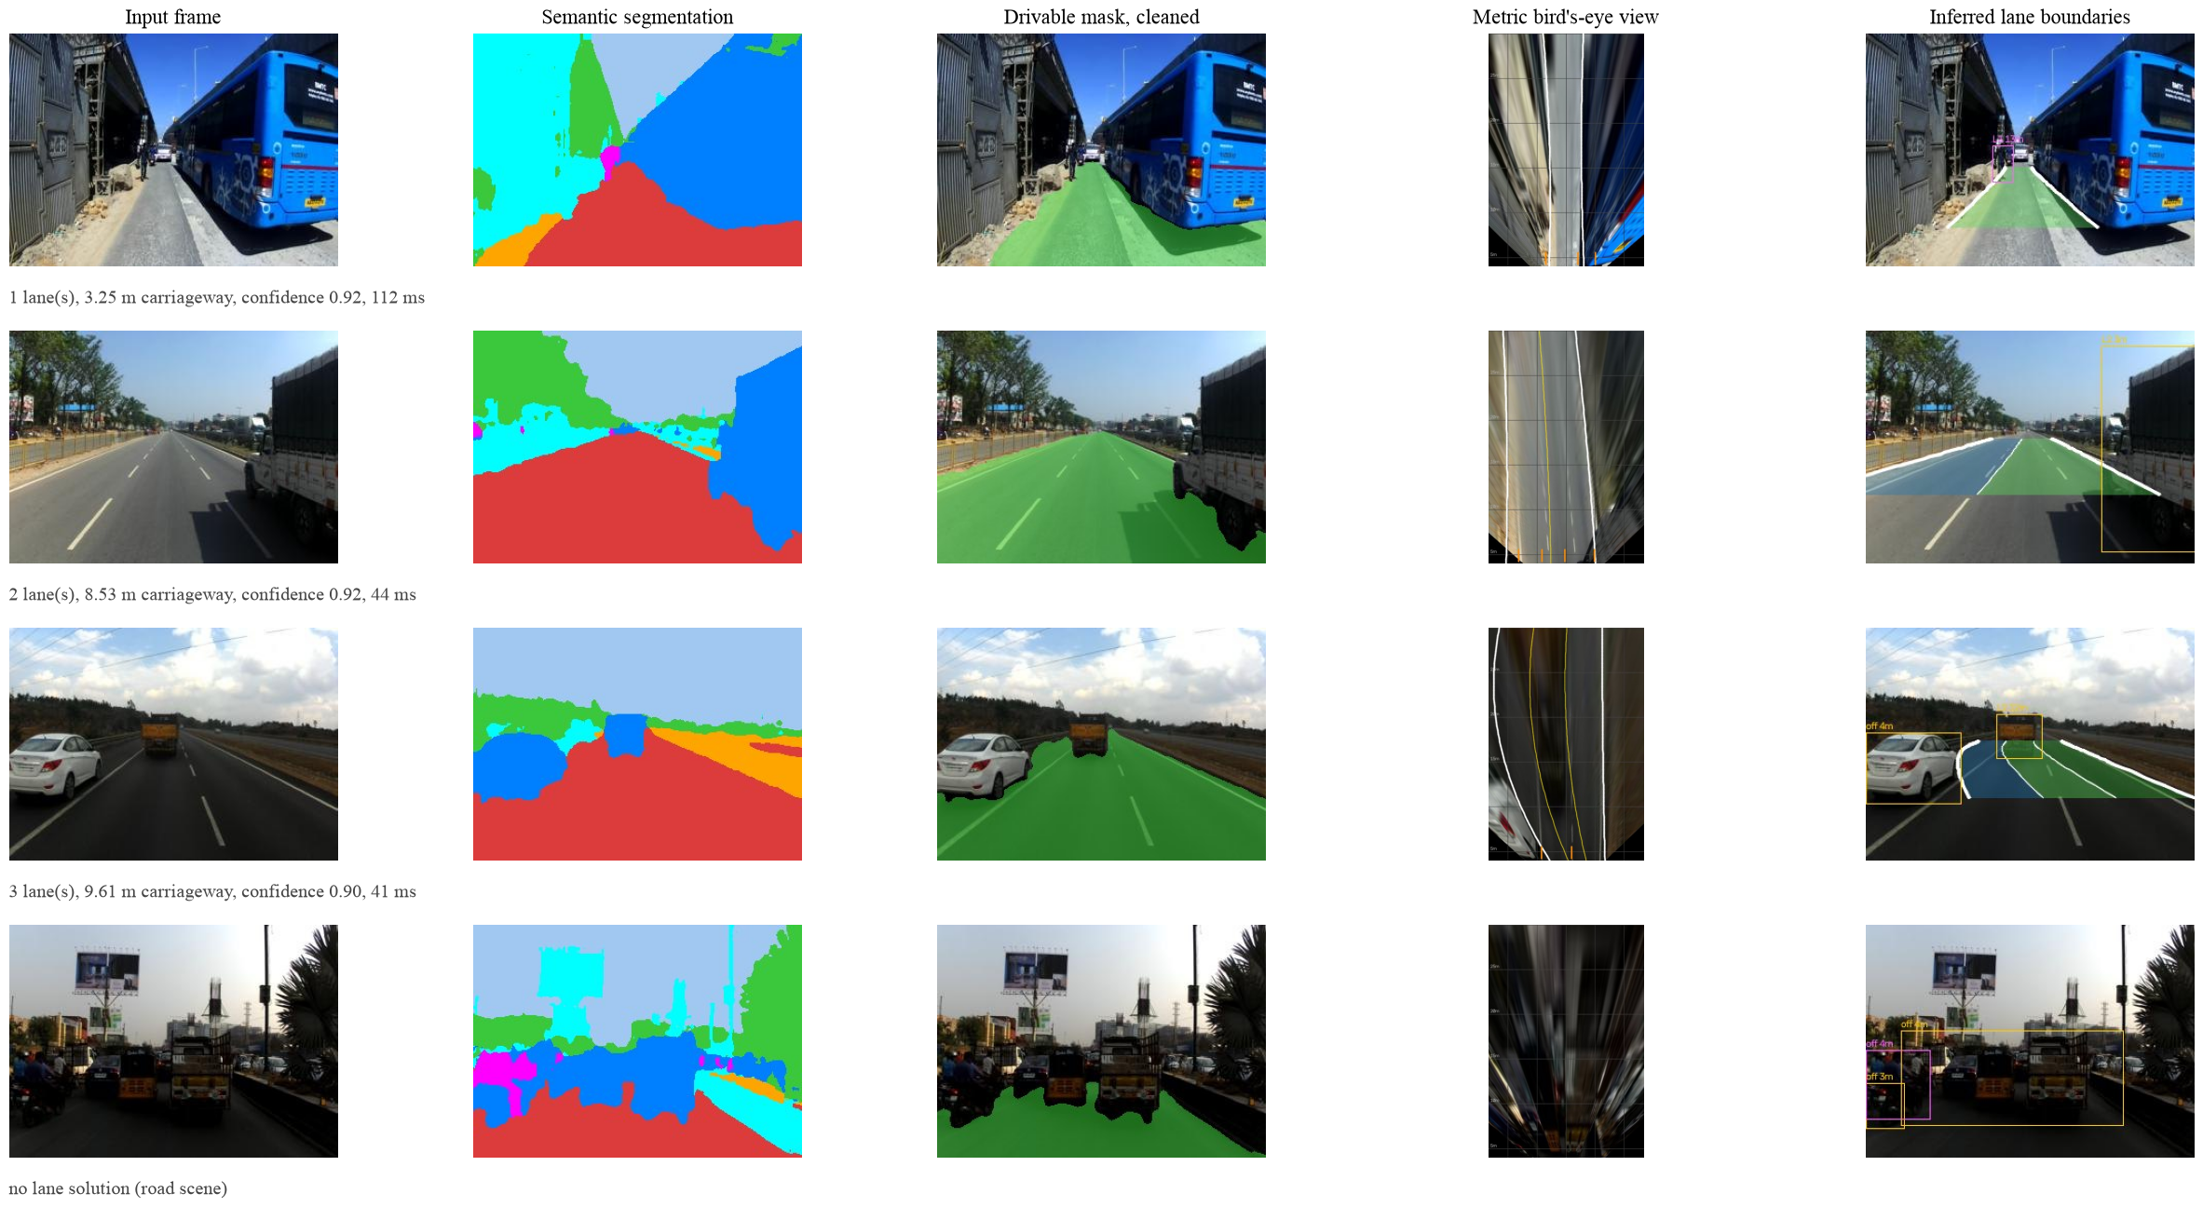
Pipeline Stages
A narrow road, a two-lane road, a painted three-lane road, and a refusal.
Notes:
The fourth row is a refusal, and that is correct behaviour rather than a failure.

Slide 11
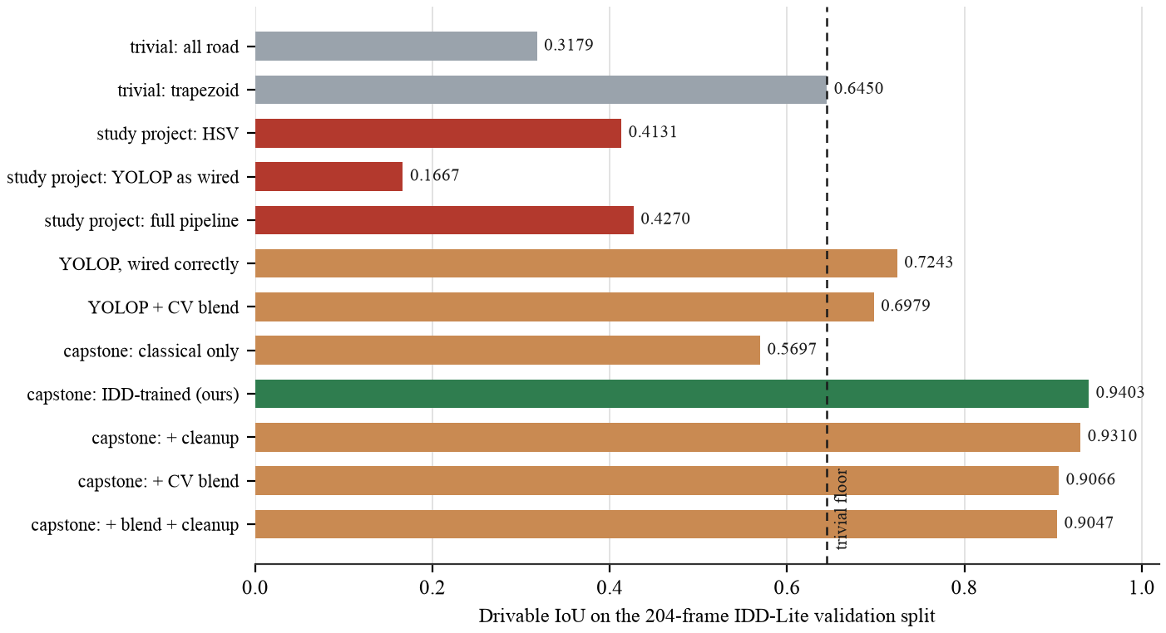
Results & Analysis
Measured on the 204-frame IDD-Lite validation split, by a harness that ships with the code.
0.9310
drivable IoU, deployed
0.7754
boundary F1, deployed
165/204
lane solutions
27 fps
end to end, 36.5 ms
Notes:
Twelve configurations, same frames, same harness. The two grey bars never look at the image; a result means nothing without a floor.

Slide 12
Is the Geometry Correct?
The hardest question in the project, and the one an examiner should ask.
0.314 m
median road-edge error
11.8%
median width error
39
refused of 204, by design
4.3
lane flips per 100 frames
Against ground truth
2,288 SAMPLES
▪ Outermost inferred boundary against the drivable label
▪ 0.314 m median, 1.526 m at p90
▪ Interior divisions have no ground truth anywhere
Confidence that predicts error
CALIBRATED
▪ Built from signals measured to predict error
▪ Gating at 0.8 takes the median from 0.425 to 0.339 m
▪ So the tail is identifiable in advance
Stable across video
150 CLIPS, 4,526 FRAMES
▪ Width jitter 0.311 to 0.038 m
▪ Count flips 20.1 to 4.3 per 100
▪ Solution rate 80.4 to 85.4 per cent
Notes:
The solution rate rising with the filter is the control: a filter that had stopped tracking would improve jitter while coverage fell.

Slide 13
Challenges & Limitations
Stated here rather than left for the viva to find.
What did not work
IMPLEMENTED, MEASURED, REJECTED
▪ Fusing the classical and learned branches: 0.9403 to 0.9066
▪ Bridging occlusions before the vanishing point
▪ Inferring lanes from observed traffic
▪ Four test-time remedies for the dashcam domain gap
What we cannot claim
LIMITATIONS
▪ Lane counts are inferred, not detected, and unvalidated
▪ Metric scale rests on an assumed 1.75 m camera height
▪ Ego lane and road-user distance are never evaluated
▪ Half the annotated data, IDD-20k Part II, is unused
▪ Not validated for control or any safety function
The defect that taught us the most
Bridging every vehicle gap joined our carriageway to the opposing one across a median. Found by checking the model against the mask it was built from, not against ground truth: the mask was within 0.20 m, the model 0.58 m wider. Handling occlusion per row took the p90 width error from 151 to 47 per cent.
Notes:
Say the occlusion bug out loud. Volunteering it is worth more than any number on the previous slide.

Slide 14
Conclusion & Future Work
The idea holds, and it is measurable rather than plausible.
165/204
frames solved
0.31 m
median edge error
0.9403
drivable IoU
58
tests, all passing
What was shown
CONCLUSION
▪ Lane structure can be inferred without markings
▪ Metric scale needs no focal length, only a height
▪ A system that refuses is more useful than one that guesses
What is next
FUTURE WORK
▪ Merge IDD-20k Part II, half the annotated data
▪ Validate ego-lane assignment, the first unmeasured output
▪ Confirm the narrow-road divisor against printed IRC
▪ Close the consumer dashcam gap with training data
Thank you
Questions. · github.com/Arkanobot/VisionBasedLaneInference
Notes:
Close on the refusal being a feature. Then take questions.

