Slide 1
Advanced AGS Configuration
Or, “Why would you want to do that?!!?!”

Slide 2
Outline
Web Farm
Virtualization
Windows Server 2008
SAN Snapshots
Resources
Questions

Slide 3
Web Farm
Single point for client connections
Linearly scalable
Redundant
Load Balancing
Hardware based (Cisco CSS)
There are software solutions as well

Slide 4
Web Farm
Challenges
Servers MUST be identical in all ways
AGS requires special configuration
Virtual Directory settings
The Cisco CSS requires special configuration
Sticky connections
Shared storage is problematic

Slide 5
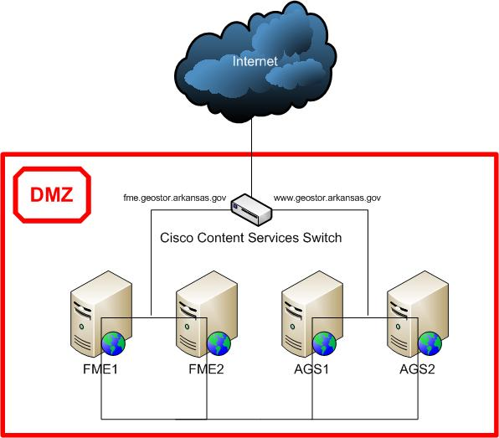
Web Farm

Slide 6
Virtualization
Virtualization is a hot topic
Hardware
Dell Blade Servers (M600 & M605)
Software
VMWare ESXi 4.0 (free)
VMWare vSphere Client
VMWare vSphere Update Client

Slide 7
Virtualization
Challenges
NONE!

Slide 8
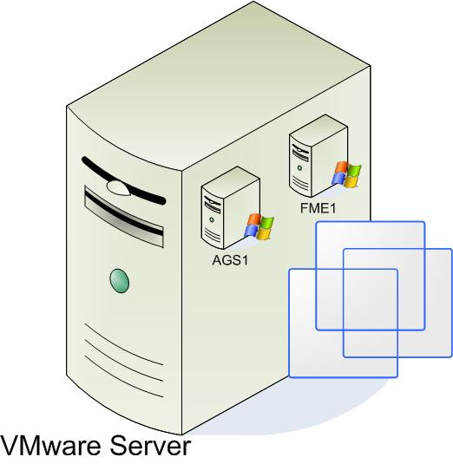
Virtualization

Slide 9
Windows Server 2008
Stable
AGS Compatible
Fast (I know, right?)
IIS 7
.Net 3.5

Slide 10
Windows Server 2008
Challenges
NONE!

Slide 11
SAN Snapshots
Create once, share many
Very cost effective
$5K for Snapshot license
Saved ~15TB of storage (~$50K)
No issues with file locks or corruption
Faster with less latency than network file access

Slide 12
SAN Snapshots
Challenges
Currently requires an outage to refresh snapshots
Web farm setup alleviates this but would be nice to refresh them on the fly
Setting them up is highly technical requiring special skills

Slide 13
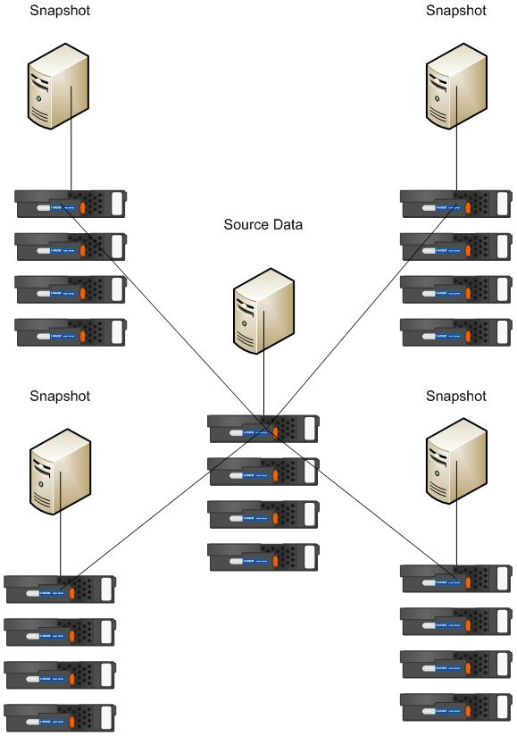
SAN Snapshots

Slide 14
Resources
Web Farm
Linearly Scaleable
Cisco CSS
VMWare
Windows Server 2008
Dell/EMC SAN
SAN Snapshots

Slide 15

Questions?

Slide 16
Conclusion
The advanced configuration gives more than enough benefits to outweigh the difficulties in setting it up
glen.rhea@arkansas.gov

