Slide 1
Synthetic news for AG News
What happens when real training articles are replaced with generated ones?
• Oleksandr Buhrii & GrAndezit
• Natural Language Processing final presentation
Synthetic Data NLP | AG News • Final presentation
1
Notes:
Oleksandr | 0:35 | Introduce the question and two linked workstreams: generating usable examples and testing them on real news.

Slide 2
Research question
Can fictional Qwen3 articles improve a real-news classifier?
• Five synthetic shares: 0%, 25%, 50%, 75%, 100%
• Fixed 8,000 training items and four balanced classes
• DistilBERT evaluated on unchanged real AG News test data
Synthetic Data NLP | AG News • Final presentation
2
Notes:
Oleksandr | 0:55 | Explain replacement rather than adding more data. State that the outcome is performance on original real articles.

Slide 3
Dataset and split design
Real validation and test data stay fixed
• Train: 8,000 real items selected from AG News
• Validation: 2,000 real items
• Test: original 7,600 items, 1,900 per class
• Seed 42; duplicate and overlap checks
Synthetic Data NLP | AG News • Final presentation
3
Notes:
Oleksandr | 0:55 | Describe class balance and why keeping validation/test real makes this a test of transfer to actual AG News.

Slide 4
Generate and screen synthetic news
Qwen3-4B-Instruct through local Ollama
• Basic: category + headline/summary request
• Advanced: concrete scenario, actors, and angle
• Filter: length, duplicates, label screening, realism
• 8,000 generated → 7,427 filtered → 8,000 balanced final
Synthetic Data NLP | AG News • Final presentation
4
Notes:
GrAndezit | 1:10 | Explain prompt contrast and screened replacements. State that automatic filters are quality proxies, not factual guarantees.

Slide 5
Data quality findings
More varied prompts did not guarantee realism
• Advanced distinct-2 exceeded basic in all four classes
• Matched synthetic diversity lower than real: 0.740 vs 0.871 distinct-2
• 208 final articles reuse one of 68 headlines
• 40-item pilot realism: advanced 2.9/5; basic 3.0/5
Synthetic Data NLP | AG News • Final presentation
5
Notes:
GrAndezit | 1:10 | Explain distinct-2 and semantic diversity briefly. Mention the small review sample and repeated headline artifacts.

Slide 6
Controlled model setup
Same architecture and optimization across mixtures
• DistilBERT, 4-label classification head
• 1 epoch • batch 16 • learning rate 5e-5 • weight decay 0.01
• Validation every 100 steps
• One fixed original AG News test set
Synthetic Data NLP | AG News • Final presentation
6
Notes:
Oleksandr | 0:55 | Distinguish this one-epoch comparison from the separate five-epoch hyperparameter grid.

Slide 7
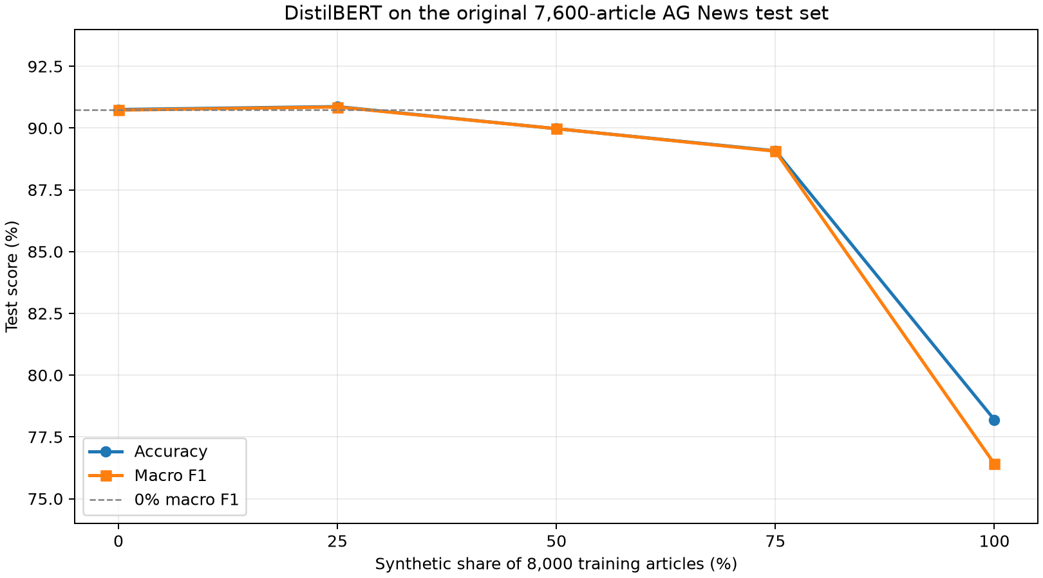
Main experiment results
25% has the highest observed test macro F1
• 0%: 0.9073
• 25%: 0.9085 (+0.0013)
• 100%: 0.7641
Synthetic Data NLP | AG News • Final presentation
7
Notes:
Oleksandr | 1:15 | Read the graph: tiny lead at 25%, decline after 50%, sharp drop at 100%. Emphasize one seed and exploratory test-set ranking.

Slide 8
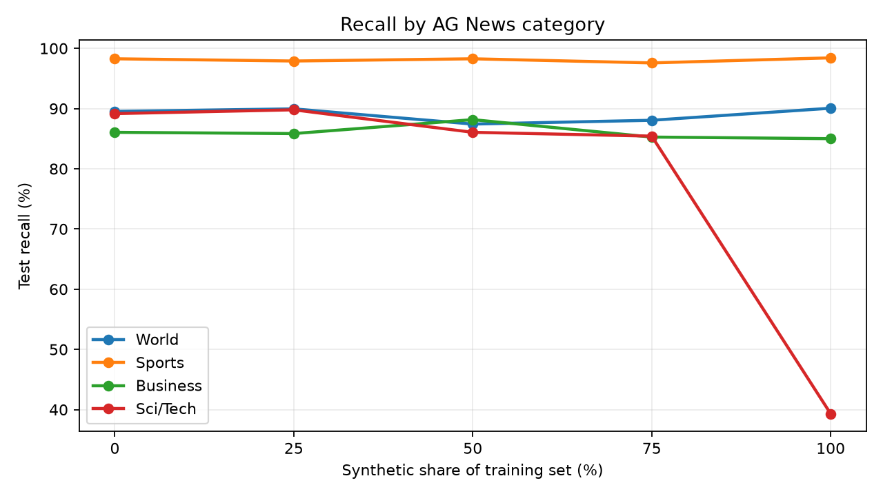
Which class suffers?
Sci/Tech collapses at 100% synthetic
• Sci/Tech recall: 0.8916 at 0% → 0.3932 at 100%
• Business–Sci/Tech confusion persists
• Aggregate macro F1 reveals this category imbalance
Synthetic Data NLP | AG News • Final presentation
8
Notes:
Oleksandr | 0:55 | Point to class recall, not only overall accuracy. Explain mixed business/technology vocabulary as a possible cause.

Slide 9
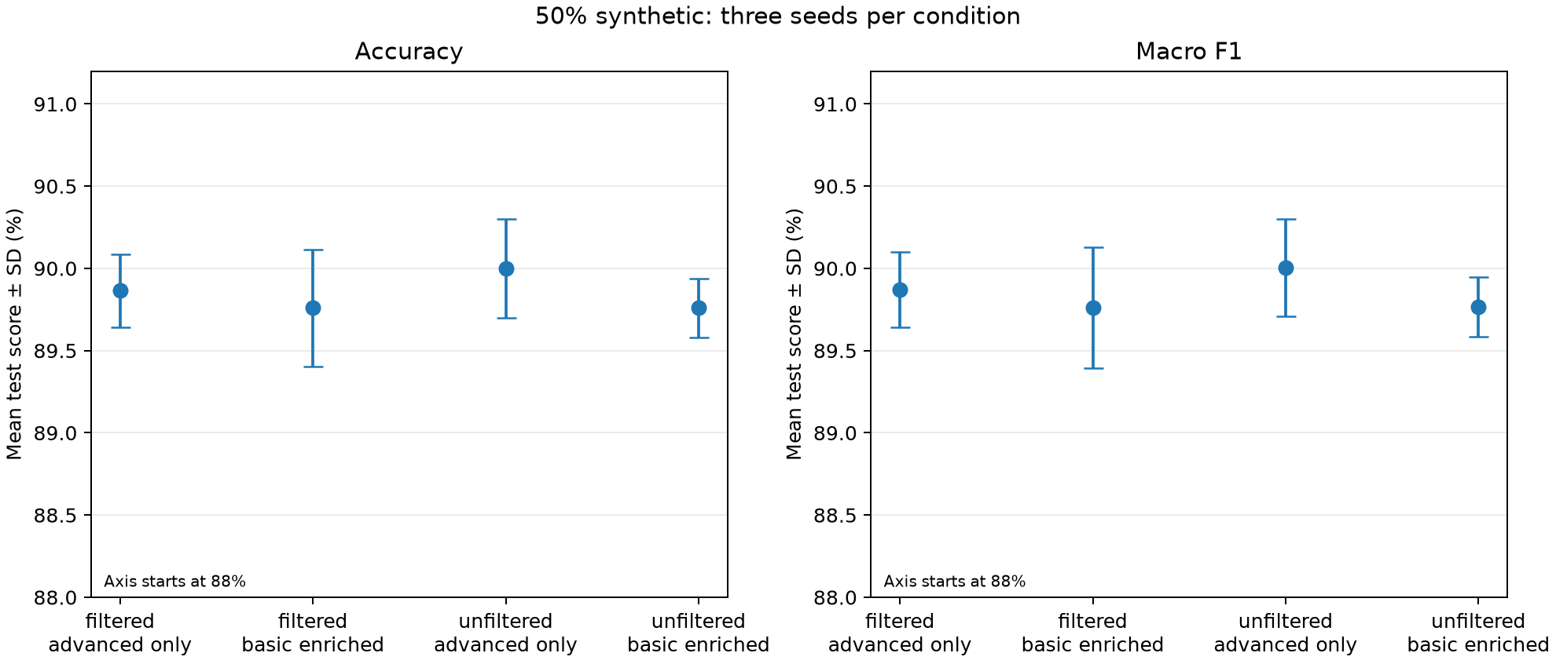
50% ablation
Three seeds per prompting/filtering condition
• 4,000 real + 4,000 synthetic in every run
• Advanced-only unfiltered mean macro F1: 0.9001
• Filtered advanced-only: 0.8987
• Differences small versus seed variation
Synthetic Data NLP | AG News • Final presentation
9
Notes:
Oleksandr | 1:05 | Clarify basic-enriched is 400 basic plus 3,600 advanced, not 100% basic. Do not claim filtering is harmful from these small differences.

Slide 10
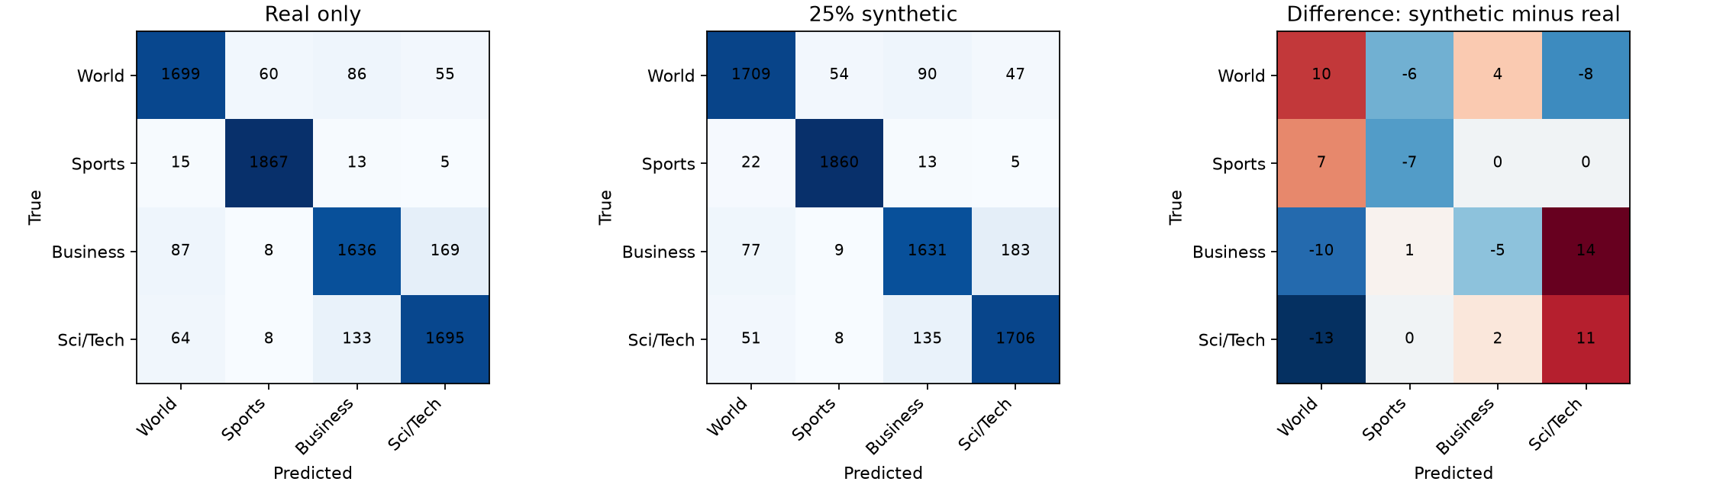
Paired error analysis
Synthetic data both fixes and creates errors
• 144 baseline errors fixed by the 25% model
• 135 new errors introduced
• 559 articles wrong in both
• Net gain: 9 correct out of 7,600
Synthetic Data NLP | AG News • Final presentation
10
Notes:
Oleksandr | 1:05 | Give one category-boundary example: a technology company story can be Business or Sci/Tech depending on its main angle.

Slide 11
Discussion and conclusion
Modest augmentation can match real-only; full replacement fails
• 25% lead is small and from one seed
• Generated text is less diverse and has template artifacts
• Next: validation-based selection, more seeds, untouched final test
• Quality screening needs broader human review
Synthetic Data NLP | AG News • Final presentation
11
Notes:
GrAndezit | 1:00 | Summarize the evidence without claiming a robust 25% optimum or a proven cause for every error.

Slide 12
Contributions and sources
Two complementary workstreams
• Oleksandr: real splits, DistilBERT training, ablations, error analysis
• GrAndezit: prompts, Qwen generation, filtering, quality/diversity audits
• Sources: AG News [1–2], DistilBERT [3], Qwen3 [4–5]
• Reproduction: README, scripts, saved CSVs and experiment index
Synthetic Data NLP | AG News • Final presentation
12
Notes:
Both | 0:40 | Each presenter closes with their contribution. Refer to the report for full citations and caveats. Total planned speaking time: 11 min 40 sec.

