Slide 1
EC 504 Final Project:
Max flow image segmentation
Joe Biernacki
Ethan Klein

Slide 2
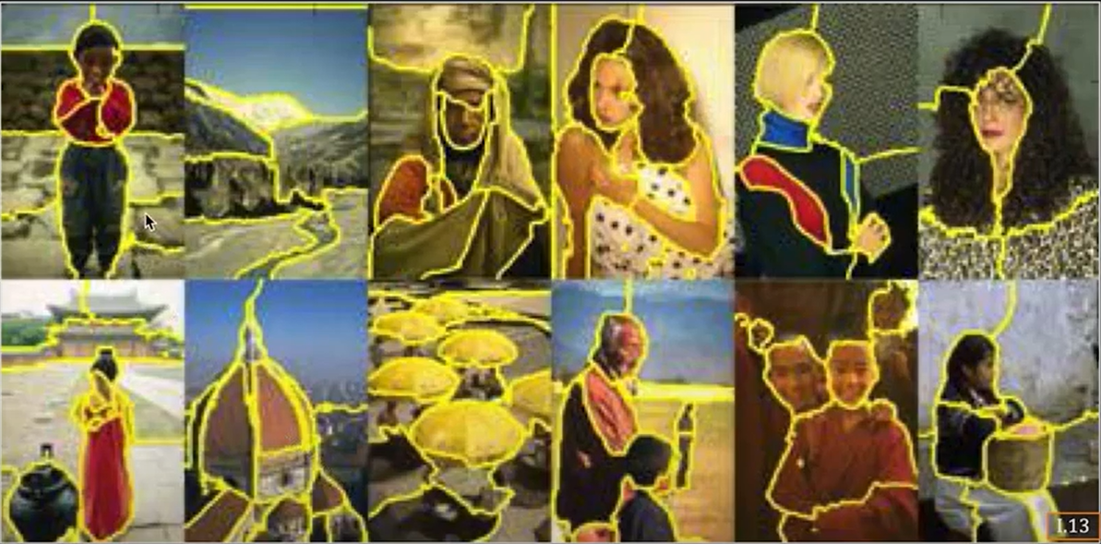
What is Image Segmentation
Image Segmentation is the division of an image into regions which are meaningful and easy to analyze.
In particular, image segmentation is often used to separate objects along their edges.

Slide 3
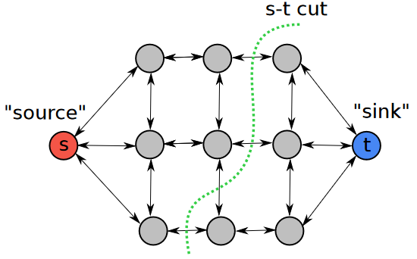
Max-flow/min cut
Theorem: max value of s - t flow on G = min capacity of s - t cut

Slide 4
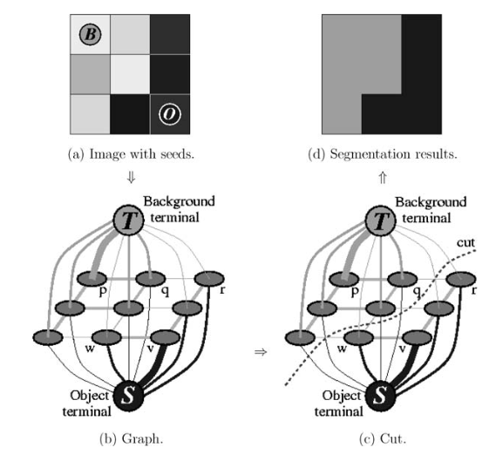
In the context of image segmentation

Slide 5
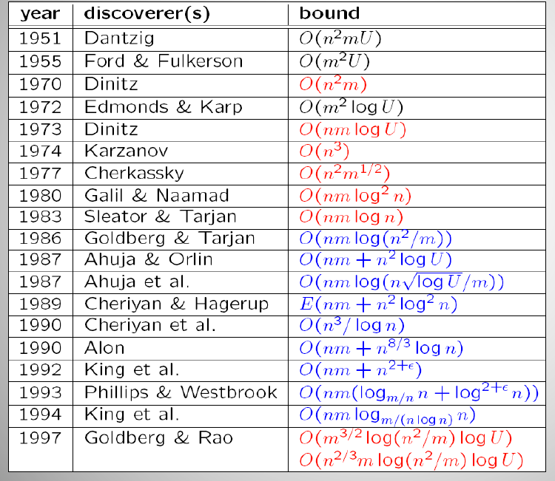
Deliverables
Test 2-4 implementations w/ increasing numbers of segmentation “targets”
Predict and then experimentally measure algorithm performance
Time permitting
Explore object detection and labeling
Increase customizability

Slide 6
Challenges
Problems we might face:
Handling images with low contrast.
Images with low contrast will have less weight between pixels(graph nodes), making it harder to distinguish where to cut.
Handling images with lots of noise.
Image noise could affect the similarity of pixels along an edge, making it harder to cut a clean line along the bounds of the object.

