Slide 1
Person Reidentification
CS517 Mini-Project
Arnav Kharbanda(2021CSB1072)
Yashasav Prajapati(2021CSB1143)

Slide 2
References
K. Zhou & T. Xiang, 2019
L. Zheng, Y. Yang, & A. G. Hauptmann, 2016
M. Xiong & Z. Gao, 2022
Github - Code Implementation

Slide 3
Boston Marathon Bombing on April 15, 2013
Two terrorists, brothers Dzhokhar Tsarnaev and Tamerlan Tsarnaev, planted two homemade pressure cooker bombs which injured hundreds of people and killed three.
The investigators had to sit through hundreds of hours of CCTV footage and one of them had to watch the same segment of the footage more than 400 times.
Later found, the suspects were already on the police records for under age drinking and other activities and were also enrolled in a University in Boston.
This investigation could’ve been faster, if they had the right technology.
This clearly shows the reason we need Person Re-identification

Slide 4
Problem Statement
Person re-identification is a computer vision task that involves identifying an individual in a series of images or video frames captured from one or more cameras. The goal is to match images of a person captured in different camera views or at different times, even if their appearance may have changed due to variations in lighting, pose, or occlusion.

Slide 5
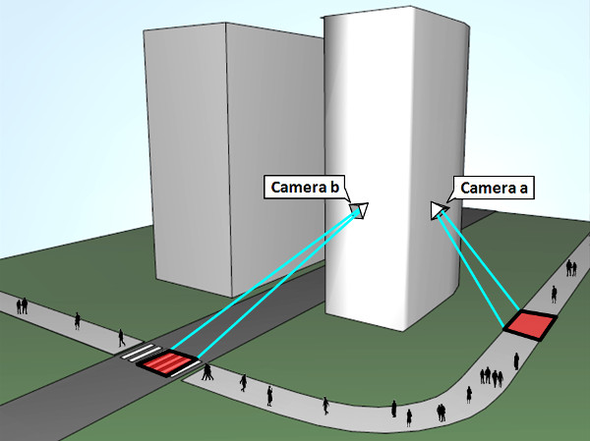
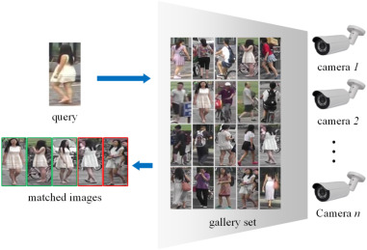
Sample
Source: Prid Webpage
Source: Science Direct

Slide 6
INPUTS
The person re-identification engine takes a single image as input and utilizes the dataset's gallery of images to identify all possible sets of images that may correspond to the same person.
Query Image

Slide 7



ILLUSTRATION
Engine
INPUTS

Slide 8
OUTPUTS
The output of the system is a set of true positive and false negative images.
True positive images are those where the system correctly matches the image of an individual from the gallery with another image of the same individual from a different camera view.
False negative images are those where the system fails to correctly match the image of an individual from the gallery with another image of the same individual from a different camera view.
Set of Images

Slide 9












ILLUSTRATION
OUTPUTS

Slide 10
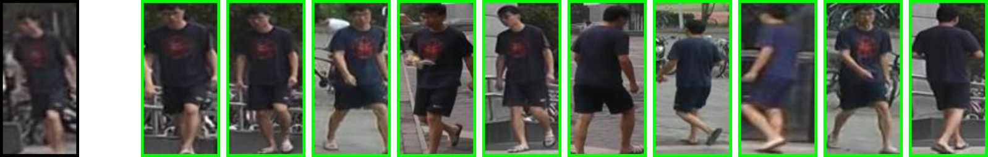
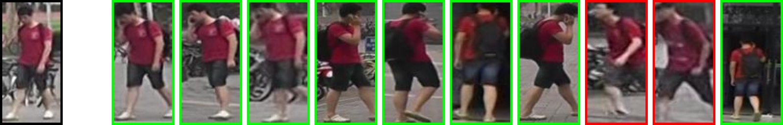
Some More Illustrations

Slide 11
DataSets Used
Market-1501
Duke MTMC - reid

Slide 12

Evaluation Metrics Used
Rank1 = total (most probable == actual true label) / total number of images
Rank5 = total(top5 most probable label == actual true label) / total number of images
Rank10 = total(top 10 most probable labels == actual true label) / total number of images
Rank20 = total(top 20 most probable labels == actual true label) / total number of images
mAP(Mean Average Precision) :
Mean of this over m queries gives mAP

Slide 13
What was the solution approach?
The general solution is a 2 step process.
Feature Extraction - Extracting features for every person images.
Feature Matching - Matching features to get a similarity score.
We use deep learning to improve upon this technique.

Slide 14
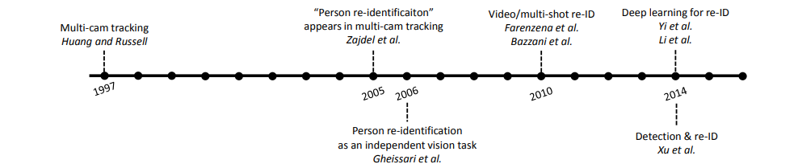
Progress in person Reidentification
Source: Person Reidentification Past, Present and Future

Slide 15
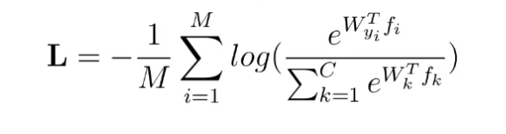
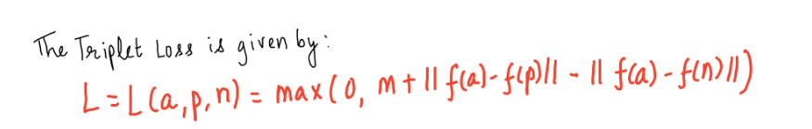
State of the art solutions - Metric Learning(uses deep learning)
Our current solution uses softmax loss or metric learning with triplet loss.
SoftMax Loss
Triplet Loss
a = anchor image
p = positive image
n = negative image
m= margin.
C is the total number of classes,
aⱼ denotes the output of the jᵗʰ neuron of the last fully connected layer before softmax activation,
pⱼ denotes the softmax activation of the jᵗʰ neuron,
xᵢ denotes the iᵗʰ image in a training batch of size M,
tᵢ denotes the target one-hot encoded vector of image i,
fᵢ be an encoding of xᵢ and it is also the input of the last fully connected layer,
W is the weight of the last fully connected layer, (bias = 0 (let)),
Lᵢ is the cross-entropy loss for image i, we have:
Works on the fact that if two images are similar, we bring them closer and if they’re not similar, we take them far apart

Slide 16
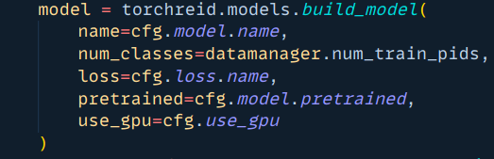
Using these losses in code to train a model
Default model we used: Resnet50(pretrained)
Total classes configured
Loss(default -> softmax)
Use Pre-trained model
Use GPU

Slide 17
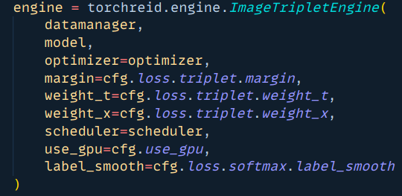
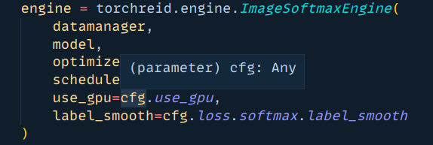
Using these losses in code to build the engine
Building Engine
Engine using SoftMax loss
Engine using Triplet Loss

Slide 18
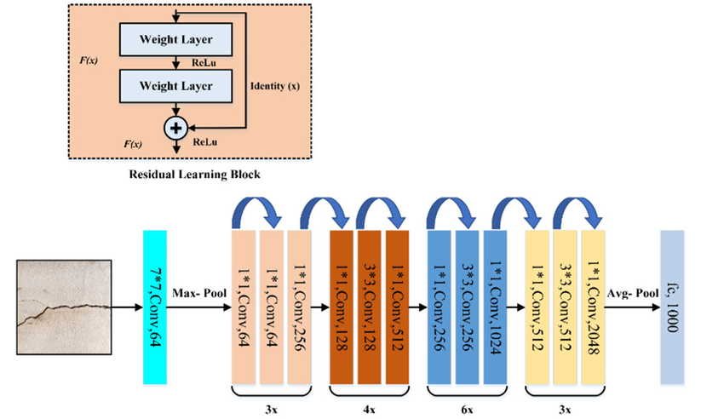
Resnet50
Residual Network - A very powerful type of convolution neural network. It’s pretrained model is used in training of the person re-identification model using the losses discussed.

Slide 19
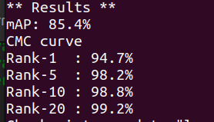
Result Evaluation Metrics Obtained from our training and testing

Slide 20
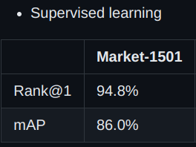
Comparison with NVIDIA Labs
Our Results
NVIDIA Labs Results(DG-Net NVIDIA’s own)
Almost similar results on Market-1501 dataset

Slide 21
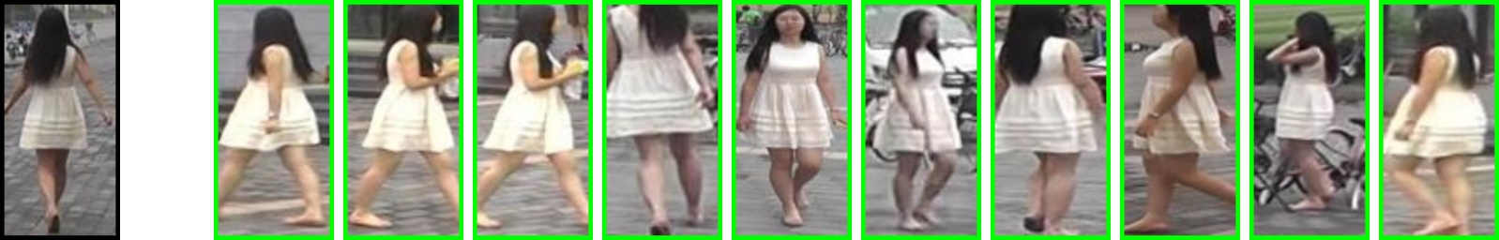
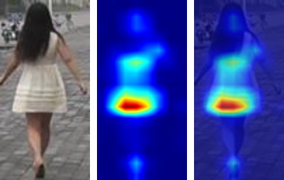
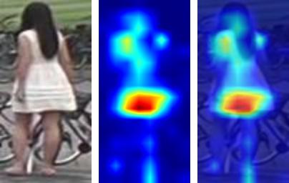
ONE OF OUR RESULTS

Slide 22
Method Based
on Multi-Attribute Feature Generation
The proposed method consists of two main steps: multi-attribute feature generation and similarity score calculation. In the multi-attribute feature generation step, the input image is processed by multiple attribute classifiers, which generate features related to the color, texture, and shape of the person. Then, the features are combined into a single representation using a feature fusion method. In the similarity score calculation step, the Euclidean distance between the feature representations of the query and gallery images is calculated to obtain the similarity scores.
Alternate method
Source: A Lightweight Efficient Person Re-Identification Method

Slide 23
Comparison with Multi-Attribute Feature Generation Method
Our Results
MAFG Result

Slide 24

Learnings
Importance of choosing appropriate distance metrics
Metric learning can learn distance metrics that effectively measure similarity between images
Choosing appropriate distance metrics can improve model performance
Need for careful selection and annotation of training data
Quality and diversity of training data impact effectiveness of metric learning
Careful selection and annotation of training data can ensure the model learns useful and relevant distance metrics
Potential for transfer learning
Metric learning can be used to learn distance metrics for person re-identification across different domains and datasets
Transfer learning can leverage knowledge learned from one domain to improve performance in another domain

Slide 25
Thanks

