Slide 1


PrabandhX:Multi-Tenant SaaS Project Management System
Under the Guidance of Mr. Rakesh Kumar Ray Assistant Professor, CSE
Presented by
AUROSMITA SAHOO (230301120265)
DISHA AGARWALLA (230301120281)

Slide 2
What is PrabandhX?
A comprehensive organization management system that streamlines:
• Project Management
• Team Collaboration
• Task Tracking
• File Sharing
🔐 Three Role-Based Access:
Admin | Manager | User

Slide 3
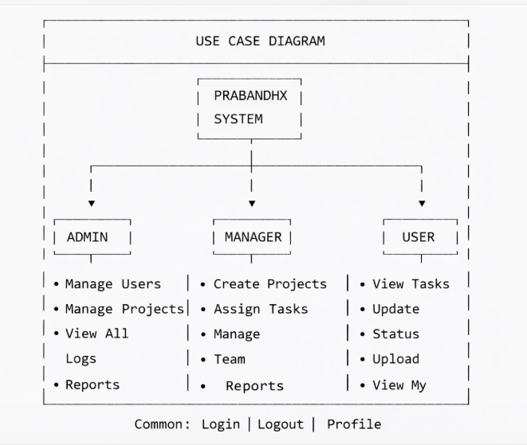
Use Case Diagram

Slide 4
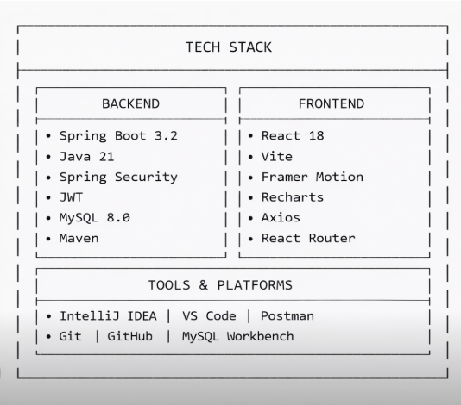
Technology Stack

Slide 5
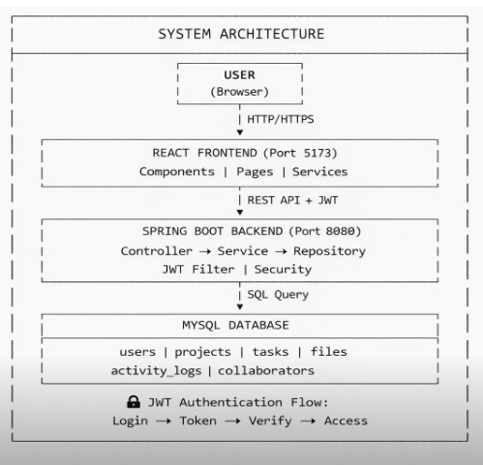
System Architecture

Slide 6
Conclusion
PROJECT SUMMARY
Organization Management System with Role-Based Access (Admin, Manager, User)
Secure JWT Authentication
Real-time Dashboard Analytics
File Management & Collaboration
KEY ACHIEVEMENTS
3 Role-based Dashboards
15+ REST API Endpoints
Responsive UI with Animations
Complete CRUD Operations
FUTURE SCOPE
Email & Push Notifications
Mobile Application
AI-based Task Recommendations
Calendar Integration

