Slide 1












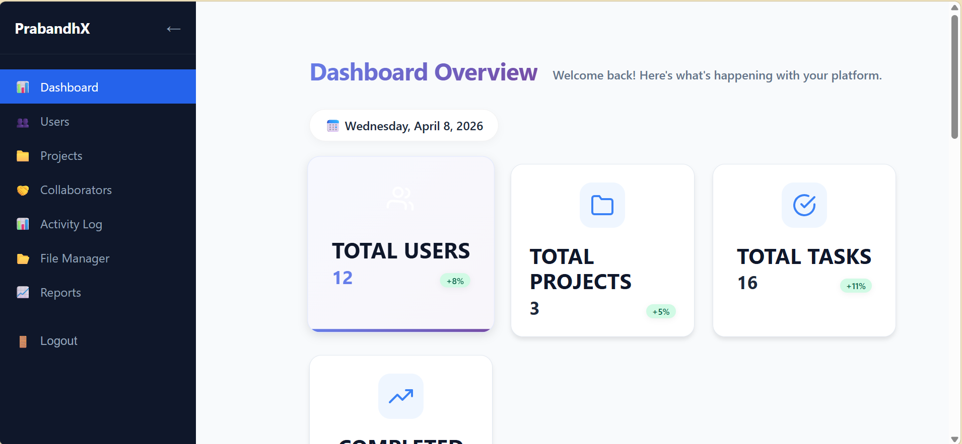

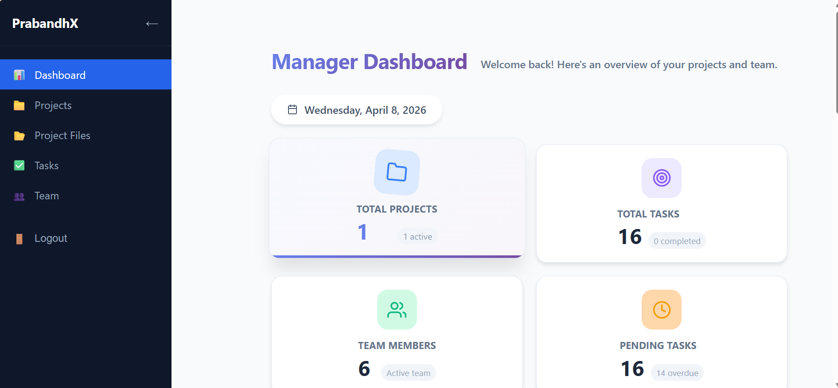
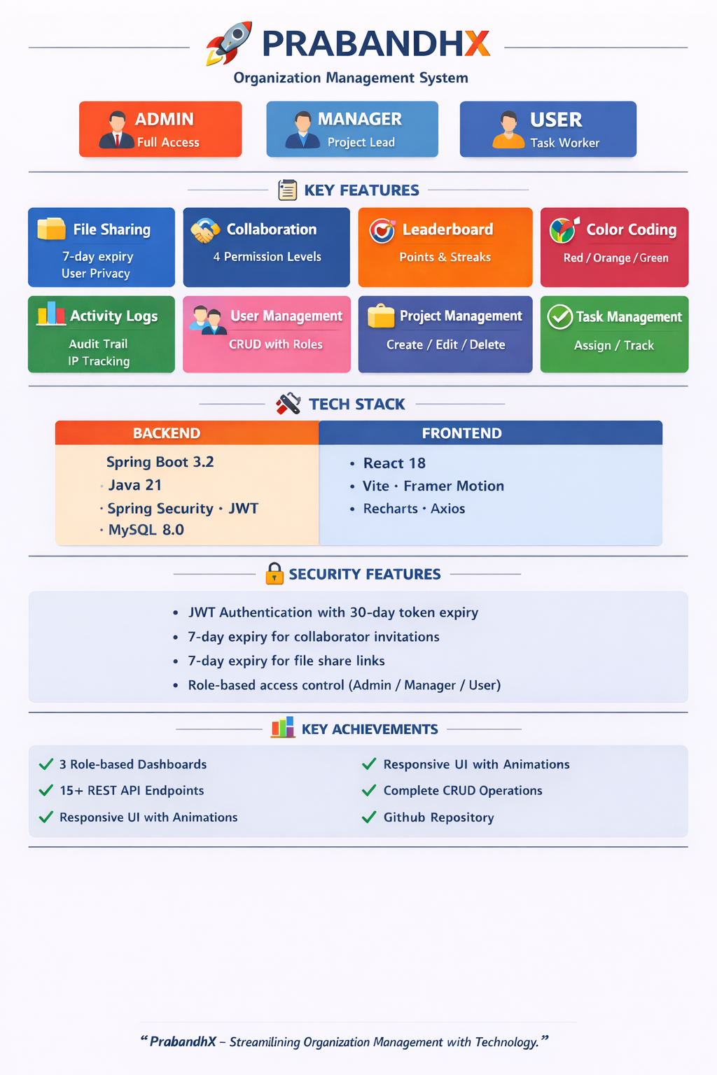


School of
Engineering
and Technology
Presents
TECHSPARK 2.0 : Igniting Ideas, Inspiring Innovation
Date : 9th April 2025
“ Where Every Spark Fuels the Future ”
Project Title :
SaaS Project Management System
Time : 09:30 AM Onwards
Venue : Aryabhata Building , CUTM
Student Name & Redg. No. :
Aurosmita Sahoo( 230301120265)
Disha Agarwalla ( 230301120281)
Guided by:
Asst. Prof. Rakesh Kumar Ray
ABSTRACT
RESULTS and DISCUSSIONS
PrabandhX is a comprehensive organization management system that centralizes project management, task tracking, team collaboration, and file sharing into a single unified platform. It replaces manual workflows with a digital solution featuring role-based access for Admin, Manager, and User. Built with Spring Boot and React, it delivers secure JWT authentication, real-time analytics, complete audit trails, and gamification through leaderboards. The platform ensures data privacy with user-specific file views and 7-day expiry for invitations and shareable links.
Fig.no :- 2 Admin Dashboard
Fig.no :- 1 Project Landing Page
PROBLEM FORMULATIONS
REFERENCES
Fig.no :- 3 Manager Dashboard
Modern organizations struggle with fragmented manual processes, lack of real-time visibility, and ineffective collaboration—challenges PrabandhX solves with a centralized, role-based platform offering real-time dashboards, secure file sharing, and audit trails, while role-based access control, 7-day expiry for shared links, and IP-tracked activity logging ensure security and accountability.
Spring Boot Documentation – https://spring.io/projects/spring-boot React Documentation – https://react.dev/ MySQL Documentation – https://dev.mysql.com/doc/ Postman – https://learning.postman.com/
Fig.no :- 4 Overview of the project
CENTURION UNIVERSITY OF TECHNOLOGY & MANAGEMENT, BHUBANESWAR, ODISHA
+91-9778118876 +91-9437376421

