Slide 1
Comparison of Intrusion Detection Systems for Use in Low-Powered Devices
Pratyay Amrit (140953430)
Under the guidance of
Ms. Ipsita Upasana,
Assistant Professor
Department of I & CT
MIT, Manipal

Slide 2
Contents
Introduction
Problem Definition
Objective
Scope
Methodology
Results
Conclusion

Slide 3
Introduction
Security in low powered devices
Rise of IoT and WSN
Intrusion Detection System (IDS)

Slide 4
Problem Definition
Why IDS for low powered devices?
Signature based IDS
Anomaly based IDS
Problems with low powered devices

Slide 5
Objectives
To determine useful features in classifying network data.
To find appropriate measures to score the different models.
To study the causes of different models performing differently
To open scope for future studies to improve the given score.

Slide 6
Scope
Cyber Security service providers
People working in IoT/WSN
Further research

Slide 7
Methodology: Dataset
UNSW-NB15 (over 2.5 million records)
9 types of attacks:
Fuzzers
Analysis
Backdoor
DoS
Exploit
Generic
Reconnaissance
Shell Code
Worm

Slide 8
Methodology: Dataset
49 features divided into 6 categories:
Flow Features(5), Basic Features(13), Content Features(8), Time Features(10), Additional Generated Features(11), Labeled Features(2)

Slide 9
Methodology: Pre-processing
Import data (python pandas)
Fill empty values
Transform nominal to numeric
Add feature names to Pandas DataFrame

Slide 10
Methodology: Feature Selection
Use ExtraTreesClassifier
Feature Importance Scores (gini impurity)

Slide 11
Methodology: K-Nearest Neighbors
Popular classification algorithm.
An object is classified as the class of the majority vote from the nearest k vectors in the feature space.

Slide 12
Methodology: Naive Bayes
Popular classification algorithm.
Assumption that features have no correlation.

Slide 13
Methodology: Decision Trees
Generates tree-like model of decisions and their consequences.
Information gain, gini impurity etc. are used to decide which feature to split at every level in the tree.

Slide 14
Methodology: Random Forests
Ensemble Method
Many small trees formed from random samples of the dataset.
Decision on the basis of majority vote among individual trees.

Slide 15
Methodology: Extra Trees
Ensemble Method
Similar to Random Forests.
Split is decided using the entire dataset, instead of a random subset.

Slide 16
Methodology: Performance Parameters
True Positive (TP): correctly classified attacks.
True Negative (TN): correctly classified normal.
False Positive (FP): incorrectly classified attacks.
False Negative (FN): incorrectly classified normal.

Slide 17
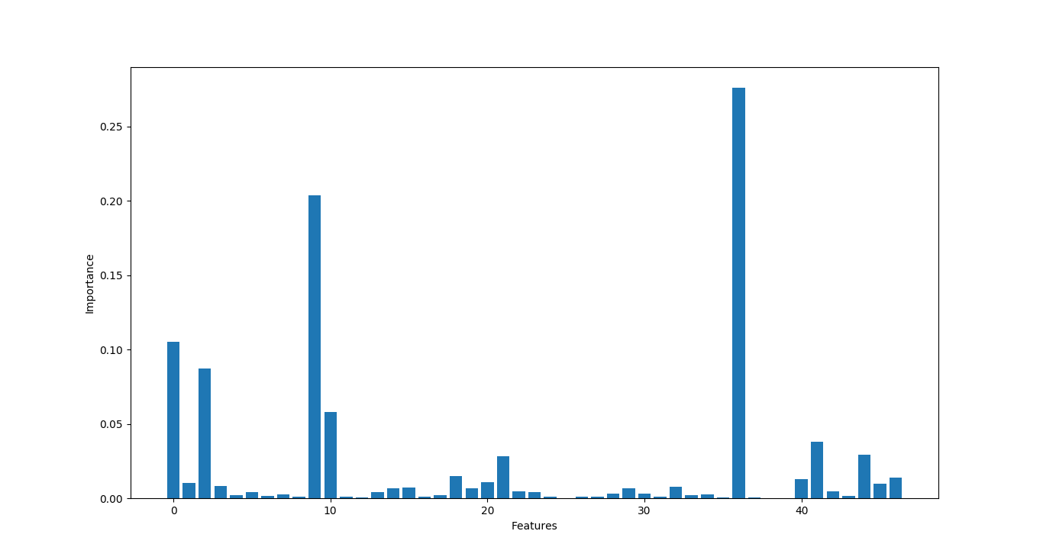
Results: Feature Selection

Slide 18
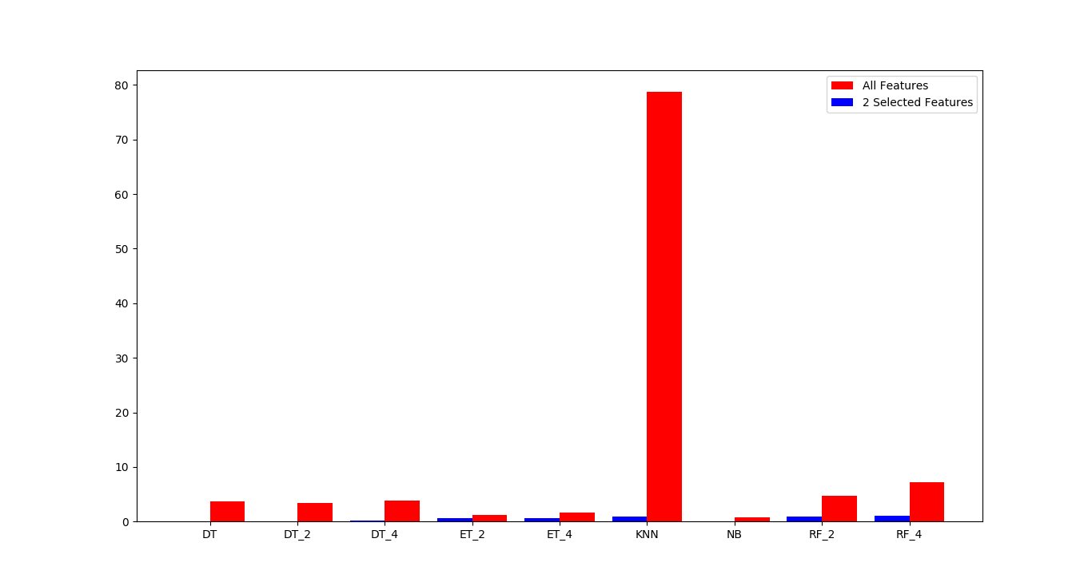
Results: Change in TTF (Table 4.1, 4.2)

Slide 19
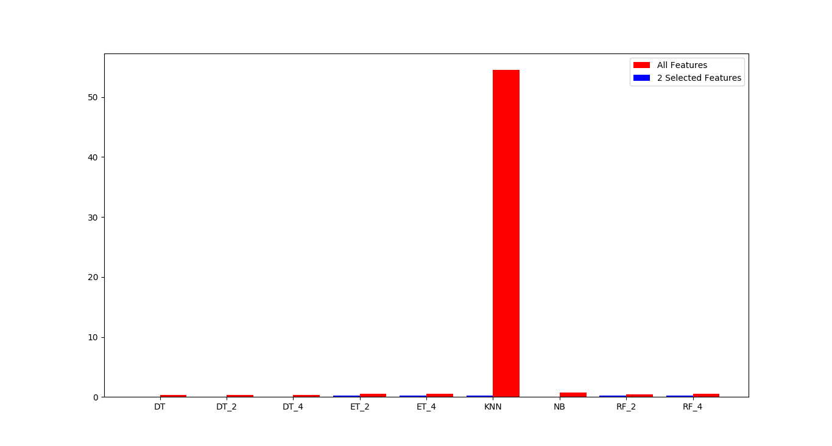
Results: Change in TTP (Table 4.1, 4.2)

Slide 20
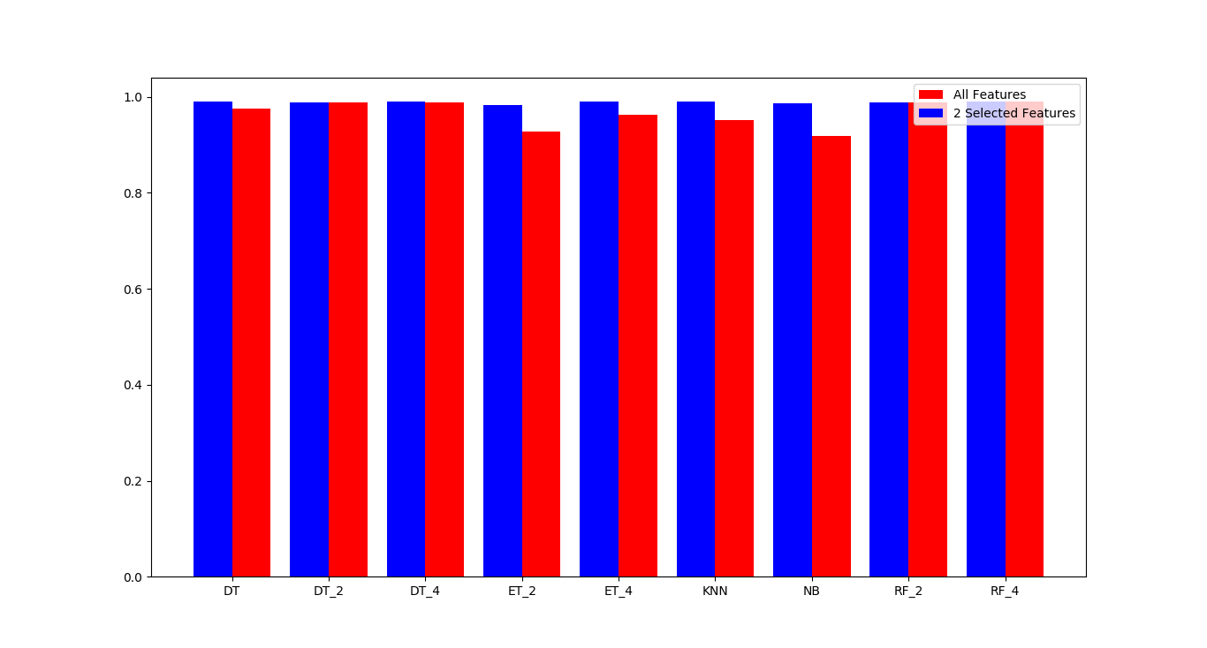
Results: Change in Accuracy (Table 4.1, 4.2)

Slide 21
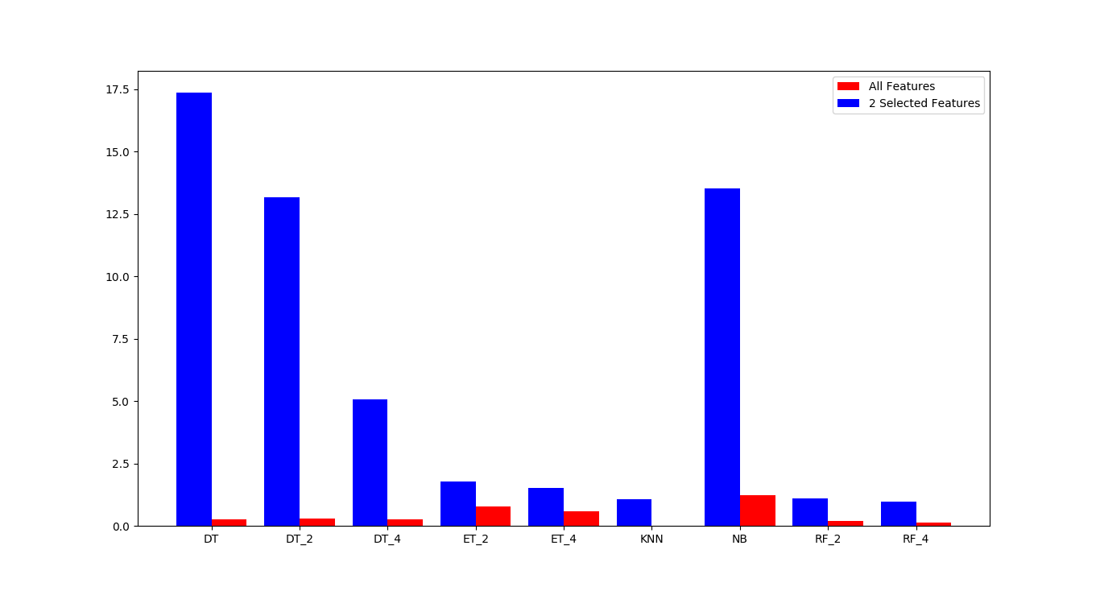
Results: Change in TS (Table 4.3)

Slide 22
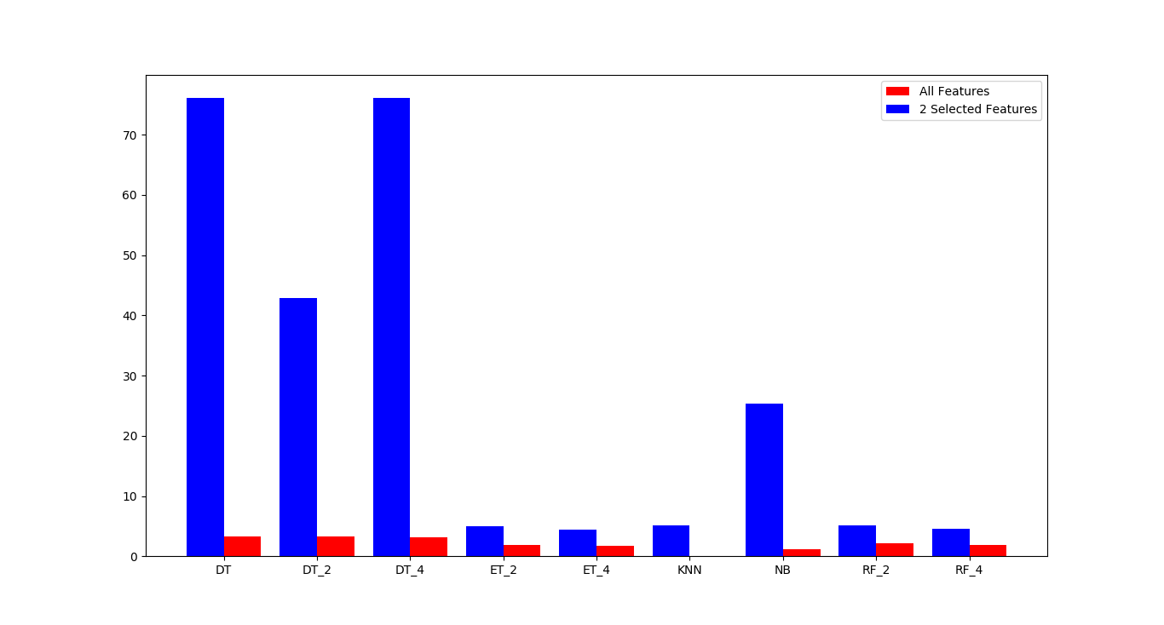
Results: Change in PS (Table 4.3)

Slide 23
Conclusion
Importance of sttl, dttl and state for IDS.
Decision Trees

Slide 24
References
H. Debar, M. Dacier, and A. Wespi, “A revised taxonomy for intrusion-detection systems,” Annales Des T´el´ecommunications, vol. 55, no. 7, pp. 361–378, Jul 2000. [Online]. Available: https://doi.org/10.1007/BF02994844
P. V. S. Alpao, J. R. I. Pedrasa, and R. Atienza, “Multilayer perceptron with binary weights and activations for intrusion detection of cyberphysical systems,” in TENCON 2017 - 2017 IEEE Region 10 Conference, Nov 2017, pp. 2825–2829.
M. Tavallaee, E. Bagheri, W. Lu, and A. A. Ghorbani, “A detailed analysis of the kdd cup 99 data set,” in 2009 IEEE Symposium on Computational Intelligence for Security and Defense Applications, July 2009, pp. 1–6
N. Moustafa and J. Slay, “Unsw-nb15: a comprehensive data set for network intrusion detection systems (unsw-nb15 network data set),” in 2015 Military Communications and Information Systems Conference (MilCIS), Nov 2015, pp. 1–6.
N. Moustafa and J. Slay, “The significant features of the unsw-nb15 and the kdd99 data sets for network intrusion detection systems,” in 2015 4th International Workshop on Building Analysis Datasets and Gathering Experience Returns for Security (BADGERS), Nov 2015, pp. 25–31.

Slide 25
References
F. Pedregosa, G. Varoquaux, A. Gramfort, V. Michel, B. Thirion, O. Grisel, M. Blondel, P. Prettenhofer, R. Weiss, V. Dubourg, J. Vanderplas, A. Passos, D. Cournapeau, M. Brucher, M. Perrot, and E. Duchesnay, “Scikitlearn: Machine learning in Python,” Journal of Machine Learning Research, vol. 12, pp. 2825–2830, 2011.
H. Zhang, “The optimality of naive bayes,” 01 2004.
T. K. Ho, “Random decision forests,” in Proceedings of 3rd International Conference on Document Analysis and Recognition, vol. 1, Aug 1995, pp.278–282 vol.1.
P. Geurts, D. Ernst, and L. Wehenkel, “Extremely randomized trees,” Machine Learning, vol. 63, no. 1, pp. 3–42, Apr 2006. [Online]. Available:https://doi.org/10.1007/s10994-006-6226-1

