Slide 1
Comparison of Intrusion Detection Systems for Low-Powered Devices
Pratyay Amrit (140953430)
Under the guidance of
Ms. Ipsita Upasana,
Assistant Professor
Department of I & CT
MIT, Manipal

Slide 2
Contents
Introduction
Problem Definition
Objective
Scope
Methodology
Work Done
Remaining Work

Slide 3
Introduction
Security in low powered devices
Rise of IoT and WSN
Intrusion Detection System (IDS)

Slide 4
Problem Definition
Why IDS for low powered devices?
Signature based IDS
Anomaly based IDS
Problems with low powered devices

Slide 5
Objectives
To find and choose a dataset that resembles a network dump as closely as possible while conforming with modern trends to make sure the IDS is well trained for novel attacks.
To develop IDSs based on two very popular classification algorithms, K-Means and Multilayer Perceptron.
To analyze and compare the two algorithms based on similar parameters.
To compare the effects of decreased computational power by testing the algorithms in low powered devices.

Slide 6
Scope
Cyber Security service providers
People working in IoT/WSN
Further research

Slide 7
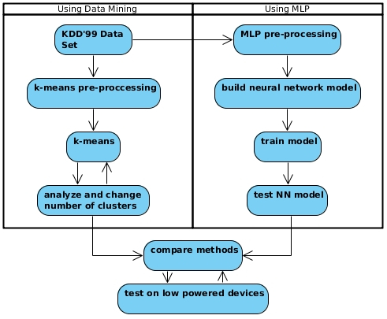
Methodology

Slide 8
Methodology: Dataset
KDD’99 vs. UNSW-NB15
9 types of attacks:
Fuzzers
Analysis
Backdoor
DoS
Exploit
Generic
Reconnaissance
Shell Code
Worm

Slide 9
Methodology: Dataset
49 features divided into 6 categories:
Flow Features(5), Basic Features(13), Content Features(8), Time Features(10), Additional Generated Features(11), Labeled Features(2)

Slide 10
Methodology: Pre-processing
Import data (python pandas)
Fill empty values
Transform nominal to numeric
Add feature names to Pandas DataFrame

Slide 11
Methodology: K-Means
Unsupervised clustering algorithm.
To reduce computational load, 2 clusters. (attack/normal)

Slide 12
Methodology: Multilayer Perceptron
A class of Artificial Neural Networks, with at least 3 layers and non-linear activation functions (except input nodes)
Learning: Backpropogation.
Optimization: Binary weights.

Slide 13
Methodology: Performance Parameters
True Positive (TP): correctly classified attacks.
True Negative (TN): correctly classified normal.
False Positive (FP): incorrectly classified attacks.
False Negative (FN): incorrectly classified normal.

Slide 14
Work Done: Overview
Week 1: Finding research material and datasets.
Week 2 – Week 5: Learning python for data science.
Week 6: Started work on project.
Week 7: Change dataset.
Week 8: Application and performance testing.

Slide 15
Work Done: Week 1
Finding research papers
Problems with selected papers
KDD’99 dataset

Slide 16
Work Done: Week 2 - 5
Learning python for data science
IPython basics
Numpy
Pandas
Scikit-learn
matplotlib

Slide 17
Work Done: Week 6
Process KDD’99 with pandas
Removing duplicates
Nominal to numeric
Apply k-means

Slide 18
Work Done: Week 7
Problems with KDD’99
UNSW-NB15
UNSW-NB15 vs. KDD’99
Started working on UNSW-NB15

Slide 19
Work Done: Week 8
Processing UNSW-NB15 [Figure 2 (report)]
Applied k-means
Analysis using performance parameters [Figure 3 (report)]
TP: 43,350
TN: 327,461
FP: 319,790
FN: 9,399
Accuracy: 52.97%

Slide 20
Remaining Work
Implement MLP
Analyze and compare on regular device
Analyze and compare on low powered device

Slide 21
References
N. Moustafa and J. Slay, “The significant features of the unsw-nb15 and the kdd99 data sets for network intrusion detection systems,” in 2015 4th International Workshop on Building Analysis Datasets and Gathering Experience Returns for Security (BADGERS), Nov 2015, pp. 25–31.
S. Duque and M. N. bin Omar, “Using data mining algorithms for developing a model for intrusion detection system (ids),” Procedia Computer Science, vol. 61, pp. 46 – 51, 2015, san Jose, CA November 2-4, 2015. [Online]. Available: http://www.sciencedirect.com/science/article/pii/S1877050915029750
P. V. S. Alpao, J. R. I. Pedrasa, and R. Atienza, “Multilayer perceptron with binary weights and activations for intrusion detection of cyber-physical systems,” in TENCON 2017 - 2017 IEEE Region 10 Conference, Nov 2017, pp. 2825–2829.
Python for Data Science Handbook. Available: https://github.com/jakevdp/PythonDataScienceHandbook
Scikit-learn documentation

