Slide 1








GRAB AND GO
Course Name : CSE 316 – Microprocessors and Microcontrollers Lab
Submitted To ,
Zaima Sartaj Taheri
Lecturer ,
Department of Computer Science & Engineering

Slide 2




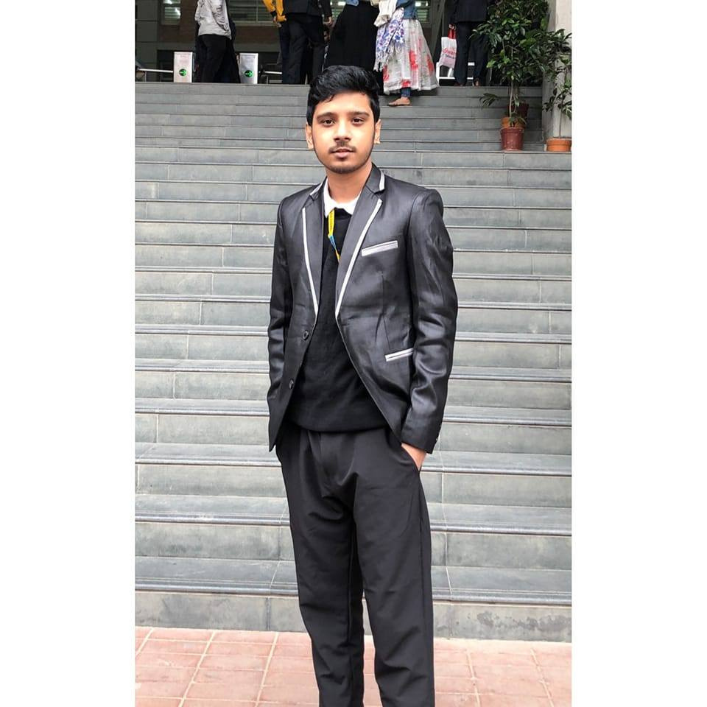
MEET OUR TEAM
02
Md. Zobaer Islam
Md Arkive
Siddatul Muntaha Chowdhury Mahin
22201149
22201151
22201158

Slide 3





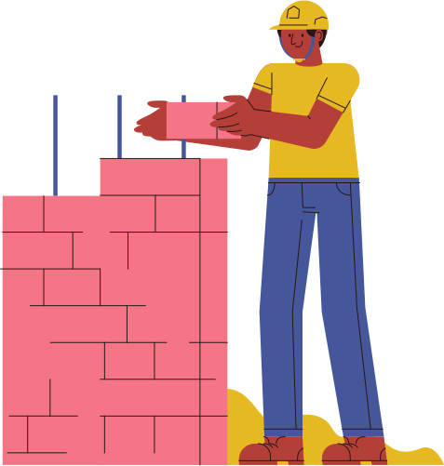
PROJECT OBJECTIVE
The purpose of this project is to design and build a miniature car integrated with a mechanical arm capable of picking, moving, and placing objects.
It aims to demonstrate how mobility and manipulation can be combined in robotics to perform tasks in areas that are hazardous, hard to reach, or unsuitable for human presence.
This system serves as a foundation for applications in automation, rescue operations, and remote handling technologies.
03

Slide 4




SOCIETAL IMPACT AND MOTIVATION
Relevance & Importance:
This project addresses the growing need for safe and efficient object handling in environments where human access is risky or impossible — such as hazardous zones, rescue missions, or industrial sites.
Beneficiaries:
Industries: For automation and precision handling tasks.
Emergency Services: For search and rescue in dangerous areas.
Students & Researchers: As an educational platform to understand robotics and control systems.
Uniqueness & Sustainability:
The system promotes low-cost automation using easily available components, encouraging sustainable learning and innovation in robotics. It also demonstrates how mobility and manipulation can be combined for future smart robotic solutions.
04

Slide 5

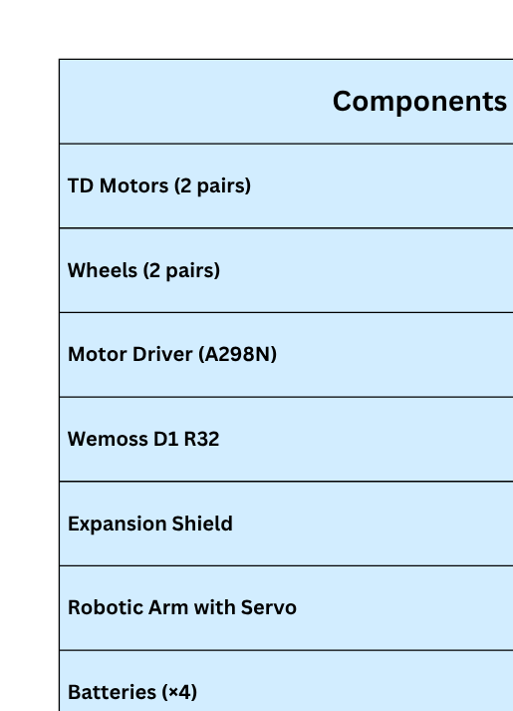
LIST OF COMPONENTS
05

Slide 6
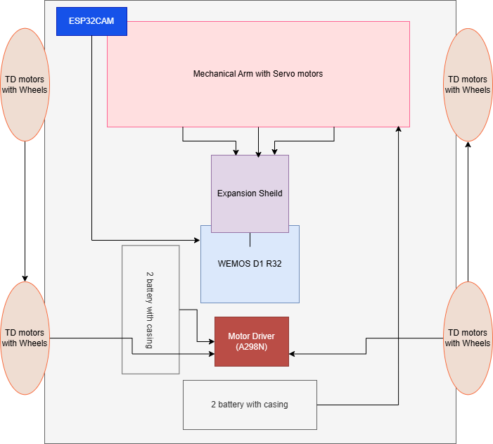






SYSTEM BLOCK DIAGRAM & METHODOLOGY
ESP32-CAM detects objects and sends signals to controller.
Wemos D1 R32 processes commands and controls movements.
A298N motor driver drives wheel motors for navigation.
Expansion shield controls servo motors of mechanical arm.
Separate battery packs supply stable power to motors and controller.
System tested step-by-step for movement and arm operation.
06

Slide 7
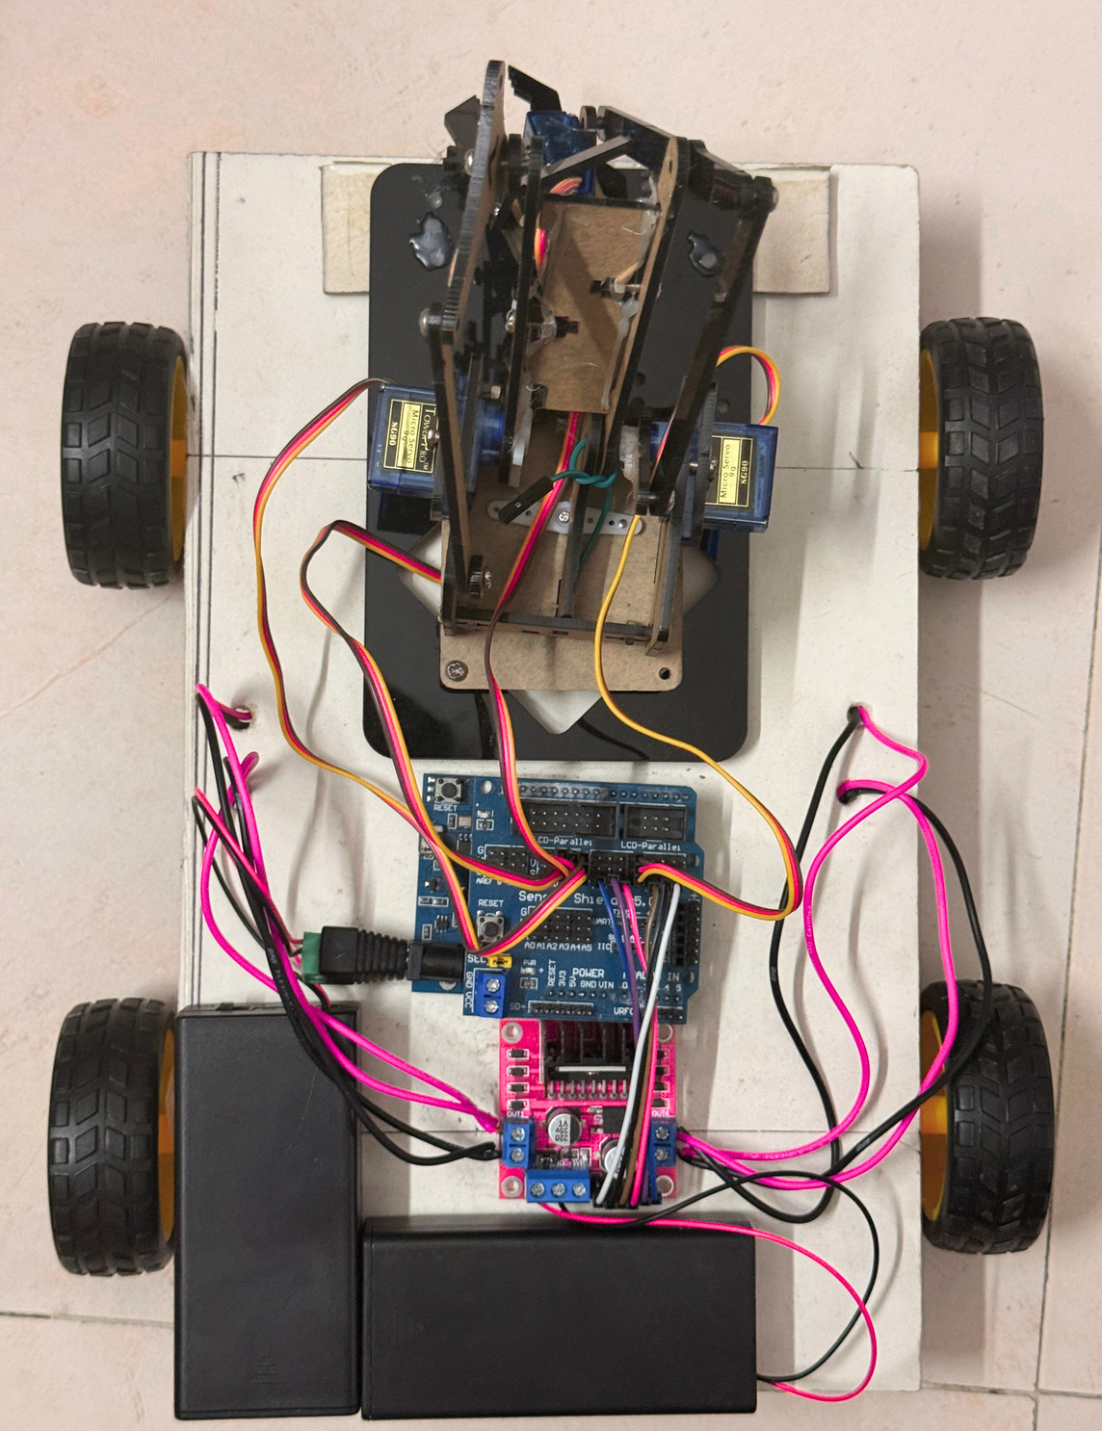
PROJECT IMPLEMENTATION IMAGE
Wheels with TD motor
Wheels with TD motor
4 Servo motors with Mechanical Arm
Expansion Shield
WEMOS D1 R32
Battery with Casing
Motor Driver
07

Slide 8

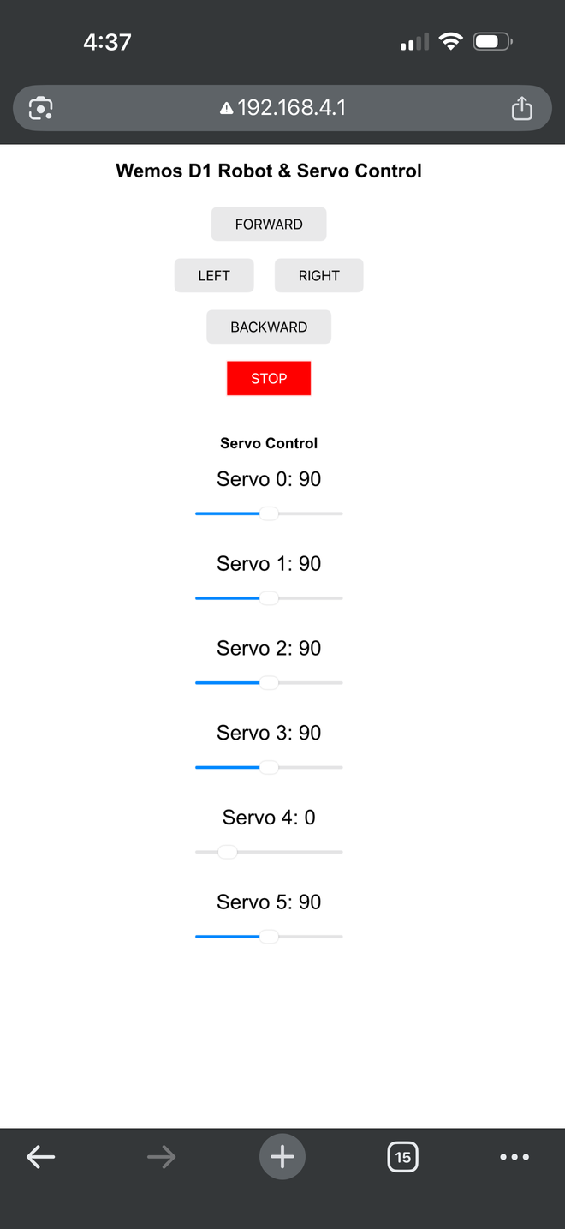

RESULTS AND ANALYSIS
Key Results & System Outputs
The robot successfully responds to web-based movement commands
4 independent servo motors are controllable through sliders with real-time angle updates
The system is fully accessible through a local IP-based web interface
User input results in instant feedback on the interface (updated angle values), showing real-time servo positioning.
Interface tested on a mobile device
How Results Meet the Project Objectives
Wireless robot control achieved through ESP32-hosted web interface
Real-time servo adjustments confirmed via live slider value updates
Low-latency response during movement controls
Mobile-friendly UI successfully tested on smartphone
Multiple servos independently controlled (4-axis control achieved)
System works without external controller → full remote automation achiev
08

Slide 9
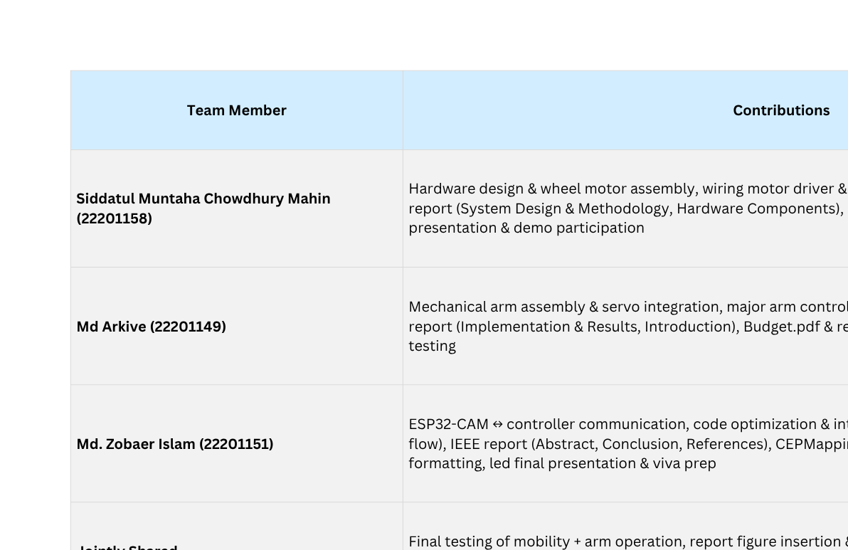
TEAM MEMBER CONTRIBUTION
09

Slide 10
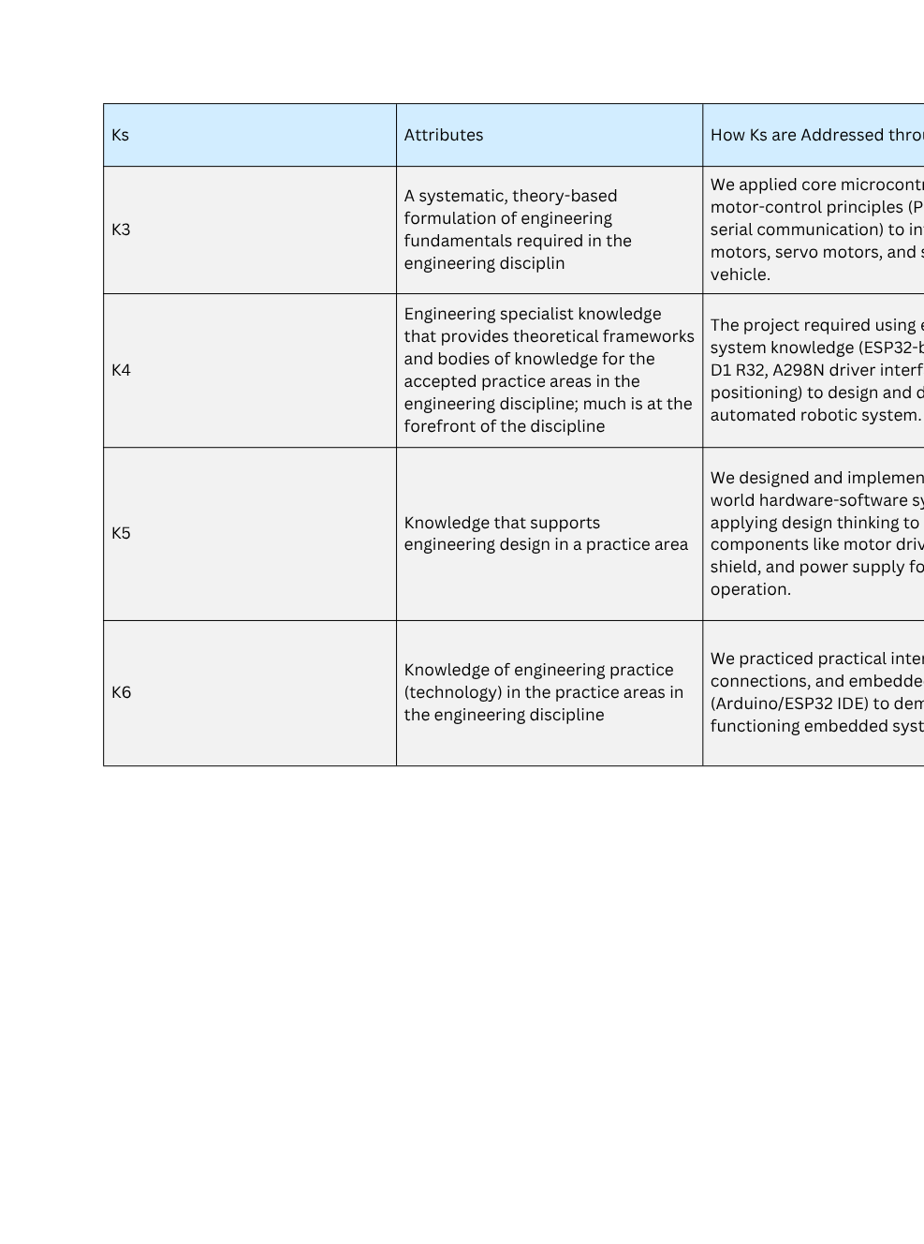
CEP OUTCOME MAPPING
The CEP Mapping demonstrates how our project aligns with the core learning objectives of this course. You must use the provided tables to complete this section.
For each attribute, a clear explanation in the 'How... are Addressed through the Project' column, describing how your project specifically relates to it is provided.
HOW K’S ARE ADDRESSED
10

Slide 11
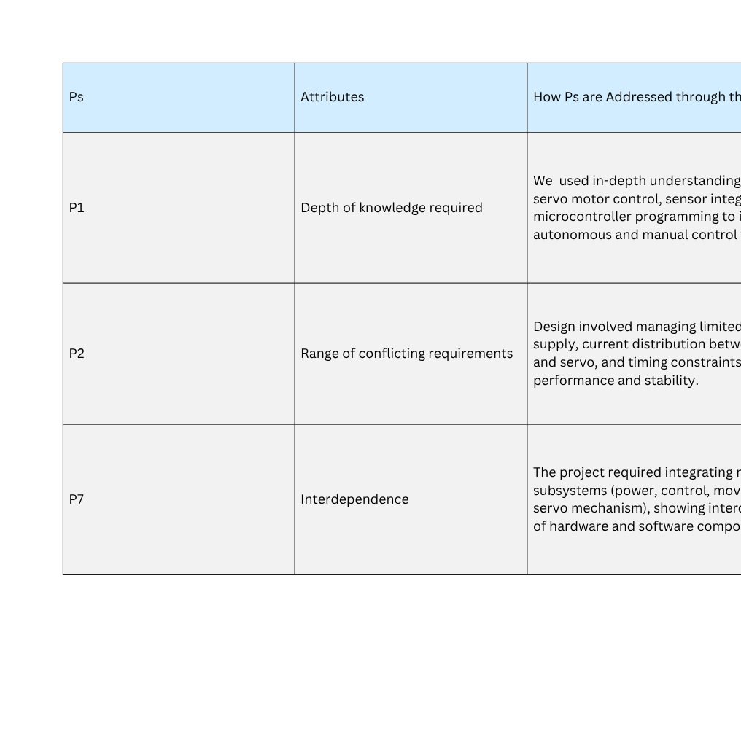
CEP OUTCOME MAPPING (CONT.)
HOW P’S ARE ADDRESSED
11

Slide 12
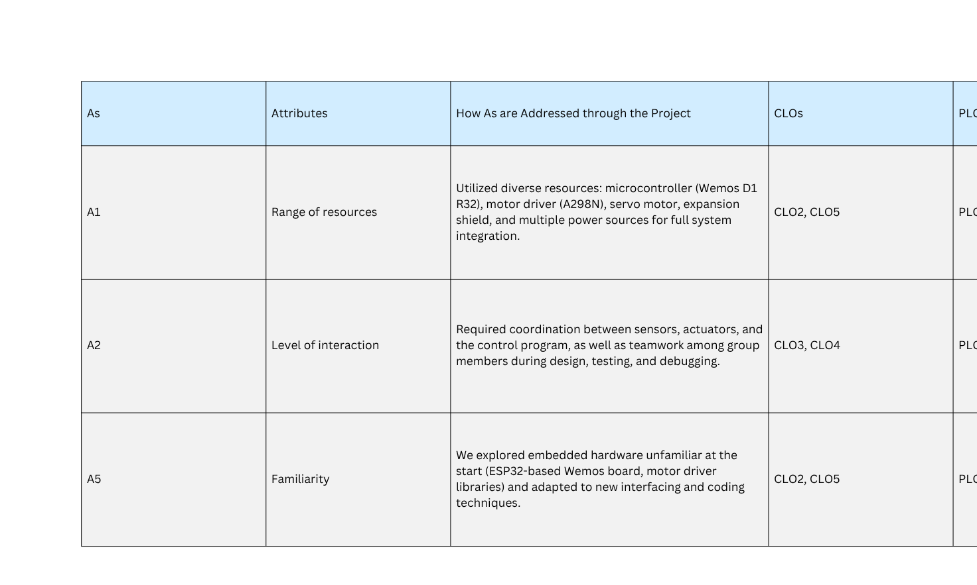
CEP OUTCOME MAPPING (CONT.)
HOW A’S ARE ADDRESSED
12

Slide 13
CONCLUSION
The Grab-n-Go robot showcases how embedded systems can combine computer vision, sensors, and mechanical control for autonomous object handling.
The prototype successfully detected, lifted, and placed objects with minimal user input — proving the potential of low-cost automation for logistics and education.
Future improvements:
Integration of LiDAR sensors
Optimized path planning
AI-based recognition for smarter operation
The project highlights the importance of intelligent robotics in reducing manual effort and enhancing safety.
13

Slide 14

THANK YOU
IF YOU HAVE ANY QUESTIONS , FEEL FREE TO ASK US
14

Slide 15
REFERENCES
R. Bostelman, T. Hong, and J. Marvel, "Survey of Research for Performance Measurement of Mobile Manipulators," J. Res. Natl. Inst. Stand. Technol., vol. 121, pp. 15–26, 2016.
J. Gros, "Unlocking the Benefits of Mobile Manipulators for Small and Medium-Sized Enterprises: A Comprehensive Study," Procedia CIRP, vol. 120, pp. 1339–1344, 2023.
O. Omijeh and O. Uhunmwangho, "Design Analysis of a Remote Controlled 'Pick and Place' Robotic Vehicle," Int. J. Eng. Res. Dev., vol. 10, no. 5, pp. 1–6, 2015.
15

